Slide 1
Proiectarea si Arhitectura Sistemelor Software Complexe Design and Architecture of Complex Software Systems
Conf.dr.ing. Ioana Şora
http://staff.cs.upt.ro/~ioana/arhit-engl/
ioana.sora@cs.upt.ro

Slide 2
Course Syllabus
Intro, Basic concepts
What is software architecture ? Patterns?
Fundamental architectural styles
Pipes and filters
Layers
Blackboard
Event-driven
Architectural patterns for :
Adaptive systems
The Reflection Pattern
Distributed systems
The Broker Pattern
Data access patterns
Pattern for Object-Relational Mappings
Pattern for decoupling data access
Week 1
Week 2, 3
Week 4, 5
Week 6, 7
Week 8, 9, 10

Slide 3
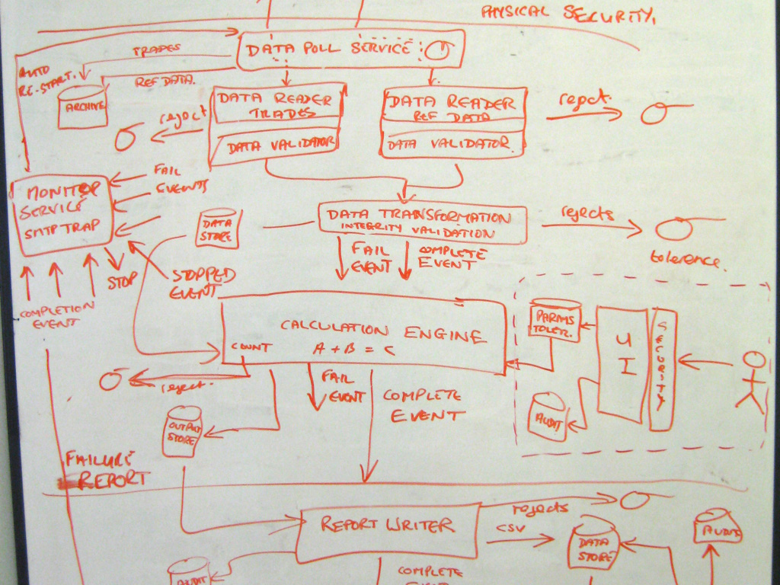
What is software architecture ? What is not software architecture ?
?
Very often, when speaking about software architecture, people are drawing “box and lines diagrams” ….
Notes:
Bass – fig.2.1

Slide 4
Example
Case study: two software engineers developed together a system doing a simple text processing: the lines of the original text are transformed in following way: odd lines are rewritten in upper case and even lines are rewritten in lower case.
The two engineers are asked, independently, to explain the architecture of their system.
Each of them draws a diagram explaining the “architecture” of the system …
Notes:
Bass – fig.2.1

Slide 5
Example – Diagram by first engineer

Slide 6
Example – Diagram by second engineer

Slide 7
?

Slide 8
Software architecture - definition
“The software architecture is the structure or structures of the system, which comprise software elements, the externally visible properties of those elements and the relationships among them”
(Bass et al)
Notes:
Structure(s) – there’s more than one

Slide 9
Software architecture definition explained (1)
“The software architecture is the structure or structures of the system, which comprise software elements, the externally visible properties of those elements and the relationships among them”
(Bass et al)
Software elements: (the term of architectural element is preferred instead of architectural component.)
A software element is an abstraction of a part of the system
Architecture is an abstraction of a system
Abstractions are hiding certain details
A structure of a system is determined by elements and their relationships

Slide 10
Software architecture definition explained (2)
“The software architecture is the structure or structures of the system, which comprise software elements, the externally visible properties of those elements and the relationships among them”
(Bass et al)
Structures of the system: Architecture is described by multiple different structures (views):
The modules structure - the static structure of a system, results in the design phase.
The interactions structure – the dynamic structure that can be observed at runtime
The allocation/deployment structures – describes how software elements are mapped onto non-software elements (hardware, staff)

Slide 11
Software architecture definition explained (3)
“The software architecture is the structure or structures of the system, which comprise software elements, the externally visible properties of those elements and the relationships among them”
(Bass et al)
Inside each structural view, software elements and relationships among them may have different meanings:
Elements can be: objects, classes, functions, processes, programs, libraries, databases, etc.
Relationships between elements: part of, synchronization, function call, etc.

Slide 12
Multiple Architectural Structures = Architectural Viewpoints
Software Architecture = a set of different views of different viewpoints
Particular case: UML for OO design:
Class Diagrams vs Object (Collaboration) Diagrams
Similar:
Maps in geography: for the same territory, we have several different viewpoints: physical map, political map, economical or resource map, road network map, etc.

Slide 13
Multiple Architectural Structures = Architectural Viewpoints
Viewpoints examples:
Module (Design/Functional Structure)
Elements: Units of implementation(classes, modules, packages. Etc).
Relationships: depends (uses), is part of
Component and Connector (Runtime)
Elements: Processing units or data storage units (objects, processes, servers, fatabases, etc)
Relationships: messages, communication, dataflows
Allocation (Deployment, Physical Structure, Team Structure)
Elements: Software and non-software elements
Relationships: allocated to
New viewpoints can be defined and used as needed

Slide 14
Module viewpoint vs C&C viewpoint
[Clements]

Slide 15
Describing software architectures
IEEE/IEC/ISO 42010:2011 “Systems and software engineering – Architecture description”
Revised by IEEE/IEC/ISO 42010:2022 “Software, systems and Enterprise – Architecture Description”
It specifies the requirements for architectural descriptions
It does not specify any description language
ADL’s (Architecture Description Languages): Wright, ACME, SysML, Rapide, etc
UML

Slide 16
The key principles of the Architecture Description Standard
Architecture descriptions should demonstrate how an architecture meets the needs of the system’s diverse stakeholders;
The architecture concerns of the diverse stakeholders can be addressed by an architecture description constructed with multiple architecture views of the system, where each view covers a subset of those concerns;
The rules for well-formedness, completeness and analyzability of each architecture view should be explicit via an architecture viewpoint;

Slide 17
Box and lines diagrams?
After all, software architectures could be represented by a set of box and lines diagrams, if:
for every diagram, you specify which viewpoint it covers and what represent the boxes(which types of elements) and what represent the lines (which types of relationships or connectors)
Notes:
Bass – fig.2.1

Slide 18
Example - the architecture

Slide 19
Why is software architecture important?
Communication between stakeholders
Early design decisions
Transferable, reusable model
Terminology, vocabulary ?
Starting points ? Reuse?
Established terminology,
good practices, standards,
success stories ….
PATTERNS

Slide 20
Pattern
“Each pattern describes a problem which occurs over and over again in our environment, and then describes the core of the solution to that problem, in such a way that you can use this solution a million times over, without ever doing it the same way twice” (Christopher Alexander, pattern in the context of civil engineering and architecture)
In software:
Pattern = general solution to a recurring problem in a specific context
Pattern = a form of reuse:
Reuse of wisdom, experience (no direct reuse of code)
Kind of partial reuse of design solutions:
At different levels of abstraction
At different levels of detail

Slide 21
Pattern
Abstraction
“An architectural style defines a family of software systems in terms of their structural organization. An architectural style expresses components and the relationships between them, with the constraints of their application, and the associated composition and design rules for their construction.”
“An architectural pattern expresses a fundamental structural organization schema for software systems. It provides a set of predefined subsystems, specifies their responsibilities, and includes rules and guidelines for organizing the relationships between them.”
“A design pattern provides a scheme for refining the subsystems of a software system, or the relationships between them. It describes a commonly-recurring structure of communicating components that solves a general design problem within a particular context.”
Detail

Slide 22
Design pattern
“A design pattern provides a scheme for refining the subsystems of a software system, or the relationships between them. It describes a commonly-recurring structure of communicating components that solves a general design problem within a particular context.”
[POSA1]
Smaller in scale than architectural patterns, independent of a particular programming language but dependent on a programming paradigm
The application of a design pattern has no effect on the fundamental structure of a software system, but may have a strong influence on the architecture of a subsystem.

Slide 23
Design pattern catalogs
Go4 Design patterns: a collection of patterns for object oriented programming
Erich Gama, Richard Helm, Ralph Johnson, John Vlissides, “Design Patterns: Elements of Reusable Object-Oriented Software ”
Pattern:
Name
Intent - what does it do
Motivation - scenario that illustrates the design problem
Applicability – situations in which the pattern can be applied
Structure – class diagram
Participants – the classes and/or objects and their responsabilities
Collaborations
Consequences

Slide 24
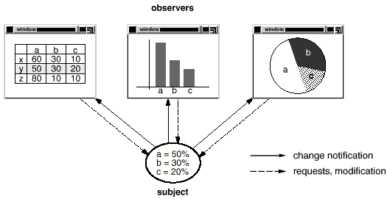
Example: The Observer Design Pattern
Observer – Motivation:
Need to maintain consistency between related cooperating objects, but without their classes tightly coupled
Example: graphical user interface classes <-> application data

Slide 25
Observer - Intent
Observer – Intent:
Define a one-to-many dependency between objects so that when one object changes state, all its dependents are notified and updated automatically.
Example: the different graphical views are dependent on the data object and therefore should be notifed of any changes in its state

Slide 26
Observer - Applicability
Observer – Applicability:
Use the Observer pattern in the following situations:
When an abstraction has two aspects, one dependent on the other. Encapsulating these aspects in separate objects lets you vary and reuse them independently.
The dependent = observer
The independent = subject, observable
When a change to one object (the subject) requires changing others (the observers), and you don't know how many objects need to be changed.
When an object (the subject) should be able to notify other (the observers) without making assumptions about who these objects are. In other words, you don’t want these objects tightly coupled.

Slide 27
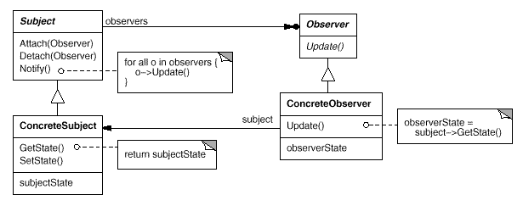
Observer – Structure
Figure from [GoF]

Slide 28
Observer – Participants
Subject:
knows its observers.
any number of Observer objects may observe a subject.
provides an interface for attaching and detaching Observer objects.
Observer:
defines an updating interface for objects that should be notified of changes in a subject.
ConcreteSubject:
stores state of interest to ConcreteObserver objects.
sends a notification to its observers when its state changes.
ConcreteObserver:
maintains a reference to a ConcreteSubject object.
stores state that should stay consistent with the subject’s.
implements the Observer updating interface to keep its state consistent with the subject's.

Slide 29
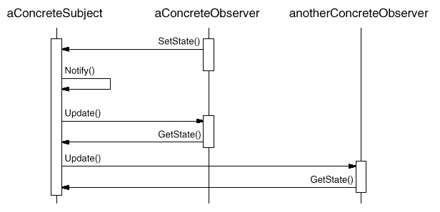
Observer – Collaborations
Figure from [GoF]

Slide 30
Observer – Consequences
Abstract coupling between subject and observers: the subject only knows that it has a list of observers, defined by the simple Observer interface
You can reuse the subject without reusing its observers
You can reuse the observers together with an other subject
You can attach many observers to a subject. The subject does not care how many observers there are (notify = broadcast type of communication)

Slide 31
Observer – Known Usages
Publisher-Subscriber
Listeners
MVC (Model-View-Controller)

Slide 32
Pattern
Abstraction
“An architectural style defines a family of software systems in terms of their structural organization. An architectural style expresses components and the relationships between them, with the constraints of their application, and the associated composition and design rules for their construction.”
“An architectural pattern expresses a fundamental structural organization schema for software systems. It provides a set of predefined subsystems, specifies their responsibilities, and includes rules and guidelines for organizing the relationships between them.”
“A design pattern provides a scheme for refining the subsystems of a software system, or the relationships between them. It describes a commonly-recurring structure of communicating components that solves a general design problem within a particular context. [Go4]”
Detail

Slide 33
Architectural Pattern
“An architectural pattern expresses a fundamental structural organization schema for software systems. It provides a set of predefined subsystems, specifies their responsibilities, and includes rules and guidelines for organizing the relationships between them.”
[POSA1]
Examples:
Model-View-Controller
Broker

Slide 34
MVC: Context & Problem
Context: Interactive application with flexible human-computer interaction
Problem:
Changes to user interface must be easy
The same information can be presented in different ways
The display and behavior of the application must reflect data changes immediately

Slide 35
MVC: Solution-Structure
MVC architectures are composed from 3 predefined subsystems:
Model: manages data and business logic. It is independent from view and controller.
If the state of this data changes, then the model will usually notify the View and in some variants also notifies the Controller
View: handles layout and display.
In some variants handles also user input and notifies Controller about user requests
Controller: routes commands to the model and view

Slide 36
MVC architectural pattern for interactive systems
Model
getData
notifyChange
updateModel
View
sendUserInput
Controller
selectView
(*) some variations may exist in the way the subsystems interact
(**)variants of the MVC pattern: MVP, MVVM, etc

Slide 37
Pattern
Abstraction
“An architectural style defines a family of software systems in terms of their structural organization. An architectural style expresses components and the relationships between them, with the constraints of their application, and the associated composition and design rules for their construction.”
“An architectural pattern expresses a fundamental structural organization schema for software systems. It provides a set of predefined subsystems, specifies their responsibilities, and includes rules and guidelines for organizing the relationships between them.”
“A design pattern provides a scheme for refining the subsystems of a software system, or the relationships between them. It describes a commonly-recurring structure of communicating components that solves a general design problem within a particular context. [Go4]”
Detail

Slide 38
Architectural Styles
“An architectural style defines a family of software systems in terms of their structural organization. An architectural style expresses components and the relationships between them, with the constraints of their application, and the associated composition and design rules for their construction.”
[POSA1]/pag.394
Example: the Pipes-and-filters architectural style
Components: all of the same type, Filter.
Components process data flows, have 1 or more input ports and 1 or more output ports
Relationships: Pipe connectors
Binary unidirectional connector, transmits dataflows from an output port to an input port of another filter
Constraints and rules:
A filter must not know the identity of the filters it sends or receives data

Slide 39
Example: Pipes and Filters Architectural Style
“The Pipes and Filters architectural style provides a structure for systems that process a stream of data. Each processing step is encapsulated in a filter component. Data is passed through pipes between adjacent filters. Recombining filters allows you to build families of related systems.” [POSA1]
Most well-known example: operating system command pipelines:
ls | grep old | more
…
Module view
C&C view

Slide 40
Pipes and Filters: another problem example
A server receives messages containing orders from clients.
The server frontend processor:
Incoming data: a stream of possibly duplicated, encrypted messages containing extra authentication data
Outgoing data: a stream of unique, simple plain-text order messages
Use the Pipes and Filters architectural style to divide the larger processing task into a sequence of smaller, independent processing steps (Filters) that are connected by channels (Pipes).
It will be possible to reuse the independent Filters in order to build the server frontend processor for another service which does not require authentication
Decrypt
Authenticate
DeDuplicate
Decrypt
DeDuplicate

Slide 41
Architectural style as an abstraction
The Pipes&Filters architectural style does not limit whether:
All Filters run in the same process or each Filter runs in its own process
Pipes (the mechanisms used for passing data) are simple method calls or Pipes are complex inter process communication mechanisms
Does not rely on a specific (Object Oriented) programming paradigm
Decrypt
Authenticate
DeDuplicate
Decrypt
DeDuplicate

Slide 42
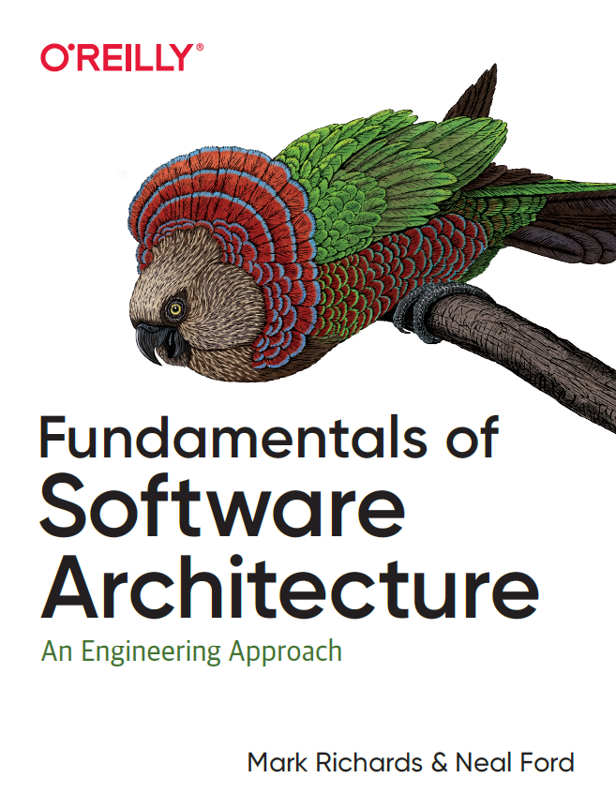
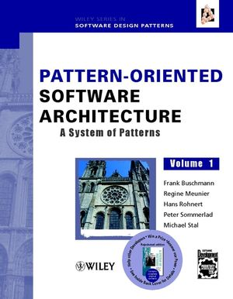
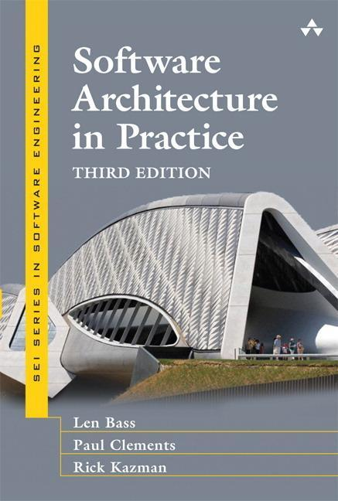
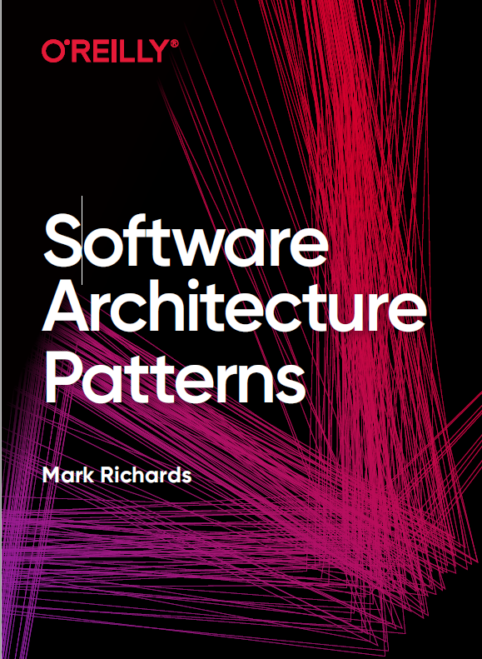
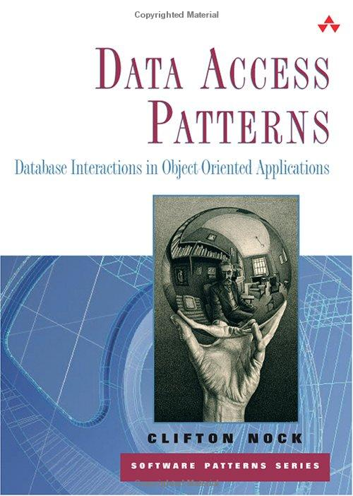
Resources

