Slide 1
Fundamental architectural styles
Continued - Part 2

Slide 2
The Event-driven architectural style
Variants:
Publisher-Subscriber Direct
GeneralPublisher-Subscriber (EventBus, EventChannel)
Notes:
POSA

Slide 3
The Event-driven style
Event driven systems are based on implicit invocation: instead of invoking a procedure directly, a component can broadcast one or more events. Other components in the system can register an interest in an event by associating a procedure with the event. When the event is announced the system itself invokes all of the procedures that have been registered for the event. Thus an event announcement ``implicitly'' causes the invocation of procedures in other modules. .
Event Service
op
Obj1
op
Obj2
Obj1
Obj2
Explicit invocation
Implicit invocation
Notes:
Definitia din Garlan&Shaw – Intro to SwArch
Exemplu din Event Notifier, a Pattern for Event Notification,
Gupta, Hartkopf, Ramaswamy, Java Report 1998

Slide 4
Characteristics of Event-driven
The components of an application do not interact directly with each other, but through implicit invocation
The implicit invocation is facilitated by an infrastructure called Event Service
Implicit invocation may happen according to the variants:
Publisher/Subscriber Direct
Event Channel (Event Bus)

Slide 5
Publisher-Subscriber Direct
Subscribers register with the publisher
Publisher notifies all its registered subscribers when it generates an event
The subscriber does not need to periodically check the state of the publisher in order to see if it changed!
“Don’t call us, we call you”
Particularites:
The subscribers know the publisher
A subscriber can register (subscribe to) several publishers
Example:
A TemperatureSensor and several displays
When temperature in the sensor changes, it notifies all registered displays

Slide 6
Publisher-Subscriber Direct Motivating Example: Sensor and Displays
Temperature sensors gives the current values of the measured temperature (Mock version: the sensor data is changed directly)
The measured temperature values are used by different components:
A NumericDisplay, which simply displays the numeric value of the current temperature
A TextDisplay, which displays “cold” if the current temp is <20, else displays “warm”
An AverageDisplay, which displays the average value of all the temperatures recorded from the period when the component is attached
Requirements:
Displays can be dynamically attached and detached to sensors
Every time the sensor data changes, all the attached displays must update
New display types can be defined and added
Sensor data could change asynchronously

Slide 7
Example: Publisher-Subscriber Direct
A TemperatureSensor and several displays
Publisher
Direct Subscribers
TemperatureSensor
NumericDisplay
register
TextualDisplay
AverageDisplay
Set new Temperature
TemperatureSensor
NumericDisplay
update
notify
SubscriberList
TextualDisplay
update
AverageDisplay
update

Slide 8
Publisher-Subscriber Direct
Examples:
The callback mechanisms
The Observer pattern
Mechanisms in some programming languages: Java Listener, Java Observable, C# Event – delegate
In all these cases the subscriber knows the publisher
aNumericDisplay1 is attached to aTemperatureSensorA and to aTemperatureSensorB, and to aTemperatureSensorC
This becomes a disadvantage if a subscriber must register to a big number of publishers and:
the subscriber is not interested in particularities of these publisher
the publishers may change (publishers appear and disappear)
example: aNumericDisplay just wants to be notified if a temperature change happens at any temperature sensor

Slide 9
Extended Scenario - Sensors and Displays Motivating Example for EventBus
We have various sensors of various types (TemperatureSensor, PressureSensor, HumiditySensor, etc)
The measured sensor values can be used by various displays of different types (NumericDisplay, TextDisplay, AverageDisplay)
Requirements:
Number of sensors of each type can dynamically vary (new sensors can be introduced at any time, existing sensors can be removed)
Every display can choose to follow all updates of a certain type of change (change in some temperature value somewhere, etc)
New display types can be defined and added
New sensor types can be defined and added
Sensor data could change asynchronously

Slide 10
General Publish-Subscribe Event Bus, Event Channel, Event Notifier
In the general case, a subscriber does NOT need to know the publishers ->general event-driven systems using an Event Bus
Some sources use the terminology Pub/Sub also for this category
Event Bus (Event Channel, Event Notifier) acts as a mediator between Publishers and Subscribers
Subscribers subscribe to types of Events (or Topics)
When a Publisher publishes an event, the Event Bus notifies all the subscribers for that type of event
aNumericDisplay1 subscribes to receive notifications whenever a new temperature event happens, regardless of the sensor producing the event

Slide 11
Example: EventBus
Several sensors and several displays
register
TemperatureEvent
Sensor1
Subscribers
NumericDisplay
Event Bus
Sensor2
TextualDisplay
Sensor3
AverageDisplay
New Temperature
publish
TemperatureEvent(5)
Sensor1
notify
NumericDisplay
update
Event Bus
Sensor2
TextualDisplay
update
Sensor3
Map(events,Subscribers)
AverageDisplay
update

Slide 12
Event Channel (Event Bus)
Publisher
Publisher
Subscriber
Subscriber
Event Channel (Event Bus)
Publisher
Publisher
Subscriber
Subscriber
Publish Event
Receive Event

Slide 13
Event Channel - Description
The central element = types of Events
Publishers: components that produce events, but they do not know the identity of the components that will “consume” these events.
It is possible that different publishers produce the same types of events.
Subscribers: components that receive certain types of events, but do not know and are not interested to know the identity of the components who publish these events
It is possible that a Subscriber is interested in several different types of events
It is possible that a component is in the same time Publisher and Subscriber (for different event types)
The participants (Publishers or Subscribers) can be dynamically added or removed in the system
New event types can be dynamically added
Components (Publishers and Subscribers) are loosely coupled, they could be located in different processes

Slide 14
Publisher-Subscriber Models of communication
Usually, when an event is received by (one or more) Subscribers, a data transfer will follow, from the Publisher who generated the event to the receiving Subscribers.
There are different models of communication, according to the type of data transfer:
Push: Publisher is the active source that initiates the transfer, while Subscriber is a passive destination.
Subscriber receives notification and all event related data together with the notification
Pull: Subscriber is active and initiates (requests) the data transfer from a passive source (Publisher) .
Subscriber receives notification and if the subscriber wants to receive all the event data it must explicitly request them !

Slide 15
The structure of an event-driven application
Components (Elements): Publishers, Subscribers
Connectors (Relations): publish event, subscribe to event type
Infrastructure: Event Channel (Event Bus, Event Service). Usually it is not part of the application, can be a general-purpose messaging infrastructure !
Publisher
Publisher
Subscriber
Subscriber
Event Channel (Event Bus, Event Service)
Publisher
Publisher
Subscriber
Subscriber

Slide 16
The structure of an event-driven application
The API offered by an Event Channel (Event Bus, Event Service):
EventChannel: subscribe(Subscriber, Event); publish(Event)
Subscriber: notify(Event)
Publisher
Publisher
Subscriber
Subscriber
Event Channel (Event Bus)
Publisher
Publisher
Subscriber
Subscriber

Slide 17
Event Service Infrastructures
Infrastructures that provides a subscribe-publish-notify API to be used by applications
Event Bus, in-process:
Akka event bus
Greenrobot – Android eventbus
Event Channel (Event Bus) inter-process: part of middleware for distributed computing
Message Broker vs. EventBus
Java Message Service (JMS)
IBM MQ, Apache ActiveMQ

Slide 18
How to implement a simple Publisher-Subscriber or Event Bus infrastructure ?
Simple example for a very simple case: in-process, no concurrency, object oriented implementation details
Publisher-Subscriber Direct: Observer
Event Bus: Notifier

Slide 19
Observer Pattern (Publisher-Subscriber Direct)

Slide 20
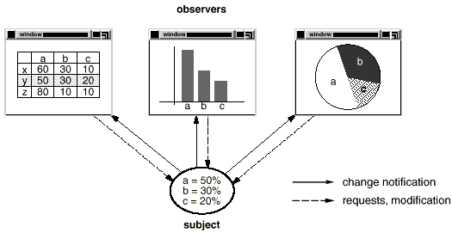
Observer - Motivation
Observer – Motivation:
Need to maintain consistency between related cooperating objects, but without their classes tightly coupled
Example: graphical user interface classes <-> application data

Slide 21
Observer - Intent
Observer – Intent:
Define a one-to-many dependency between objects so that when one object changes state, all its dependents are notified and updated automatically.
Example: the different graphical views are dependent on the data object and therefore should be notifed of any changes in its state
Figure from [GoF]

Slide 22
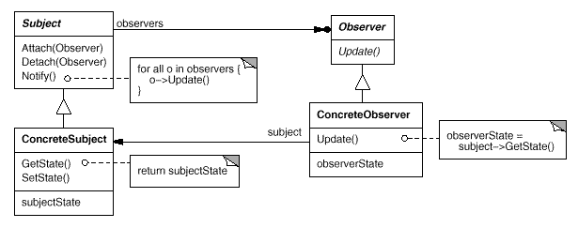
Observer – Structure
Figure from [GoF]

Slide 23
Observer – Participants
Subject:
knows its observers.
any number of Observer objects may observe a subject.
provides an interface for attaching and detaching Observer objects.
Observer:
defines an updating interface for objects that should be notified of changes in a subject.
ConcreteSubject:
stores state of interest to ConcreteObserver objects.
sends a notification to its observers when its state changes.
ConcreteObserver:
maintains a reference to a ConcreteSubject object.
stores state that should stay consistent with the subject’s.
implements the Observer updating interface to keep its state consistent with the subject's.

Slide 24
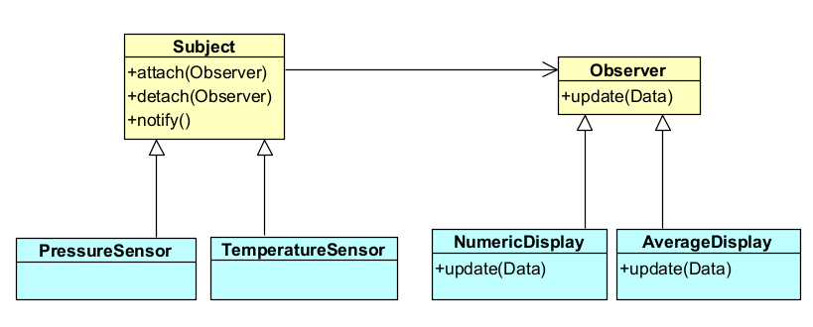
Example: Sensors and Observers

Slide 25
Observer – Implementation
The Subject calls the update() method on all the Observers, in order to communicate that there was a change in the Subject’s state.
Most often, the Observer needs more information about the change/the data that was changed.
How does the Observer get this information/the data that was changed?
2 approaches:
The PULL approach: the subject only sends the notification that a change happened, then the concrete observer explicitly pulls the data from the concrete subject:
The concrete observer gets all the data from the concrete subject by calling getter methods on the concrete subject.
The concrete observer must have/must get a reference to the concrete subject
The update() method in the Observer interface has as argument the Subject object
The diagrams from [GoF] depict the PULL approach
The PUSH approach: the subject sends all the possible data together with the notification:
the update() method in the Observer interface has as arguments the data transmitted from the subject to the observer.
The concrete observer does not need to call getter methods on the concrete subject.
The concrete observer does not need a reference to the concrete subject while updating
It is easier to implement

Slide 26
Observer – Consequences
Abstract coupling between subject and observers: the subject only knows that it has a list of observers, defined by the simple Observer interface
You can reuse the subject without reusing its observers
You can reuse the observers together with an other subject
You can attach many observers to a subject. The subject does not care how many observers there are (notify = broadcast type of communication)

Slide 27
Sensor and Displays with Observer
ConcreteSubject = TemperatureSensor
ConcreteObservers = NumericDisplay, TextDisplay, AverageDisplay
Implementation decision: Choose the PUSH approach for passing temperature values

Slide 28
public interface Observer {
void update(int value);
}
The update() method transmits all the data from the subject to the observer (PUSH approach)
public interface Subject {
public void attach(Observer o);
public void detach(Observer o);
public void notifyObservers();
}

Slide 29
public class TemperatureSensor implements Subject{
private ArrayList<Observer>observers;
private int tempState;
public TemperatureSensor(int initialTemp){
tempState=initialTemp;
observers=new ArrayList<Observer>();
}
public int getTemp(){
return tempState;
}
public void setTemp(int newTemp){
tempState=newTemp;
notifyObservers();
}
public void attach(Observer o) {
observers.add(o);
}
public void detach(Observer o) {
observers.remove(o);
}
public void notifyObservers(){
for (Observer o:observers)
o.update(tempState);
}
}
Concrete Subject

Slide 30
Concrete Observer
public class NumericDisplay implements Observer{
private int value;
public NumericDisplay(){
}
public void update(int value) {
this.value=value;
display();
}
public void display(){
System.out.println(“Value = "+value);
}
}
All the data has been automatically pushed to the observer

Slide 31
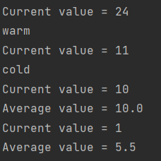
public class MainDriver {
public static void main(String[] args) {
TemperatureSensor s=new TemperatureSensor(7);
NumericDisplay o1=new NumericDisplay();
TextDisplay o2 = new TextDisplay();
AverageDisplay o3=new AverageDisplay();
s.attach(o1);
s.attach(o2);
s.setTemp(24);
s.setTemp(11);
s.detach(o2);
s.attach(o3);
s.setTemp(10);
s.setTemp(1);
}
}

Slide 32
Notifier Pattern (General Publisher-Subscriber, Event Bus, Event Channel, Event Service)

Slide 33
The Notifier (BasicEventBus) Solution
Notifier results from combining Mediator and Observer:
Subject - Observer
Subscriber
Pub1
EventBus
Sub1
Pub2
Mediator
Sub2
Assures a better decoupling between publishers and subscribers:
Publishers do not know the identity of objects that are Subscribers
Subscribers do not know the identity of publisher objects, only the types of events generated by these:

Slide 34
Notifier (BasicEventBus) - Applicability
When an object should be able to notify other objects of an event without needing to know who these objects are or what they do in response.
When the event notification includes all data on the event (PUSH mode)
When an object needs to be notified of an event, but does not need to know where the event originated.
When more than one object can generate the same kind of event.
When some objects are interested in a broader classification of events, while others are interested in a narrower classification.
When an object may be interested in more than one kind of event.
When you need to dynamically introduce new kinds of events.
When objects participating in notification may be dynamically introduced or removed, as in distributed systems.

Slide 35
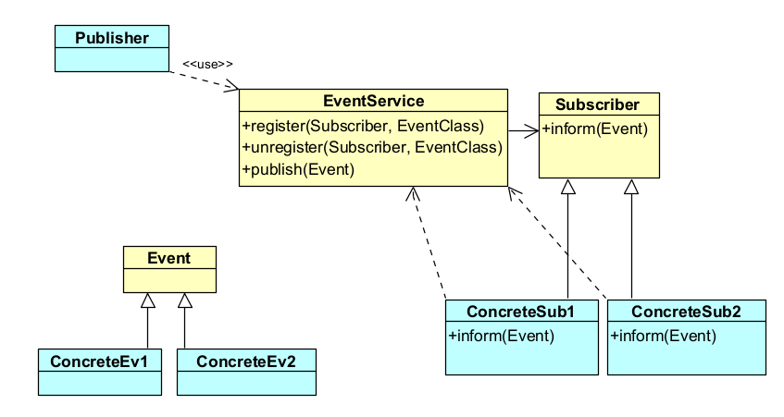
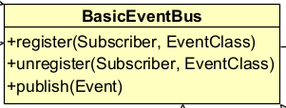
BasicEventBus
publish(thisEvent) {
for all subscriptions (s, ev)
if Typeof thisEvent is ev
s.inform(thisEvent)
}

Slide 36
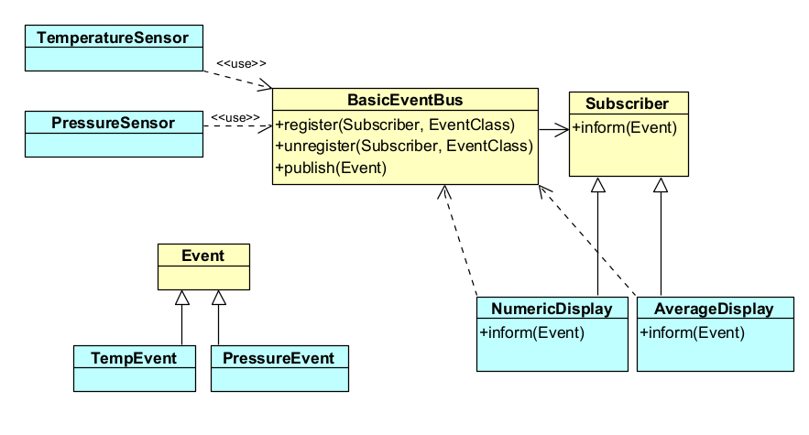
Example: Sensors and Displays with BasicEventBus

Slide 37
The BasicEventBus API
public interface Event { }
public interface Subscriber { void inform(Event event); }
public interface BasicEventBus { void publish(Event event); void subscribe(Class<?> eventType, Subscriber subscriber);
void unsubscribe(Class<?> eventType, Subscriber subscriber);
}

Slide 38
Detailed Implementation of the BasicEventBus as an Event Notifier [Gupta, Hartkopf, Ramaswamy]
Participants:
Event: A common ancestor type for all events.
ConcreteEvent (example: TemperatureEvent, PressureEvent): Represents a specific occurrence, possibly containing data about that occurrence.
Publisher (TemperatureSensor, PressureSensor): Emits or produces events.
Subscriber: Defines an interface for all objects that need to handle events.
ConcreteSubscriber (NumericDisplay, AverageDisplay) Registers for events, and handles events by implementing the Subscriber interface.
EventBus: intermediary between subscriber and publisher. Maintains a map of subscriptions for different event types

Slide 39
public class BasicEventBusImpl implements BasicEventBus {
private class Subscription { public Class<?> eventType; public Subscriber subscriber; public Subscription(Class<?> anEventType, Subscriber aSubscriber) { eventType = anEventType; subscriber = aSubscriber; } }
static private BasicEventBusImpl singleton = null;
private final Class<?> eventClass = Event.class;
protected List<Subscription> subscriptions; private BasicEventBusImpl() {// Prevents direct instantiation of the singleton event service subscriptions = new ArrayList<>(); } static public BasicEventBusImpl instance() {// Provides access point to singleton Eventbus if (singleton == null) singleton = new BasicEventBusImpl(); return singleton; } …

Slide 40
public void publish(Event event) { // publish on all subscribers for (Subscription subscription : subscriptions) { if (subscription.eventType.isAssignableFrom(event.getClass())) subscription.subscriber.inform(event); } } public void subscribe(Class<?> eventType, Subscriber subscriber) throws
InvalidEventTypeException {
if (!eventClass.isAssignableFrom(eventType)) throw new InvalidEventTypeException(); // Prevent duplicate subscriptions Subscription subscription = new Subscription(eventType, subscriber); if (!subscriptions.contains(subscription)) subscriptions.add(subscription); }

Slide 41
BasicEventBus Implementation: Discussion
Subscription is based on event types and not on identity of the publisher
Publishers and Subscribers are independent. Coupling between them is reduced to knowing the set of allowed event types
Implementation detail: use the Class metaobject to describe the type of the subscribed event:
Subscribing to a certain event type automatically comprises all its subtypes
Disadvantage: type safety vs generality

Slide 42
Example with the BasicEventBus
public class MainSensors { public static void main(String[] args) { GeneralDisplay d1 = new GeneralDisplay("Display1"); GeneralDisplay d2 = new GeneralDisplay("Display2"); BasicEventBus.instance().subscribe(TemperatureEvent.class, d1); BasicEventBus.instance().subscribe(TemperatureEvent.class, d2); TemperatureSensor ts1 = new TemperatureSensor("TS001", "Arad", 99.9F); TemperatureSensor ts2 = new TemperatureSensor("TS002", "Timisoara", 98.5F); ts1.setTemperatureValue(24); ts2.setTemperatureValue(12); ts1.setTemperatureValue(5); ts2.setTemperatureValue(8); }

Slide 43
Events with the BasicEventBus
public class TemperatureEvent implements Event{ TemperatureSensor theSensor; public TemperatureEvent(TemperatureSensor t){ theSensor=t; } public TemperatureSensor getTheSensor(){ return theSensor; } }
public class WaterLevelEvent implements Event{ WaterLevelMonitor theMonitor; public WaterLevelEvent(WaterLevelMonitor t){ theMonitor=t; } public WaterLevelMonitor getTheMonitor(){ return theMonitor; } }

Slide 44
A Publisher with the BasicEventBus
public class TemperatureSensor { private int temperatureValue; private String ID; private String location; private float precision; public TemperatureSensor(String ID, String location, float precision) { this.ID=ID; this.location=location; this.precision=precision; this.temperatureValue=0; } public void setTemperatureValue(int newValue){ temperatureValue=newValue; BasicEventBus.instance().publish(new TemperatureEvent(this)); }
// …

Slide 45
A Subscriber with the BasicEventBus
public class GeneralDisplay implements Subscriber { int value; String explanation; String name;
// ….
@Override public void inform(Event event) { if (event instanceof TemperatureEvent) { TemperatureEvent e = (TemperatureEvent) event; value = e.getTheSensor().getTemperatureValue(); explanation = " the temperature in " + e.getTheSensor().getLocation(); } if (event instanceof WaterLevelEvent) { WaterLevelEvent e = (WaterLevelEvent) event; WaterLevelMonitor m = e.getTheMonitor(); value = m.getLevelValue(); explanation = " the water height on river " + m.getRiver() + " at km " + m.getPosition(); } display(); } }
Problem: all Subscribers must have the same handler method, imposed by the Subscriber interface, and thus they cannot handle different event types in a “nicer” way

Slide 46
Requirements for an Improved EventBus
No common type for Events, each should be free to define own event types
Each Subscriber must be free to define its own kinds of handler methods, having as arguments its own subscribed Event types, thus no more fixed Subscriber interface
Solution Variant 1: The subscriber transmits the name of its handler method when subscribing to an event type
Solution Variant 2: The subscriber uses custom annotations to signalize which ones of its methods are event handlers (used by Greenrobot Eventbus)
Both solution variants rely on using reflective languages (see Lecture week 4)

Slide 47
Example: Greenrobot - an EventBus for Java
https://greenrobot.org/eventbus/documentation/how-to-get-started/

Slide 48
GreenRobot EventBus
Events are POJO (plain old Java objects) without any specific requirements
Subscribers implement event handling methods (also called “subscriber methods”) that will be called when an event is posted. These are defined with the @Subscribe annotation.
the method name can be chosen freely but names such as onXYZEvent are usual
the method takes as argument the subscribed event (the subscribed event is inferred from the type of this method’s argument)

Slide 49
Example with Greenrobot
import org.greenrobot.eventbus.*; public class MainSensors { public static void main(String[] args) { EventBus eventBus = EventBus.getDefault(); GeneralDisplay d1 = new GeneralDisplay(eventBus,"Display1"); GeneralDisplay d2 = new GeneralDisplay(eventBus, "Display2"); eventBus.register(d1); eventBus.register(d2); TemperatureSensor ts1 = new TemperatureSensor(eventBus, "TS001", "Arad", 99.9F); TemperatureSensor ts2 = new TemperatureSensor(eventBus, "TS002", "Timisoara", 98.5F); ts1.setTemperatureValue(24); ts2.setTemperatureValue(12); ts1.setTemperatureValue(5); ts2.setTemperatureValue(8); }

Slide 50
A Subscriber with Greenrobot
import org.greenrobot.eventbus.*; public class GeneralDisplay {
…
@Subscribe public void onTemperatureEvent(TemperatureEvent e) { value = e.getTheSensor().getTemperatureValue(); explanation = " the temperature in " + e.getTheSensor().getLocation(); display(); } @Subscribe public void onWaterLevelEvent(WaterLevelEvent e) { WaterLevelMonitor m = e.getTheMonitor(); value = m.getLevelValue(); explanation = " the water height on river " + m.getRiver() + " at km " + m.getPosition(); display(); }

Slide 51
A Publisher with Greenrobot
public class TemperatureSensor { private int temperatureValue; private String ID; private String location; private float precision; private EventBus evBus; public TemperatureSensor(EventBus eb, String ID, String location, float precision) { this.evBus = eb; this.ID=ID; this.location=location; this.precision=precision; this.temperatureValue=0; } public void setTemperatureValue(int newValue){ temperatureValue=newValue; evBus.post(new TemperatureEvent(this)); }

Slide 52
Hybrid Event-Driven Architectures
Active Database: Event-Driven combined with Blackboard
Distributed Event Notification: Event-Driven combined with Broker

Slide 53
Active Database
Combines Blackboard and Event Driven
The Blackboard publishes different events when different data changes happen, and the interested Subscribers will be notified.
The KnowledgeSources will not do execCondition() any more. Instead, they become Subscribers on these conditions. When notified, the KnowledgeSource=Subscriber does execAction()

Slide 54
Fundamental architectural styles: Conclusions (1)
They describes ways of structuring a system from different viewpoints:
Module viewpoint (static structure): Layers
Component & connector viewpoint (dynamic, runtime structure): Pipes-Filters, Blackboard, Event-driven
They describe elementary structures
In real systems, they may appear “pure” or “hybrids”

Slide 55
Event-driven architectures
Event-driven architectures use events to communicate between decoupled services:
http://www.eaipatterns.com/Messaging.html
https://learn.microsoft.com/en-us/azure/architecture/guide/architecture-styles/event-driven
https://aws.amazon.com/event-driven-architecture/#:~:text=An%20event%2Ddriven%20architecture%20uses,on%20an%20e%2Dcommerce%20website.

