Slide 1
Very short intro to Network Programming

Slide 2
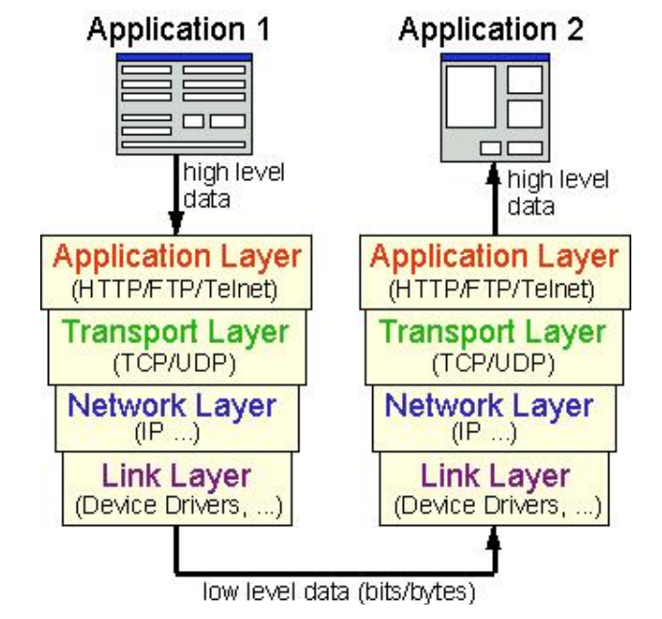
Network Protocol Layers
TCP: connection based protocol, provides a reliable point-to-point communication channel for applications.
UDP: connectionless, datagram. Faster but not reliable

Slide 3
Sockets
A communication channel is defined by:
2 communication endpoints (Sockets)
the protocol
A communication endpoint (Socket):
Address: has 2 components: identification of host + port
a computer usually has a single physical connection to the network, but different applications can open their own communication channels using different ports on the same physical network connection.
Host (computer's address): a 32-bit (4 bytes) IP address.
The 4 bytes represented as numbers separated by points: 193.226.12.16
Can be given as hostname, which will be solved by DNS: staff.cs.upt.ro
“localhost” =127.0.0.1 = the loopback IP address
Port: a 16-bit number ranging from 0 to 65535, with ports 0-1023 reserved for well-known applications
Sockets allow you to exchange information between processes on the same machine or across a network
Socket APIs are offered by the operating system
Socket API’s are the network standard for TCP/IP

Slide 4
Interaction pattern for network applications
Client-Server:
A server is an application that provides a "service" to various clients who request the service
A server must have an addressable communication endpoint (a server socket)
Clients have simple ephemeral communication endpoints (sockets)
Peer-to-Peer:
Participants are equal, all can be clients or servers at any time

Slide 5
Typical Client-Server Interaction
SERVER
Open communication channel,
open ServerSocket
and binds it to its
port addres
CLIENT
Waits for a client request
Open Socket and
connects to a
communication channel
opened by a server
Accept request
request
Read (data)
Write (data)
answer
Write (data)
Read (data)
Close communication channel
notification

Slide 6
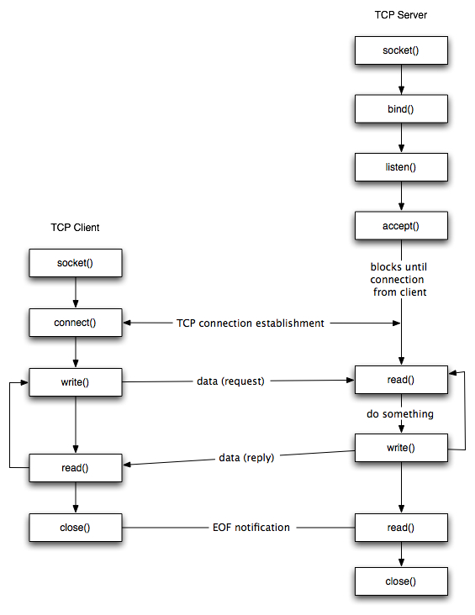
The Socket API in the Unix Operating System

Slide 7
The Socket API in Java
serverSocket =
new ServerSocket(SERVER_PORT);
socket = serverSocket.accept();
socket =
new Socket(ServerHost, ServerPort);
socket.getInputStream()
socket.getOutputStream()
socket.getOutputStream()
socket.getInputStream()
socket.close()

Slide 8
Example: Simple Echo-Server
The Server receives lines from clients and repeats back every line prefixed by “Echo”
EchoServer.java
EchoClient.java

Slide 9
Example: Simple Echo-Server
import java.io.*; import java.net.*; public class EchoServer { public static void main(String[] args){ try{ ServerSocket ss=new ServerSocket(1234); System.out.println("Opened Serversocket and waiting"); while (true) { Socket s = ss.accept();//establishes connection DataInputStream dis = new DataInputStream(s.getInputStream()); String str = (String) dis.readUTF(); // receives from client System.out.println("Received from client the message= " + str); String response= "Echo "+str; //computes response for client DataOutputStream dos = new DataOutputStream(s.getOutputStream()); dos.writeUTF(response);// sends to client dos.flush(); dos.close(); System.out.println("Response was sent to client"); s.close(); } }catch(Exception e){System.out.println(e);} } }

Slide 10
Example: Simple Echo-Client
import java.io.*; import java.net.*; public class EchoClient { public static void main(String[] args) { try { Socket s = new Socket("localhost", 1234);
DataOutputStream dout = new DataOutputStream(s.getOutputStream()); dout.writeUTF("Bla bla bla");
DataInputStream din = new DataInputStream(s.getInputStream()); String response = din.readUTF(); System.out.println("Server said " + response);
dout.flush(); dout.close(); s.close(); } catch (Exception e) { System.out.println(e); } } }

Slide 11
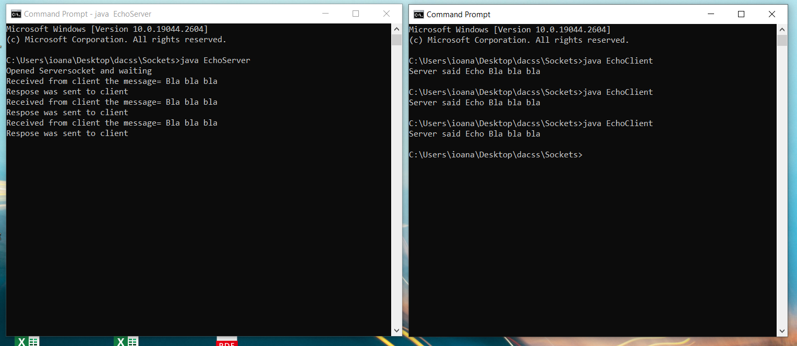
Example: Running Echo-Server and Client
First you must start the server.
Then you can start the client. In the example in this screenshot the client has been run three times

Slide 12
More complex example: InfoServer
InfoServer: gives information about the weather and road traffic
Weather today in Arad ?
Clouds and rain
InfoServer
Client1
How is traffic on Road DN2 ?
Max speed 25
Server imposes message format for requests:
WEATHER <date> <location>
TRAFFIC <road>
Client2

Slide 13

Example: InfoServer with Sockets
import java.io.*; import java.net.*; public class InfoServer { public static void main(String[] args){ try{ ServerSocket ss=new ServerSocket(1234); System.out.println("Opened Serversocket and waiting"); while (true) { Socket s = ss.accept();//establishes connection DataInputStream dis = new DataInputStream(s.getInputStream()); String str = (String) dis.readUTF(); // receives from client System.out.println("Received from client the message= " + str); String response= computeResult(str); //computes response for client DataOutputStream dos = new DataOutputStream(s.getOutputStream()); dos.writeUTF(response);// sends to client dos.flush(); dos.close(); System.out.println("Respose was sent to client"); s.close(); } }catch(Exception e){System.out.println(e);} } }
The client must encode his request in the sent message, according to the protocol imposed by the server
computeResult(str) tokenizes the received message, identifies the command (WEATHER or TRAFFIC) and its parameters, calls the functions which get weather or traffic information, and formats their result as the message to be returned to the client

Slide 14
Transmitting Bytes over Sockets
The Socket API of the operating system transmits only bytes over sockets
Th Java Socket API wraps the Java Stream API over sockets and allows to transmit various data
When transmitting a variable number of bytes over sockets:
The sender must send first a counter of the bytes and only after that the actual bytes
The receiver receives first the counter and only so it knows how many bytes it must read
Example:
ByteClient sends an array of bytes
ByteServer receives the array of bytes

Slide 15
Example: ByteClient
public class ByteClient { public static void main(String[] args) { try { Socket s = new Socket("localhost", 2345); DataOutputStream dOut = new DataOutputStream(s.getOutputStream()); byte[] message=new byte[] {(byte)0xA3, (byte)0x1F, (byte)0x2c };
// when sending an array of bytes, we send first a counter and then the bytes dOut.writeInt(message.length); // write the length of the message dOut.write(message); // write the bytes of the message dOut.flush(); dOut.close(); s.close(); } catch (Exception e) { System.out.println(e); } } }

Slide 16
Example: ByteServer
public class ByteServer { public static void main(String[] args) { try { ServerSocket ss = new ServerSocket(2345); System.out.println("Opened Serversocket and waiting"); Socket s = ss.accept();//establishes connection DataInputStream dIn = new DataInputStream(s.getInputStream()); int length = dIn.readInt(); // read the length of the incoming message if (length > 0) { byte[] message = new byte[length]; dIn.readFully(message, 0, message.length); // read the bytes of the message System.out.print("Received an array of " + length + " bytes: "); for (int i = 0; i < length; i++) System.out.print(Integer.toHexString(message[i] & 0xFF) + " "); System.out.println(); } s.close(); ss.close(); } catch (Exception e) { System.out.println(e); } } }

Slide 17
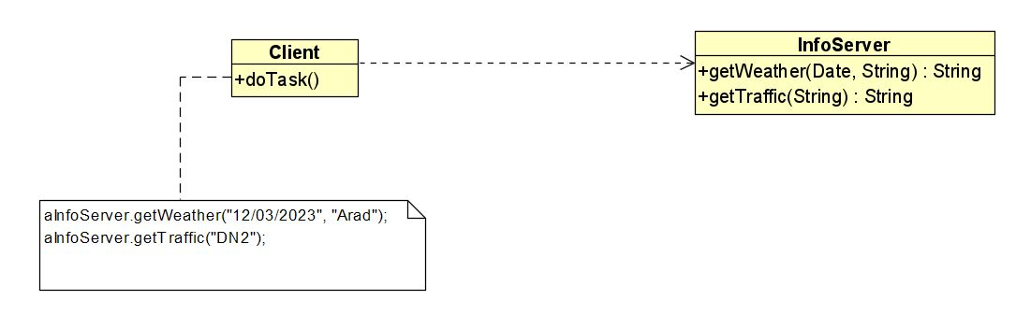


What we want: access a remote service as if it were local!
process1 (computer1)
process2 (computer2)
Remote Method Invocation
Remote Procedure Call
The aInfoServer object is in another process. What is needed in order to allow the client to interact with the server by “normal” invocation of methods?
An Object Request Broker is needed!

Slide 18
Access a remote service by calling remote methods or remote functions
process1 (computer1)
process2 (computer2)
Examples of technologies: past, current, future:
Unix RPC (~1980)
CORBA (~1990)
Java RMI (~2000)
WCF (Windows Communication Foundation) (2006)
gRPC (RemoteProcedureCall) (2016)

