Slide 1
Proiectarea si Arhitectura Sistemelor Software Complexe Design and Architecture of Complex Software Systems
Conf.dr.ing. Ioana Şora
http://staff.cs.upt.ro/~ioana/arhit-engl/
ioana.sora@cs.upt.ro

Slide 2
Quizz
What do the following software systems have in common?

Slide 3
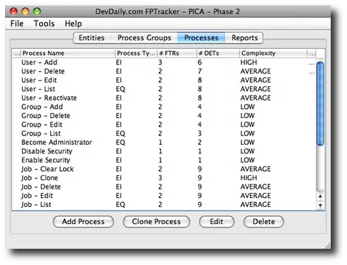
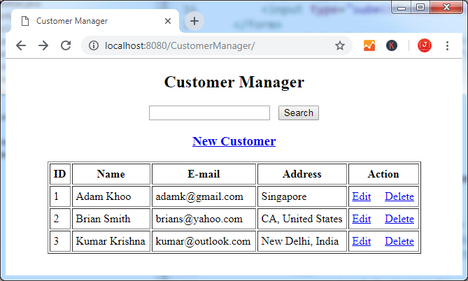
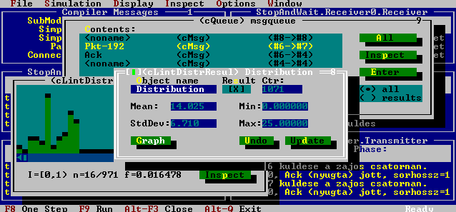

Slide 4
What do they have in common?
Model View Controller (MVC) architectures
Spring MVC web application
Java Swing application
ASP.NET
MFC (MVP)
Ruby on Rails
WPF (MVVM)
Laravel
First MVC GUI framework: in Smalltalk
(cca 1980)
TurboVision application
(cca 1990)
Django
TurboVision application
(cca 1990)
Notes:
MFC Microsoft Foundation Classes – MVP Model View Presenter or Document-View
WPF Windows Presentation Foundation – MVVM Model View ViewModel

Slide 5
MVC architectural pattern for interactive systems
MVC architectures are composed from 3 predefined subsystems:
Model: manages data and business logic.
If the state of this data changes, then the model will usually notify the View and in some variants also notifies the Controller
View: handles layout and display.
In some variants handles also user input and notifies Controller about user requests
Controller: routes commands to the model and view

Slide 6
MVC architectural pattern for interactive systems
Model
getData
notifyChange
updateModel
View
sendUserInput
Controller
selectView
(*) some variations may exist in the way the subsystems interact
(**)variants of the MVC pattern: MVP, MVVM, etc

Slide 7
Technologies, Frameworks
Architectural Patterns

Slide 8
Course goals. Course topics
Understand architectural patterns and styles
Fundamental architectural styles and patterns
Identify architectural patterns for some relevant application domains:
Adaptive systems: The Reflection pattern. Meta Layer Architectures.
Distributed systems: Broker. Remote Proxy.
Data access patterns:
Decoupling data access
Mapping OO program model on Data models (Data binding, ORM)

Slide 9
Practical assignments
Small projects where you have to apply/implement the patterns discussed in the lectures
4 main topics => 4 assignments. Each assignment 2-3 weeks
Every assignment has multiple options, with various degrees of complexity, from easy to more difficult
Can add bonus points for exam.
By default, final grade = (lab + written exam +bonus points)/2
Enough points (6 points) -> no more written exam at all
Need (good) OO programming knowledge background. Can use implementation language of your choice, but examples in lectures are mostly Java-related
PDSS (SSD): nice to have but not an absolute prerequisite
“Rescue assignment”: pass lab+exam with final grade 5: write an essay about a topic from the domain of software design and architecture

Slide 10
Practical assignments
Many projects are “toy”-versions of real frameworks.
Some example of assignmets (and their real life ”competitors”)
an EventBus (Assignm 2-Option A4, Assignm 3-TrackB),
a Serializer(Assignm 2-Option A3) see Java (writeObject), .NET (System.Runtime.Serialization)
an Object Request Broker (Assignm 3-TrackA) see Java RMI, .NET WCF – proxies for services
a Data Binder(Assignm4-TrackB) see JAXB for XML-Java; JSON-object
a DAO Generator(Assignm 4 -TrackC) see Spring Data - generates query methods
an ORM(Assignm4-TrackD) see Hibernate, JPA, Jakarta Persistence
Why?
Challenging exercises of design and implementation
Understand what kind of designs are inside of some types of wellknown frameworks
“Rescue assignment”: for 5 in lab+exam: write an essay about a topic from the domain of software design and architecture

Slide 11
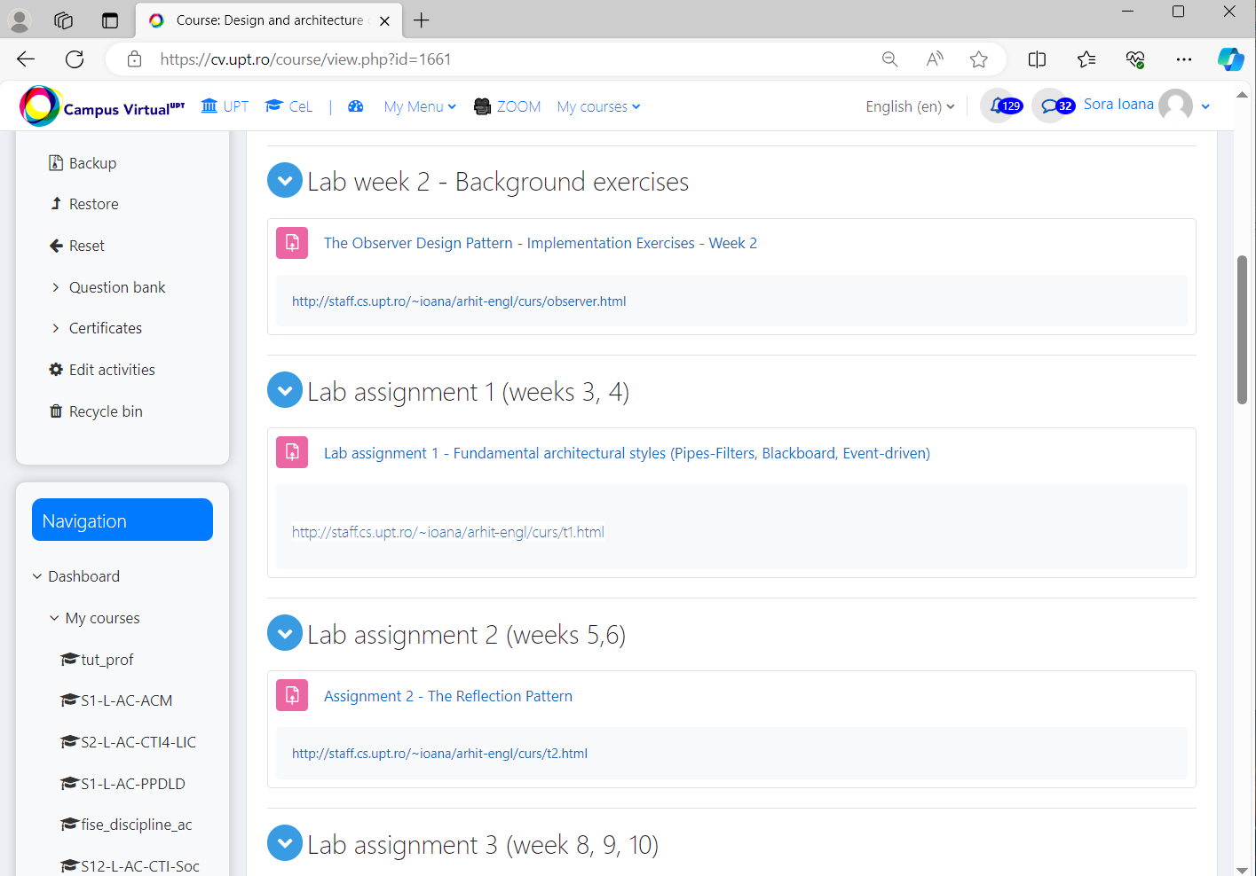

Slide 12
Course Webpage
On Campus Virtual
PASSC https://cv.upt.ro/course/view.php?id=1604
DACSS https://cv.upt.ro/course/view.php?id=1661
http://staff.cs.upt.ro/~ioana/arhit-engl/
Lectures slides and schedule
Lab assignments
Bibliographic pointers and additional resources

Slide 13
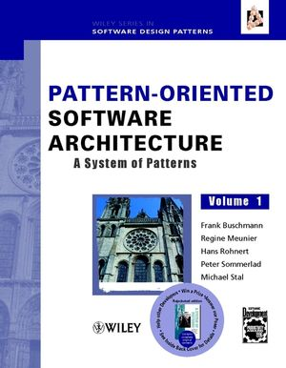
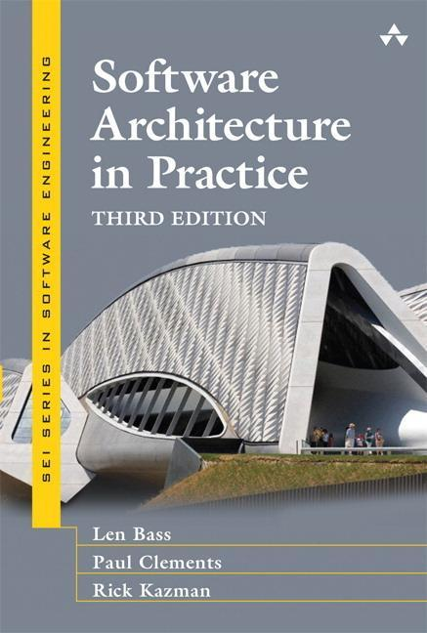
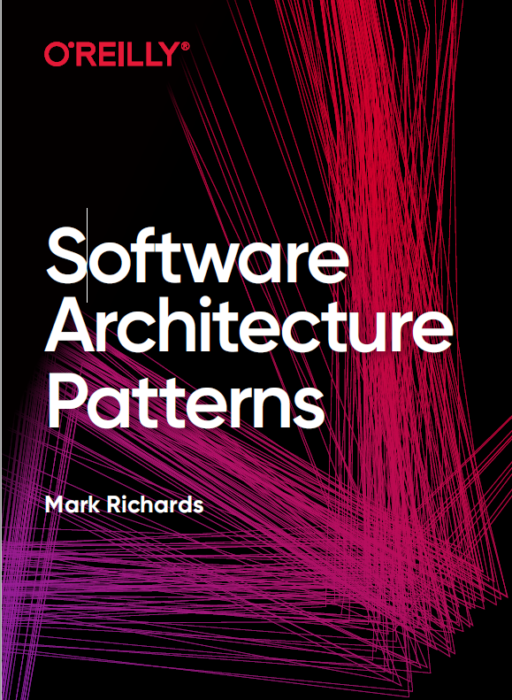
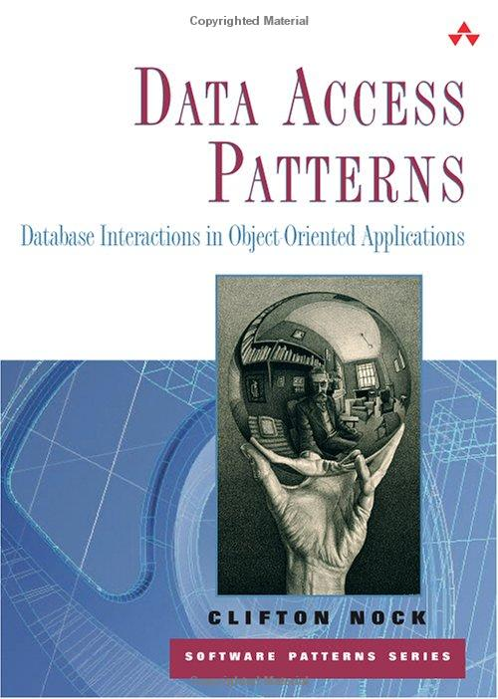
Resources

