Slide 1
Embedded Systems
“Politehnica” University of Timisoara, Romania
Faculty of Automation and Computers
Computer and Software Engineering Department
Instructor: Assist. Prof. dr. eng. Razvan Bogdan razvan.bogdan@cs.upt.ro

Slide 2
Administrative
Mobile computing, sensor networks and embedded systems
B413A/B
Interests
  Embedded Systems
  Ambient Intelligence
  Dependability of Computer Systems
  Testing of Computer Systems
  Complex Networks, Data Analysis med. prj.
  e-Learning Technologies
Course page:
  http://staff.cs.upt.ro/~rbogdan/?es3eng

Slide 3
Administrative
Laboratories + Project
  B413B
  ZK-S12-B boards – industrial process
  Dragon S12 boards – basic applications
Students counseling
  Thursday 14-16 in B413A/B414
Evaluation
  Final mark:
    40%: lab (20%) + project (20%) (semester practical activities)
    60% written exam: theory and problems; >=5 each part
    The written exam will not be recognized on parts
Additional readings (course, but also lab) should be read ☺

Slide 4
Administrative - MOOCs
  Massive Open Online Courses (MOOCs)
  MOOCs allow large numbers of people across the world to take university courses for free, on many different topics, and to access the course materials at a time and place which is convenient for them.
  There are several different types of MOOC, some requiring participants to sign up, others with content and activities openly available to anyone with a web connection. Some are based around watching video lectures and reading articles, some emphasize the use of social media, such as blogs and Twitter, and most make use of some form of discussion among participants.
      Source: https://www.brookes.ac.uk/Studying-at-Brookes/courses/Open-Online/What-are-MOOCs/

Slide 5
Administrative - MOOCs
Coursera: https://www.coursera.org/courses?languages=en
Udemy: https://www.udemy.com/courses/
Udacity: https://www.udacity.com/
Khan Academy: https://www.khanacademy.org/
  https://www.mooc-list.com/?static=true
  https://www.futurelearn.com/
Example:
  Coursera: An Introduction to Programming the Internet of Things (IOT) Specialization
  Introduction to the Internet of Things and Embedded Systems (4 weeks)
  The Arduino Platform and C Programming (4 weeks)
  The Raspberry Pi Platform and Python Programming for the Raspberry Pi (4 weeks)
  Minimum 60% of 3 such courses => 3 points for theory

Slide 6
Course objectives
Knowing the definition, characteristics, structure and functioning of an embedded system (ES);
Typical problems that arise in the design of ES based on microcontroller;
Study on components and specific instruments used in ES design;
Study of some typical applications;
Acquiring knowledge in order to design an ES based on microcontroller with predetermined functionality.

Slide 7

Textbook
    Main textbook:
      Han-Way Huang, The HCS12/9S12: An Introduction to Software and Hardware Interfacing, Cengage Learning, 2010 (Minnesota State University)
    Secondary:
      Jonathan W. Valvano, Introduction to Embedded Systems. Interfacing to the Freescale 9S12, Cengage Learning, 2010 (University of Texas at Austin)
      Peter Marwedel, Embedded System Design, Springer, 2011 (Dortmund University)

Slide 8
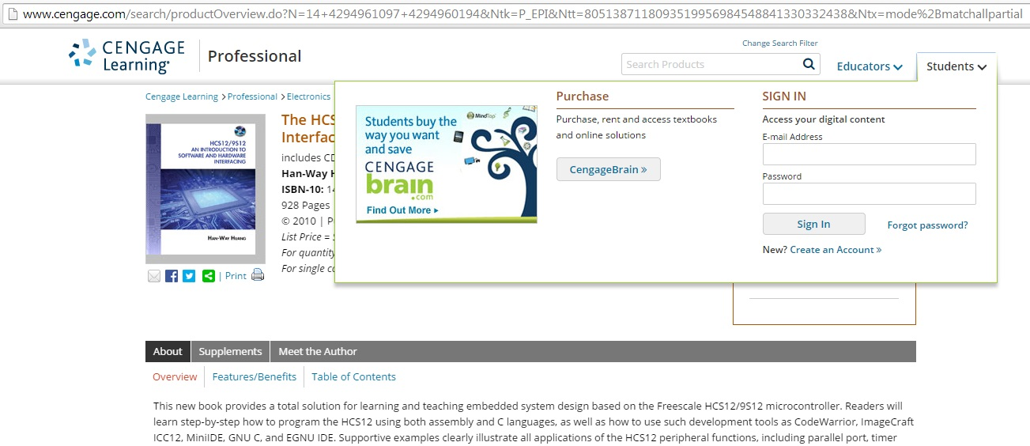
Textbook
    Main textbook:
      Han-Way Huang, The HCS12/9S12: An Introduction to Software and Hardware Interfacing, Cengage Learning, 2010 (Minnesota State University) -> check student resources

Slide 9
Content
Introduction
  Motivation for course
  What are embedded systems ? (ES)
  Applicability areas
  Features and requirements
  Directions in the study of Embedded Systems
  Embedded System and “ubiquituous and pervasive computing”
  Market features
  The typical structure of Embedded System
Design flow
  Specification (Requirements)

Slide 10
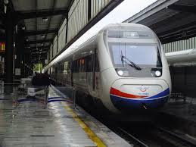



Motivation for course (1)
According to forecasts, future of IT characterized by terms such as
  Disappearing computer,
  Ubiquitous computing,
  Pervasive computing,
  Ambient intelligence,
  Post-PC era,
  Cyber-physical systems,
  Internet-of-things
Basic technologies:
  Embedded System technologies
  Communication technologies

Slide 11

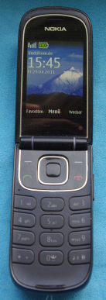
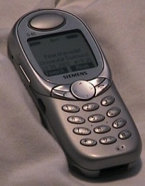
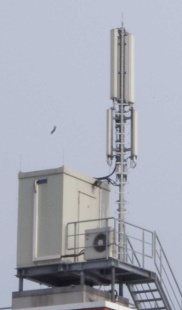

Motivation for course (2)
National Research Council Report (US)
Embedded Everywhere, 2001:
“Information technology (IT) is on the verge of another revolution. …..
networked systems of embedded computers ... have the potential to change radically the way people interact with their environment by linking together a range of devices and sensors that will allow information to be collected, shared, and processed in unprecedented ways. ...
The use … throughout society could well dwarf previous milestones in the information revolution.”
© P. Marwedel, 2011

Slide 12
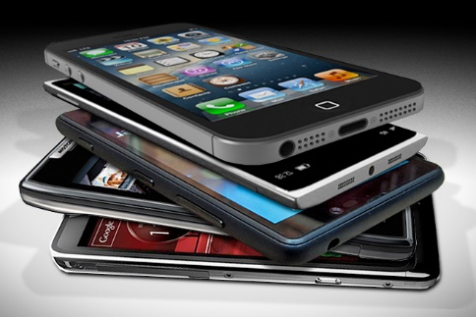
Motivation for course (3)
Growing importance of Embedded Systems
  As of January 2014:
    90% of American adults have a cell phone
    58% of American adults have a smartphone
    32% of American adults own an e-reader
    42% of American adults own a tablet computer
  As of May 2013, 63% of adult cell owners use their phones to go online.
  34% of cell internet users go online mostly using their phones, and not using some other device such as a desktop or laptop computer

Slide 13
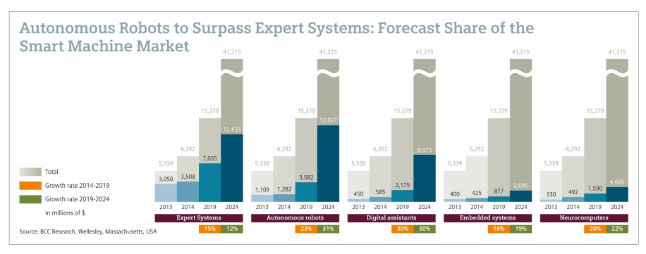
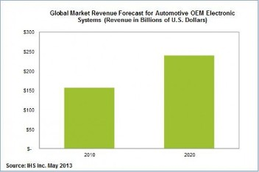
Motivation for course (4)

Slide 14
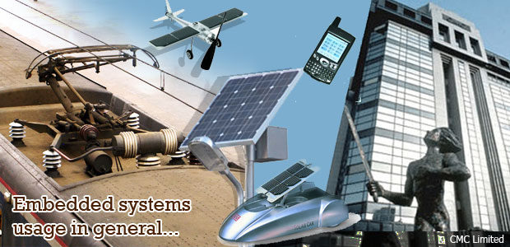
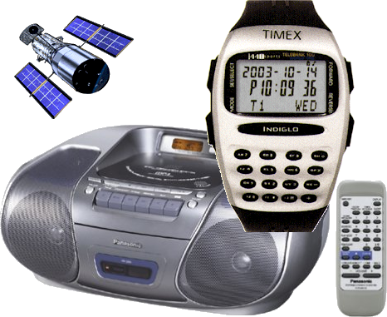
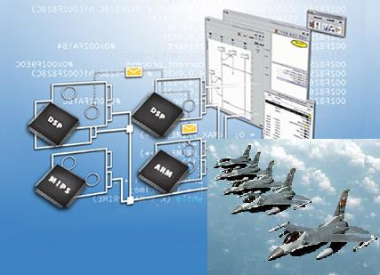
Motivation for course (5)
The future is embedded, embedded is the future

Slide 15
What are embedded systems ?
Definition 1: An ES is a system that integrates hardware and software and is designed for a specific functionality.
Definition 2: An ES is a computer system with predefined goal included in a device and leads him.
Definition 3: An ES is a computer system with specific requirements. Unlike general purpose computer, ES perform predefined tasks.
Definition 4: An ES is an information processing system, part of a larger system or device.
Definition 5: An ES is a combination of hardware and software with programming and fixed facilities designed for a variety of applications.

Slide 16
What are embedded systems ?
Definition 6: An ES is a combination of hardware and software, and possibly mechanical or other components, designed to perform a dedicated function. In some cases, ES is part of a larger system or product, such as the ABS system ("Breaking antilock System") from - an automobile.
The updated definition: ES is a subdomain of the domain of computer engineering, based on programmable logic circuits by user, and oriented on real-time applications.
Berkeley: [Edward A. Lee]:
Embedded software is software integrated with physical processes. The technical problem is managing time and concurrency in computational systems.

Slide 17
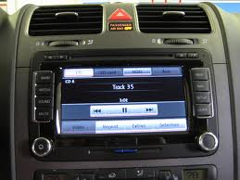
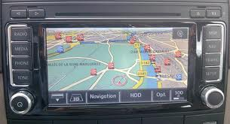
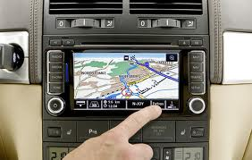
What are embedded systems ?
In general, "embedded system" is not a strictly definable term, as most systems have some element of extensibility or programmability. For example, handheld computers share some elements with embedded systems such as the operating systems and microprocessors that power them, but they allow different applications to be loaded and peripherals to be connected. On a continuum from "general purpose" to "embedded", large application systems will have subcomponents at most points even if the system as a whole is "designed to perform one or a few dedicated functions", and is thus appropriate to call "embedded".

Slide 18
What are embedded systems ?
Programmable logic circuits
    Microprocessor: a programmable logic circuit used for general purpose applications;
    Microcontroller: a programmable logic circuit used for real-time applications.
    DSP: a programmable logic circuit for digital processing of analog signals.
Different development paths:
    Microprocessors: developed for processing applications (the greatest possible speed, manageable memory capacity as large as possible);
    Microcontrollers + DSP: developed for real use applications
    (low consumption, small size, low cost, high safety, high reliability).

Slide 19
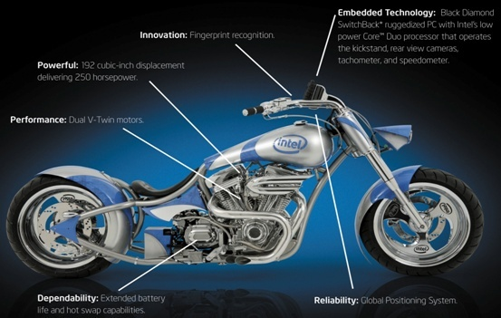
What are embedded systems ?
ES are intended for an application or family of applications.
ES may contain a microcomputer but are generally independent systems included in a device and leads him.
ES are based on microcontroller or DSP !

Slide 20
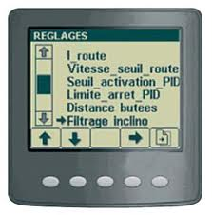
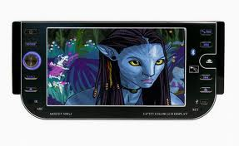
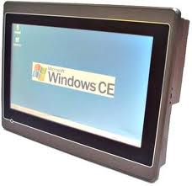
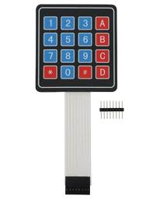
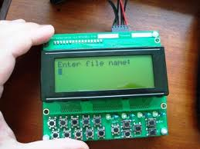
What are embedded systems ?
Differences between ES and general-purpose computers:
    Human interface: led, LCD, switches, keypad;
    Simple system with Input/output, without the periphery;
    May include diagnostic ports;
    May include FPGA, analog circuits;

Slide 21
What are embedded systems ?
The software has a fixed functionality specific to the application;
a general-purpose computer can execute several programs, the choice belongs to the user, while an ES can run several programs but the choice belongs to the programmer.

Slide 22
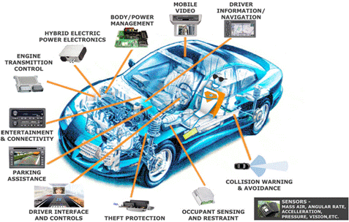
Applicability areas
Automotive: the number of ES in automobiles is growing steadily (at least 65-100)
  ABS: Anti-lock braking systems
  ESP: Electronic stability control
  Airbags
  Efficient automatic gearboxes
  Theft prevention with smart keys
  Blind-angle alert systems
  ... etc ...

Slide 23
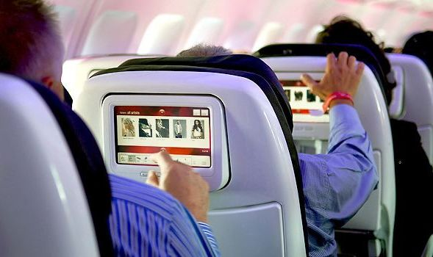
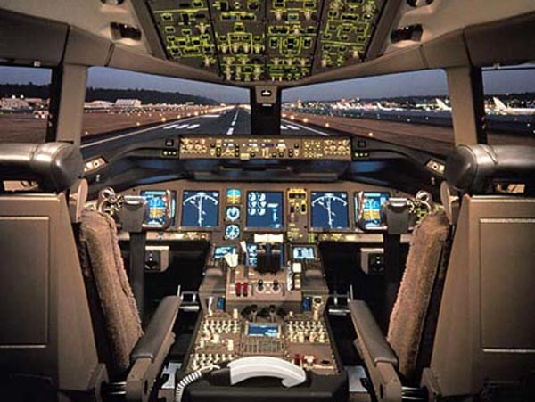
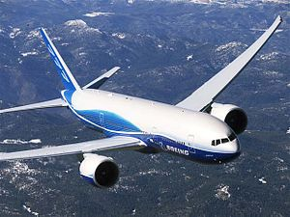
Applicability areas
Aviation industry:
  Flight control systems
  Anti-collision systems
  Pilot information systems
  Power supply system
  Flap control system
  Entertainment system
  (Boeing 777: more than 1,200 processors and
  more than 4,000,000 lines of code)
Aerospace industry
Dependability is of outmost importance

Slide 24
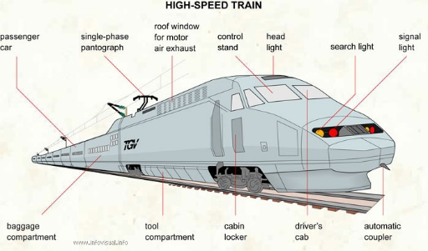

Applicability areas
Transport:
  Railroad
    Gauge spreading
    Track twist faults
    Cyclic top faults
    Broken rails
    Track buckles
    Vandalism
  Water ways
    measuring turbidity (particle load),
    salinity (conductivity)
    Ships functioning
Dependability is of outmost importance

Slide 25
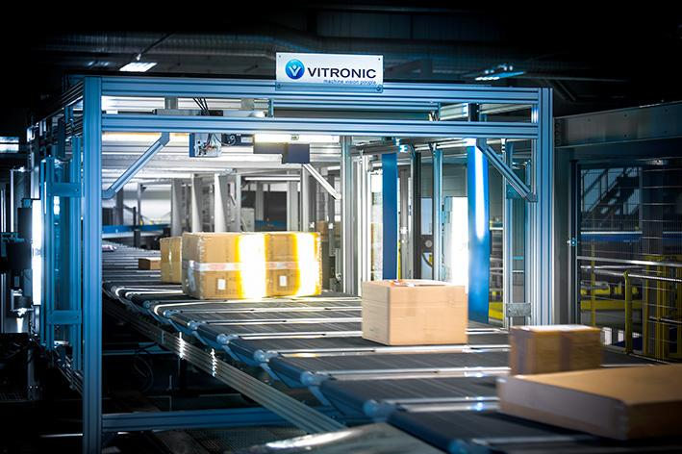
Applicability areas
Logistics
    Radio frequency identification (RFID) technology provides easy identification of each and every object, worldwide.
    Mobile communication allows unprecedented interaction.
    The need of meeting real-time constraints and scheduling are linking embedded systems and logistics.
    The same is true of energy minimization issues

Slide 26
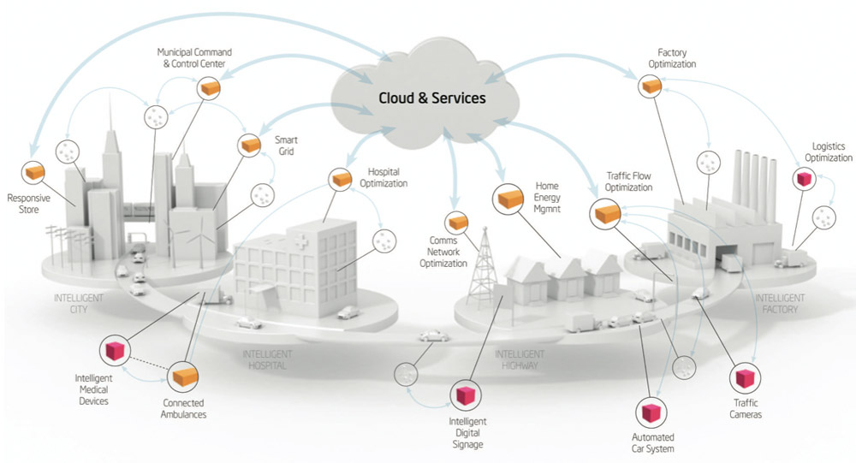
Applicability areas
Internet of Things
    “developers can expect to see embedded system design projects pop up everywhere from assembly line machinery and building automation systems to pacemakers and even toothbrushes.”
    [http://rtcmagazine.com/articles/view/103677]

Slide 27




Applicability areas
Structural safety
Sensors + data analysis
© P. Marwedel, 2011
Möhne lake dam
Kilauea, Hawaii
Bridge at Vancouver
Taipeh 101

Slide 28
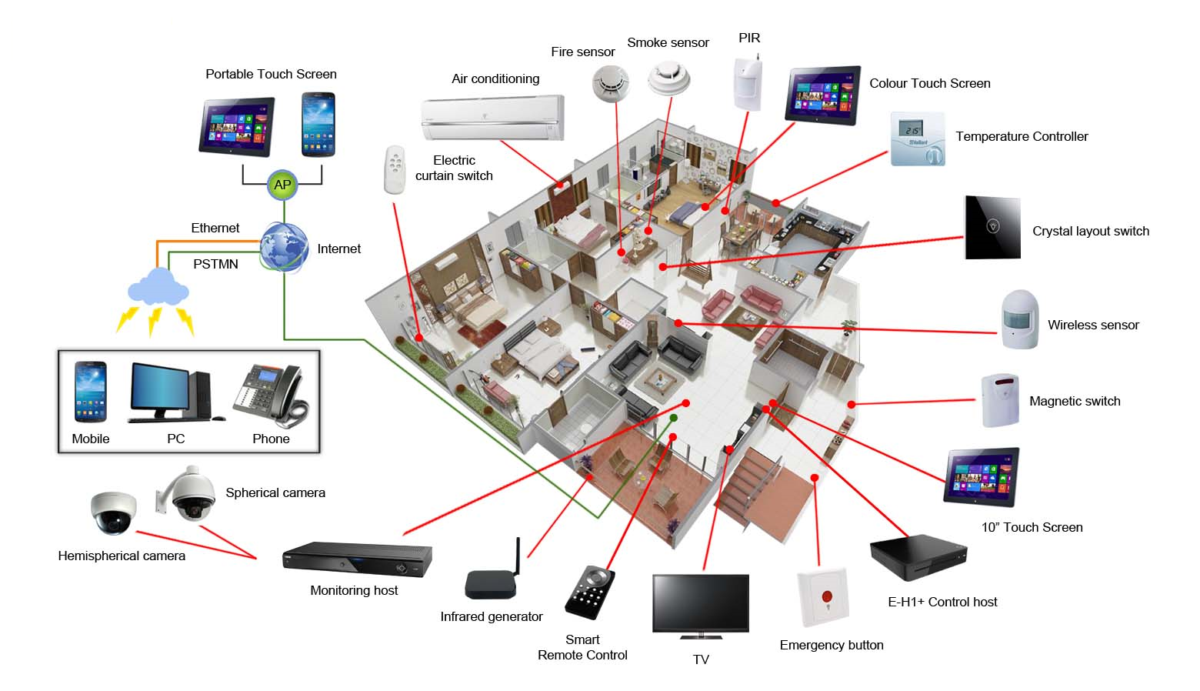
Applicability areas
Smart Homes
  Zero energy building, generates as much energy as it consumes
  Provides safety and security
  Supports owners
  Provides maximum comfort
  Ambient assisted living

Slide 29
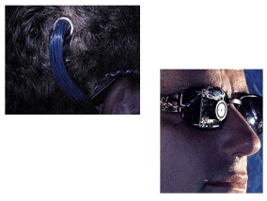
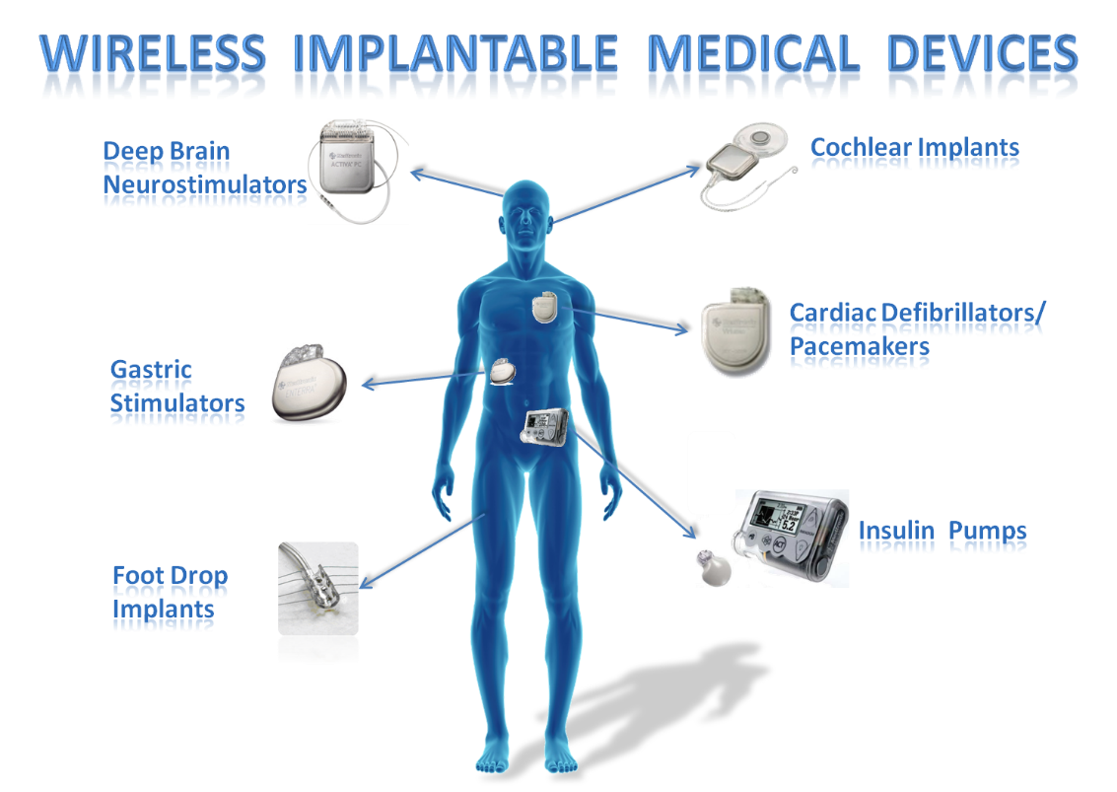
Applicability areas
Medical systems
    For example:
      Artificial eye: several approaches, e.g.:
        Camera attached to glasses; computer worn at belt; output directly connected to the brain, “pioneering work by William Dobelle”. Previously at [www.dobelle.com]
© P. Marwedel, 2011

Slide 30
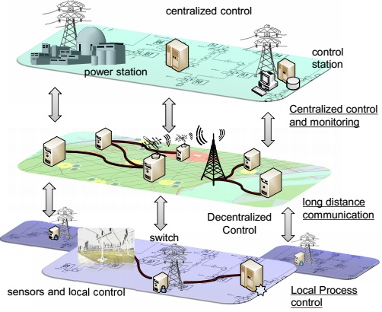
Applicability areas
Smart Grid
© P. Marwedel, 2011

Slide 31
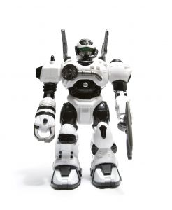
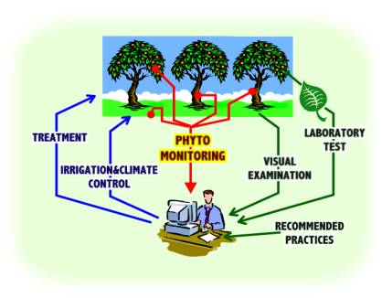
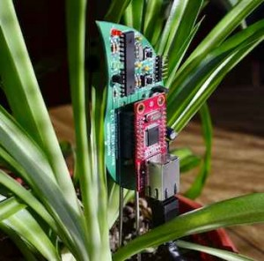
More applicability areas
Telecommunications: cell phones +…;
Domestic Applications: household appliances, toys, electronics, etc.
Robotics
Industry: management processes, manufacturing equipment, chemical equipment, automatic machines for sale, personnel monitoring, etc
Hotel industry
Military industry
Agriculture

Slide 32
Features and requirements
An ES must work in conditions more restrictive than a general purpose computer.
Features and requirements:
Connection to the external environment , will monitor it via sensors and ordering through actuators. An actuator can be defined as a device that converts numeric values ​​to physical effects.
Reactive operation: a reactive system is in constant interaction with the environment and executes tasks at a rate determined by the environment; a reactive system can be thought of as being in a particular state, waiting for an entry; for each entry executes one or more operations and generate an exit; such a system can be modeled very well by an automated;
Real-time operation: time becomes a parameter of the execution of operations; there are hard time constraints (severe effects, sometimes disastrous; for non-compliance )and soft (negative effect for non-compliance)

Slide 33
Features and requirements
Efficiency: a ES must be effective; this can be evaluated with the following metrics:
    Power consumption: must be minimized, especially for mobile ES;
    Size: large code → great program memory, possible external →additional circuits → larger size of ES, higher consumption, lower reliability;
    Execution involving the minimum of circuits;
    Small size and weight;
    Low Cost
Running in heavy environments : excessive heat, vibration, corrosion , fluctuations of the supply voltage;
Dependability: very important due to the connection with the external environment, comprises the following aspects of a system:
    Reliability: the probability that a system will not be damaged;
    Maintainability: the probability that a defect can be repaired in a certain time;
    Safety: probability that a failure will not cause catastrophic;
    Availability: the probability that a system is available.

Slide 34
Direction in the study of Embedded System
    Directions in the study of Embedded Systems:
        Hardware and basic circuits (microcontrollers, DSPs)
        Programming languages​​;
        Operating Systems;
        Networks of ES;
        Modeling, simulation and validation;
        Applications.

Slide 35
Embedded System and “ubiquituous and pervasive computing
    The first wave in computing: large computers, 1 computer - many people;
    The 2nd wave: PC‘s, 1 computer - 1 man;
    The 3rd wave ("post PC was"): "ubiquitous and pervasive computing", several computers - 1 man.
    "Ubiquitous computing" ("ubicomp") and "pervasive computing" (UPC)
      It is a new computing model, post desktop the computer systems are around human being ever ready to process information
      Unlike desktop model in which a user used a computer system to perform a task, in UPC man determines information processing by multiple systems, in its current work, without having to be aware of it;
      It is based on small computer systems, often unnoticed by humans, with particular tasks, that communicate with each other and possibly with a central system; it is based on the ES;

Slide 36
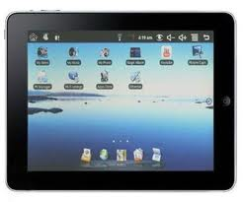
Embedded System and “ubiquituous and pervasive computing
Areas of research needed in UPC:
    Embedded Systems and ES networks
    Distributed computing
    Mobile computing
    Sensors and sensor networks
    Man – machine Interaction
    Artificial Intelligence
UPC is at the intersection of 3 subdomains of TIC:
    Processing
    Communications
    User interface
Processing: relying on the equipment; There is a wide range of tablets, smart phones to very small systems included in the environment; are divided into 3 types:
    Sensors
    Processors
    Actuators

Slide 37
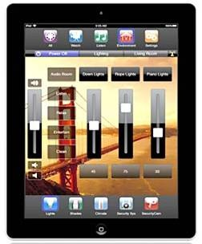
Embedded System and “ubiquituous and pervasive computing
The equipment must be able to work alone, have own power supply, and be able to communicate.
Communications: equipments are interconnected, forming networks and communication can be:
    Wired for example. Ethernet or
    Wireless, for example. technologies WiFi, Bluetooth, ZigBee, etc.
User Interface:
    Active voice, physiognomy recognition etc.
    Passive: equipment detects human presence, they activity, and react without the need for man to be aware of this.
Applications in multiple domains:
    Health: monitoring status of patients and medication planning → ​​decreases the number of days of hospitalization;
    Monitoring and care at home: in England, now, 20% of the population over 65 → will rise to 40% in 2025;
    Environmental Monitoring;
    Intelligent Transport Systems: to increase security for alternative routes etc .
    Smart Homes: ex. Lighting system.

Slide 38
Embedded System and “ubiquituous and pervasive computing
Issues:
  Engineering: lack of cheap technology for placing equipment; lack of suitable power supply sources; defects (troubleshooting will be difficult due to interconnection);
  Personal privacy ("Privacy") has two aspects:
      Permanent monitoring will affect human intimacy;
      Data transfer can be intercepted by unauthorized persons.
  Security: continuous monitoring of man can show weaknesses in its environment;
  Safety: the introduction of such equipment may affect human safety; ex. if such equipment is placed in the car and the man uses this feature, safety will be affected by its failure;
  Environment: the widespread use of such equipment raises storage, issues, recycling, environment damage
  Health: thanks to wireless communication, problem of radiation arises, especially in terms of proximity to the human body of equipment and their continued operation;
  Digital divide: the problem is of social nature and consist the possible isolation of those who for various reasons do not use UPC

Slide 39
Market features
In 2000, 8 billion CPUs were manufactured, of which 2% used in PCs, laptops, servers, workstations, and the remaining 98% in ES; 5 billion of these was on 8-bit!
The global market of ES, was 45,9 billion dollars in 2004, 88 billion dollars in 2010!
2015- estimate at 158 billion dollars
90% of automotive innovations are in the ES area !
Regarding the domestic domain there is a variant of Moore's law: "for most products from electronics domain, the code capacity will double every two years", issued by Vaandrager!
If in 1980 a TV, included about 1 Ko code today includes min. 200 MB of code!
A current phone (medium as possibility) contains min.1 million lines of code!

Slide 40
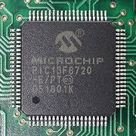
Structure of ES
Central Unit,
Memory,
Specific Inputs/Outputs
Basic Software (System Software)
Application software
Central Unit: to decide if a processor is suitable for an ES must to be taken into consideration several features: :
  Number of i/o pins: The number of i/o pins must be compared with that of lines that should be monitored/controlled; some i/o pins can be multiplexed;
  Number of interfaces
  Memory requirements
  Number of interrupt lines

Slide 41
Structure of ES
Real time facilities: capture/compare registers, PWM etc.; These may be made without specific facilities but with cost of time;
Speed​​: is not always given just by clock frequency, internal structure must be known : ex. Atmel 8 MHz microcontroller is faster than a PIC 20 MHz microcontroller;
Set of instructions: RISC or CISC; subset of decision instructions and at Bit level, has special significance;
Development Tools: decisive in testing and debugging; their cost should be taken into account.
Memory
  Ideal situation: when internal, data and program memory, is sufficient;
  Otherwise, the external memory is required;
  The amount of memory managed by a microcontroller is smaller than the one managed by a microprocessor, being in the domain of nx10 bytes-nx10 Mo, real time applications do not generally require a lot of memory.

Slide 42
Structure of ES
Inputs / Outputs specific:
  Microcontrollers include interfaces and peripheral modules as a result they are no longer independent in ES.
  ES have no peripherals: hard drives, monitors, printers, mouse etc.
  Inputs/outputs of ES are specific:
    Read information from analog or digital sensors,
    Receiving orders from outside, either on digital lines from the switches, keypad,
    Displays information on LEDs, LCDs, 7-segment displays
    Order actuators.
  ES can communicate via serial lines, wired or wireless, with other ES or
general purpose computers;
  Can have serial port for system programming;
  Can have port for system debugging.

Slide 43
Structure of ES
Basic Software (System Software):
  Consists in operating systems in real time(RTOS), necessary for complex ES, ex. distributed ES;
  Example of RTOS: NetBSD, eCOS, Windows CE, OSEK etc.
  Simple ES, for example most of the domestic applications, requires no base software.
Application Software:
  Implements required functionality
  Requires programming language and programming environment the programming environment runs on PC (not always the case)
  Provides operations as: monitoring processing, command and control.

Slide 44

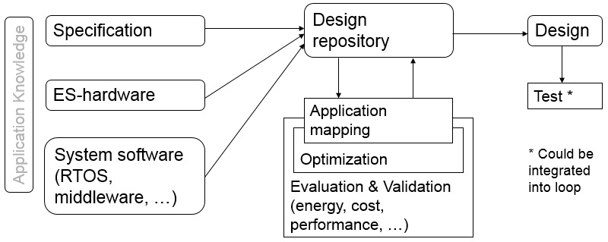
Design flow
The Generic Model [P. Marwedel]
Boxes with rounded corners for stored information and rectangles for transformations on data
In particular, information is stored in the design repository;
The repository allows keeping track of design models. In most cases, the repository should provide version management or “revision control”, such as CVS [Cederqvist, 2006] or SVN [Collins-Sussman et al., 2008], IBM Rationale Synergy

Slide 45
Design flow
The design repository can be extended into an integrated development environment (IDE), also called design framework
During design iterations, applications are mapped to execution platforms and new (partial) design information is generated. The generation comprises the mapping of operations to concurrent tasks, the mapping of operations to either hardware or software (called hardware/software partitioning), compilation, and scheduling.
Designs should be evaluated with respect to various objectives including performance, dependability, energy consumption, manufacturability etc.
At the current state of the art, none of the design steps can be guaranteed to be correct. Therefore, it is also necessary to validate the design.
Validation consists of checking intermediate or final design descriptions against other descriptions (e.g. requirements). Thus, each new design should be evaluated and validated.
Notes:
Using the repository, design decisions can be taken in an iterative fashion. At each step, design model information must be retrieved. This information is then considered.

Slide 46
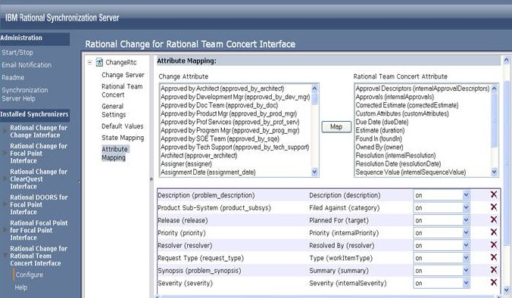
Design flow
Due to the importance of the efficiency of embedded systems, optimizations are important: including high-level transformations (such as advanced loop transformations) and energy-oriented optimizations.
Design iterations could also include test generation and an evaluation of the testability. Testing needs to be included in the design iterations if testability issues are already considered during the design steps.
Specific tools for problem (bug) tracking: IBM Change Synergy

Slide 47
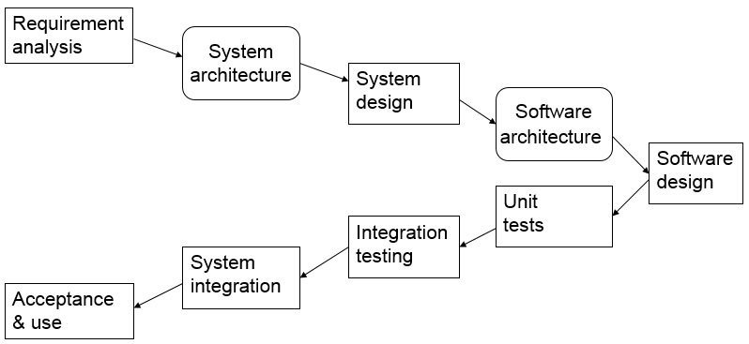
Design flow
The V-model of design flow – iterative design
Application knowledge, system software and system hardware are not explicitly shown.
The V-model also includes a model of the integration and testing phase (lower “wing”) of the diagram. This corresponds to an inclusion of testing in the loop
Notes:
Fig. 1.8 very clearly shows the different steps that must be performed. The steps correspond to certain phases during the software development process (the precise meaning is again not relevant in the context of this book). Note that taking design decisions, evaluating and validating designs is lumped into a single box in this diagram. Application knowledge, system software and system hardware are not explicitly shown. The V-model also includes a model of the integration and testing phase (lower “wing”) of the diagram. This corresponds to an inclusion of testing in the loop of fig. 1.6. The shown model corresponds to the V-model version “97”. The more recent V-model XT allows a more general set of design steps. This change matches very well our
interpretation of design flows in fig. 1.6. Other iterative approaches include the waterfall model and the spiral model. More information about software engineering for embedded systems can be found in a book by J. Cooling [Cooling, 2003].

Slide 48
Design flow
The V-model of design flow – iterative design
Development and test are two equal branches
Each development level has a corresponding test level
Tests (right hand side) are designed in parallel with software development (left hand side)
Testing activities take place throughout the complete software life cycle
The development process adopted for a project will depend on the project aims and goals.
There are numerous development life cycles that have been developed in order to achieve different required objectives.
These life cycles range from lightweight and fast methodologies, where time to market is of the essence, through to fully controlled and documented methodologies where quality and reliability are key drivers.

Slide 49
Specification (Requirements)
The Generic Model

Slide 50

Specification (Requirements)
Motivation for considering specs & models
Why considering specs and models in detail?
If something is wrong with the specs,
then it will be difficult to get the design right, potentially wasting a lot of time.
  Talk with the Requirements manager
  Ask the client for better specification
Typically, we work with models of the system under design (SUD)
What is a model anyway?

Slide 51
Specification (Requirements)
Models
Definition:
  A model is a simplification of another entity, which can be a physical thing or another model.
  The model contains exactly those characteristics and properties of the modeled entity that are relevant for a given task.
  A model is minimal with respect to a task if it does not contain any other characteristics than those relevant for the task. [Jantsch, 2004]

Slide 52
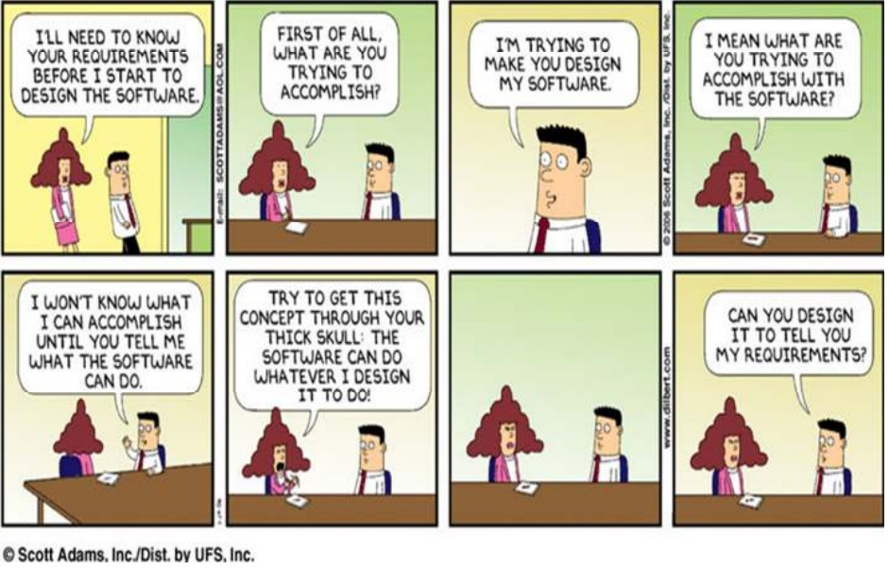
Specification (Requirements)
Requirements for modeling specification

Slide 53
Specification (Requirements)
Requirements for modeling specification: Hierarchy
Humans not capable to understand systems containing more than ~5 objects. Most actual systems require more objects
  => Hierarchy (+ abstraction)
  Behavioral hierarchy: containing objects necessary
  to describe the system behavior
  Examples: states, processes, procedures.
  Structural hierarchy: how systems are composed of
  physical components
  Examples: processors, racks, printed circuit boards
proc
proc
proc

Slide 54
Specification (Requirements)
Requirements for modeling specification: Component-based design
Systems must be designed from components
Must be “easy” to derive behavior from behavior of subsystems
If two components are connected, the resulting new behavior should be predictable.
  Example: suppose that we add another component (say, some GPS unit) to a car. The impact of the additional processor on the overall behavior of the system (including buses etc.) should be predictable.

Slide 55
Specification (Requirements)
Requirements for modeling specification: Timing (1)
Timing behavior: essential for embedded systems!
Additional information (periods, dependences, scenarios, use cases) welcome
Also, the speed of the underlying platform must be known
Far-reaching consequences for design processes
“The lack of timing in the core abstraction (of computer science) is a flaw, from the perspective of embedded software” [Lee, 2005]

Slide 56
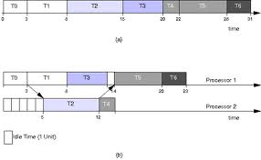
Specification (Requirements)
Requirements for modeling specification: Timing (2)
4 types of timing specs required, according to Burns, 1990:
Measure elapsed time
Check, how much time has elapsed since last call
?
execute
t
Means for delaying processes
T
t

Slide 57
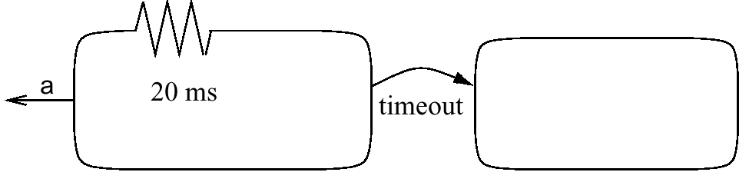

Specification (Requirements)
Requirements for modeling specification: Timing (3)
3. Possibility to specify timeouts
Stay in a certain state a maximum time.
Methods for specifying deadlines
Not available or in separate control file.
execute
t

Slide 58
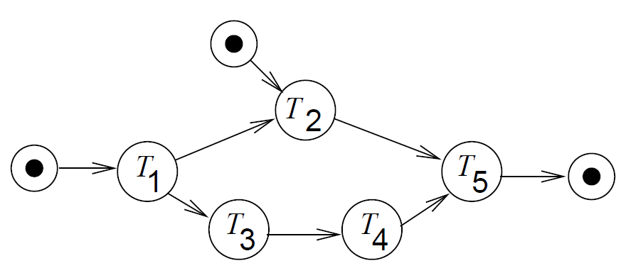
Specification (Requirements)
Requirements for modeling specification: Support for designing reactive systems
State-oriented behavior
Required for reactive systems;
classical automata insufficient.
Event-handling
(external or internal events)
Exception-oriented behavior
Not acceptable to describe exceptions for every state

Slide 59
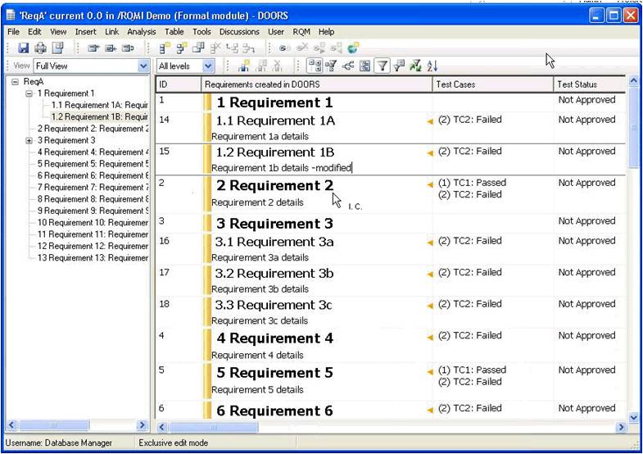
Specification (Requirements)
Capturing the requirements as text
In the very early phases of some design project, only descriptions of the system under design (SUD) in a natural language exist.
Expectations for tools:
  Machine-readable
  Version management
  Dependency analysis
  Example:
  DOORS® [Telelogic/IBM]

Slide 60
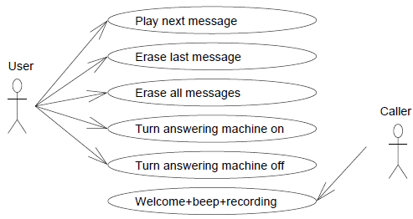
Specification (Requirements)
Use cases
  Use cases describe possible applications of the SUD
  Included in UML (Unified Modeling Language)
  Example: Answering machine
  Neither a precisely specified model of the computations nor a precisely specified model of the communication

Slide 61
Specification (Requirements)
(Message) Sequence charts
  Explicitly indicate exchange of information
  One dimension (usually vertical dimension) reflects time
  The other reflects distribution in space
  Example (1)
  Included in UML

Slide 62
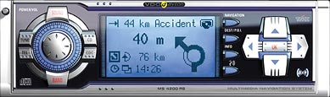
Specification (Requirements)
Application: In-Car Navigation System
  Car radio with navigation system
  User interface needs to be responsive
  Traffic messages (TMC) must be processed in a timely way
  Several applications may execute concurrently

Slide 63
Specification (Requirements)
Application: In-Car Navigation System
  System Overview
MMI
Communication
NAV
RAD
DB

Slide 64
Specification (Requirements)
Application: In-Car Navigation System
  Use case 1: Change Audio Volume
< 200 ms
MMI
< 50 ms
Communication
NAV
RAD
DB

Slide 65
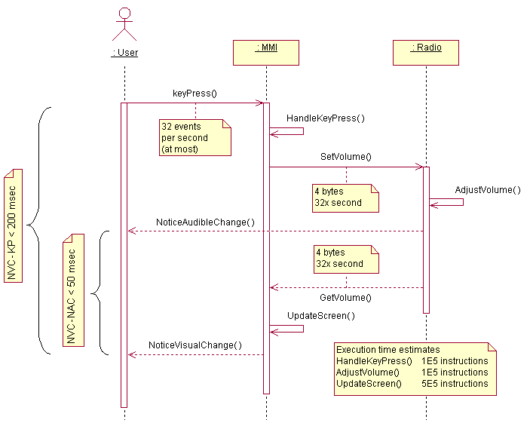



Specification (Requirements)
Application: In-Car Navigation System
  Use case 1:
  Change Audio
  Volume – Communication
  Resource Demand

Slide 66
Specification (Requirements)
Application: In-Car Navigation System
  Use case 2: Lookup Destination Address
< 200 ms
MMI
Communication
NAV
RAD
DB

Slide 67
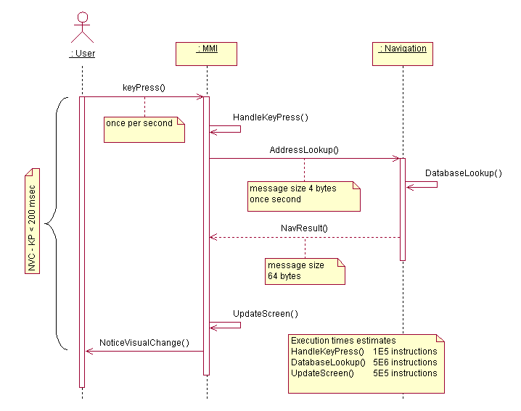
Specification (Requirements)
Application: In-Car Navigation System
  Use case 1:
  Lookup Destination Address

Slide 68
Specification (Requirements)
Statecharts
  A visual formalism for specifying hierarchical state machines
    “A Visual Formalism for Complex Systems,” David Harel, Science of Computer Programming, 1987
  Especially useful for modeling reactive systems
    systems which continuously react to internal or external events without terminating
  Statecharts is a formal language, it has formal semantics

Slide 69
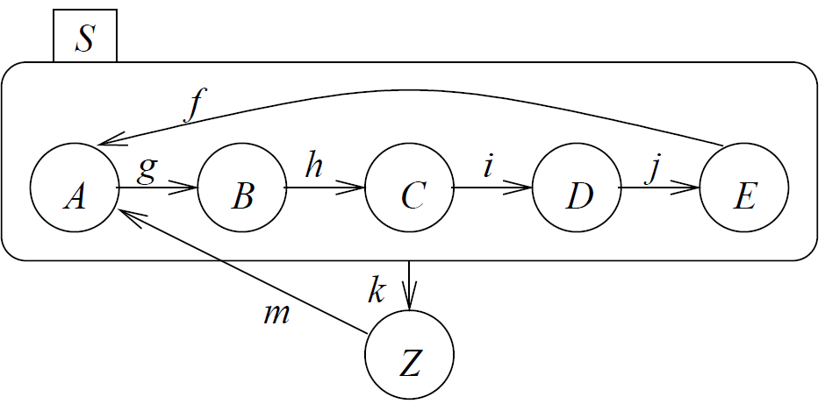
Specification (Requirements)
Statecharts
Statecharts characteristics:
Hierarchical grouping of states
  superstates are formed by grouping other states

Slide 70
Specification (Requirements)
Statecharts
Statecharts characteristics:
Superstates can be formed using AND composition or OR composition
  When the system is in an AND-state it is in all of its substates
  When the system is in an OR-state it is in only one of its substates
  If a state has no substates it is an atomic state
Synchronization and communication between different parts of the system is achieved using events

Slide 71
Specification (Requirements)
Statecharts
Statecharts characteristics:
Transitions: statechart transitions have a source state and a target state and are labeled as
trigger-event [guard-condition] / generated-events
source state
trigger-event[guard-condition]/action
target state

Slide 72
Specification (Requirements)
Statecharts
Statecharts characteristics:
Transitions:
  The transition is enabled if the trigger-event occurs and the guard-condition is true while the system is in the source state of the transition
  A transition can be taken if it is enabled
  The events can be generated by the state machine itself (internal events) or can be generated by the environment (external events)
  When a transition is taken it generates the generated-events (a set of events) which may enable other transitions and it transitions to its destination state
  Guard condition is a boolean expression that combines predicates in the form In(state) (such a predicate is true when the system is in the specified state)

Slide 73
Specification (Requirements)
Statecharts: OR-states
superstate
substates
Super-states S are called OR-states, if exactly one of the sub-states of S is active whenever S is active

Slide 74
Specification (Requirements)
Statecharts
Initial (default) state is A
If event x occurs while in state A, the next state will be B
If event y occurs while in state A, the next state will be C
x
A
B
y
C
t
D
Given the event sequence: y, x, t
Behavior of the state machine is: A → C → D
The x event is ignored since it does not enable any transition when the system is in state C
Note that we are interested in the behavior of the machine — the paths it takes (including the states it visits. This is different then using the state machines as language recognizers (as in automata theory or compilers)
y
t

Slide 75
Specification (Requirements)
Statecharts
Default state mechanism
Try to hide internal structure from outside world!
=> Default state
Filled circle
indicates sub-state entered whenever super-state is entered.
Not a state by itself!

Slide 76
Specification (Requirements)
Statecharts
History mechanism
(behavior different from last slide)
For input m, S enters the state it was in before S was left (can be A, B, C, D, or E).
If S is entered for the first time, the default mechanism applies.

Slide 77
Specification (Requirements)
Statecharts: AND-states (concurrency)
R
R is an AND-state
When the system is in the AND-state
R, it is both in state A and state D
A and D are OR-states
When the system is in state A it is
either in state B or in state C (but not in both)
When the system is in state D it is in only
one of E or F or G
A
D
B
E
t
x
y[in G]
v
z
F
C
G
x
A hierarchical state machine
Equivalent basic
state machine
t
z
Note that event x causes
a synchronization between
states A and D when A
is in B and D is in F.
They make a concurrent
transition:
A goes from B to C
D goes from F to G
B-F
B-E
B-G
v
x
x
y
x
v
C-G
C-E
x
t
C-F
z

Slide 78

Specification (Requirements)
Statecharts: AND-states (concurrency)
Example:

Slide 79

Specification (Requirements)
Statecharts: AND-states (concurrency)
Example:
Line-monitoring and key-monitoring are entered and left, when service switch is operated.

Slide 80

In this unit we talked about
Introduction
  Motivation for course
  What are embedded systems ? (ES)
  Applicability areas
  Features and requirements
  Directions in the study of Embedded Systems
  Embedded System and “ubiquituous and pervasive computing”
  Market features
  The typical structure of Embedded System
Design flow
  Specification (Requirements)

Slide 81
Additional resources:
  John Anderson's article, Choosing a microcontroller: http://www.electronicsweekly.com/Articles/15/05/2006/38623/Choosing-a-microcontroller.htm
  Manfred Broy, from Technische Universität München:
  Requirements Engineering for Embedded Systems http://citeseerx.ist.psu.edu/viewdoc/download?doi=10.1.1.16.9749&rep=rep1&type=pdf
  Electronic magazine “Azi” : http://www.electronica-azi.ro/revista.php
  https://www.linkedin.com/pulse/iot-how-internet-things-driving-knowledge-revolution-ronald-van-loon?trk=mp-reader-card

