Slide 1
HCS12 Architecture
Razvan Bogdan
Embedded Systems

Slide 2
Content
Overview of the HCS12 Architecture
Basic Architecture
HCS12 Architecture Details
Addressing Modes
Instruction Set
Program trace

Slide 3
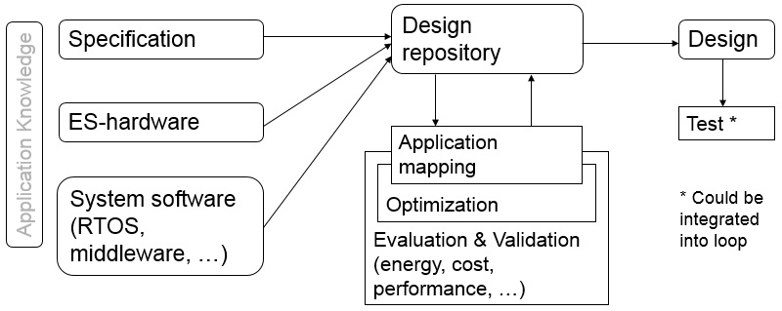
ES - hardware
The Generic Model

Slide 4
Overview of the HCS12 Architecture
Freescale designed the 68HC12 as an upgrade to the 8-bit 68HC11 microcontroller
8 MHz of 68HC12 – not satisfactory => Freescale revised the design to achieve a bus clock rate of 25 MHz (a few microcontrollers can run at 33 MHz).
The revised 68HC12 was referred to as the Star12 family.
Automotive and process control applications are the two major target markets of the HCS12. This is evidenced by the inclusion of such peripheral functions as
  input capture (IC), output compare (OC), pulse-width modulation (PWM), controller area network (CAN), and byte data link control (BDLC).
Other application areas:
  the MC9S12NE64 was designed for applications that need to access the Internet
  the MC9S12UF32 was designed for interfacing with the USB bus

Slide 5
Overview of the HCS12 Architecture
Freescale product numbering system for the HCS12 ☺

Slide 6
Basic Architecture
The architecture of a computer system defines how its processor, RAM, ROM, input devices, and output devices are connected, including the assembly instructions used to access RAM, ROM, and I/O devices

Slide 7
Basic Architecture. Princeton and Harvard
The main difference is the memory structure
Princeton Architecture (the case of HCS12)
  Known as Von Neumann architecture
  Single memory contains both the program code and the data.
Memory
Address/Control
Data/Instructions
Microprocessor
Input
Input /
Output
Processor
(ALU)
Control Unit
Data
Output
Status/Control
Clock

Slide 8
Basic Architecture. Princeton and Harvard
The main difference is the memory structure
B. Harvard Architecture
  Two separate memories. One contains only data while the other is containing only program code.
  The length of an instruction could be different from the data size
  Both data and a program instruction can be read at the same time
Data Memory
Code
Memory
Data
Instructions
Address
/Control
Microprocessor
Input
Input /
Output
Processor
(ALU)
Control Unit
Data
Output
Status/Control
Clock

Slide 9
Basic Architecture. Major components
1. Processor
Also called an arithmetic logic unit (ALU).
Operations such as addition, subtraction, bit-wise AND and OR, shift operations.
The processor has registers (groups of D flip-flops used to store binary values).
Many microcontrollers perform operations on data that is located in a register. This requires the microcontroller to
  load the data from memory into a register in the processor,
  manipulate the data,
  then store the new value back to memory.
The processor also generates signals that indicates when values are negative, zero, or when arithmetic overflow occurs.

Slide 10
Basic Architecture. Major components
2. Control Unit
A synchronous sequential machine that coordinates the flow of data between the other units and operations of the other blocks.
The sequence of states and control output of the unit depend on the inputs: the current program instruction, the status outputs of the other blocks, and the input/output block.
Generally speaking, central processing unit (CPU) refers to not only the processor but also the control unit.

Slide 11
Basic Architecture. Major components
3. Memory
Memory is the place where program code and data are stored.
A sequence of directly addressable ‘locations.’
Therefore, the number of addresses available in a memory is limited by the number of bits used to represent the address.
If 16 bits are used for the address, there are 65,536 (=2¹⁶) different addresses available.

Slide 12
Basic Architecture. Major components
3. Memory - continued
A memory location is referred to as an information unit which has two components: its address and its contents.
The content indicated by an address can be interpreted by the microprocessor as one of two things.
  Instruction code are used as inputs into the control unit and determine how it operates. A group of instruction is called a program.
  Data are the numbers to be processed or the results of operations in the processor.
CPU
Address bus lines
Memory
Data bus lines

Slide 13
Basic Architecture. Major components
3. Memory – continued: MCS12 Address Space
MC9S12 has 16 address lines
MC9S12 can address 2¹⁶ distinct locations
For MC9S12, each location holds one byte (eight bits)
MC9S12 can address 2¹⁶ bytes
2¹⁶ = 65536
2¹⁶ = 2⁶ × 2¹⁰ = 64 × 1024 = 64 KB
(1K = 2¹⁰ = 1024)
MC9S12 can address 64 KB
Lowest address: 0000000000000000₂ = 0000₁₆ = 0₁₀
Highest address: 1111111111111111₂ = FFFF₁₆ = 65535₁₀

Slide 14
Basic Architecture. Major components
3. Memory – continued: MCS12 Memory Type
RAM: Random Access Memory (can read and write)
ROM: Read Only Memory (programmed at factory)
PROM: Programmable Read Only Memory
  (Programmed once at site)
EPROM: Erasable Programmable Read Only Memory
  (Program at site, can erase using UV light and reprogram)
EEPROM: Electrically Erasable Programmable Read Only Memory
  (Program and erase using voltage rather than UV light)
MCS12DG256 has:
  12 KB RAM
  4 KB EEPROM (Normally can only access 3 KB)
  256 KB Flash EEPROM (Can access 16 KB at a time)

Slide 15
Basic Architecture. Major components
4. Clock
A periodic signal for the sequential machine in the control unit.
Also used by other blocks to synchronize operations
5. Input/Output
The Input/Output (I/O for short) block represents the interface between the internals of the microcomputer and the outside world.
Keyboard, LED and LCD display, printers for example.

Slide 16
Basic Architecture. Instruction Codes
Instruction codes consist of Operation Code and Operand
Operation Code (Opcode or Op code for short)
  This tells the microcomputer what action to perform and how to interpret the operand. All instructions must have an op code.
Operand
  The operand contains the data that microcontroller will perform the action on.
  Some operands include several numbers for op codes that specify more complex actions.
  Some operation codes that perform simple tasks do not need to have operands.

Slide 17
Basic Architecture. Instruction Length
Fixed and Variable-length
Fixed length
  Each instruction is the same number of bits as all others.
Variable length*
  The length of each instruction may be different.
Op Code 1
Operand
Op Code 2
Operand
Op Code 3
Operand
Op Code 1
Operand
Op Code 2
Operand
Op Code 3
Operand

Slide 18
Basic Architecture. Programming Flow
High Level Code
C, C++, Basic, Pascal, Fortran, and others
Usually exist as a text file.
A portion of high level may be written without regard to the specific processor that will eventually run the program
A compiler converts high level code to assembly code that runs on the same processor as the compiler runs
A cross-compiler runs on one type of processor and converts high level code to assembly for a different type of processor.
High level languages do not have instructions that can access all of a microcomputer’s instructions. Many programs written mainly in a high level language have sections of assembly code.
One line in a high level language may compile into several, possibly hundreds, of lines of assembly.
High Level Code
Assembly Code
Machine Code
Hardware

Slide 19
Basic Architecture. Programming Flow
Assembly Code
A somewhat “human readable” form of the exact code that will be executed on the processor
Usually exists as a text file
An assembler converts assembly code to machine code that runs on the same processor as the assembler runs
A cross-assembler runs on one type of processor and converts assembly code to machine code for a different type of processor.
Assembly code itself is not executed
Assembly code is specific to a given type, or family, of processors.
Each line of assembly code uniquely corresponds to one instruction in machine code.
High Level Code
Assembly Code
Machine Code
Hardware

Slide 20
Basic Architecture. Programming Flow
Machine Code
The string of 1’s and 0’s representing the operations.
The exact values that are loaded by the microprocessor from memory to execute the program.
On PCs, these are executable (often .EXE) files.
May not be executed on other types of microprocessors
High Level Code
Assembly Code
Machine Code
Hardware

Slide 21
HCS12 Architecture Details
The microcontrollers in the 9S12 family differ by the amount of memory and by the types of I/O modules. All 9S12 microcontrollers have
  a 16-bit central processing unit (HCS12CPU),
  a system integration module (SIM),
  RAM (volatile random access memory),
  Flash EEPROM (nonvolatile electrically erasable programmable read only memory),
  a phase-locked loop (PLL).
The 9S12 microcontrollers are configured with zero, one, or more of the following modules:
  asynchronous serial communications
  interface (SCI),
  serial peripheral interface (SPI),
  inter-integrated circuit (I2C),
  Key wakeup,
  16-bit timer,
  a pulse width modulation (PWM),
  10-bit or 12-bit analog-to-digital converter (ADC),
  8-bit digital-to-analog converter (DAC),
  liquid crystal display driver (LCD),
  controller area network (CAN 2.0),
  universal serial bus (USB 2.0) interface,
  Ethernet (MAC FEC 10/100) interface,
  memory expansion logic.
Notes:
The PLL allows the software to increase or decrease the execution speed. Typically, the SPI and I2C modules allow the 9S12 to communicate with other dedicated peripheral devices.
Whereas, typically the SCI, CAN, USB, and Ethernet allow the 9S12 to communicate with other computers. The ADC module (together with sensors and analog amplifiers) can be used to collect information. The PWM module can be used to control delivered power to motors and lights. We can use key wakeup modules to interface digital inputs to the 9S12.

Slide 22
HCS12 Architecture
Details. 9S12E128
8 KB of RAM, 128 KB of flash EEPROM
12 input capture/output compare timer pins,
12 pulse-width modulated output pins,
16 ADC inputs, two DAC outputs,
one SPI modules, three SCI modules, one I2C interface.
There are two sizes of the 9S12E128 chip one with 80 pins and the other with 112 pins.
The 112-pin chip has 92 I/O pins
We clear (0) a bit in the direction register to make that pin an input and set it (1) to make it an output

Slide 23
HCS12 Architecture
Details. 9S12E512
512 KB EEPROM
91 I/O pins
Etc. Etc.
We clear (0) a bit in the direction register to make that pin an input and set it (1) to make it an output

Slide 24
HCS12 Architecture Details. MC9S12DG256
16-bit CPU (central processing unit), 256KB of flash memory, 12KB of RAM, 4KB of EEPROM and many on-chip peripherals
The main features of the MC9S12DG256 are listed below:
  Powerful 16-bit CPU
  256K bytes of flash memory
  12K bytes of RAM
  4K bytes of EEPROM
  2 SCI ports
  3 SPI ports
  2 CAN 2.0 ports
  I²C interface
  8-ch 16-bit timers
  8-ch 8-bit or 4-ch 16 bit PWM
  16-channel 10-bit A/D converter
  Fast 25 MHz bus speed via on-chip Phase Lock Loop
  BDM for in-circuit programming and debugging
  112-pin LQFP package offers up to 91 I/O in a small footprint
Notes:
The MC9S12DG256 is the replacement for the MC9S12DP256 since the latter has been discontinued by Freescale. The only differences between DG256 and DP256 are the number of CAN ports and the BDLC communication. The DG256 has 2 CAN ports and no BDLC, but the DP256 has 5 CAN ports and has BDLC. Other than the different number of CAN port and BDLC these two microcontrollers have the same features. If you don't use more than 2 CAN ports and don't use the BDLC, these two chips are identical and all datasheets and manuals for the DP256 can be used for the DG256.

Slide 25
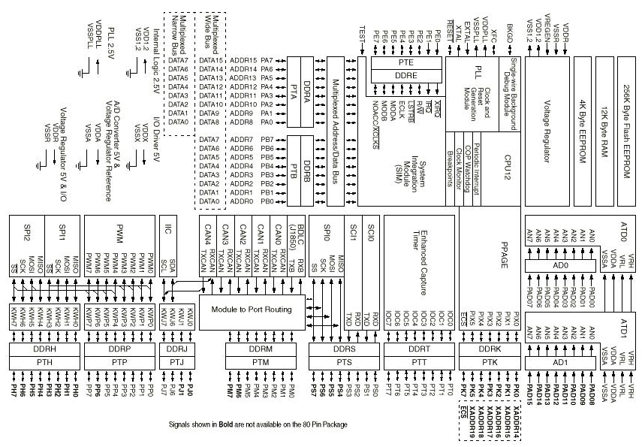
HCS12 Architecture Details. MC9S12DG256 Block Diagram

Slide 26
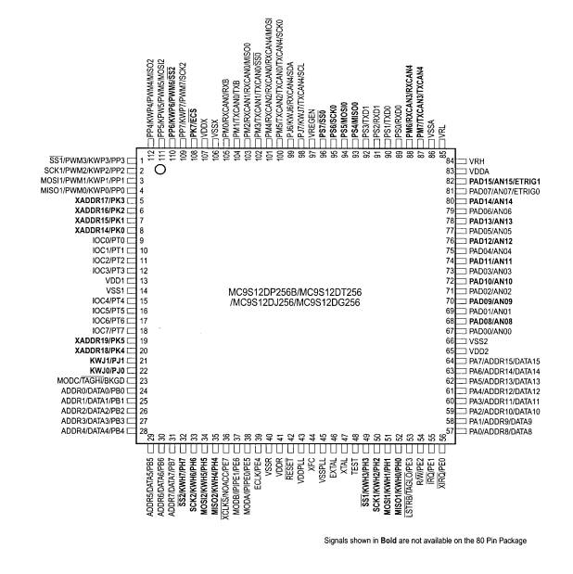
HCS12 Architecture Details. MC9S12DG256 Pin Assignments

Slide 27
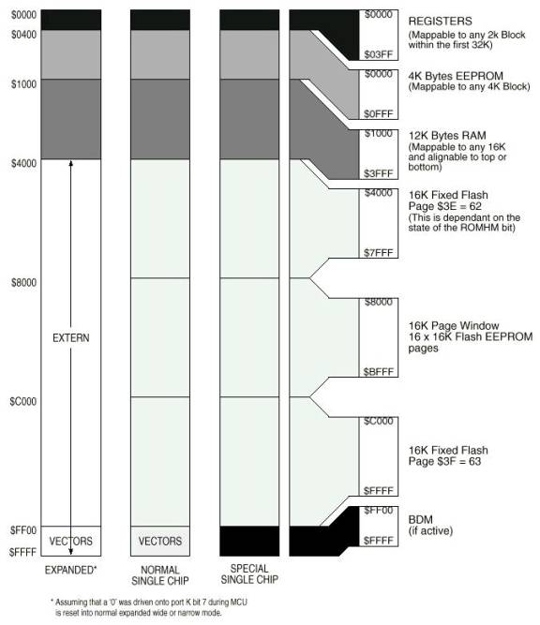
HCS12 Architecture Details. MC9S12DG256 Memory Map

Slide 28
HCS12 Architecture Details. Register Set
Programming Model
8-bit accumulators A & B
7 A 0
7 B 0
16-bit accumulator D
15 D 0
Index Register X
15 X 0
Index Register Y
15 Y 0
Stack Pointer
15 SP 0
Program Counter
15 PC 0
Condition Code Register
S
X
H
I
N
Z
V
C
The register set is also called the programming model of the computer.
Programming Model
  An abstract model of the microprocessor registers
  This provides enough detail to understand the fundamentals of programming.
In many processors, data may only be operated on if it is in a register.
Notes:
The HCS12 microcontroller has registers for supporting general-purpose operations and
controlling the functioning of peripheral modules. These registers are divided into two categories:
CPU registers and I/O registers. CPU registers are used solely to perform general-purpose operations
such as arithmetic, logic, and program flow control. I/O registers are mainly used to configure the
operations of peripheral functions, to hold data transferred in and out of the peripheral subsystem,
and to record the status of I/O operations. The I/O registers in a microcontroller can further be classified
into data, data direction, control, and status registers. These registers are treated as memory
locations when they are accessed. CPU registers do not occupy the HCS12 memory space.
The CPU registers of the HCS12 are shown in Figure 1.10 and are listed next. Some of the
registers are 8 bit and others are 16 bit.

Slide 29
HCS12 Architecture Details. Registers
General Purpose Registers
A
  A one-byte (8-bit) general purpose register.
  Since many mathematical operations can be performed using A, it is also referred to as the A accumulator.
B
  A one-byte (8-bit) general purpose register.
  Since many mathematical operations can be performed using B, it is also referred to as the B accumulator.
D
  A two-byte (16-bit) general purpose register.
  The D register is actually the concatenation of the A and B registers.
  A is used as the more significant byte with B as the less significant byte.
  Note, the two bytes worth of registers may be used as either A and B or as D, but not both at the same time.

Slide 30
HCS12 Architecture Details. Registers
Index Registers and Others
X
  A two-byte (16-bit) register primarily used to hold addresses. Very few mathematical operations can.
Y
  A two-byte (16-bit) register primarily used to hold addresses. Very few mathematical operations can.
SP
  A two-byte (16-bit) register used to manipulate the stack data structure.
PC
  Called the program counter, this is a two-byte (16-bit) register that holds the address of the next instruction to be executed.
CCR
  The condition code register maintains general operating status of the processor and some information used for branching. This one-byte register is the concatenation of eight 1-bit signals.

Slide 31
HCS12 Architecture Details. Registers
Registers Interaction – simple processor diagram

Slide 32
HCS12 Architecture Details. Registers
Condition Code Register
8 bit register
Used to keep track of the program execution status
Control the execution of conditional instructions
Enable the interrupt handling
Most important for arithmetic (5 bits for this); 3 bits for control

Slide 33
HCS12 Architecture Details. Registers
Condition Code Register
Carry – Flag is set when and addition/subtraction generates a borrow/carry in/out of the highest bit position
Overflow
  Flag is set when addition of two positive numbers results in a negative number and vice-versa.
  i.e. whenever the carry from the most significant bit and the second most significant bit differs
Zero – Flag is set when a particular operation leads to a result of zero
Negative – Flag is set whenever the most significant bit of the result of an operation is 1, i.e. result is negative
Interrupt Mask – When set , all maskable interrupts are disabled (detailed explanation provided during lecture on interrupts)
Half Carry – Flag is set whenever there is a carry from the lower four bits to the upper four bits
X Interrupt Mask – Set during the system reset (detailed explanation provided during lecture on interrupts)
Stop – Clearing this bit keeps the processor in standby mode (detailed explanation provided during lecture on interrupts)

Slide 34
HCS12 Architecture Details. Memory Model
The way in which the microcontroller stores data
Programmers usually visualize memory as a bunch of sequential spaces.
Each space has a unique address that is used to refer the location.
Number of memory units
  Remember the two different architectures: Princeton* and Harvard
Bit size of each location
  The number of bits stored in each location
Bit size of the address
  The number of bits used for the address limits the number of memory location
0000
B6
.
.
.
A128
B6
A129
C1
A12A
12
.
.
.
FFFE
32
FFFF
73

Slide 35


HCS12 Architecture Details. Memory Model. Endianness
Gulliver’s Travels
Big
Little End
Big-endians crack soft-boiled eggs at the big end, and little-endians crack them at the other end in the story.
Big End

Slide 36
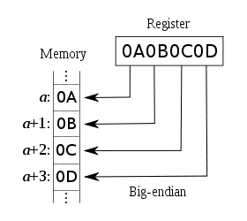
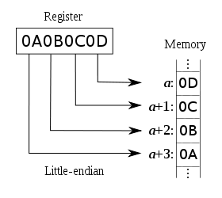
HCS12 Architecture Details. Memory Model. Endianness
Big and Little-endian
A microprocessor may need to store a number that is larger than a single memory location (in the HCS12, the size of memory location is 1 byte).
How to store 16-, 32- or 64-bit word to 8-bit address space.
Endianness means which byte is put first into the memory!
  Big-endian (HCS12): put the big number portion of the large number first into the memory (the Most Significant Byte (MSB) occupies the lowest address space)
  Little-endian (Intel, TI MSP430): put the little number portion of it first into the memory (the Least Significant Byte (LSB) occupies the lowest address space)

Slide 37
HCS12 Architecture Details. Memory Model. Endianness
Example
The number 1234h stored at address 2000h
=> The memory map for the S12 which has 16-bit addresses and 8-bit locations.

Slide 38
HCS12 Architecture Details. Addressing Modes
How to get effective addresses
The operand of an instruction can use different methods for specifying data in the memory (=addressing modes).
  If the data number is in registers (inside the microprocessor), a memory address is not needed.
  The addressing mode may specify a value, a register, or a memory location to be used as an operand.
The HCS12 has six addressing modes
    Extended (EXT)
    Direct (DIR)
    Inherent (INH)
    Immediate (IMM)
    Relative (REL) : Used only with branch instructions.
    Index (IDX)
Effective Address
  The effective address is the location that holds the data to be used by the operation.
  The operand is often used to construct the effective address.
  An addressing mode tells the microprocessor the way of calculation to get the effective address.
A HCS12 instruction consists of one or two bytes of opcode and zero to five bytes of operand addressing information.
Opcode bytes specify the operation to be performed by the CPU

Slide 39
HCS12 Architecture Details. Addressing Modes
Methods for specifying a particular address in memory
1. Extended – 16-bit absolute address in the instruction.
2. Direct – 8-bit absolute address is in the instruction.
3. Inherent – not really an addressing mode, there is no memory address specified.
4. Immediate – Data itself is part of the instruction.
5. Relative – Offset relative to the instruction itself specifies a branch target address.
6. Indexed – A base address + offset point to the data.
  Indexed-indirect – A base address + offset point to an address, which points to the data.

Slide 40
1. Extended Addressing (EXT)
Also called Absolute Addressing
Effective address:
  No operation needed.
  Extended addressing tells the full memory address.
Format:
  Two-byte hexadecimal number (4-digit) preceded with a $. Actually ‘$’ simply means that the number is a hexadecimal number. (A number could be followed by ‘h’ excluding ‘’).
Example:
  (Assuming the instruction is stored at $2000)
  LDAA $3000
    Load a byte value stored at address $3000 into the register A.
    LDAA opr16a (M) ➔ A EXT B6 hh ll
    98 ➔ A
.
.
2000
B6
2001
30
2002
00
.
.
3000
98
.
.

Slide 41
2. Direct Addressing (DIR)
Also called Zero-Paging Addressing
Effective address:
  This addressing mode only supplies the lower byte of the address.
  Extend the one byte address to two-bytes by concatenating $00 to the beginning of the operand.
Format:
  One byte hexadecimal number (2-digit) preceded with a $.
Example:
  (Assuming the instruction is stored at $2000)
  LDAA $80
    Load a byte value stored at address $0080 into the register A.
    LDAA opr8a (M) ➔ A DIR 96 dd
    98 ➔ A
.
.
0080
98
.
.
2000
B6
2001
30
.
.

Slide 42
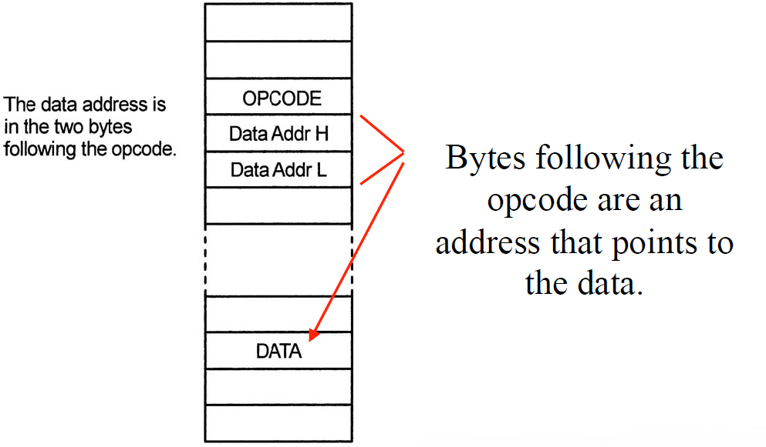
2. Direct Addressing and Extended Addressing

Slide 43
3. Inherent Addressing (INH)
Also called Implied Addressing
Effective address:
  No operation.
Format:
  No operand.
Example:
  (Assuming the instruction is stored at $2000)
  INCA
    Increase register A by 1
    INCA (A) + $01 ➔ A INH 42
.
.
2000
42
.
.

Slide 44
4. Immediate Addressing (IMM)
.
.
Effective address:
  No operation. The data itself is supplied as the operand.
Format:
  Number preceded with a #. ‘#’ is followed by a number that is a value instead of an address!
Example:
  (Assuming the instruction is stored at $2000)
  LDAA #$80
    Load a byte value(the operand itself) into the register A.
    80₁₆ ➔ A
  LDD #1000
    1000 is 03E8₁₆➔ D (meaning 03 → A and E8 → B)
The size of an operand
  Register A and B have one-byte immediate operands.
  Register D, X, Y, SP, and PC have two-byte ones.
2000
86
2001
80
.
.
.
.
2000
CC
2001
03
2002
E8
.
.
Notes:
# (hash)

Slide 45
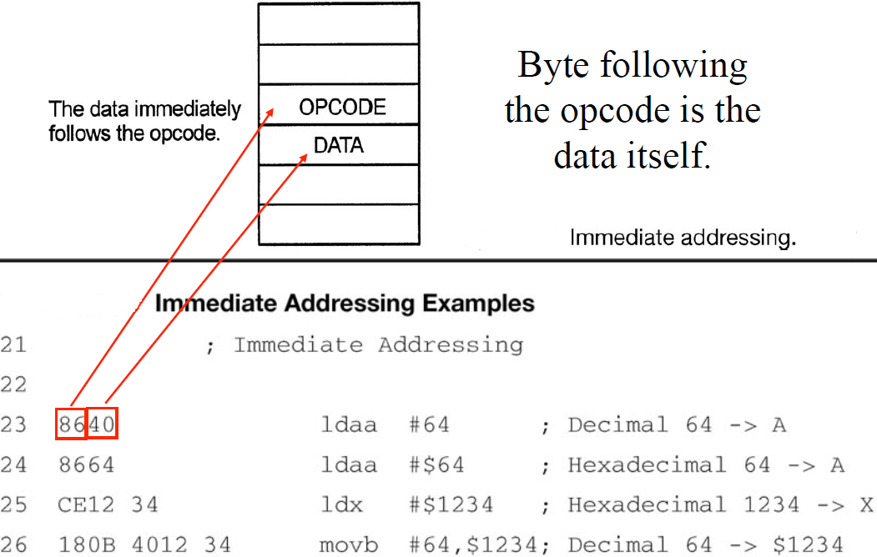
4. Immediate Addressing (IMM)

Slide 46
5. Relative Addressing (REL)
Also called PC-Relative addressing
Used only by branch instructions that change the PC
  Short and long conditional branch instructions use the relative mode. That’s way it’s also called PC-Relative addressing
A short branch instructions (ex. BGT,…) consists of an 8-bit opcode and a signed 8-bit offset.
  The short relative mode can specify a range of -128 (-80h) ~ +127 (7Fh) from the current PC location.
A long branch instruction (ex. LBEQ,…) consists of an 8-bit opcode and a signed 16-bit offset.
  The range of the long relative mode is from -32768 ~ +32767.

Slide 47
5. Relative Addressing (REL)
Also called PC-Relative addressing
Effective Address:
  Add the operand as a signed number to the value in the PC.
The effective address is loaded into the PC, and the program executes form the new address
Examples
  BRA $30
    Branch always to the instruction
    30h bytes forward.
  BRA -10
    Branch always to the instruction
    10 bytes backwards
REL
Op Code
Effective Address
Relative offset
Program Counter
2000
20
2000
20
2001
30
2001
F6

Slide 48
5. Relative Addressing (REL)
Calculating Branch Destinations - Valid range: -$80 ~ $7F for short relative mode
‘Branch’ means changing a value of the program counter in the point of view of the microprocessor.
The destination address can be calculated by adding the operand (either + or -) to the value of the current PC.
Destination: $2085
Destination: $1F80
2000
20
2000
20
2001
5E
2001
EE
pc
pc
2000
20
2000
20
2001
XX
2001
XX
pc
pc
Destination: $2060
Destination: $1FF0
Valid destination: $1F82 ~ $2081 if PC is $2002
Notes:
Valid destination: $1F82 ~ $2081 if PC is $2002 bcz 1F82 = 2002-80 etc.; 2002+7f = $2081

Slide 49
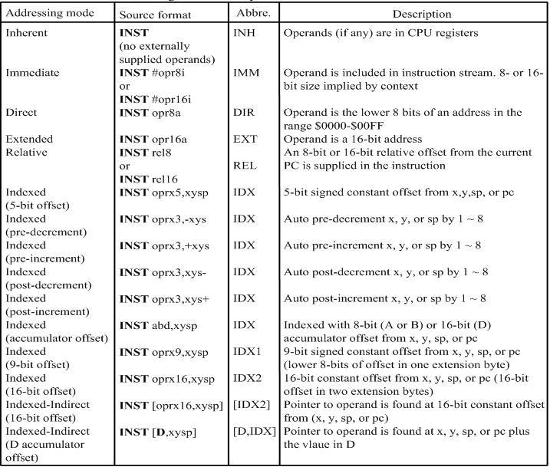
…..Addressing Modes – where are we?......

Slide 50
6. Index Addressing
Effective Address
  Add the operand as a signed number to the value in the X, Y, PC, or S registers.
Format
  Signed number, Register (X, Y, PC, or S)
Example:
  LDAA 0,X
    The effective address is the value(=address) in register X. (=X+0)
  LDD -100,Y
    The effective address is 100 lower than the value in Y. (=Y-100)
  LDX 1000, Y
    The effective address is 1000 higher than the value in Y. (=Y+1000)
Notes:
  The value in the specified register is not changed.
  The smallest number of bits will be used to represent the address.

Slide 51
6. Index Addressing. Postbytes
An operand in the index addressing is called a postbyte.
The postbyte tells the processor which two-byte register to be used as the base address, the size of the offset.
Register | rr
X | 00
Y | 01
SP | 10
PC | 11
Postbyte for 5-bit Offset: rr0nnnnn
Postbytes for 9-bit Offset: 111rr00n nnnnnnnn
Postbytes for 16-bit Offset: 111rr010 nnnnnnnn nnnnnnnn

Slide 52
6. Index Addressing
Examples
Instruction | Machine Code
LDAA 4,Y | A6 | 44
 |  | 01 0 00100
LDD -100,X | EC | E1 | 9C
 |  | 111 00 00 1 | 10011100
LDX -1000,Y | EE | EA | FC | 18
 |  | 111 01 010 | 111101100 | 0001 1000
Register | rr
X | 00
Y | 01
SP | 10
PC | 11
Postbyte for 5-bit Offset: rr0nnnnn
Postbytes for 9-bit Offset: 111rr00n nnnnnnnn
Postbytes for 16-bit Offset: 111rr010 nnnnnnnn nnnnnnnn

Slide 53
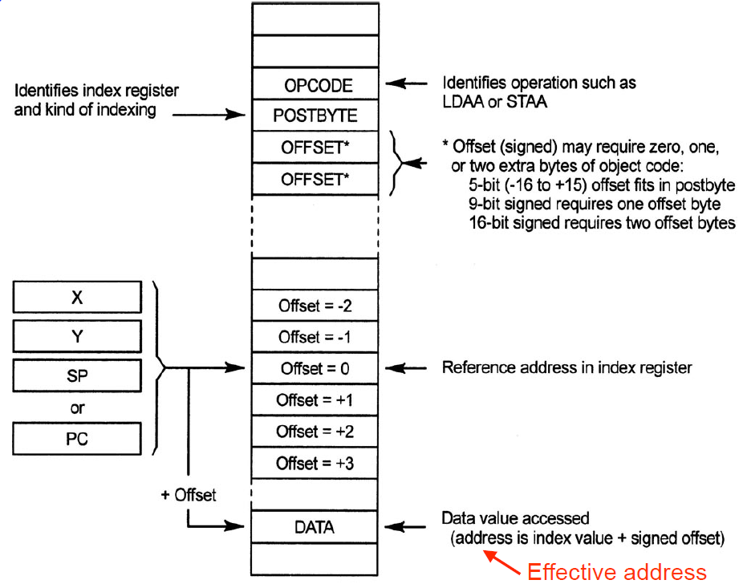
6. Index Addressing

Slide 54
Addressing Mode Summary
How to Get an Effective Address
INH
Op Code
IMM
Op Code
Op Code
Data
Data-high
Data-low
DIR
Op Code
Effective Address
Addr-low
00
Addr-low
EXT
Op Code
Effective Address
Addr-high
Addr-high
Addr-low
Addr-low
IDX
Op Code
Effective Address
Offset
Index Register
REL
Op Code
Effective Address
Relative offset
Program Counter

Slide 55
HCS12 Architecture Details. Instruction Set
A list of all the operations that a processor can perform.
A small section of the HCS12 instruction set.
Source Form:
  Assembly code for the instruction
Operation
  A brief description that explains what the instruction does.
Addressing mode
  It tells how the instruction uses the operand(s), if any.
Source Form | Operation | Addr. Mode | Machine Coding | Access Detail | S X H I | N Z V C
LDAA #opr8i LDAA opr8a | (M) ⇒ A Load Acc. A | IMM DIR | 86 ii 96 dd | P rPf | - - - - | Δ Δ 1 0
LDAB #opr8i LDAB opr8a | (M) ⇒ B Load Acc. B | IMM DIR | C6 ii D6 dd | P rPf | - - - - | Δ Δ 1 0

Slide 56
HCS12 Architecture Details. Instruction Set
Source Form | Operation | Addr. Mode | Machine Coding | Access Detail | S X H I | N Z V C
LDAA #opr8i LDAA opr8a | (M) ⇒ A Load Acc. A | IMM DIR | 86 ii 96 dd | P rPf | - - - - | Δ Δ 1 0
LDAB #opr8i LDAB opr8a | (M) ⇒ B Load Acc. B | IMM DIR | C6 ii D6 dd | P rPf | - - - - | Δ Δ 1 0
Machine Coding
  The hexadecimal value that represents the instruction in memory.
  Also called the instruction format since it shows how to convey the operation and its operands to the processor.
Access Detail
  Each letter stands for the internal operation performed during each clock cycle required by the operation.
  The number of letters = the number of clock cycles taken.
SXHINZVC: Condition Code Register
  Δ: affected by operation, 1: set 1, and 0: set 0 after the instruction.

Slide 57
HCS12 Architecture Details. Instruction Examples
The LOAD and STORE Instructions
The LOAD instruction copies the contents of a memory location or places an immediate value into an accumulator or a CPU register.
STORE instructions save the contents of a CPU register into a memory location.
N and Z flags of the CCR register are automatically updated and the V flag is cleared.
All except for the relative mode can be used to select the memory location or value to be loaded into an accumulator or CPU register.
All except for the relative and immediate modes can be used to select memory location to store contents of the CPU register.

Slide 58
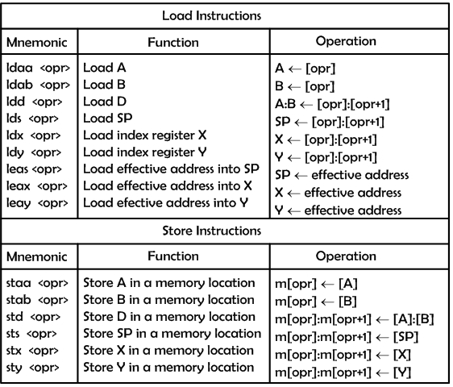
HCS12 Architecture Details. Instruction Examples
The LOAD and STORE Instructions

Slide 59
HCS12 Architecture Details. Instruction Examples
The LOAD and STORE Instructions
the following instruction loads the contents of the memory location pointed to by index register X into accumulator A:
  ldaa 0,X
The following instruction loads the contents of the memory location at $1004 into accumulator B:
  ldab $1004
The following instruction stores the contents of accumulator A in the memory location at $20:
  staa $20
The following instruction stores the contents of index register X in memory locations at $8000 and $8001:
  stx $8000

Slide 60
HCS12 Architecture Details. Instruction Examples
Transfer and Exchange Instructions
Transfer instructions copy the contents of a CPU register or accumulator into another CPU register or accumulator.
TFR is the universal transfer instruction, but other mnemonics are accepted for compatibility with the 68HC11.
The TAB and TBA instructions affect the N, Z, and V condition code bits.
The TFR instruction does not affect any condition code bits. For example,
  TFR D,X ; [D] => X
  TFR A,B ; [A] => B
  TFR A,X ; sign-extended of [A] => X
  ; A is signed extended to 16-bit and assigned to X
  TFR X,A ; X[7:0] => A ; lower 8 bits copied to A
The EXG instruction exchanges the contents of a pair of registers or accumulators. For example,
  exg A, B
  exg D,X
  exg A,X ; A <- X[7:0], X <- $00:[A]
  exg X,B ; X <- $00:[B], B <- X[7:0]

Slide 61
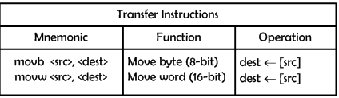
HCS12 Architecture Details. Instruction Examples
Move Instructions
These instructions move data bytes or words from a source to a destination in memory.
Six combinations of immediate, extended, and index addressing modes are allowed to specify the source and destination addresses:
IMM => EXT, IMM => IDX, EXT => EXT,
EXT => IDX, IDX => EXT, IDX => IDX
Move instructions allow the user to transfer data from memory to memory or from I/O registers to memory and vice versa.
For example, the following instruction copies the contents of the memory location at $1000 to the memory location at $2000:
  movb $1000, $2000
The following instruction copies the 16-bit word pointed to by X to the memory location pointed to by Y:
  movw 0,X, 0,Y

Slide 62
HCS12 Architecture Details. Instruction Examples
Add and Subtract Instructions
These instructions perform fundamental arithmetic operations.
The destinations of these instructions are always a CPU register or accumulator.
There are two-operand and three-operand versions of these instructions.
Three-operand ADD or SUB instructions always include the C flag as one of the operand.
Three-operand ADD or SUB instructions are used to perform multi-precision addition or subtraction.
Example 1: Write an instruction sequence to add the numbers stored at $1000 and $1001 and store the sum at $1004.
Solution: To add these two numbers, we need to put one of them in an accumulator.
  ldaa $1000 ; copy the number stored in memory location at $1000 to A
  adda $1001 ; add the second number to A
  staa $1004 ; save the sum at memory location at $1004

Slide 63
HCS12 Architecture Details. Instruction Examples
Add and Subtract Instructions
Example 2: Write an instruction sequence to add 3 to the memory locations at $10 and $15.
Solution: A memory location cannot be the destination of an ADD instruction. Therefore, we need to copy the memory content into an accumulator, add 3 to it, and then store the sum back to the same memory location.
  ldaa $10 ; copy the contents of memory location at $10 to A
  adda #3 ; add 3 to A
  staa $10 ; store the sum back to memory location at $10
  ldaa $15 ; copy the contents of memory location at $15 to A
  adda #3 ; add 3 to A
  staa $15 ; store the sum back to memory location at $15

Slide 64
HCS12 Architecture Details. Instruction Examples
Example 3: Time Delays
The HCS12 uses the bus clock (we will call it the E-clock from now on) signal as a timing reference (generation of the E-clock is described in later course)
The execution times of instructions are also measured in E cycles. The execution time of each instruction can be found in the column “Access Detail” in Datasheet. The number of letters in that column indicates the number of E cycles that a specific instruction takes to complete the execution.
For example, the Access Detail column of the pula instruction contains three letters, ufo, which indicates that the pula instruction takes three E cycles to complete
2 steps:
  1. Select a sequence of instructions that takes a certain amount of time to execute.
  2. Repeat the instruction sequence for the appropriate number of times.
Notes:
Instruction Execution Cycle
- One or more read cycles to fetch instruction opcode bytes and addressing information.
- One or more read cycles to fetch the memory operand(s) (optional).
- Perform the operation specified by the opcode.
One or more write cycles to write back the result to either a register or a memory
location (optional).
Instruction Queue
- The HCS12 executes one instruction at a time and many instructions take several clock
cycles to complete.
- When the CPU is performing the operation, it does not need to access memory.
- The HCS12 pre-fetches instructions when the CPU is not accessing memory to speedup
the instruction execution process.
- There are two 16-bit queue stages and one 16-bit buffer. Unless buffering is required,
program information is first queued in stage 1, and then advanced to stage 2 for
execution.

Slide 65
HCS12 Architecture Details. Instruction Examples
Example 3: Time Delays
The following instruction sequence takes 40 E-clock cycles to execute:
loop psha ; 2 E cycles
  pula ; 3 E cycles
  psha
  pula
  psha
  pula
  psha
  pula
  psha
  pula
  psha
  pula
  psha
  pula
  nop ; 1 E cycle
  nop ; 1 E cycle
  dbne x,loop ; 3 E cycles
Example 3.1: Write an instruction sequence to create a 100-ms time delay for a demo board with a 24-MHz bus clock
Solution: In order to create a 100-ms time delay, we need to repeat the preceding instruction sequence 60,000 times [100 ms ÷ (40 ÷ 24,000,000) μs = 60,000].
ldx #60000 ; 2 E cycles
loop psha ; 2 E cycles
  pula ; 3 E cycles
  psha ; 2 E cycles
  pula ; 3 E cycles
  psha ; 2 E cycles
  pula ; 3 E cycles
  psha ; 2 E cycles
  pula ; 3 E cycles
  psha ; 2 E cycles
  pula ; 3 E cycles
  psha ; 2 E cycles
  pula ; 3 E cycles
  psha ; 2 E cycles
  pula ; 3 E cycles
  nop ; 1 E cycle
  nop ; 1 E cycle
  dbne x,loop ; 3 E cycles

Slide 66
HCS12 Architecture Details. Instruction Examples
Example 3.1: Write an instruction sequence to create a delay of 10 sec.
Solution: we need to use a two-layer loop.
ldab #100 ; 1 E cycle
out_loop ldx #60000 ; 2 E cycles
inner_loop psha
      pula
      psha
      pula
      psha
      pula
      psha
      pula
      psha
      pula
      psha
      Pula
      psha
      pula
      psha
      pula
      psha
      pula
nop
nop
dbne x,inner_loop
dbne b,out_loop ; 3 E cycles

Slide 67
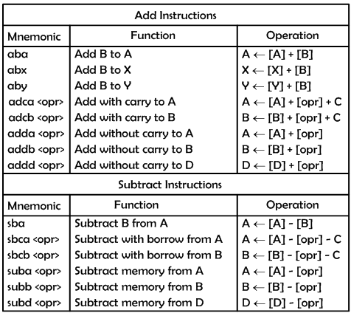
HCS12 Architecture Details. Instruction Examples
Add and Subtract Instructions

Slide 68
Program Trace
A diagram showing the contents of the HCS12 memory which contains a program.
A program trace shows the contents of the processor’s registers as the program is executed.
Very useful for debugging programs
2000
B6
LDAA 3000h
2001
30
2002
00
2003
C6
LDAB #2
2004
02
2005
18
ABA
2006
06
2007
7A
STAA 3001h
2008
30
2009
01
200A
3F
“Stop”
3000
19
3001
FF
Notes:
Imagine that your embedded software project is progressing nicely through the final stages of testing when, suddenly, the software unexpectedly crashes. The engineers who found this bug cannot give you a reproducible test case, yet they are able to get the product to crash periodically. Sound familiar? As an engineer, you want to solve this problem, yet there is no reliable way to reproduce it. And to add to the stress of the situation, your manager is pressuring you to release the product because you need to get to market as quickly as possible. Software teams encounter this situation all the time and are forced to release products even though they know that there are serious bugs lurking in the code.
Now imagine that there is a tool that gives you nearly perfect visibility into what your software was doing when the system crashed, making it easy to find and fix these intermittent and difficult bugs. The technology that makes this dream a reality is trace data generated by embedded microprocessors, and the tools that collect and analyze this trace data make it possible for you to analyze what went wrong and find the cause of the undesirable behavior.
Hardware trace data has been around for years, yet it has traditionally only been used by hardware and low-level firmware engineers to track down board-level problems and initialization failures. However, the concept behind hardware trace data is familiar to software engineers because they have been using a similar technique—printf() logging and debugging—since the advent of modern software development.
Hardware trace data provides a complete log of the instructions executed by the processor, essentially giving you full printf() debugging in a completely nonintrusive fashion. This lets you easily look at interactions between multiple tasks and interrupts in your system. However, hardware trace data can also be used in many embedded systems where normal code instrumentation is less than ideal.
http://www.drdobbs.com/embedded-systems/using-trace-to-debug-real-time-systems/229100158

Slide 69
Program Trace
To read: Trace Recording for Embedded Systems: Lessons Learned from Five Industrial Projects, by Johan Kraft et. Al. ☺
http://holgerkienle.wikispaces.com/file/view/KWK-RV-10.pdf
Another Example
Trace Line | Address | Instruction | PC | X | A | B
1 | 2000 | LDX #3001h | 2003 | 3001 | - | -
2 | 2003 | LDD 1,X | 2005 | 3001 | 45 | 99
3 | 2005 | INCB | 2006 | 3001 | 45 | 9A
4 | 2007 | STD -1,X | 2009 | 3001 | 00 | 9A
5 | 2009 | “STOP” | - | - | - | -
2000
CE
LDX #3001H
2001
30
2002
01
2003
EC
LDD 1,X
2004
01
2005
87
CLRA
2006
6C
STD -1,X
2007
1F
2008
3F
“Stop”
X requires a 2-byte operand with immediate addressing since it is a 2-byte register.
Note that using indexed addressing to load/store register D does not change the value in register X.
What are the values in memory locations from 3000h to 3003h after the program is done executing? 45-9A-45-99
3000
EC
3001
27
3002
45
3003
99

Slide 70

Content
Overview of the HCS12 Architecture
Basic Architecture
HCS12 Architecture Details
Addressing Modes
Instruction Set
Program trace

