Slide 1
Advanced parallel i/o
Razvan Bogdan
Embedded Systems

Slide 2
Content
Overview of HCS12 Parallel Ports
Basic Concepts of I/O
I/O Addressing
I/O Schemes
I/O Transfer Synchronization
Port A, B, E, K, T, S, M, H, J, P, AD0, AD1
Timing compatibility
Interfacing with Output Devices

Slide 3
Overview of HCS12 Parallel Ports
HCS12 device may have from 48 to 144 pins arranged in 3 to 12 I/O ports and packaged in a quad flat pack (QFP) or low profile quad flat pack (LQFP).
A QFP or Quad Flat Package is an integrated circuit package with leads extending from each of the four sides. It is used for surface mounting (SMD) only, socketing or hole mounting is not possible. There are versions having from 32 to over 200 pins with a pitch ranging from 0.4 to 1.0 mm. Special cases include LQFP (Low profile QFP) and TQFP (Thin QFP).

Slide 4
Overview of HCS12 Parallel Ports (1 of 3)
All I/O pins serve multiple functions.
  When a peripheral function is enabled, its associated pins cannot be used as general purpose I/O pins.
Each I/O port has several registers to support its operation.
  Registers related to I/O ports have been assigned a mnemonic name and the user can use these names to refer to them.

Slide 5
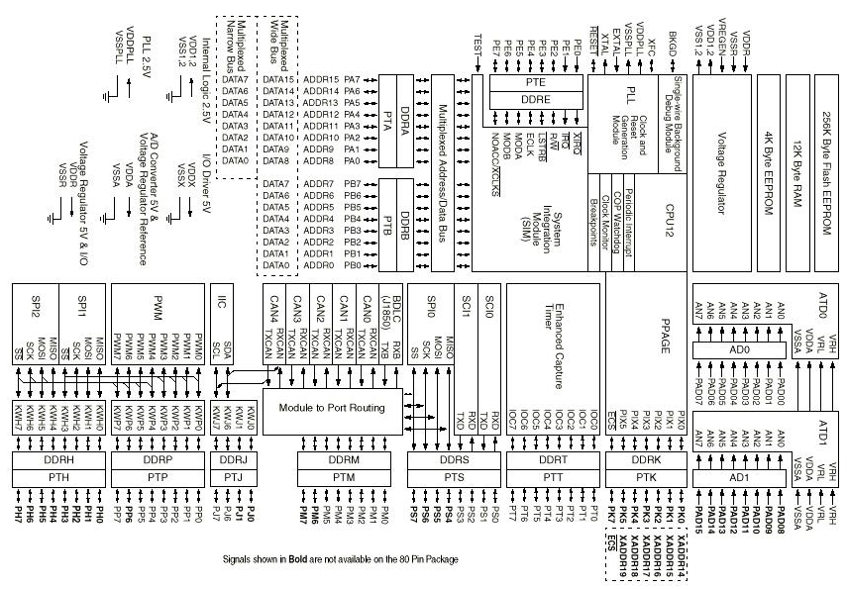
DP256 CPU Pins and Peripherals (No internal Busses Shown)

Slide 6
Port Integration Module (PIM)
Port Integration Module (PIM) Block User Guide V02.07
S12DP256PIMV2.pdf
Notes:
The functionality of each pin is described in the appropriate device user guide. The detailed functionality of the GPIO is described in the appropriate Port Integration Module (PIM) block user guide.

Slide 7
HCS12 I/O Parallel Ports
The number of pins available in each I/O port for HCS12
  are (see mc9s12dp256.s and mc9s12dp256.h for names):
  – PORTA -> 8 pins -> PA7 – PA0
  – PORTB -> 8 pins -> PB7 – PB0
  – PORTE -> 8 pins -> PE7 – PE0
  – PTH -> 8 pins -> PH7 – PH0
  – PTJ -> 4 pins -> PJ7, PJ6, PJ1, PJ0
  – PORTK -> 7 pins -> PK7, PK5 – PK0
  – PTM -> 8 pins -> PM7 – PM0
  – PTP -> 8 pins -> PP7 – PP0
  – PTS -> 8 pins -> PS7 – PS0
  – PTT -> 8 pins -> PT7 – PT0
  – PORTAD1, PORTAD0 -> 16 pins -> PAD15 – PAD0

Slide 8
Overview of HCS12 Parallel Ports (2 of 3)
All I/O ports (except PORTAD0 and PORTAD1) have an associated data direction register and a data register.
The name of the data direction register is formed by adding the letters “DDR” as the prefix to the port letter. For example, DDRA, DDRB, and DDRM.
  To configure a pin for output, write a ‘1’ to the associated bit in the data direction register.
  To configure a pin for input, write a ‘0’ to the associated bit in the data direction register.
movb #$FF,DDRA ; configure port A for output
movb #0,DDRA ; configure port A for input
bset DDRA,$81 ; configure Port A pin 7 and 0 for output

Slide 9
Overview of HCS12 Parallel Ports (3 of 3)
We use “PORT” as the prefix to the port name for port A, B, E, and K.
The other port data registers are formed by adding letters “PT” as the prefix to the port letter.
Output a value to a port is done by storing that value to the port data register.
  movb #$FF, DDRH ; configure Port H for output
  movb #$37, PTH ; output the hex value 37 to port H
Input a value from an input port is done by loading from the port data register.
  movb #0, DDRH ; configure Port H for input
  ldaa PTH ; read data from port H into A

Slide 10
Basic Concepts of I/O
I/O devices are also called peripheral devices.
  For microcontrollers, they are usually part of the IC
  For microprocessors, they are usually separate ICs
I/O devices are consist of circuitry (logic or a device) that exchange data with a computer processing unit (CPU).
  Examples data includes: switches, light-emitting diodes, cathode-ray tube screens, printers, modems, keyboards, and disk drives.

Slide 11
Common Peripherals
Embedded peripherals
  Internal address, data, and control bus
External Peripherals - Parallel
  Interface to using parallel pins
External Peripherals – Serial
  Use HC12 internal SCI or SPI interfaces

Slide 12
HCS12 Built in Peripherals
Serial Communications – RS-232E compatible
Serial Communications – SPI
Serial Bus Standard –Controller area network (CAN)
  A bus used for cars and light trucks (OBDII) and general automotive applications
PWM controlled outputs
Timer/Counter peripheral
Interrupt pins
Analog-to-digital converter
  (external pins must be different than normal digital I/O pin)

Slide 13
Peripheral Interface Registers
Each peripheral has parallel control registers that are set to tell the peripheral how it is supposed to perform
  The DDR# register is an example for parallel ports
Each peripheral has a parallel data register
  Read or write for input or output
Typically each peripheral has a status register
  Describes the current state of the peripheral
  Includes an “event pending” bit for polling or interrupts.

Slide 14
I/O Addressing
Interface devices normally have several registers
Address must be assigned to each of these registers so that they can be accessed
Two issues are related to the access of I/O registers:
  Address Space -> I/O devices can share the same memory space with memory devices like the HC12 (SRAM, ROM etc) or have their own separate I/O memory space
    Current trend is to use “memory mapped I/O” by using the same address space for memory and I/O devices
  Instruction set and Addressing Modes -> I/O devices may have their own instruction set and addressing modes or use the same instruction set and addressing modes as memory devices
    Current trend is to use same instruction set and addressing modes with memory devices
Notes:
• Address space. This issue is related to the question of whether I/O devices should
be treated the same as memory devices, that is, whether the I/O devices should
occupy the same address space (some people like to call it memory space) as the
memory devices (SRAM, DRAM, EEPROM, or flash memory). Both approaches
have been used by microprocessor and microcontroller vendors. The current trend
is for I/O devices and memory components to share the same memory space.
• Addressing modes and instructions. I/O devices may have their own addressing
modes and instruction set or share the same addressing modes and instruction set
with the memory devices. In the first approach, the microprocessor may use the
following instructions for input and output:
out 3: sends data in accumulator to I/O device at address 3.
in 5: inputs a byte from input device 5 to the accumulator.
In the second approach, the microprocessor uses the same instructions and addressing
modes to perform input and output operations. Again, the current trend is the second
approach.
Traditionally, Motorola microprocessors and microcontrollers have used the same addressing
modes and instruction sets to access I/O and memory devices. Memory and I/O devices
share a single memory space.

Slide 15
I/O Schemes
1. Isolated I/O scheme
The microprocessor has dedicated instructions for I/O operations.
The microprocessor has a separate address space for I/O devices.
2. Memory-mapped I/O scheme
The microprocessor uses the same instruction set to perform memory accesses and I/O operations.
The I/O devices and memory components are resident in the same memory space.

Slide 16
I/O Transfer Synchronization
The role of an interface chip
  Synchronizing data transfer between the CPU and the interface chip.
  Synchronizing data transfer between the interface chip and the I/O device.

Slide 17
I/O Synchronization Input (1 of 2)
Microprocessor needs to make sure that the interface chip has correctly latched data from the input device
Polling Method:
  Interface chip uses a status flag to indicate whether it has valid data for the microprocessor
  Microprocessor knows that the interface chip has valid data when the status flag is 1
  Microprocessor keeps checking the status flag until the status flag is set to 1, and then reads data from the data register
  When this method is used, microprocessor is tied up and cannot do any other task
  This method is very simple to implement and is often used when the microprocessor has nothing else to do except wait for completion of the operation

Slide 18
I/O Synchronization Input (2 of 2)
Interrupt Driven method
  The interface chip asserts an interrupt signal to the microprocessor when it has valid data in the data register
  Microprocessors then executes the service routine associated with the interrupt to read the data
  Advantage with this method is that microprocessor can perform other tasks till the interface chip asserts the interrupt signal

Slide 19
I/O Synchronization Output (1 of 2)
To output data successfully, microprocessor needs to make sure that the output device is ready to accept data
Polling Method:
  Interface chip has a data register that holds data to be output to an output device
  New data should be sent to the interface chip only when the data register of the interface chip is empty
  Interface chip consists of a status bit to indicate whether the output data register is empty
  Microprocessor keeps checking the status flag until it indicates that the output data register is empty and then writes data into it

Slide 20
I/O Synchronization Output (2 of 2)
Interrupt Driven Method:
  Interface chip asserts an interrupt signal to the microprocessor when the output data register is empty
  Microprocessor then executes the service routine associated with the interrupt and outputs the data
  M6821 from Motorola and i8255 from Intel supports both methods
  HCS12 supports neither methods (there is no data status bit associated with any I/O ports)

Slide 21
I/O Synch Interactions
The circuit designer is responsible for making sure that data is properly transferred to and from I/O devices
  Microcontroller exists, so make sure the interface devices work appropriately. Internal devices have been done by design, external devices are left to the designer.
The following methods have been used to synchronize data transfer between the interface chip and I/O devices
  Brute-Force method
  Strobe Method
  Hand-Shake Method

Slide 22
I/O Synch: Brute Force
This method is useful in situations in which the timing of data is unimportant.
Brute-Force Method:
  For input-- The microprocessor reads the interface chip and the interface chip returns the voltage levels on the input port pins to the microprocessor.
  For output --The interface chip places the data that it received from the microprocessor directly on the output port pins.
  HCS12 microcontroller supports this Brute-Force method for all general purpose I/O ports available
This method can be used to:
  Test voltage levels of a signal
  Set the voltage levels of an output pin to low or high
  Drive LED’s

Slide 23
I/O Synch: Strobe
Strobe Method -- a strobe signal used to indicate that data are stable on I/O port pins
  For input -- Input device asserts a strobe signal when data are stable on the input port pins. Interface chip latches data into the data register using the strobe signal.
  For output -- Interface chip first places data on the output port pins when the data becomes stable, the interface chip asserts a strobe signal to inform output device to latch data on the output port pins
HCS12 I/O ports does not support this method, but it can be implemented for outputs.
  Use one or more “parallel port” pins as strobe signals
  Software creates a strobe output (set and then clear parallel pin)
  Sometimes called bit banging as software is controlling single bits at a time to accomplish a task

Slide 24
I/O Synch: Handshaking (1 of 2)
Handshake Method:
  The previous two methods cannot guarantee correct data transfer between an interface chip and I/O device when the timing of data is critical
  Best solution is to use a handshake protocol
Two handshake methods are available:
  Interlocked handshake
  Pulse-mode handshake
Both the handshake methods make use of two handshake signals H1 and H2
  H1 -> asserted by the interface chip
  H2 -> asserted by the I/O device

Slide 25
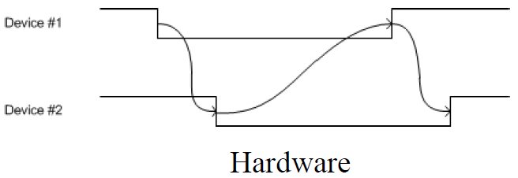
I/O Synch: Handshaking (2 of 2)
One devices offers.
  The other agrees (continue) or
  ignores (time out)
The agreeing devices acknowledges the offer
  A transaction has begun and can continue
The first device concludes the transaction
  The asserted state is deasserted
The second device acknowledges the end

Slide 26
Port A and Port B
When configured in single-chip mode, these two ports are used as general purpose I/O ports
  Each PORTA and PORTB can be configured as input or output pins
In expanded mode PORTA and PORTB are used as time-multiplexed address/data pins
  i.e. when used for external bus interfacing to access external memory
In the HCS12 expanded mode,
  PORTA carries time-multiplexed upper address and data signals (A15/D15 – A8/D8), whereas
  PORTB carries the time-multiplexed lower address and data signals (A7/D7 – A0/D0)

Slide 27
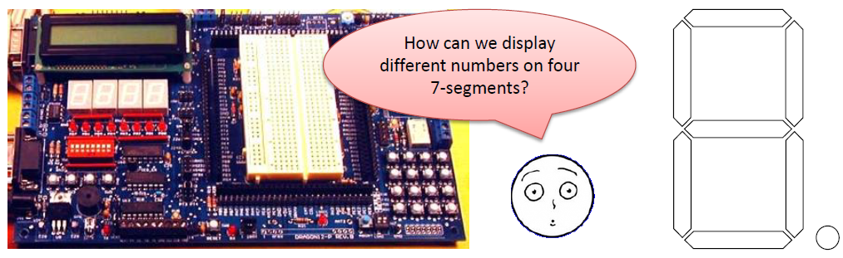
Port B in the Dragon12+
Port B –7 segment digits
Port B supplies the values to the 7-segment digits
Each digit actually has 8 LEDs including decimal point.
The diagram shows which bit controls each LED.
The pins of Port B are connected to all four digits in the Dragon12+.

Slide 28
Port E
PORTE pins are used for bus control and interrupt service request signals
  PE1, PE0 can only be used for input when set for interrupt service, and the states of these pins can be read in the port data register when they are used for interrupt services
When a pin is not used for one of these specific functions, it can be used as a general purpose I/O
  It has DDRE and PORTE registers to set data direction and to access the port
PE7 - PE0 pins
  Can be used as general-purpose I/O pins
  Used for various operations during expanded mode
  Used for interrupt services

Slide 29
Port E
Port E pins are used for bus control and interrupt service request signals.
When a Port E pin is not used as control or interrupt signal, it can be used as general I/O pin.

Slide 30
Port E Registers (1 of 4)
Port E assignment register (PEAR)
  In expanded mode, the PEAR register assigns the function of each port E pin.
MODE register
  This register establishes the operation mode and other miscellaneous functions.
Pull-up control register (PUCR)
  This register selects the pull-up resistors for the pins associated with the core ports.
  Port A, B, E, and K are in the core part.
Reduced drive register (RDRIV)
  This register selects reduced drive for the pins associated with the core ports.
  This gives reduced power consumption and reduced RFI with a slight increase in transition time.
External bus interface control register (EBICTL)
  Only bit 0 is implemented (ESTR).
  The ESTR bit enables/disables the E clock stretching.

Slide 31
Port E Registers (2 of 4)

Slide 32
Port E Registers (3 of 4)

Slide 33
Port E Registers (4 of 4)

Slide 34
Port K
PORTK has a Port K data direction register (DDRK) and a Port K data register (PORTK)
Apart from using as general purpose I/O port K is used to carry expanded address XADDR14 – XADDR19, and Chip-Select signals
PK6 pin is only available in the H sub family ( not available in M9S12DP256 used in the lab)

Slide 35
Port T
Has Port T Data Register (PTT), Port T Data Direction Register (DDRT), Port Input Register (PTIT), Reduced Drive Register (RDRT), Pull Device Enable Register (PERT), and Port Polarity Select Register (PPST).
  The PTIT register allows the user to read back the status of Port T pins.
  The RDRT register can configure the drive strength (current output) of each port pin as either full or reduced load.
  The PERT register is used to enable an input Port T pin pull-up or pull-down device.
  The PPST register selects whether a pull-down or pull-up device is connected to the pin.

Slide 36
Port T (1of 2)
Port T pins are also used as timer input capture/output compare pin
All pins on the port T can be used as general and can also be used as input capture or output compare pins
Input Capture -> Used to capture periodic Square wave signals
Output Compare -> Used to generate periodic Square wave signals
Port T can only be used as general purpose I/O when not being used for input capture or output compare functions

Slide 37
Port T (2 of 2)

Slide 38
Port S
Port S has a port I/O register (PTS), Port data direction register (DDRS)
Port S can be used as general purpose I/O pins or serial interface signals
PS0 – PS3
  – General purpose I/O
  – SCI0 -> Receiver/Transmitter,
  - SCI1 -> Receiver/Transmitter
PS4 – PS7
  – General purpose I/O
  – Serial Peripheral Interface pins

Slide 39
Port M
General Purpose I/O or Serial Peripheral Interface (SPI) or support CAN bus
Port M has all the equivalent registers that Port S has and also a module routing register (MODRR).
  The MODRR configures the rerouting of CAN0, CAN4, SPI0, SPI1, and SPI2 on defined port pins.

Slide 40
Port H, J, and P
These three I/O ports have the same set of registers:
    Port I/O register (PTH, PTJ, PTP)
    Port Input Register (PTIH, PTIJ, PTIP)
    Port Data Direction Register (DDRH, DDRJ, DDRP)
    Port Reduced Drive Register (RDRH, RDRJ, RDRP)
    Port Pull Device Enable Register (PERH, PERJ, PERP)
    Port Polarity Select Register (PPSH, PPSJ, PPSP)
    Port Interrupt Enable Register (PIEH, PIEJ, PIEP)
    Port Interrupt Flag Register (PIFH, PIFJ, PIFP)
The Port Interrupt Register allows the user to enable interrupts on these three ports.
  These ports have edge-triggered interrupt capability in the wired- OR fashion.
  The interrupt edges can be rising or falling and are programmed through Port Device Enable Register and Port Polarity Select Register.
The SPI function pins (Port M) can be rerouted to Port H and P.

Slide 41
Port H, J, and P

Slide 42
Port P and Dragon12+
Port P –Selecting a 7-segment digit
7 segment digit selection
  Port P is used to select which of the four 7-segment LED digits are enabled.
  Remember that the display pattern is determined by Port B.
  Those digits that are not selected will be off (all LEDs off).
  Note: only lower 4 bits are used .
Enable/Disable

Slide 43
Port H and Dragon12+
Port H –switch input
Port H is used to read the 8-DIP switches and 4 push buttons.
Only four pins that monitor both switches.
Way to distinguish which is being pressed?

Slide 44
Port AD0 and AD1
Many HCS12 devices have two 8-channel A/D converters (AD0 and AD1).
  Device that have only one 8-channel module refers to that module as AD.
When A/D functions are disabled, these two ports can be used as general input port.
  These two ports do not have data direction registers.
Each module has a Digital Input Enable Register.
  In order to use an A/D pin as a digital input, one needs to set its associated bit in this register.

Slide 45
Electrical Characteristic Consideration for
I/O Interfacing
Most systems require the use of logic chips and/or peripheral devices apart from the microcontroller to perform their function
These chips may use different types of Integrated Circuit (IC) technologies, there is a concern that the resultant system may not function properly
One primary question is: are they electrically compatible?
Two issues involve
  Voltage-level compatibility
  Current drive capacity

Slide 46
Timing compatibility
Timing compatibility needs to be taken into consideration if the I/O pin is driving an external devices, particularly flip-flops or latches
Latch or flip-flop has a control signal or clock signal to collect the input signal.
Setup time, Hold time

Slide 47
Timing compatibility (2)
Setup and hold times describe the timing requirement on the input of the flip-flop with respect to the clock input
  Setup time is the time that the input must be valid before the flip-flop samples the signal
  Hold time is the time that the input must be maintained valid after the flip flop samples the signal
Therefore, setup and hold time define a window of time during which the input must be valid and stable in order to get the valid data on the output

Slide 48
Timing compatibility (3)
Main timing consideration is the setup (t_{su})and hold time (t_{hd}) requirements for all flip-flop and latches
If the signal passes through several intermediate devices before it reaches latches or flip-flops, time delays of all intermediate devices needs to be taken into account

Slide 49
Interfacing with Output Devices
Many embedded devices only require interfacing with simple input and output devices such as switches, light emitting devices, keypads, seven segment displays etc.
Interfacing with LED’s:
  LED’s are often used to indicate the system operation mode
    • Whether the system is turned on
    • Whether the system operation is normal
    • Whether the system is in error mode etc.
  A LED can illuminate when it is forward biased and has sufficient current following through it
  The current required to light an LED may range from a few to more than 10mA

Slide 50
Interfacing with LEDs
An LED has an anode and cathode terminal.
  The anode terminal must function at a voltage at least 1.6 V above that of the cathode terminal (forward biased) in order for the LED to be lighted.
Three methods for interfacing with LED’s
  Method A and B are only recommended for use with LEDs that need only 1 to 2mA to produce enough brightness
For most of the LEDS: the forward current required to light an LED is from a few to more than 10 mA. Recommended circuit C
The resistors R1, R2, are R3 are called current-limiting resistors. Resistor value can be between 220 ohm and 1 Kohm

Slide 51
Interfacing with LEDs
Buffer the HC12 port – provide current sinking
Resistor between +5 and LED
  The resistor provides current limiting
Resistor Value
  LED needs ~1.2 to 1.5 V drop
  LED wants ~ 10 mA or more
Notes:
Current sourcing is when a device or integrated circuit supplies an output signal at a specified voltage and can drive current through a load (such as a relay coil) whose other side is connected to ground or system common.
Current sinking is similar, except the load is connected to a power supply and the IC completes the path from the load to ground or system common.
Sinking and Sourcing are terms used to define the control of direct current flow in a load. A sinking digital I/O (input/output) provides a grounded connection to the load, whereas a sourcing digital I/O provides a voltage source to the load.

Slide 52
Interfacing with seven-segments displays (1 of 6)
Seven-segment displays are mainly used to display decimal digits and a small set of letters.
The displays common pin is generally used to identify which type of 7-segment display it is. As each LED has two connecting pins, one called the “Anode” and the other called the “Cathode”, there are therefore two types of LED 7-segment display called: Common Anode (CA) and Common Cathode (CC).

Slide 53
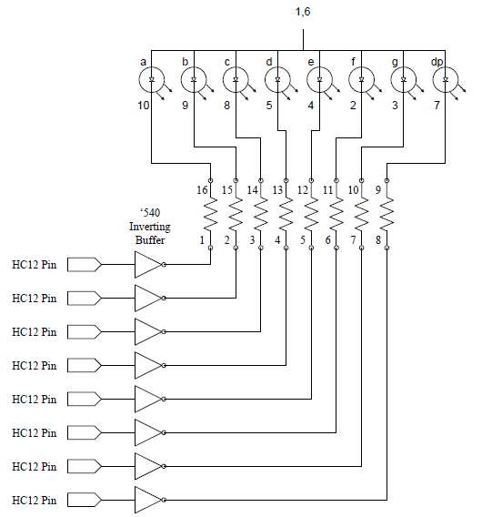
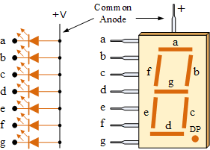
Interfacing with seven-segments displays (2 of 6)
The Common Anode (CA)
  all the anode connections of the LED segments are joined together to logic “1”. The individual segments are illuminated by applying a ground, logic “0” or “LOW” signal via a suitable current limiting resistor to the Cathode of the particular segment (a-g).

Slide 54
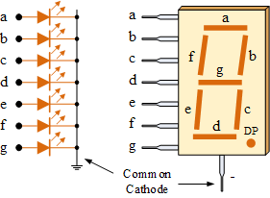

Interfacing with seven-segments displays (3 of 6)
The Common Cathode (CC)
  all the cathode connections of the LED segments are joined together to logic “0” or ground. The individual segments are illuminated by application of a “HIGH”, or logic “1” signal via a current limiting resistor to forward bias the individual Anode terminals (a-g).

Slide 55
Interfacing with seven-segments displays (4 of 6)
The HCS12 I/O port can drive a seven-segment display directly.
  Buffer chips are used mainly to save excessive current draw from the HCS12.
  Port B drives a common-cathode seven-segment display through the buffer chip 74HC244.
The V_{OH} (output high voltage) value of the 74HC244 is about 5 V. Adding a 330-Ω resistor will set the display segment current to about 6.4 mA, which should be sufficient to light an LED segment.
Some may use PB0 to PB6 to drive segment g to a instead (for example, Dragon12 board).
The microcontroller must send an appropriate value to the output in order to display a certain value

Slide 56
Interfacing with seven-segments displays (5 of 6)

Slide 57
Interfacing with seven-segments displays (6 of 6)
Example: Write a sequence of instructions to display a value on the 7segment display previously shown.
Solution: Output the appropriate hex value to port A
.org $1000 ; Set starting value of location counter where code or data will go
Seg7: .byte $3F, $06, $5B, $4F, $66, $6D, $7D, $07, $7F, $6F, $77, $7C, $39, $5E,$79, $71
SegVal = $0X ; Segment Hex Value to be displayed
.text
_main::
  movb #$FF,DDRA ; configure PORT A for output
  ldaa #SegVal ; load the Segment Value
  ldx #Seg7
  ldaa a,x ; load the 7 Segment Value
  staa PORTA ; output to 7 segment display
  swi
Additional Hex
Outputs

Slide 58
DIP Switches (1 of 3)
Switch is probably the simplest input device available
To make input more efficient, a set of eight switches organized as a Dual inline package (DIP) is often used
A DIP package can be connected to any input port with eight pins such as PortA, PortB etc
When a switch is closed, the associated port input is 0, otherwise the associated port input is 1
Each port input is pulled up high via a 330 ohm or 1Kohm resistor when the associated switch is open

Slide 59
DIP Switches (2 of 3)
Instruction to read data from DIP switches on PTA
  Step1: Define the corresponding Data Direction Register and Data Register of PTA
  Step2: Set the Data Direction Register of PTA to configure port as an input port
  Step3: Read the data from the Data register of PTA according to the requirements of the program.
Data from the DIP switches is always available in the Data Register of the corresponding port with which it’s interfaced

Slide 60
DIP Switches (3 of 3)
Example: Write a sequence of instructions to read the value from an eight-switch DIP connected to Port A of the HCS12 into accumulator A.
Solution:
    movb #$0,DDRA ; configure Port A for input
    ldaa PTA
    …

Slide 61
Interfacing with a keypad (1 of 8)
A keypad is arranged as an array of switches, which can be mechanical, membrane, capacitors, or Hall-effect in construction.
  Mechanical switches or keypads are most popular due to their low cost and minimal strength of construction
Mechanical switches have a problem called contact bounce.
Closing a mechanical switch generates a series of pulses because the switch contacts do not come to rest immediately.
  When the key is not presses, everything is fine
  In order to detect which key has been presses, controller needs to scan every key of keypad and may, due to contact bounce, determine that every low is a new key press (you get repeated characters when one was desired!)

Slide 62
Interfacing with a keypad (2 of 8)
Contact Switch Bounce
  The switch bounces or chatters in transitioning from one to zero.
  The signal that falls and rises within a period of up to 5ms is likely a contact bounce

Slide 63
Interfacing with a keypad (3 of 8)
De-bouncing
a de-bouncer could recognize that the switch is closed after the voltage is low for about 10ms and then could recognize after that the switch is open after the voltage is high for about 10ms.
Both H/W and S/W solutions to the key bounce problem are available
Software Debouncing Technique
The most popular and simple one has been the wait and see method. In this method, the program simply waits for about 10 ms and reexamine the same key again to see if it is still pressed.

Slide 64
Interfacing with a keypad (4 of 8)
Keypad Scanning
Keypad scanning is usually performed row-by-row or column-by-column
A 16-key keypad can be easily interfaced using any available 8-bit I/O port
For the keypad application the upper four pins of the port should be configured for output and the lower four pins of the port should be configured for input (with pull-ups)
The rows and columns of a keypad are simply conductors
The keypad interface setup to HCS12 PortA is as shown in the next slide

Slide 65
Interfacing with a keypad (5 of 8)
Keypad Circuitry with HCS12

Slide 66
Interfacing with a keypad (6 of 8)
Keypad Operation
Whenever a key switch is pressed, the corresponding row and column are shorted together
In order to distinguish the row and column of the key pressed
  Scan a zero through the columns (! !)
  If an input row becomes zero, the key pressed must be connected to the zeroed column. Just remember:

Slide 67
Interfacing with a keypad (7 of 8)
Keypad Operation

Slide 68
Interfacing with a keypad (8 of 8)
De-bouncing - Hardware Debouncing Technique
Set-Reset Latches
A key switch can be de-bounced using the S-R latches
Before being presses, the key is touching the set input and the Q voltage is high
When pressed the key touches the reset position, the Q voltage will go Low
If the key is bouncing and touching neither Set or Reset, both inputs are pulled low by the pull-down resistor. Since both Set and reset are low, the Q voltage will remain low and the key will be recognized as pressed
CMOS gate debouncer
The CMOS buffer output is identical to its input
When the switch is pressed, the input to the buffer chip is grounded and hence Vout is forced low
When the key switch is bouncing, the resistor R keeps the output voltage low. This is due to the high input impedance of the buffer, which causes a negligible voltage drop on the feedback resistor
Integrated de-bouncers
The RC constant of the integrator determines the rate at which the capacitor charges up towards the supply voltage once the ground connection via the switch has been removed
As long as the capacitor voltage does not exceed the logic 0 threshold value, the Vout signal will be recognized as logic 0
The cheapest approach!

Slide 69
Stepper Motor Control (1 of 10)
Is digital in nature and provides high degree of control.
In its simplest form, a stepper motor has a permanent magnet rotor and a stator consisting of two coils. The rotor aligns with the stator coil that is energized.
By changing the coil that is energized, the rotor is turned.
  Figure 7.37a to 7.37d illustrate how the rotor rotates clockwise in full step.
  By changing the energizing order as shown in Figure 7.38, the stepper will rotate counterclockwise in full step.

Slide 70
Stepper Motor Control (2 of 10)
  Figure 7.37a to 7.37d illustrate how the rotor rotates clockwise in full step.

Slide 71
Stepper Motor Control (3 of 10)
  By changing the energizing order as shown in Figure 7.38, the stepper will rotate counterclockwise in full step.

Slide 72
Stepper Motor Control (4 of 10)
In a four-pole stepper motor shown in Figure 7.37 & 7.38, a full step is 90 degrees.
The stepper motor may also operate with half step. A half step occurs when the rotor (in a four-pole step) is moved to eight discrete positions (45º).
To operate the stepper motor in half steps, sometimes both coils may have to be on at the same time. When two coils in close proximity are energized there is a resultant magnetic field whose center will depend on the relative strengths of the two magnetic fields.
The step sizes of the stepper motors may vary from approximately 0.72º to 90º. The most common step sizes are 1.8º, 7.5º, and 15º.

Slide 73
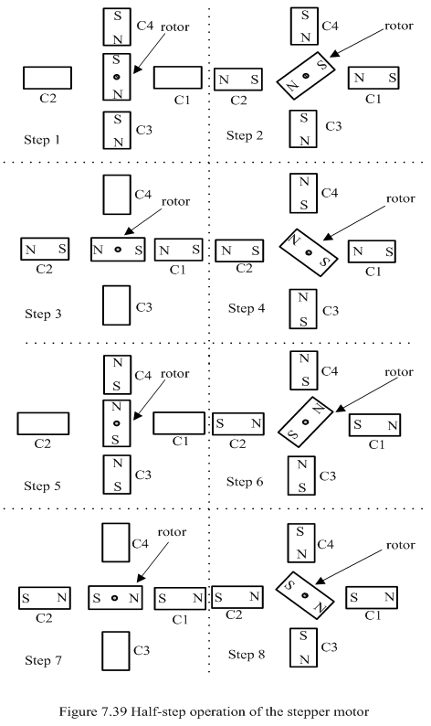
Stepper Motor Control
(5 of 10)
  A half step occurs when the rotor (in a four-pole step) is moved to eight discrete positions (45º).

Slide 74
Stepper Motor Control (6 of 10)
Driving a step motor involves applying a series of voltages to the coils of the motor.
A subset of coils is energized at a time to cause the motor to rotate one step. The pattern of coils energized must be followed exactly for the motor to work correctly.
A microcontroller can time the duration that the coil is energized, and hence control the speed of the stepper motor in a precise manner.
The circuit in Figure 7.41 shows how the transistors are used to switch the current to each of the four coils of the stepper motor.
The diodes in Figure 7.41 are called fly back diodes and are used to protect the transistors from reverse bias.
The transistor loads are the windings in the stepper motor. The windings are inductors, storing energy in a magnetic field.
When the current is cut off, the inductor dispenses its stored energy in the form of an electric current.
This current attempts to flow through the transistor, reversely biasing its collector-emitter pair. The diodes are placed to prevent this current from going through the transistors.

Slide 75
Stepper Motor Control (7 of 10)

Slide 76
Stepper Motor Control (8 of 10)
The normal full-step sequence shown in Table 7.13 should be used for high torque applications.
For lower-torque applications, the half-step mode is used and its sequence is shown in Table 7.14.
The microcontroller outputs the voltage pattern in the sequence shown in Table 7.13 or 7.14.
Table 7.13 & 7.14 are circular. The values may be output in the order as shown in the table, which will rotate the motor clockwise; or in the reverse order, which will rotate the motor counterclockwise.
A delay about 5 to 15 ms is required between two steps to prevent motor from missing steps.

Slide 77
Stepper Motor Control (9 of 10)

Slide 78
Stepper Motor Control (10 of 10)
Example: Assuming that pins PP3...PP0 are used to drive the four transistor in Figure 7.41, write a subroutine to rotate the stepper motor clockwise one cycle using the half-step sequence.
Solution:
movb #step5,PTP
bsr delay10ms
movb #step6,PTP
bsr delay10ms
movb #step7,PTP
bsr delay10ms
movb #step8,PTP
bsr delay10ms
movb #step1,PTP
bsr delay10ms
rts
; the following subroutine waits for 10 ms
delay10ms
movb #$90,TSCR1 ; enable TCNT & fast flags clear
movb #$06,TSCR2 ; configure prescale factor to 64
bset TIOS,IOS0 ; enable OC0
ldd TCNT
addd #3750 ; start an output compare operation
std TC0 ; with 10 ms time delay10ms
brclr TFLG1,$01,*
rts
end
step1 equ $08
step2 equ $0C
step3 equ $04
step4 equ $06
step5 equ $02
step6 equ $03
step7 equ $01
step8 equ $09
HStep movb #$FF,DDRP
; configure PTP for output
movb #step1,PTP
bsr delay10ms
movb #step2,PTP
bsr delay10ms
movb #step3,PTP
bsr delay10ms
movb #step4,PTP
bsr delay10ms

Slide 79
Key Wakeups (1 of 4)
Many embedded products are powered by battery. To lengthen the battery life, most microcontrollers have incorporated power saving modes such as the WAIT, STOP modes.
All HCS12 members have incorporated the key wakeup feature which would wake up the CPU when keys connected to certain input ports are pressed.
After entering the wait or stop mode, the MCU will be interrupted when one of these pins is pressed.
The port H, J, and P of the HCS12 have implemented the key-wakeup function.
The user select the active edge for wakeup by programming the Port Device Enable Register and the Port Polarity Select Register.
The Port Interrupt Enable Register and the Interrupt Flag Register together allow the user to wake up the MCU.

Slide 80
Key Wakeups (2 of 4)
Key Wakeup Initialization
Step 1: Set the direction of the key wakeup bits to input by writing zeros to the data direction register.
Step 2: Select the rising edge or the falling edge of the wake up pin to interrupt the MCU by programming the related registers.
Step 3: Write the service routine for the key wakeup interrupt and initialize the key wakeup interrupt vector.
Step 4: Clear any flags that have been set in the key wakeup flag register.
Step 5: Enable the key wakeup function by setting the appropriate bits in the wakeup interrupt enable register.
Step 6: Clear the global interrupt mask (the I bit of the CCR register).

Slide 81
Key Wakeups
(3 of 4)

Slide 82
Key Wakeups (4 of 4)
Example: Write an instruction sequence to configure Port P upper four pins for wakeup feature. Program the port P so that pins PP7...PP4 generate interrupt whenever there is a falling edge applied to any one of these four pins.
Solution:
…
bclr DDRP,$F0 ; configure PP<7:4> pins for input
bset PERP,$F0 ; enable PP7~PP4 pins’ pull device
bclr PPSP,$F0 ; choose pull-up device
movb #$FF,PIFP ; clear the Port P key wakeup flags
bset PIEP,$F0 ; enable Port P interrupt
cli ; enable key wakeup interrupt globally

Slide 83

Content
Overview of HCS12 Parallel Ports
Basic Concepts of I/O
I/O Addressing
I/O Schemes
I/O Transfer Synchronization
Port A, B, E, K, T, S, M, H, J, P, AD0, AD1
Timing compatibility
Interfacing with Output Devices

