Slide 1
C Language programming
Razvan Bogdan
Embedded Systems

Slide 2
Why C?
Why C?
ANSI C
The language suitable for embedded systems
Microcontrollers accept instructions in machine code
All software: assembly, C, C++, Java must be translated into machine code in order to be executed by the CPU
Interpretation of machine code by the engineer is error prone and time consuming
Efficiency of the programming language: embedded processors have limited processor power and limited available memory
The Embedded
Difference
Examples

Slide 3
Why C?
Why C?
ANSI C
The language suitable for embedded systems
Compromise between safety, maintainability, portability
Characteristics of the required language:
  efficient
  high-level
  offers low-level access to hardware
  well defined
  in common use
  read from and write to particular memory locations (e.g. by a mechanism such as “pointers”)
  reuse the code (which has already been tested)
The Embedded
Difference
Examples
C is a solution

Slide 4
Why C?
Why C?
ANSI C
Features of the C programming language:
“mid-level”
  “low-level” features (access to hardware via pointers)
  “high-level” features (support for functions and modules)
In common use
Different compilers are available for every embedded processor (8-bit to 32-bit or more)
The Embedded
Difference
Examples

Slide 5
ANSI C – Identifiers
C Program
Why C?
ANSI C
Identifiers
Numbers, Variables
Expressions
Program flow
Arrays & Pointers
Functions
Preprocessor
The Embedded
Difference
Examples

Slide 6
ANSI C – Identifiers
Why C?
ANSI C
Identifiers
Numbers, Variables
Expressions
Program flow
Arrays & Pointers
Functions
Preprocessor
Tokens:
  identifiers
  keywords
  constants
  string literals
  operators
  other separators
  blanks, horizontal and vertical tabs, new lines and comments (“white spaces”) - ignored
The Embedded
Difference
Examples

Slide 7
ANSI C – Identifiers
Why C?
ANSI C
Identifiers
Numbers, Variables
Expressions
Program flow
Arrays & Pointers
Functions
Preprocessor
Identifiers:
  a sequence of letters and digits
  functions, structures, unions and enumeration members of structures or unions, enumeration constants, defined types (typedef)
Rules:
  The first character must be a letter
  The underscore _ counts as a letter
  Upper and lower case letter are different
  Identifiers may have any length and for internal identifiers, at least the first 31 characters are significant
The Embedded
Difference
Examples

Slide 8
ANSI C – Identifiers
Why C?
ANSI C
Identifiers
Numbers, Variables
Expressions
Program flow
Arrays & Pointers
Functions
Preprocessor
The compiler allocates memory for all identifiers
As the compiler reads a program, it records all identifier names in a symbol table.
The compiler uses the symbol table internally as a reference to keep track of the identifiers: name, type and the location in memory
When the compiler finishes translating a program into machine language, it will have replaced all the identifier names used in the program with instructions that refer to the memory addresses associated with these identifiers
The Embedded
Difference
Examples

Slide 9
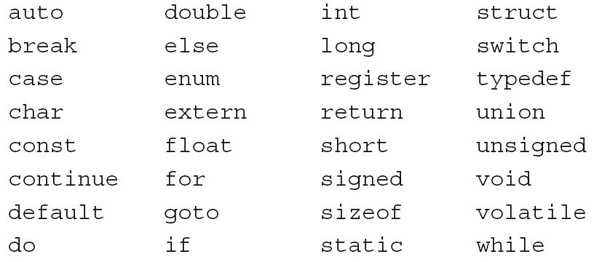
ANSI C – Identifiers
Why C?
ANSI C
Identifiers
Numbers, Variables
Expressions
Program flow
Arrays & Pointers
Functions
Preprocessor
An identifier can not be a C Keywords:
Some implementations also reserve the asm keyword
The Embedded
Difference
Examples

Slide 10
ANSI C – Identifiers
Why C?
ANSI C
Identifiers
Numbers, Variables
Expressions
Program flow
Arrays & Pointers
Functions
Preprocessor
Variable Data Identifiers:
  Identifiers which represent variable data values, called variables, require portions of memory which can be altered during the execution of the program
  The compiler will allocate a block of its data memory space, usually in RAM, for each variable identifier
    Example: variable declaration
    int currentTemperature; /* will cause the compiler to allocate a single byte of RAM */
  The keyword int in the variable declaration tells the compiler that currentTemperature will contain an integer value and will require a single byte of RAM to contain this value
The Embedded
Difference
Examples

Slide 11
ANSI C – Identifiers
Constant Data Identifiers:
  allocated from computer program memory space
  constant data values do not require alterable memory: once the value of a constant has been written in memory it need never change => the compiler will allocate a block of its program memory space, usually in ROM, for each of these identifiers (most of the cases)
    Example: constant data value declaration
    const int maxTemperature = 20;
  the keyword const tells the compiler that the identifier is a constant and that a single byte in ROM should be reserved to contain the value 20
  when the identifier maxTemperature is used in the program it refers to the memory location in ROM which contains the value 20.
Why C?
ANSI C
Identifiers
Numbers, Variables
Expressions
Program flow
Arrays & Pointers
Functions
Preprocessor
The Embedded
Difference
Examples

Slide 12
ANSI C – Identifiers
Why C?
ANSI C
Identifiers
Numbers, Variables
Expressions
Program flow
Arrays & Pointers
Functions
Preprocessor
Function Identifiers:
  not altered during program execution
  Once the value of a function has been written in the computer’s memory it need never change
  When a function is defined, the compiler places the program instructions associated with the function into ROM
  What happens to the local variables used in a function’s body of statements?
  The compiler will write in the data memory, addresses where local variable values will be stored in RAM when the program runs
  Each program has a main() function
The Embedded
Difference
Examples

Slide 13
ANSI C – Data Types
Why C?
ANSI C
Introduction
Identifiers
Data Types
Expressions
Program flow
Arrays & Pointers
Functions
Preprocessor
Numbers
Variables
Memory class modifier
External variables
Scope rules
Static variables
Register variables
Initialization
Data Types
Data encapsulation with struct
Data encapsulation with union
Bit fields
Enumerated data types
Definition of private types
Type Conversion
The Embedded
Difference
Examples

Slide 14
ANSI C – Data Types
Why C?
ANSI C
Introduction
Identifiers
Data Types
Expressions
Program flow
Arrays & Pointers
Functions
Preprocessor
Constants
  Text constants
  Numerical constants
Text constants
  char Ex: ‘P’, ‘R’, ‘7’, ‘#’
  string Ex: “Politehnica”
For string constants an array of appropriate length is reserved and the character ‘\0’ is automatically added to the end. In this way the string end can be recognized by the program.
The Embedded
Difference
Examples

Slide 15
ANSI C –Data Types
Embedded systems
Why C?
ANSI C
Introduction
Identifiers
Numbers, Variables
Expressions
Program flow
Arrays & Pointers
Functions
Preprocessor
Embedded SW Design
Text constants
Example: String Constant
Why C?
ANSI C
Introduction
Identifiers
Data Types
Expressions
Program flow
Arrays & Pointers
Functions
Preprocessor
‘S’ | ‘y’ | ‘s’ | ‘t’ | ‘e’ | ‘m’ | ‘s’ | ‘\0’
53 | 79 | 73 | 74 | 65 | 6D | 73 | 00
A char constant doesn’t end with the terminal ‘\0’
The Embedded
Difference
Examples

Slide 16
ANSI C –Data Types
Embedded systems
Why C?
ANSI C
Introduction
Identifiers
Numbers, Variables
Expressions
Program flow
Arrays & Pointers
Functions
Preprocessor
Embedded SW Design
Numerical constants
  Numbers always start with a digit
  Expressing values in different notations except the decimal:
    0xnnnn hexadecimal number (digits: 0-9, a-f or A-F)
    0nnn octal number (digits: 0-7)
    0bnnnn binary number (digits: 0,1)
      Example:
// all octal values begin with 0
int octalInt = 030;
// all hex values begin with 0x
int hexadecimalInt = 0x40;
// all binary values begin with 0b
int binaryInt = 0b00100000;
Why C?
ANSI C
Introduction
Identifiers
Data Types
Expressions
Program flow
Arrays & Pointers
Functions
Preprocessor
The Embedded
Difference
Examples

Slide 17
ANSI C –Data Types
Why C?
ANSI C
Introduction
Identifiers
Data Types
Expressions
Program flow
Arrays & Pointers
Functions
Preprocessor
Numerical constants
  Long integer constants are specified with an ending L
    Example: long var1 = 11L;
  Unsigned integer constants are specified with an ending u
    Example: unsigned int var2 = 5u;
  Floating point values should contain a decimal point,
    Example: float var3 = 2.;
  Floating point values may be written with mantissa and exponent,
    Example: float var4 = 0.4e-5;
The suffixes may be omitted, but this might sometimes result to an error
The Embedded
Difference
Examples

Slide 18
ANSI C –Data Types
Why C?
ANSI C
Introduction
Identifiers
Data Types
Expressions
Program flow
Arrays & Pointers
Functions
Preprocessor
Symbolic definition of Constants
  Symbolic constants are defined with the pre-processor directive #define
    Example:
#define MAX 350
#define TEXT “Embedded Systems”
  It is recommended to define a symbolic constant for each constant value for improved readability
The Embedded
Difference
Examples

Slide 19
ANSI C –Data Types
Why C?
ANSI C
Introduction
Identifiers
Data Types
Expressions
Program flow
Arrays & Pointers
Functions
Preprocessor
Symbolic definition (#define) vs. const
  constants declared with const are stored in ROM - disadvantage
  constants declared with const are visible in debuggers - advantage
  symbolic constants do not take up space in ROM, but are not visible in debuggers;
  Symbolic constants are recommended for embedded systems where ROM memory is critical
The Embedded
Difference
Examples

Slide 20
ANSI C –Data Types
Why C?
ANSI C
Introduction
Identifiers
Data Types
Expressions
Program flow
Arrays & Pointers
Functions
Preprocessor
Variables - characterized by:
  value
  address
  attribute (modifier)
  type
  Lifetime
  [class] [modifier] [type] <name> [, <name1>][,…]
  When the compiler comes across a variable declaration it checks that the variable has not previously been declared and then allocates an appropriately sized block of RAM
The Embedded
Difference
Examples

Slide 21
ANSI C –Data Types
Why C?
ANSI C
Introduction
Identifiers
Data Types
Expressions
Program flow
Arrays & Pointers
Functions
Preprocessor
Variables
  The modifier can be one of:
    volatile
    Const
  Volatile
    volatile <type> <name>
  directs the compiler not to perform certain optimizations on an object because that object can have its value altered in ways beyond the control of the compiler
  must always be read from its original location and is not kept in a register at any time
  compiler optimizations are not available, therefore it must be used only if necessary
  useful for controlling access to memory-mapped device registers, as well as for providing reliable access to memory locations used by asynchronous processes
The Embedded
Difference
Examples

Slide 22
ANSI C –Data Types
Why C?
ANSI C
Introduction
Identifiers
Data Types
Expressions
Program flow
Arrays & Pointers
Functions
Preprocessor
Const
  const <type> <name>
  allows only read access to the variable
  may only be initialized once in a program, the initialization being performed in the startup code
  allows the compiler to perform type checking
  announces objects that may be placed in read-only memory, and perhaps to increase opportunities for optimization
The Embedded
Difference
Examples

Slide 23
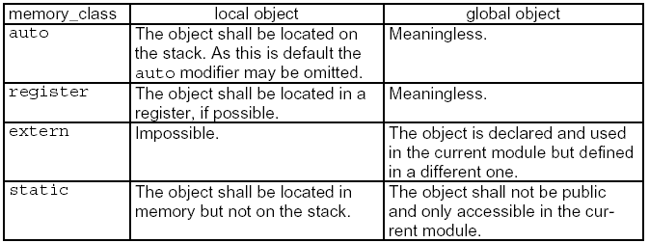
ANSI C –Data Types
Why C?
ANSI C
Introduction
Identifiers
Data Types
Expressions
Program flow
Arrays & Pointers
Functions
Preprocessor
Memory class modifiers
auto
  default storage class
  local lifetime
  is not initialized automatically, but explicitly
  visible only in the block in which it is declared
The Embedded
Difference
Examples

Slide 24
ANSI C –Data Types
Why C?
ANSI C
Introduction
Identifiers
Data Types
Expressions
Program flow
Arrays & Pointers
Functions
Preprocessor
Memory class modifiers
static
global lifetime
visible only within the block in which it is declared
register
mostly obsolete
used for optimizations for heavily used variables; the variable is assigned to a high-speed CPU register (rather than an ordinary memory location)
you cannot generate pointers to them using the & operator !
extern:
reference to a variable with the same name defined at the external level in any of the source files of the program
the identifier declared has its defining instance somewhere else
used to make the external-level variable definition visible within the block
The Embedded
Difference
Examples

Slide 25
ANSI C –Data Types
External variables – how to use them:
- A variable declared inside a function is called an internal variable.
- A variable defined outside of a function is called an external variable.
- An external variable is available to many functions.
- External variables provide an alternative to function arguments and return values for communicating data between functions.
- Any function may access an external variable by referring to it by name if the name has been declared somewhere.
The use of static with a local variable declaration inside a block or a function causes a variable to maintain its value between entrances to the block or function.
Why C?
ANSI C
Introduction
Identifiers
Data Types
Expressions
Program flow
Arrays & Pointers
Functions
Preprocessor
The Embedded
Difference
Examples

Slide 26
ANSI C –Data Types
Why C?
ANSI C
Introduction
Identifiers
Data Types
Expressions
Program flow
Arrays & Pointers
Functions
Preprocessor
External variables – how to use them:
The Embedded
Difference
Examples

Slide 27
ANSI C –Data Types
Variable scope
The visibility of a declared variable is called the variable’s scope; if a portion of a program lies outside a variable’s scope then the compiler will give an error if you refer to the variable in that portion
  For automatic variables declared at the beginning of a function, the scope is the function in which the name are declared
  Local variables of the same name in different functions are unrelated
  The same is true of the parameters of the function, which are in effect local variables
Why C?
ANSI C
Introduction
Identifiers
Data Types
Expressions
Program flow
Arrays & Pointers
Functions
Preprocessor
The Embedded
Difference
Examples

Slide 28
ANSI C –Data Types
Why C?
ANSI C
Introduction
Identifiers
Data Types
Expressions
Program flow
Arrays & Pointers
Functions
Preprocessor
Variable scope
  The scope of an external variable or function lasts from the point at which it is declared to the end of the file being compiled; the compiler does not allocate memory when it sees an extern variable declaration
  There must be only one definition of an external variable among all the files that make up the source program; other files may contain “extern” declarations to access it
The Embedded
Difference
Examples

Slide 29
ANSI C –Data Types
Why C?
ANSI C
Introduction
Identifiers
Data Types
Expressions
Program flow
Arrays & Pointers
Functions
Preprocessor
Variable scope
What happens when scopes overlap? The most recently declared instance of a variable is used. If you declare a global variable called temp outside all statement blocks and a local variable called temp inside your main(), function, the compiler gives the local variable precedence inside main().
While the computer executes statements inside main()’s scope (or statement block), temp will have the value and scope assigned to it as a local variable. When execution passes outside main()’s scope, temp will have the value and scope assigned to it as a global variable
The Embedded
Difference
Examples

Slide 30
ANSI C –Data Types
Why C?
ANSI C
Introduction
Identifiers
Data Types
Expressions
Program flow
Arrays & Pointers
Functions
Preprocessor
Static variables
  the scope of the object is limited to the rest of the source file being compiled
  function names are global, visible to any part of the entire program
  a static function is invisible outside of the file in which it is declared
  function local variables can also be declared as static. These are local to the function, but they remain in existence after the function terminates its execution.
  static variables are allocated in the “global” memory space (heap)
The Embedded
Difference
Examples

Slide 31
ANSI C –Data Types
Why C?
ANSI C
Introduction
Identifiers
Data Types
Expressions
Program flow
Arrays & Pointers
Functions
Preprocessor
Register variables
makes sense for heavily used variables
register variables are to be placed in machine registers, which may result in smaller an faster programs
obsolete, compilers are able to optimize the code without such hints
The Embedded
Difference
Examples

Slide 32
ANSI C –Data Types
Embedded systems
Why C?
ANSI C
Introduction
Identifiers
Numbers, Variables
Expressions
Program flow
Arrays & Pointers
Functions
Preprocessor
Embedded SW Design
Why C?
ANSI C
Introduction
Identifiers
Data Types
Expressions
Program flow
Arrays & Pointers
Functions
Preprocessor
Variable initialization
global variables are guaranteed to be initialized to zero
automatic and register variables have undefined initial values
for explicitly initialized global variables the initializer must be a constant expression
for automatic and register variables, the initializer is not restricted to being a constant. It may be any expression involving previously defined values, even function calls
The Embedded
Difference
Examples

Slide 33
ANSI C –Data Types
Why C?
ANSI C
Introduction
Identifiers
Data Types
Expressions
Program flow
Arrays & Pointers
Functions
Preprocessor
Example:
The Embedded
Difference
Examples

Slide 34
ANSI C –Data Types
Embedded systems
Why C?
ANSI C
Introduction
Identifiers
Numbers, Variables
Expressions
Program flow
Arrays & Pointers
Functions
Preprocessor
Embedded SW Design
Example
When the file 1 is compiled, the variable able is marked as external, and memory is allocated for its storage. When the file 2 is compiled, the variable able is recognized to be external because of the extern keyword, and no memory is allocated for the variable
All address references to able in file 2 will be assigned the address of able that was defined in file 1
The example above in which the declaration
extern int able;
allowed access to able from the file 2 will not work if able had been declared as follows in file 1:
static int able;
Why C?
ANSI C
Introduction
Identifiers
Data Types
Expressions
Program flow
Arrays & Pointers
Functions
Preprocessor
The Embedded
Difference
Examples

Slide 35
ANSI C –Data Types
Embedded systems
Why C?
ANSI C
Introduction
Identifiers
Numbers, Variables
Expressions
Program flow
Arrays & Pointers
Functions
Preprocessor
Embedded SW Design
Data Types
  act as filters between your program and computer memory
  Type definition is used for:
    the definition of the range of values
    the size of memory (the amount of memory the computer must reserve for a value of that type)
    the operations allowed
    the scaling of pointers
Why C?
ANSI C
Introduction
Identifiers
Data Types
Expressions
Program flow
Arrays & Pointers
Functions
Preprocessor
The Embedded
Difference
Examples

Slide 36
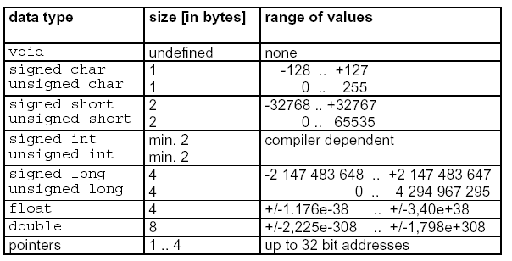
ANSI C –Data Types
Why C?
ANSI C
Introduction
Identifiers
Data Types
Expressions
Program flow
Arrays & Pointers
Functions
Preprocessor
Data types:
The Embedded
Difference
Examples

Slide 37
ANSI C –Data Types
Why C?
ANSI C
Introduction
Identifiers
Data Types
Expressions
Program flow
Arrays & Pointers
Functions
Preprocessor
Data encapsulation - struct
  encapsulates several data of different types that belong to the same object
  support the meaningful grouping of program data
  Syntax:
struct [struct_name]
{
data_type1 ivar_list1;
data_type2 ivar_list2;
...
} [svar_list];
The Embedded
Difference
Examples

Slide 38
ANSI C –Data Types
Why C?
ANSI C
Introduction
Identifiers
Data Types
Expressions
Program flow
Arrays & Pointers
Functions
Preprocessor
Data encapsulation - struct
  Example: a structured type for the number shown by an LED display
      struct Display_tag
      {
      int DisplaySelected;
      int hundreds;
      int tens;
      int ones;
      char AorP;
      };
The Embedded
Difference
Examples

Slide 39
ANSI C –Data Types
Why C?
ANSI C
Introduction
Identifiers
Data Types
Expressions
Program flow
Arrays & Pointers
Functions
Preprocessor
Data encapsulation - struct
  Example (contd.): the compiler allocates no memory for the structure declaration itself because it is used solely as a template for variable declarations. When you declare a variable for a structure, the compiler will allocate an appropriate block of memory:
  struct Display_tag CurrentTime;
  You must repeat the keyword struct because Display_tag is not a valid data type, it is a structure tag
The Embedded
Difference
Examples

Slide 40
ANSI C –Data Types
Why C?
ANSI C
Introduction
Identifiers
Data Types
Expressions
Program flow
Arrays & Pointers
Functions
Preprocessor
Data encapsulation – struct
  The access to a member of the structure is performed with the dot operator ”.” and the structure pointer operator, “->”
  The order of the structure elements bears compiler specific consequences.
  Usually, data are aligned to even address boundaries.
The Embedded
Difference
Examples

Slide 41
ANSI C –Data Types
Why C?
ANSI C
Introduction
Identifiers
Data Types
Expressions
Program flow
Arrays & Pointers
Functions
Preprocessor
Data encapsulation – struct
  If there is a structure declaration:
struct s1
{
unsigned char cId;
unsigned int iLength;
unsigned char cMsg;
};
the compiler may reserve four, six, or even more bytes of memory, depending on the alignment
The Embedded
Difference
Examples

Slide 42
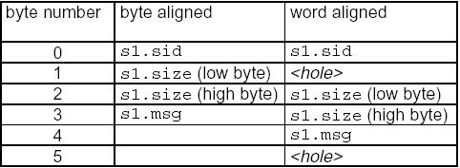
ANSI C –Data Types
Why C?
ANSI C
Introduction
Identifiers
Data Types
Expressions
Program flow
Arrays & Pointers
Functions
Preprocessor
Data encapsulation – struct
  alignment of structure members depends on the memory alignment of the system
The Embedded
Difference
Examples

Slide 43
ANSI C –Data Types
Example:
Why C?
ANSI C
Introduction
Identifiers
Data Types
Expressions
Program flow
Arrays & Pointers
Functions
Preprocessor
The Embedded
Difference
Examples

Slide 44
ANSI C –Data Types
Why C?
ANSI C
Introduction
Identifiers
Data Types
Expressions
Program flow
Arrays & Pointers
Functions
Preprocessor
Data encapsulation – union
  A union means an overlay of elements of different data types to the same memory location.
  Syntax:
union [union_name]
{
data_type1 ivar_1;
data_type2 ivar_2;
...
} [uvar_list];
The Embedded
Difference
Examples

Slide 45
ANSI C –Data Types
Why C?
ANSI C
Introduction
Identifiers
Data Types
Expressions
Program flow
Arrays & Pointers
Functions
Preprocessor
Data encapsulation – union
The size of the union is determined by the size of its biggest member element
Example:
union
{
unsigned char c[2];
long l;
} u1;
  The size of u1 is equivalent to the size of long (4 bytes). The lowest byte of u1 may now be accessed by u1.c[0] as well as by u1.l
The Embedded
Difference
Examples

Slide 46
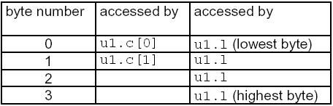
ANSI C –Data Types
Why C?
ANSI C
Introduction
Identifiers
Data Types
Expressions
Program flow
Arrays & Pointers
Functions
Preprocessor
Data encapsulation – union
Example (contd):
union
{
unsigned char c[2];
long l;
} u1;
The Embedded
Difference
Examples

Slide 47
ANSI C –Data Types
Example:
Why C?
ANSI C
Introduction
Identifiers
Data Types
Expressions
Program flow
Arrays & Pointers
Functions
Preprocessor
Data encapsulation – union
  One common use of the union type in embedded systems is to create a scratch pad variable that can hold different types of data. This saves memory by reusing one 16 bit block in every function that requires a temporary variable
The Embedded
Difference
Examples

Slide 48
ANSI C –Data Types
Why C?
ANSI C
Introduction
Identifiers
Data Types
Expressions
Program flow
Arrays & Pointers
Functions
Preprocessor
Data encapsulation – union
  Another common use for union is to facilitate access to data as different types. For example, the Microchip PIC16C74 has a 16 bit timer/counter register called TMR1 made up of two 8 bit registers called TMR1H (high byte) and TMR1L (low byte). It is possible that sometimes you would like to access the register as two 8 bit values or as one 16 bit value. A union will facilitate this type of data access:
  Example:
struct asByte
{
int TMR1H; //high byte
int TMR1L; //low byte
};
union TIMER1_tag
{
long TMR1_word; //access as 16 bit register
struct asByte TMR1_byte;
} TMR1;
The Embedded
Difference
Examples

Slide 49
ANSI C –Data Types
Why C?
ANSI C
Introduction
Identifiers
Data Types
Expressions
Program flow
Arrays & Pointers
Functions
Preprocessor
Bit fields
  offer the possibility to access single bits or groups of bits in the not bit addressable memory.
  The order of the bits can be defined with the help of the struct keyword:
struct [bitfield_name]
{
data_type1 ivar_1: n_bit_1;
data_type2 ivar_2: n_bit_2;
...
} [bitfield_list];
The Embedded
Difference
Examples

Slide 50
ANSI C –Data Types
Why C?
ANSI C
Introduction
Identifiers
Data Types
Expressions
Program flow
Arrays & Pointers
Functions
Preprocessor
Bit fields
n_bit is the size of the bit field element ivar in bits. Negative values are forbidden, values with more bits than that of the standard word width of the controller might lead to errors. A value of zero means that the current bitgroup fills up the remaining bits to the next word (=int) boundary.
Bitfields are used especially in connection with control and status registers of the periphery of microcontrollers
The ordering of the bits is compiler specific. This means that some compilers assign the LSBs to the first bits of the bit field definition, while others use the MSBs
The Embedded
Difference
Examples

Slide 51

ANSI C –Data Types
Bit fields – Example 1
struct TxIC
{
unsigned int glvl: 2;
unsigned int ilvl: 4;
unsigned int ie: 1;
unsigned int ir: 1;
unsigned int : 0;
} t7ic;
t7ic.ilvl = 12;
The compiler will assign the bits as given below:
Why C?
ANSI C
Introduction
Identifiers
Data Types
Expressions
Program flow
Arrays & Pointers
Functions
Preprocessor
The Embedded
Difference
Examples

Slide 52
ANSI C –Data Types
Bit fields – Example 2
  for the Motorola MC68HC705C8 defines the Timer Control Register (TCR) bits as bit fields in the structure called TCR
Why C?
ANSI C
Introduction
Identifiers
Data Types
Expressions
Program flow
Arrays & Pointers
Functions
Preprocessor
The Embedded
Difference
Examples

Slide 53
ANSI C –Data Types
Why C?
ANSI C
Introduction
Identifiers
Data Types
Expressions
Program flow
Arrays & Pointers
Functions
Preprocessor
Enumerated data types
  The most straightforward complex data type is the enumerated data type, declared as type enum. The enum type is used to represent a set of possible values.
    Syntax:
enum [enum_name]
{
value_1 [= ival]
[,value_2 [= ival]]
...
} [enum_list];
ival is the value that value_x shall be represented with. If not specified value_1 will be assigned 0, value_2 = 1, etc.
The Embedded
Difference
Examples

Slide 54
ANSI C –Data Types
Embedded systems
Why C?
ANSI C
Introduction
Identifiers
Numbers, Variables
Expressions
Program flow
Arrays & Pointers
Functions
Preprocessor
Embedded SW Design
Enumerated data types
Observations
    Internally, an enum variable is treated as a signed integer
    The compiler does not check the variable against the defined values of the enumeration value list
    enum variables should only be used in assignment and comparison operations
    Enumerated values can be used as if they were defined as a macro, what means that they are known at compile time and can thus be used in switch-case statements
Why C?
ANSI C
Introduction
Identifiers
Data Types
Expressions
Program flow
Arrays & Pointers
Functions
Preprocessor
The Embedded
Difference
Examples

Slide 55
ANSI C –Data Types
Enumerated data types - Examples:
    creates an enumerated type called WEEK, provides seven possible values, and declares a variable called dayOfWeek of this new enumerated type.
      enum WEEK { Su, Mo, Tu, We, Th, Fr, Sa } dayOfWeek;
    separate this process into two declarations
    enum WEEK { Mo, Tu, We, Th, Fr, Sa, Su };
    enum WEEK dayOfWeek; // WEEK is called a tag
    The tag is useful as it can represent a list of enumerated elements to declare more than one variable of that type
      enum WEEK { Su, Mo, Tu, We, Th, Fr, Sa } dayOfWeek;
  enum WEEK dayOFWeek;
  enum WEEK payDay = Th;
  enum WEEK groceryDay = Sa;
Embedded systems
Why C?
ANSI C
Introduction
Identifiers
Numbers, Variables
Expressions
Program flow
Arrays & Pointers
Functions
Preprocessor
Embedded SW Design
Why C?
ANSI C
Introduction
Identifiers
Data Types
Expressions
Program flow
Arrays & Pointers
Functions
Preprocessor
The Embedded
Difference
Examples

Slide 56
ANSI C –Data Types
Definition of private types
struct, union, and enum keywords allow both type declaration and data definition in one statement
in order to separate declaration and definition, the typedef keyword can be used
syntax:
typedef basic_type type_name;
where:
typedef “C“-keyword for data structure declaration
basic_type may be any type such as char, int, float, struct, union, enum, etc
type_name is any name allowed
Why C?
ANSI C
Introduction
Identifiers
Data Types
Expressions
Program flow
Arrays & Pointers
Functions
Preprocessor
The Embedded
Difference
Examples

Slide 57
ANSI C –Data Types
Definition of private types
Useful type definitions:
  typedef unsigned char uint8;
  typedef signed char int8;
  typedef unsigned int uint16;
  typedef signed int int16;
  typedef unsigned long uint32;
  typedef signed long int32;
the above type definitions allow writing platform- independent code
Why C?
ANSI C
Introduction
Identifiers
Data Types
Expressions
Program flow
Arrays & Pointers
Functions
Preprocessor
The Embedded
Difference
Examples

Slide 58
ANSI C –Data Types
Why C?
ANSI C
Introduction
Identifiers
Data Types
Expressions
Program flow
Arrays & Pointers
Functions
Preprocessor
Type Conversion
  Implicit type conversion
  Explicit type conversion
Implicit type conversion
  when operands of different types are combined in expressions
  the conversions are implicitly performed according to standard rules
The Embedded
Difference
Examples

Slide 59
ANSI C –Data Types
Why C?
ANSI C
Introduction
Identifiers
Data Types
Expressions
Program flow
Arrays & Pointers
Functions
Preprocessor
Type Conversion
  Implicit cast
    all char and short operands are converted to int
    if one operand is unsigned, the other operand is converted to unsigned as well
    all float operand are converted to double
    if the operand of an expression are of different types, calculations always occur with the widest type. (Width of a data type simply means the number of bytes a value occupies.
    the result of an expression is always adjusted to the type of variable the result has.
The Embedded
Difference
Examples

Slide 60
ANSI C –Data Types
Why C?
ANSI C
Introduction
Identifiers
Data Types
Expressions
Program flow
Arrays & Pointers
Functions
Preprocessor
Type Conversion
  Implicit cast – Example:
char v1;
int v2;
double v3;
v2 = v1+v3; /*expression is double, result is int*/
v1 = v2 - 2*v1;/* expression is int. The result variable is of type char. The most significant part of result is lost */
The Embedded
Difference
Examples

Slide 61
ANSI C –Data Types
Type Conversion
  Explicit cast
    to avoid hidden code which might lead to wrong results, every type conversion must be casted explicitly.
    explicit cast is expressed by writing the desired data type in parenthesis as an operator in front of them
    Example:
unsigned int i1;
char c1, c2;
c1 = (char)(i1 - (int)c2);
    /* there is a value range reduction by casting the expression as char */
Why C?
ANSI C
Introduction
Identifiers
Data Types
Expressions
Program flow
Arrays & Pointers
Functions
Preprocessor
The Embedded
Difference
Examples

Slide 62
ANSI C – Assignment, Expression, Operators
Why C?
ANSI C
Introduction
Identifiers
Data Types
Expressions
Program flow
Arrays & Pointers
Functions
Preprocessor
Variable assignment
Simple variable assignment
variable = expression;
variable - defined or declared memory location
= assignment operator
expression - constituted from one more operands and operator
; end of statement
Multiple variable assignment
var_1 = var_2 = [=…] = expression;
Assigns the same value to multiple variables
The Embedded
Difference
Examples

Slide 63
ANSI C – Assignment, Expression, Operators
Why C?
ANSI C
Introduction
Identifiers
Data Types
Expressions
Program flow
Arrays & Pointers
Functions
Preprocessor
Expressions
[unary operator] operand [binary operator][operand][…];
unary operator: concern a single operand only
+ positive sign
- negative sign
++ increment
-- decrement
& address of
* indirection
sizeof(name) size of name in byte
(type cast) explicit type casting
! logical negation
~ bit by bit inversion
The Embedded
Difference
Examples

Slide 64
ANSI C – Assignment, Expression, Operators
Why C?
ANSI C
Introduction
Identifiers
Data Types
Expressions
Program flow
Arrays & Pointers
Functions
Preprocessor
Binary operators
performs a two operand operation
arithmetic operators
+ sum
- difference
* multiplication
/ division
% modulo operation
comparison operators
< less than
<= less or equal
> greater than
>= greater or equal
== equivalence
!= not equal
&& logical AND
|| logical OR
The Embedded
Difference
Examples

Slide 65
ANSI C – Assignment, Expression, Operators
Why C?
ANSI C
Introduction
Identifiers
Data Types
Expressions
Program flow
Arrays & Pointers
Functions
Preprocessor
Binary operators
bit-by-bit operations
& AND
| OR
^ XOR (exclusive OR)
<< shift left
>> shift right
compound assignment operators
+= -= *= /= %=
<<= >>= &= |= ^=
& | 0 | 1
0 | 0 | 0
1 | 0 | 1
| | 0 | 1
0 | 0 | 1
1 | 1 | 1
The Embedded
Difference
Examples
^ | 0 | 1
0 | 0 | 1
1 | 1 | 0

Slide 66
ANSI C – Assignment, Expression, Operators
Why C?
ANSI C
Introduction
Identifiers
Data Types
Expressions
Program flow
Arrays & Pointers
Functions
Preprocessor
Binary operators. Bitwise (bit-by-bit) operations
& is often used to clear one or more bits of an integral variable to 0.
PTH = PTH & 0xBD // clears bit 6 and bit 1 of PTH to 0
// PTH is of type char
| is often used to set one or more bits to 1
PTB = PTB | 0x40; // sets bit 6 to 1 (PTB is of type char)
^ can be used to toggle a bit.
abc = abc ^ 0xF0; // toggles upper four bits (abc is of type char)
The Embedded
Difference
Examples

Slide 67
ANSI C – Assignment, Expression, Operators
Binary operators. Bitwise (bit-by-bit) operations
>> can be used to shift the involved operand to the right for the specified number of places. For unsigned numbers, the bit positions that have been vacated by the shift operation are zero-filled. For signed numbers, the sign bit is used to fill the vacated bit positions. In other words, if the number is positive, 0 is used, and if the number is negative, 1 is used
xyz = xyz >> 3; -- shift right 3 places
<< can be used to shift the involved operand to the left for the specified number of places. The bit positions that have been vacated by the shift operation are zero-filled.
xyz = xyz << 4; -- shift left 4 places
The assignment operator = is often combined with the operator. For example,
  PTH &= 0xBD;
  PTB |= 0x40;
  xyz >>= 3;
  xyz <<= 4;
Why C?
ANSI C
Introduction
Identifiers
Data Types
Expressions
Program flow
Arrays & Pointers
Functions
Preprocessor
The Embedded
Difference
Examples

Slide 68
ANSI C – Assignment, Expression, Operators
Why C?
ANSI C
Introduction
Identifiers
Data Types
Expressions
Program flow
Arrays & Pointers
Functions
Preprocessor
Binary operators. Bitwise (bit-by-bit) operations
multiplication and divisions can be avoided for operands of value 2x, what results in a faster code.
Example:
1. z = x * 2; => z = x << 1;
2. z = x / 2; => z = x >> 1;
there is no overflow checking mechanism available!
The Embedded
Difference
Examples

Slide 69
ANSI C – Assignment, Expression, Operators
Why C?
ANSI C
Introduction
Identifiers
Data Types
Expressions
Program flow
Arrays & Pointers
Functions
Preprocessor
Comparison operators
if (!(ATD0STAT0 & 0x80))
statement₁; // if bit 7 is 0, then execute statement₁
if (i > 0 && i < 10)
statement₂; // if 0 < i < 10 then execute statement₂
if (a1 == a2)
statement₃; // if a1 == a2 then execute statement₃
The Embedded
Difference
Examples

Slide 70
ANSI C – Assignment, Expression, Operators
Why C?
ANSI C
Introduction
Identifiers
Data Types
Expressions
Program flow
Arrays & Pointers
Functions
Preprocessor
Expressions
ternary operator: performs a three operand operation
? : conditional
operand:
constant
variable
pointer
return value of a function
The Embedded
Difference
Examples

Slide 71
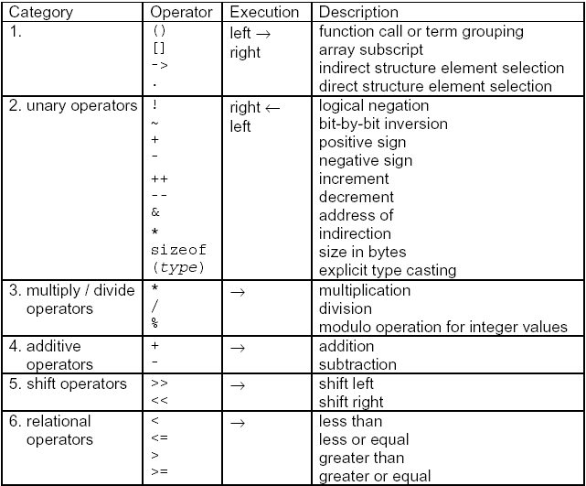
ANSI C – Assignment, Expression, Operators
Operator’s Hierarchy
Why C?
ANSI C
Introduction
Identifiers
Data Types
Expressions
Program flow
Arrays & Pointers
Functions
Preprocessor
The Embedded
Difference
Examples

Slide 72
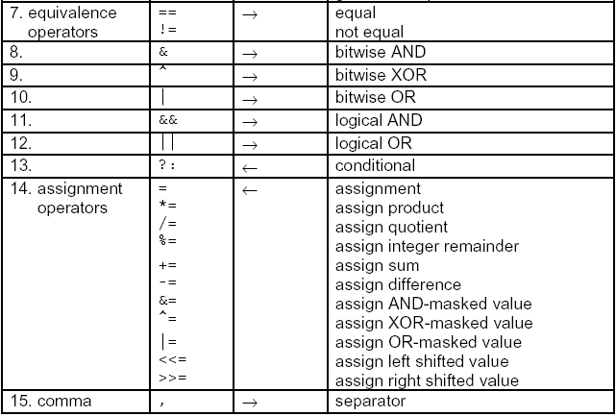
ANSI C – Assignment, Expression, Operators
Operator’s Hierarchy
Why C?
ANSI C
Introduction
Identifiers
Data Types
Expressions
Program flow
Arrays & Pointers
Functions
Preprocessor
The Embedded
Difference
Examples

Slide 73
ANSI C – Assignment, Expression, Operators
Why C?
ANSI C
Introduction
Identifiers
Data Types
Expressions
Program flow
Arrays & Pointers
Functions
Preprocessor
Operators
Examples:
  Incrementing before the calculated value is used: x=++n;
  Incrementing after the calculated value is used: x=n++;
  ++n && ++i
  If n evaluates to 0, ++i is not executed any more.
  x = ++ (x+y); x = 10++ not allowed
The Embedded
Difference
Examples

Slide 74
ANSI C – Assignment, Expression, Operators
Why C?
ANSI C
Introduction
Identifiers
Data Types
Expressions
Program flow
Arrays & Pointers
Functions
Preprocessor
Operators
Examples:
  x = x | MASK; all bits of x which are set in MASK are set
  n = ~ n; negation of bits
  res = status & (~1); clear the bit 0
The Embedded
Difference
Examples

Slide 75
ANSI C – Assignment, Expression, Operators
Why C?
ANSI C
Introduction
Identifiers
Data Types
Expressions
Program flow
Arrays & Pointers
Functions
Preprocessor
Operators
Increment and decrement operators can be used in prefix or postfix notation. They must not be used for expressions.
An increment/decrement of pointers is type specific
Example:
long *i_ptr = 0x100;
i_ptr++; // i_ptr points to 0x104
The Embedded
Difference
Examples

Slide 76
ANSI C – Assignment, Expression, Operators
Why C?
ANSI C
Introduction
Identifiers
Data Types
Expressions
Program flow
Arrays & Pointers
Functions
Preprocessor
Operators
The order of unary operations is important as this may affect the result.
Example:
unsigned char a = 0x7f; unsigned int b1, b2;
b1 = (unsigned int)~a; // b1 = 0x0080;
b2 = ~(unsigned int)a; // b2 = 0xff80;
The Embedded
Difference
Examples

Slide 77
ANSI C – Assignment, Expression, Operators
Why C?
ANSI C
Introduction
Identifiers
Data Types
Expressions
Program flow
Arrays & Pointers
Functions
Preprocessor
Operators
The modulo operation works for integer-by-integer divisions only. It returns the integer remainder.
Instead of the conditional operator, an if-...construct should be used,
Example:
x = (a ? 1 : 0); should be replaced by
if (a) x=1;
else x=0;
The Embedded
Difference
Examples

Slide 78
ANSI C – Assignment, Expression, Operators
Why C?
ANSI C
Introduction
Identifiers
Data Types
Expressions
Program flow
Arrays & Pointers
Functions
Preprocessor
Logical expressions
It is rare for logical values to be stored in variables
They are usually generated as required by comparing two numeric values
they are evaluated from the left to the right
in order to reduce calculation time, put to the first place the most unlike condition in an AND connection (&&) and the most probable condition in an OR connection (||).
The Embedded
Difference
Examples

Slide 79
Program Flow Statements
Why C?
ANSI C
Introduction
Identifiers
Data Types
Expressions
Program flow
Arrays & Pointers
Functions
Preprocessor
Sequences
Single Branching: The “if“-Statement
Double Branching: The “if-else“-Statement
Multiple Branching: The “switch - case“-Statement
Loop with Testing in the Beginning: The “while“-Statement
Indexed Loop with Testing in the Beginning: The “for“-Statement
Loop with Testing in the End: The “do - while“-Statement
Other Program Flow Statements: continue, break, goto
The Embedded
Difference
Examples

Slide 80
Program Flow Statements
Why C?
ANSI C
Introduction
Identifiers
Data Types
Expressions
Program flow
Arrays & Pointers
Functions
Preprocessor
Single Branching: The “if“-Statement
if ( expression )
sequence
Only if the boolean expression in parenthesis evaluates to logical TRUE, the sequence will be executed
To compare an unsigned int variable with unlike 0 the following syntax should be preferred :
if (var != 0) or if (var) instead of if (var>0)
The Embedded
Difference
Examples

Slide 81
Program Flow Statements
Why C?
ANSI C
Introduction
Identifiers
Data Types
Expressions
Program flow
Arrays & Pointers
Functions
Preprocessor
Double Branching: The “if-else“-Statement
if ( expression )
sequence_1
else
sequence_2
the expression should be formulated so that the most probable result is TRUE. Then, most often the branch to sequence_2 may not be taken, which results in a shorter program execution time.
encapsulation of several “if - else“ statements can be avoided by using boolean algebra:
if ( expression_1 || ( expression_2 && expression_3) )
sequence_1
The Embedded
Difference
Examples

Slide 82
Program Flow Statements
Why C?
ANSI C
Introduction
Identifiers
Data Types
Expressions
Program flow
Arrays & Pointers
Functions
Preprocessor
Multiple Branching: The “switch - case“-Statement
switch ( expression )
{
case const_expression_1: statement_1; break;
...
case const_expression_n: statement_n; break;
default: statement_n+1; break;
}
expression will be evaluated. The result is of type int or unsigned int
The Embedded
Difference
Examples

Slide 83
Program Flow Statements
Why C?
ANSI C
Introduction
Identifiers
Data Types
Expressions
Program flow
Arrays & Pointers
Functions
Preprocessor
Multiple Branching: The “switch - case“-Statement
const_expression must be a constant value which is known at compile time. If the expression in parenthesis matches the const_expression, the subsequent statements are evaluated up to the next break statement respectively the end of the block.
The order of the constant expressions should be chosen according to the plausibility of their occurrence for runtime reasons.
The Embedded
Difference
Examples

Slide 84
Program Flow Statements
Why C?
ANSI C
Introduction
Identifiers
Data Types
Expressions
Program flow
Arrays & Pointers
Functions
Preprocessor
Multiple Branching: The “switch - case“-Statement
break “C“-keyword that causes leaving the actual block. Every case should have a break statement.
default is a predefined label for all cases that do not match any of the other constant expressions in the block. In ANSI-“C“ it may be missing, which however means a bad programming style.
put the cases in the order according to their probability because the compiler sometimes generates an assembly code which rather reflects an if … elseif ... else structure, especially if only few cases are given
The Embedded
Difference
Examples

Slide 85
Program Flow Statements
Why C?
ANSI C
Introduction
Identifiers
Data Types
Expressions
Program flow
Arrays & Pointers
Functions
Preprocessor
The “while“-Statement
while ( expression )
sequence
The condition given by expression is evaluated first. Only if the result is TRUE the sequence is executed. It will be repeated as long as the expression is TRUE.
Potentially endless loops must be equipped with a software watchdog:
while (*int_ptr <= TopValue && special_exit == 0);
The Embedded
Difference
Examples

Slide 86
Program Flow Statements
Why C?
ANSI C
Introduction
Identifiers
Data Types
Expressions
Program flow
Arrays & Pointers
Functions
Preprocessor
The “for“-Statement
for ( [init_list] ; [expression]; [continue_list] )
sequence
init_list is a list of statements separated by commas which will be executed unconditionally in advance of the loop.
expression results in a boolean value TRUE or FALSE. As long as it is TRUE, the sequence is executed, followed by the statements of the continue_list.
continue_list is a list of statements separated by commas which are evaluated as long as the expression is TRUE.
The Embedded
Difference
Examples

Slide 87
Program Flow Statements
Why C?
ANSI C
Introduction
Identifiers
Data Types
Expressions
Program flow
Arrays & Pointers
Functions
Preprocessor
The “for“-Statement
The loop control variable must only be changed in the continue_list but nowhere else.
Likewise, the loop exit condition must only be checked in the expression.
To compare a decreasing local counter with unlike 0 the following syntax should be used:
for (i = 10; i > 0; i--) instead of for (i = 10; i != 0; i--)
The Embedded
Difference
Examples

Slide 88
Program Flow Statements
Why C?
ANSI C
Introduction
Identifiers
Data Types
Expressions
Program flow
Arrays & Pointers
Functions
Preprocessor
The “do - while“-Statement
do
sequence
while ( expression );
The sequence is executed at least once. After that the expression is evaluated, and the sequence is repeated as long as it’s result is TRUE.
The Embedded
Difference
Examples

Slide 89
Program Flow Statements
Why C?
ANSI C
Introduction
Identifiers
Data Types
Expressions
Program flow
Arrays & Pointers
Functions
Preprocessor
Other Program Flow Statements
goto
continue
break
goto must and the other two instructions should be avoided as they lead to an ill structured program flow
goto causes the program to continue at the label which is defined at any other place in the program by a subsequent colon.
The Embedded
Difference
Examples

Slide 90
Program Flow Statements
Why C?
ANSI C
Introduction
Identifiers
Data Types
Expressions
Program flow
Arrays & Pointers
Functions
Preprocessor
Other Program Flow Statements
continue is used in loop constructs and means a shortcut to continue with testing the next loop condition. Therefore, the statements following the continue statement won’t be executed.
break statement causes the program to continue at the next label outside the current block. It should be used in connection with switch - case constructs but not otherwise.
The Embedded
Difference
Examples

Slide 91
Arrays, Pointers
Why C?
ANSI C
Introduction
Identifiers
Data Types
Expressions
Program flow
Arrays & Pointers
Functions
Preprocessor
Arrays
Pointers
  Pointers scaling
  Pointers and Function Arguments
  Pointers and Arrays
  Pointers vs.. Multi-dimensional Arrays
Functions
  Function Header
  Function Body
  Calling a function
The Embedded
Difference
Examples

Slide 92
Arrays, Pointers
Why C?
ANSI C
Introduction
Identifiers
Data Types
Expressions
Program flow
Arrays & Pointers
Functions
Preprocessor
Arrays
Encapsulate multiple elements of a single data type with one variable name.
No checking mechanism for the boundaries
Index must be of an unsigned type
Data are contiguously allocated
Array Declaration:
<type> <name> [<size>];
The Embedded
Difference
Examples

Slide 93
Arrays, Pointers
Why C?
ANSI C
Introduction
Identifiers
Data Types
Expressions
Program flow
Arrays & Pointers
Functions
Preprocessor
Arrays
type could be any type;
size is mandatory: it's the maximal number of elements in the array
The declaration is going to allocate enough bytes for the whole array
Array could be initialized when declaring :
  <type> <name> [<optional size>] = { <value list> }
in this case, the size is optional (if the size is not given, the size of the array is set to the number of element in the declaration list)
The Embedded
Difference
Examples

Slide 94
Arrays, Pointers
Why C?
ANSI C
Introduction
Identifiers
Data Types
Expressions
Program flow
Arrays & Pointers
Functions
Preprocessor
Arrays
Examples:
  int t [4] ;
  int j [] = {1, 2, 3 } ; /* size 3 */
  int k [5] = {1,2}; /* other elements are initialized to 0 */
  float t[2][3] = {{2.3, 4.6, 7.2}, {4.9, 5.1, 9.3}};
  int l [2] = {1, 2, 3 } ; /* Incorrect */
  char vocals[5] = {‘a’, ‘e’, ‘i’, ‘o’, ‘u’ };
  char string[] = “This is a string”;
The Embedded
Difference
Examples

Slide 95
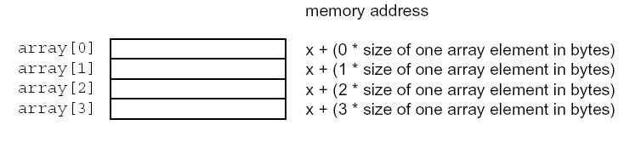
Arrays, Pointers
Why C?
ANSI C
Introduction
Identifiers
Data Types
Expressions
Program flow
Arrays & Pointers
Functions
Preprocessor
Arrays
The access to an element of the array is done with the index between brackets
Example: r = a [i] + b [j];
The first element of the array is 0 (zero-based index)
The Embedded
Difference
Examples

Slide 96
Arrays, Pointers
Why C?
ANSI C
Introduction
Identifiers
Data Types
Expressions
Program flow
Arrays & Pointers
Functions
Preprocessor
Pointers
Are variables that contain the address of an object (variable or function).
Enable indirect access to an object.
Are defined with the dereference operator (*)
Definition:
type * pointer_name;
type is the type of the object the pointer points to.
pointer_name is a free chosable name of the pointer.
The Embedded
Difference
Examples

Slide 97
Arrays, Pointers
Why C?
ANSI C
Introduction
Identifiers
Data Types
Expressions
Program flow
Arrays & Pointers
Functions
Preprocessor
Pointers
unsigned u16Val;
unsigned *p = &u16Val;
….
p is 0x0186 (address of u16Val)
*p is 0x55AA; (value located at address 0x0186, the value of u16Val)
The Embedded
Difference
Examples

Slide 98
Arrays, Pointers
Why C?
ANSI C
Introduction
Identifiers
Data Types
Expressions
Program flow
Arrays & Pointers
Functions
Preprocessor
Pointers
A pointer can take the value of another pointer, an address of an object with “address-of” operator &, or a pointer expression
char *p ; int *q;
char a; int b;
p = &a; /*correct*/
p = &b; /* incorrect */
q = &a; /* incorrect */
q= &b ; /* correct */
p = &q; /* address of the pointer */
The Embedded
Difference
Examples

Slide 99
Arrays, Pointers
Why C?
ANSI C
Introduction
Identifiers
Data Types
Expressions
Program flow
Arrays & Pointers
Functions
Preprocessor
Pointers
Const keyword can be used in pointer declarations.
Example:
int a;
int *p;
int *const ptr = &a; // Constant pointer
*ptr = 1; // Legal
ptr =p; // Error
The Embedded
Difference
Examples

Slide 100
Arrays, Pointers
Why C?
ANSI C
Introduction
Identifiers
Data Types
Expressions
Program flow
Arrays & Pointers
Functions
Preprocessor
Pointers
A pointer to a variable declared as const can only be assigned to a pointer that is also declared as const.
Example:
int a; int *p; const int *q;
const int *ptr = &a; // Pointer to constant data
*ptr = 1; // Error
ptr =p; // Error
ptr =q; // Legal
The Embedded
Difference
Examples

Slide 101
Arrays, Pointers
Why C?
ANSI C
Introduction
Identifiers
Data Types
Expressions
Program flow
Arrays & Pointers
Functions
Preprocessor
Pointers scaling
The type of the object a pointer points to serves the compiler as a basis for relative address calculations using pointer addition, subtraction, increment, and decrement.
The Embedded
Difference
Examples

Slide 102
Arrays, Pointers
Why C?
ANSI C
Introduction
Identifiers
Data Types
Expressions
Program flow
Arrays & Pointers
Functions
Preprocessor
Pointers scaling
Example:
long *sl_ptr = 0x4000;
char *sc_ptr;
sc_ptr++ = (char *)(sl_ptr + 2);
will result in
tmp = sl_ptr + 2*sizeof(long)
= 0x4000 + 2*4
= 0x4008 => sc_ptr
sc_ptr++ = 0x4008 + 1*sizeof(char)
= 0x4008 + 1*1
= 0x4009 => sc_ptr
The Embedded
Difference
Examples

Slide 103
Arrays, Pointers
Why C?
ANSI C
Introduction
Identifiers
Data Types
Expressions
Program flow
Arrays & Pointers
Functions
Preprocessor
Pointers and Function Arguments
Pointer arguments enable a function to access and change objects in the function that called it. For instance, a sorting routine might exchange two out-of-order elements with a function called swap:
swap(&a, &b);
Since the operator & produces the address of a variable, &a is a pointer to a.
the parameters are declared to be pointers, and the operands are accessed indirectly through them.
The Embedded
Difference
Examples

Slide 104
Arrays, Pointers
Why C?
ANSI C
Introduction
Identifiers
Data Types
Expressions
Program flow
Arrays & Pointers
Functions
Preprocessor
Pointers and Function Arguments
void swap(int *px, int *py) /* interchange *px and *py */
{
int temp;
temp = *px;
*px = *py;
*py = temp;
}
The Embedded
Difference
Examples

Slide 105
Arrays, Pointers
Why C?
ANSI C
Introduction
Identifiers
Data Types
Expressions
Program flow
Arrays & Pointers
Functions
Preprocessor
Pointers and Arrays
Any operation which can be achieved by array subscripting can also be done with pointers.
The pointer version will in general be faster
The declaration
int a[10]
defines an array a of size 10, that is a block of 10 consecutive objects named a[0], a[1], ..., a[9].
The Embedded
Difference
Examples

Slide 106
Arrays, Pointers
Why C?
ANSI C
Introduction
Identifiers
Data Types
Expressions
Program flow
Arrays & Pointers
Functions
Preprocessor
Pointers and Arrays
The notation a[i] refers to the i-th element of the array If pa is a pointer to an integer, declared as
int *pa
then the assignment
pa = &a[0];
sets pa to point to element zero of a:
pa contains the address of a[0].
Now the assignment x = *pa will copy the contents of a[0] into x.
The Embedded
Difference
Examples

Slide 107
Arrays, Pointers
Why C?
ANSI C
Introduction
Identifiers
Data Types
Expressions
Program flow
Arrays & Pointers
Functions
Preprocessor
Pointers and Arrays
If pa points to a particular element of an array, then by definition:
  pa+1 points to the next element, pa-i points i elements before pa, and
  pa+i points i elements after.
Thus, if pa points to a[0], then *(pa+1)
refers to the contents of a[1], pa+1 is the address of a[i], and *(pa+i) is the contents of a[i].
The Embedded
Difference
Examples

Slide 108
Arrays, Pointers
Why C?
ANSI C
Introduction
Identifiers
Data Types
Expressions
Program flow
Arrays & Pointers
Functions
Preprocessor
Pointers and Arrays
By definition, the value of a variable or expression of type array is the address of element zero of the array. Thus after the assignment
pa = &a[0]
pa and a have identical values
The assignment pa=&a[0] can also be written as pa = a;
The Embedded
Difference
Examples

Slide 109
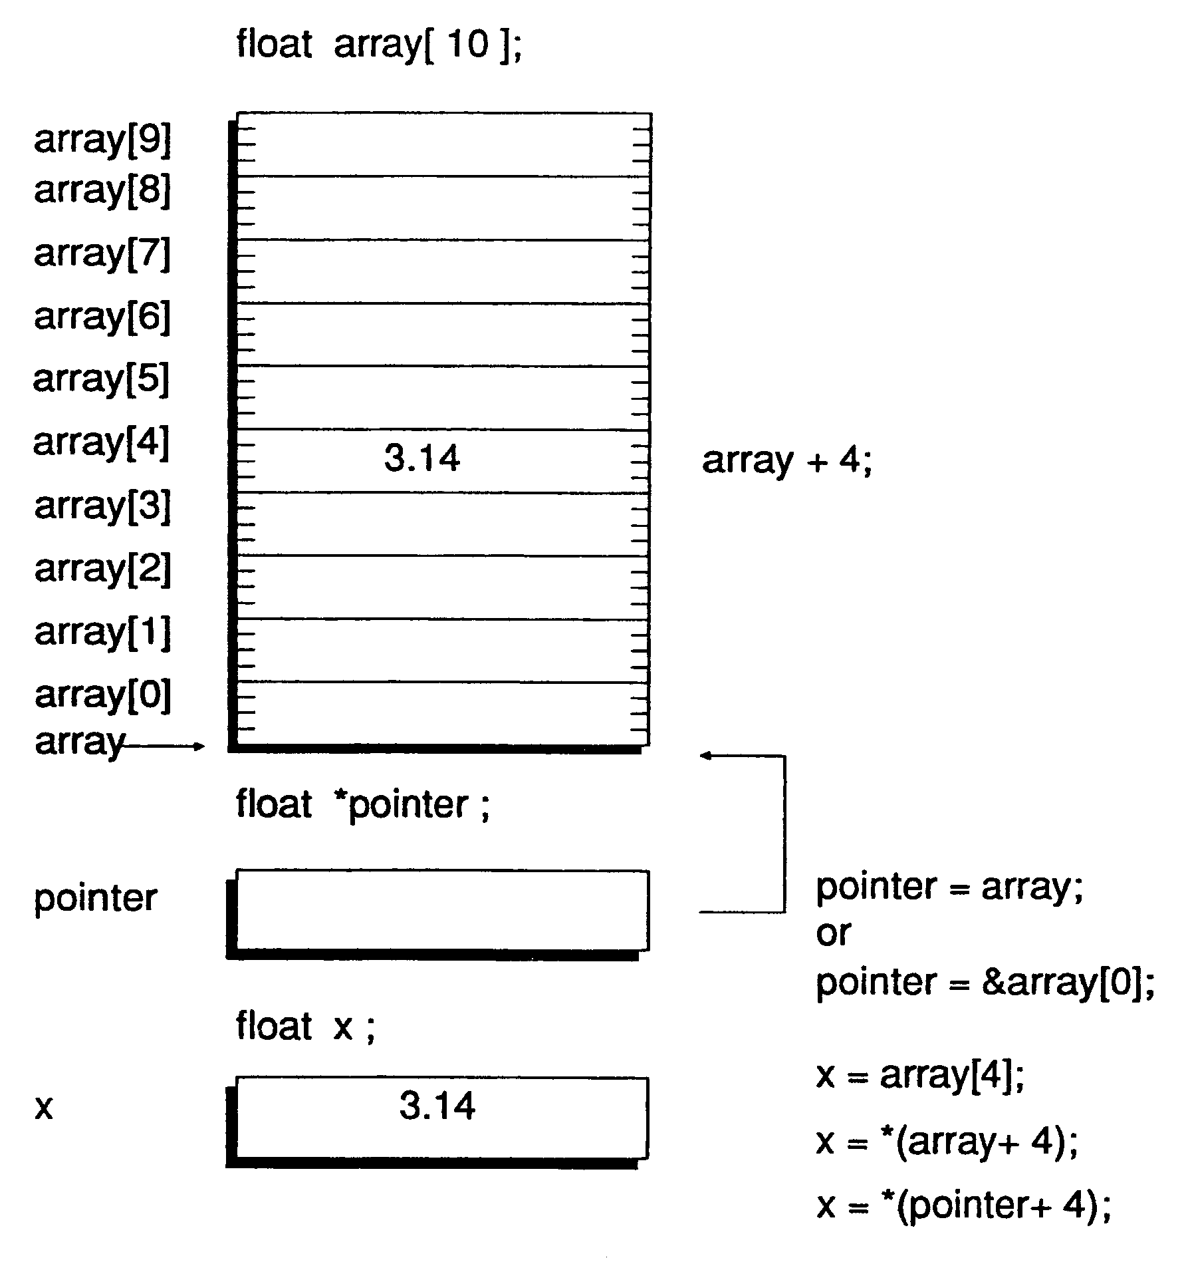
Arrays, Pointers
Pointers and Arrays
Why C?
ANSI C
Introduction
Identifiers
Data Types
Expressions
Program flow
Arrays & Pointers
Functions
Preprocessor
The Embedded
Difference
Examples

Slide 110
Arrays, Pointers
Why C?
ANSI C
Introduction
Identifiers
Data Types
Expressions
Program flow
Arrays & Pointers
Functions
Preprocessor
Arrays of Pointers
  The most common use for an array of pointers is to use an array of pointers to type char which are pointed to strings. This technique can be used to send messages to a screen.
the array is declared in main but the array is passed to a function where the values of the pointers are assigned
(about functions – a little bit later ☺)
The Embedded
Difference
Examples

Slide 111
Arrays, Pointers
Why C?
ANSI C
Introduction
Identifiers
Data Types
Expressions
Program flow
Arrays & Pointers
Functions
Preprocessor
Pointers vs. Multi-dimensional Arrays
Given the declarations
int a[10] [20];
int *b[10];
Array a is a true two-dimensional: 200 int-sized locations have been set aside, and the calculation 20xrow+col is used to find the element a[row,col]
For b, the definition only allocates 10 pointers and does not initialize them; initialization must be done explicitly, either syntactically or with code.
The Embedded
Difference
Examples

Slide 112
Arrays, Pointers
Why C?
ANSI C
Introduction
Identifiers
Data Types
Expressions
Program flow
Arrays & Pointers
Functions
Preprocessor
Pointers vs. Multi-dimensional Arrays
char array [3][12] = {“The Course\n”,
“is\n”,
“boring\n”};
array[2]
array[1]
array[0]
b | o | r | i | n | g | \n | \0
i | s | \n | \0
T | h | e |  | C | o | u | r | s | e | \n | \0
The Embedded
Difference
Examples

Slide 113
Arrays, Pointers
Why C?
ANSI C
Introduction
Identifiers
Data Types
Expressions
Program flow
Arrays & Pointers
Functions
Preprocessor
Pointers vs. Multi-dimensional Arrays
char *array[] = {“The Course\n”,
“is\n”,
“boring\n”};
array[2]
array[1]
array[0]
b | o | r | i | n | g | \n | \0
i | s | \n | \0
The Embedded
Difference
Examples
T | h | e |  | C | o | u | r | s | e | \n | \0
Advantage of the pointer array is that the rows of the array may be of different lengths. That is, each element of b need not point to a twenty-element vector; some may point to two elements, some to fifty, and some to none at all

Slide 114
Arrays, Pointers
Why C?
ANSI C
Introduction
Identifiers
Data Types
Expressions
Program flow
Arrays & Pointers
Functions
Preprocessor
Pointer to Strings
C does not know string, only arrays of characters.
for the processing of strings, (searching, comparing, copying), standard routines exist.
to be able to use subprograms, pointers to strings are used when passing parameters. The whole processing of strings relies on the use of pointers
The Embedded
Difference
Examples

Slide 115
Arrays, Pointers
Why C?
ANSI C
Introduction
Identifiers
Data Types
Expressions
Program flow
Arrays & Pointers
Functions
Preprocessor
Pointer to Strings
the incrementing of a pointer on characters shifts the pointer to the next valid element of the string.
char *text, character;
text = “C - tutorial”;
character = *(text+4);
The Embedded
Difference
Examples

Slide 116
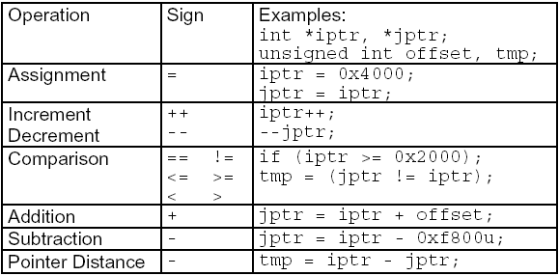
Arrays, Pointers
Why C?
ANSI C
Introduction
Identifiers
Data Types
Expressions
Program flow
Arrays & Pointers
Functions
Preprocessor
Pointers
only a small selection of operations are defined for pointers:
The Embedded
Difference
Examples

Slide 117
Functions
Why C?
ANSI C
Introduction
Identifiers
Data Types
Expressions
Program flow
Arrays & Pointers
Functions
Preprocessor
Functions
A function is defined by
  a header (name, type, formal parameters)
  a body
A function has
  a scalar type (char, int, long or pointer) : actual function
  void type : procedure
non void functions have a result
void functions do not return any result
The Embedded
Difference
Examples

Slide 118
Functions
Why C?
ANSI C
Introduction
Identifiers
Data Types
Expressions
Program flow
Arrays & Pointers
Functions
Preprocessor
Functions
Function Header
Syntax:
<visibility<type><name>(<parameters list>)
Type
void for procedure
scalar type (default int)
Visibility
static modifier used to hide the function
The Embedded
Difference
Examples

Slide 119
Functions
Why C?
ANSI C
Introduction
Identifiers
Data Types
Expressions
Program flow
Arrays & Pointers
Functions
Preprocessor
Functions - Function Header
Parameter types:
input parameters (or value parameters): when calling the function, the caller copies a value in each input parameter. The const keyword could be used to declare those parameters as constant (optional)
input-output parameters (or address parameters): when calling the function, the caller gives the address of a variable to the formal parameter. Those parameters are marked with the dereference, *, operator
The Embedded
Difference
Examples

Slide 120
Functions
Why C?
ANSI C
Introduction
Identifiers
Data Types
Expressions
Program flow
Arrays & Pointers
Functions
Preprocessor
Functions - Function Header
Examples of headers :
a function f which has an input parameter x and return an integer value
int f (const int x);
int f (int x);
a function f which has an input parameter x and an input-output parameter y and return an integer value.
int f (int x, int *y);
The Embedded
Difference
Examples

Slide 121
Functions
Why C?
ANSI C
Introduction
Identifiers
Data Types
Expressions
Program flow
Arrays & Pointers
Functions
Preprocessor
Functions - Function Body
Delimited by { and }
Allows local declarations
  Automatic data – located on the stack
  Static data – located in global memory
If type is not void, the function includes a return statement which affects the result
the return exits the function
Input parameters are used as they have been declared
Output parameters are used using the * operator
The Embedded
Difference
Examples

Slide 122
Functions
Why C?
ANSI C
Introduction
Identifiers
Data Types
Expressions
Program flow
Arrays & Pointers
Functions
Preprocessor
Functions - Calling a function
The call of a function is done using the name of the function, and with a list of actual parameters
parenthesis are mandatory, even if no parameter is required
input parameters accept expression of same type
input-output parameters require the address of a variable. The address of a variable is given by the operator &
The Embedded
Difference
Examples

Slide 123
Functions
Why C?
ANSI C
Introduction
Identifiers
Data Types
Expressions
Program flow
Arrays & Pointers
Functions
Preprocessor
Functions – Example: Function with input parameter :
int f (int x)
  {
  return x+1 ;
  }
Calling:
  int a;
  const b = 14 ;
  int r;
  a=3;
  r = f (a) ; /* r is set to 4 */
  r = f(b+r-1) /* r is set to 18 */
The Embedded
Difference
Examples

Slide 124
Functions
Why C?
ANSI C
Introduction
Identifiers
Data Types
Expressions
Program flow
Arrays & Pointers
Functions
Preprocessor
Functions – Example: Function with input-output parameter:
void g (int *y, int x)
  {
  *y = x+1 ;
  }
Calling:
  int a; const b = 14 ; int r;
  a=3;
  g(&r,a) ; /* r is set to 4 */
  g(&r,b+r-1) /* r is set to 18*/
  g(r,a) ; /* incorrect, protection fault */
The Embedded
Difference
Examples

Slide 125
Functions
Why C?
ANSI C
Introduction
Identifiers
Data Types
Expressions
Program flow
Arrays & Pointers
Functions
Preprocessor
Functions – Example: Function bad example:
Function with input parameter as an output parameter
  void g (int y, const int x)
  {
  y = x+1 ;
  }
Calling:
  int a; const b = 14 ; int r;
  r=0;
  a=3;
  g(r,a) ; /* r is not affected */
  g(&r,a) ; /* compilation error */
The Embedded
Difference
Examples

Slide 126
Functions
Why C?
ANSI C
Introduction
Identifiers
Data Types
Expressions
Program flow
Arrays & Pointers
Functions
Preprocessor
Pointer to Functions
The address of a function can be assigned to a pointer variable
a function can also be passed as a parameter
the call happens with the aid of the dereferencing operator “*”
The Embedded
Difference
Examples

Slide 127
Functions
Why C?
ANSI C
Introduction
Identifiers
Data Types
Expressions
Program flow
Arrays & Pointers
Functions
Preprocessor
Pointer to Functions
type (*name)();
void sort(char *v[], int n, int (*comp)())
{
…
  int comp_res;
comp_res = (*comp)();
  ...
}
int main()
{
extern int strcmp(), numcmp();
…
if(numerical)
sort(lineptr, nlines, numcmp);
else
sort(lineptr, nlines, strcmp);
}
The Embedded
Difference
Examples

Slide 128
Functions
Why C?
ANSI C
Introduction
Identifiers
Data Types
Expressions
Program flow
Arrays & Pointers
Functions
Preprocessor
Creating Header File
To reuse functions that we have created, we can collect the set of functions that are of the same nature into one file and also put the prototype declarations of these functions into one header file.
When reusing these functions, we need to add the C file that contains them into the project and also add the header file into the file that invoke these functions.
The Embedded
Difference
Examples

Slide 129
Preprocessor directives
Why C?
ANSI C
Introduction
Identifiers
Data Types
Expressions
Program flow
Arrays & Pointers
Functions
Preprocessor
Macro definition
File inclusion
Conditional compilation
Memory model
The Embedded
Difference
Examples

Slide 130
Preprocessor directives
Why C?
ANSI C
Introduction
Identifiers
Data Types
Expressions
Program flow
Arrays & Pointers
Functions
Preprocessor
preprocessing is scheduled before compilation process
It mainly consist in a text analyzing and processing tool. The produced file is used as input for compilation process
the goal: flexible software for different application parameters and different software development tools
preprocessor directives always start with # character in the first column line
The Embedded
Difference
Examples

Slide 131
Preprocessor directives
Why C?
ANSI C
Introduction
Identifiers
Data Types
Expressions
Program flow
Arrays & Pointers
Functions
Preprocessor
#define
  introduces the definition of a preprocessor macro
#undef
  clears a preprocessor macro definition
#include
  includes the source text of another file
#if
  evaluates an expression for conditional compilation.
#ifdef
  checks for conditional compilation whether a macro is defined
The Embedded
Difference
Examples

Slide 132
Preprocessor directives
Why C?
ANSI C
Introduction
Identifiers
Data Types
Expressions
Program flow
Arrays & Pointers
Functions
Preprocessor
#ifndef: checks for conditional compilation whether a macro is not defined
#elif: introduces an alternative #if branch following a not compiled #if, #ifdef, #ifndef or #elif branch
#else: introduces an alternative branch following a not compiled #if, #ifdef, #ifndef or #elif branch
#endif: completes a conditional compilation branch
#line: indicates the line number and, optionally, a file name which is used in error logging files to identify the error position.
#error: eports an error which is determined by the user
The Embedded
Difference
Examples

Slide 133
Preprocessor directives
Why C?
ANSI C
Introduction
Identifiers
Data Types
Expressions
Program flow
Arrays & Pointers
Functions
Preprocessor
#pragma
Inserts a compiler control command.
Options for the compilation can be given just as in the command line.
A #pragma directive not known to the compiler is ignored and leads to a portable code.
The Embedded
Difference
Examples

Slide 134
Preprocessor directives
Why C?
ANSI C
Introduction
Identifiers
Data Types
Expressions
Program flow
Arrays & Pointers
Functions
Preprocessor
Macro definitions
#define Macro_Name [ [(parameters)] replace_text]
#define: preprocessor directive
Macro_Name: is the name of the macro. Will be substituted by replace_text.
parameters: used literally in the replace_text and replaced when the macro is expanded
replace_text: the given text will replace the macro call literally
The Embedded
Difference
Examples

Slide 135
Preprocessor directives
Why C?
ANSI C
Introduction
Identifiers
Data Types
Expressions
Program flow
Arrays & Pointers
Functions
Preprocessor
It is forbidden to define macro with side effect (eg. increment) - disturbs the error checks consistency.
String operator: #
is used in the replace_text to induce that the subsequent string is interpreted as the name of parameter. This name is replaced at the time the macro is expanded.
Token-pasting operator: ##
precedes or follows a formal parameter. When it is expanded, the parameter is concatenated with the other text of the token.
The Embedded
Difference
Examples

Slide 136
Preprocessor directives
Why C?
ANSI C
Introduction
Identifiers
Data Types
Expressions
Program flow
Arrays & Pointers
Functions
Preprocessor
Files inclusion
#include <file_name>
#include ”file_name”
  Additional information can be used in a source file (data types, function prototypes, ...) => header files.
  “…” - source file path is the first path were the include file is searched. If it can not be found there, the project specific include path will be inspected.
  <...> - omits the current source path and start the search of the include search path of the project.
The Embedded
Difference
Examples

Slide 137
Preprocessor directives
Why C?
ANSI C
Introduction
Identifiers
Data Types
Expressions
Program flow
Arrays & Pointers
Functions
Preprocessor
Files inclusion
Some problem might arise if a header file defines some symbols and is included in multiple modules. The content of a header file must be delimited by a preprocessor switch
Solution:
#ifndef __HEADER_FILE_H__
#define __HEADER_FILE_H__
……..
header-file content
……..
#endif
The Embedded
Difference
Examples

Slide 138
Miscellaneous Items
Input and Output Examples
- Not part of the C language itself.
- Four I/O functions will be discussed.
1. int getchar ( ). char xch;
-- returns a character when called xch = getchar ();
2. int putchar (int). putchar(‘a’);
-- outputs a character on a standard
output device
3. int puts (const char *s). puts (“Hello everyone :) ! \n”);
-- outputs the string pointed by s on
a standard output device
4. int printf (formatting string, arg1, arg2, …).
-- converts, formats, and prints its arguments
on the standard output device.
Why C?
ANSI C
Introduction
Identifiers
Data Types
Expressions
Program flow
Arrays & Pointers
Functions
Preprocessor
The Embedded
Difference
Examples

Slide 139
Miscellaneous Items
Formatting String for Printf
- The arguments of printf can be written as constants, single variable or array
names, or more complex expressions.
- The formatting string is composed of individual groups of characters, with one
character group associated with each output data item.
- The character group starts with %.
- The simplest form of a character group consists of the percent sign followed by
a conversion character indicating the type of the corresponding data item.
- Multiple character groups can be contiguous, or they can be separated by other
characters, including whitespace characters. These “other characters” are simply
sent to the output device for display.
- Examples:
printf (“this is a challenging course ! \n”);
printf(%d %d %d”, x1, x2, x3); // outputs x1, x2, and x3 using minimal number
// of digits with one space separating each value
printf(“Today’s temperature is %4.1d\n”, temp);
Why C?
ANSI C
Introduction
Identifiers
Data Types
Expressions
Program flow
Arrays & Pointers
Functions
Preprocessor
The Embedded
Difference
Examples

Slide 140
Miscellaneous Items
Using the C Compilers
- The special edition C compiler from CodeWarrior has a size limit of 32 kB.
- The demo version of ImageCraft C compiler has a size limit of 8 kB.
- The GNU C compiler does not have size limit but the EGNU IDE cannot program flash memory which limits it to download program into the on-chip SRAM only.
Accessing Peripheral Registers
- Depending on the size of a peripheral register, it can be declared in one of the following methods:
#define reg_name *(volatile unsigned char *) reg_addr // 8-bit wide register
#define reg_name *(volatile unsigned int *) reg_addr // 16-bit wide register
- The HCS12 allows all of the peripheral registers to be relocated as a block.
For this reason, the ImageCraft uses the following method to define peripheral registers:
#define reg_base 0x0000 // base address
#define reg_name1 *(volatile unsigned char *) (reg_base + offset1)
#define reg_name2 *(volatile unsigned int *) (reg_base + offset2)
Why C?
ANSI C
Introduction
Identifiers
Data Types
Expressions
Program flow
Arrays & Pointers
Functions
Preprocessor
The Embedded
Difference
Examples

Slide 141
Miscellaneous Items
- The header file hcs12.h uses the following format:
#define IOREGS_BASE 0x0000
#define _IO8(off) *(unsigned char volatile *)(IOREGS_BASE + off)
#define _IO16(off) *(unsigned short volatile *)(IOREGS_BASE + off)
#define PORTA _IO8(0x00) // port A data register
#define PTA _IO8(0x00) // alternate name for PORTA
#define ATD0DR0 _IO16(0x90) // ADC result 0 register (a 16-bit register)
Peripheral Register Bit Definitions
- A value is assigned to each bit in the peripheral register that represents its weight.
- For example, the ADPU bit of the ATD0CTL2 register is defined to be 0x80 that is the
positional weight (bit 7) of this bit. It is defined as follows:
ADPU equ $80
This bit can be set using the following statement:
ATD0CTL2 |= ADPU;
Why C?
ANSI C
Introduction
Identifiers
Data Types
Expressions
Program flow
Arrays & Pointers
Functions
Preprocessor
The Embedded
Difference
Examples

Slide 142
Miscellaneous Items
C Programming Style
Programming style refers to a set of rules and guidelines used when writing a program.
The essence of good programming style is communication.
The objective of a good programming style is to make the program easy to understand and debug.
A programmer uses three primary tools to communicate their intentions: comment,
naming of variables, constants, and functions, and program appearance (spacing,
alignment, and indentation).
General Guidelines to Comments
The programmer should explain what every function does, what every variable does, and every tricky expression or section of code.
The comment should be added before the programmer defines a variable or writing a function or section of code.
Avoid obscure programming language constructs and reliance on language-specific
precedence rules.
Why C?
ANSI C
Introduction
Identifiers
Data Types
Expressions
Program flow
Arrays & Pointers
Functions
Preprocessor
The Embedded
Difference
Examples

Slide 143
Miscellaneous Items
Program Documentation
All programs should include, at the beginning of the program, a comment block that
Includes at least:
The programmer’s name
The date of creation
The operating system and IDE for which the program was written
Hardware environment (circuit connection) to run the program
Program structure (organization)
Algorithm and data structures of the program
How to run the program
An Example is in the next page:
Why C?
ANSI C
Introduction
Identifiers
Data Types
Expressions
Program flow
Arrays & Pointers
Functions
Preprocessor
The Embedded
Difference
Examples

Slide 144
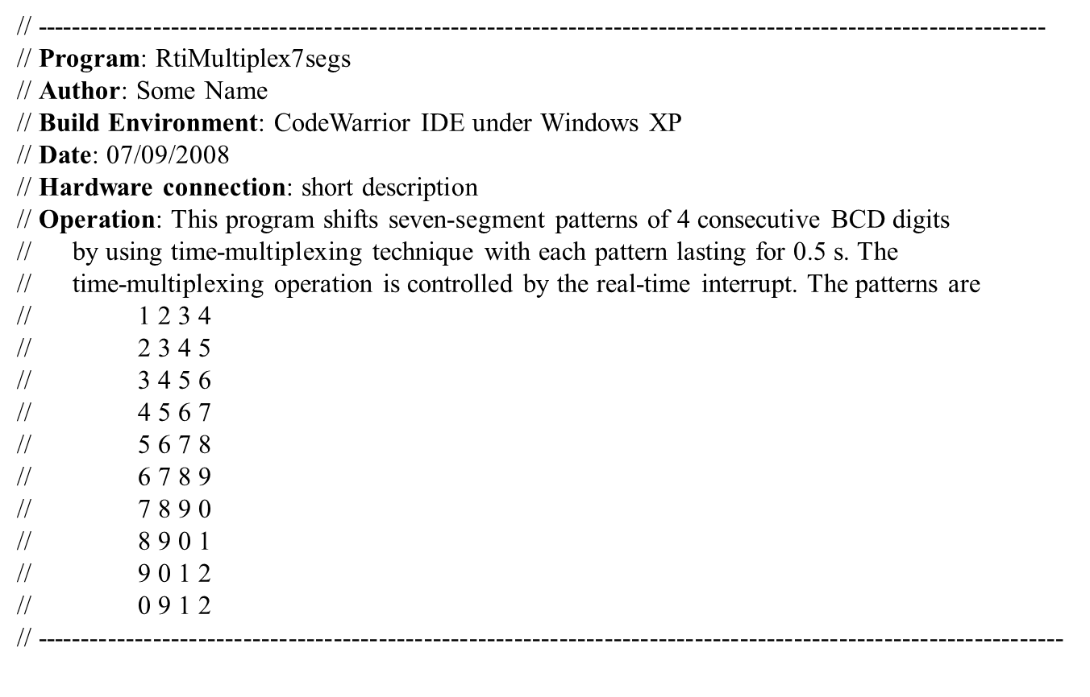
Miscellaneous Items
Why C?
ANSI C
Introduction
Identifiers
Data Types
Expressions
Program flow
Arrays & Pointers
Functions
Preprocessor
The Embedded
Difference
Examples

Slide 145
Miscellaneous Items
Function Documentation
- Every function should be preceded by a comment describing the purpose and use of that
Function. An example is as follows:
//--------------------------------------------------------------------------------------------------------
// Function: FindSquareRoot
// Purpose: Computes and returns the square root of a 32-bit unsigned integer
// Parameter: A 32-bit unsigned integer of which the square root is to be found
// Called by: PrimeTest()
// Returned value: the square root of a 32-bit unsigned integer
// Side effects: none
//---------------------------------------------------------------------------------------------------------
Code Appearance
Program readability can be improved by
Proper spacing
Proper indentation
Vertical alignment
Why C?
ANSI C
Introduction
Identifiers
Data Types
Expressions
Program flow
Arrays & Pointers
Functions
Preprocessor
The Embedded
Difference
Examples

Slide 146
Miscellaneous Items
Proper Spacing
for (i=0;i<15;i++) & for (i = 0; i < 15; i++)
easier to read
Proper Indentation
- The following code is hard to read without proper indentation:
while(TRUE) {
for (i = 0; i < 10; i++) { // pattern array start index
for (j = 0; j < 100; j++) { // repeat loop for each pattern sequence
for (k = 0; k < 6; k++) { // select the display # to be lighted
PTB = SegPat[i+k]; // output segment pattern
PTP = digit[k]; // output digit select value
delayby1ms(1); // display one digit for 1 ms
}
}
}
}
Why C?
ANSI C
Introduction
Identifiers
Data Types
Expressions
Program flow
Arrays & Pointers
Functions
Preprocessor
The Embedded
Difference
Examples

Slide 147
Miscellaneous Items
Proper Spacing, Proper indentation
With proper indentation, the code section becomes easier to read:
while(TRUE) {
for (i = 0; i < 10; i++) { // pattern array start index
for (j = 0; j < 100; j++) { // repeat loop for each pattern sequence
for (k = 0; k < 6; k++) { // select the display # to be lighted
PTB = SegPat[i+k]; // output segment pattern
PTP = digit[k]; // output digit select value
delayby1ms(1); // display one digit for 1 ms
}
}
}
}
Why C?
ANSI C
Introduction
Identifiers
Data Types
Expressions
Program flow
Arrays & Pointers
Functions
Preprocessor
The Embedded
Difference
Examples

Slide 148
Miscellaneous Items
Vertical Alignment
- It is often helpful to align similar elements vertically, to make typo-generated bugs
more obvious.
- Compare the next two sections of code. It is obvious that the second one is easier to
Identify errors:
Why C?
ANSI C
Introduction
Identifiers
Data Types
Expressions
Program flow
Arrays & Pointers
Functions
Preprocessor
The Embedded
Difference
Examples

Slide 149
Miscellaneous Items
Naming of Variables, Constants, and Functions
The names of variables, constants, and functions should spell out their meaning or purpose.
A variable name may have one word or multiple words. Use lowercase when the name contains only one word. For example, sum, limit, and average.
A multiple-word variable name should be in mixed case starting with lowercase. For example, inBuf, outBuf, squareRoot, and arrayMax.
Function names should follow the same principle. A few examples follow:
sevenSegShift(), putcSPI(), putsSPI(), openLCD(), and putsLCD()
Named constants should be all uppercase using underscore (_) to separate words.
SONG_TOTAL_NOTES, HI_DELAY_COUNT, LO_DELAY_COUNT
Why C?
ANSI C
Introduction
Identifiers
Data Types
Expressions
Program flow
Arrays & Pointers
Functions
Preprocessor
The Embedded
Difference
Examples

Slide 150
The Embedded Difference
Why C?
ANSI C
Most embedded systems programs include a header file which describes the target processor
The header files contain descriptions of reset vectors, ROM and RAM size and location, register names and locations, port names and locations, register bit definitions and macro definitions
Most compiler companies will provide header files for devices supported by their compilers
Example: for MC9S12DJ256
  #include "mc9s12dj256.h"
The Embedded
Difference
Examples

Slide 151
The Embedded Difference
Why C?
ANSI C
Another important aspect of device knowledge is the limits of the device for which the program is written.
A certain device may have very limited memory resources and great care must be taken in developing programs which use memory frugally
Along with issues of size comes issues of speed. Different devices run at different speeds and use different techniques to synchronize with peripherals
It is essential that you understand device timing for any embedded systems application
The Embedded
Difference
Examples

Slide 152
The Embedded Difference
Why C?
ANSI C
Embedded systems developers require direct access to registers such as the accumulator
The regular use of the infinite loop while(1). Embedded developers often use program control statements which are avoided by other programmers
Example:
The Embedded
Difference
Examples
while (1)
{
if (PortA.1 == PUSHED)
{
PortA.0 = ON;
wait(10); // wait ten seconds
PortA.0 = OFF;
}
}

Slide 153
The Embedded Difference
Techniques used in an embedded system program are often based upon knowledge of specific device or peripheral operation
Example:
  When a button is pressed it “bounces” which means that it is read as several pushes instead of just one
  It is necessary to include debouncer support in order to ensure that a real push has occurred and not a bounce
  Solution: a wait() function which creates a delay before the button is checked again
Why C?
ANSI C
The Embedded
Difference
Examples

Slide 154
The Embedded Difference
Why C?
ANSI C
Many developers prefer to write some code segments in assembly language for reasons of code efficiency or while converting a program from assembly language to C
The following two definitions of the wait() function show the function written in C and the equivalent function in Motorola 68HC705C8 assembly language
#asm vs. #endasm
The Embedded
Difference
Examples

Slide 155
The Embedded Difference
Why C?
ANSI C
Example:
MC68HC705C8
The Embedded
Difference
Examples

Slide 156
Examples
Example 1. Writing C Programs to Perform Simple I/O
The user needs to configure the direction of each I/O pin
A pin can be configured for output by setting the corresponding bit
in the associated data direction register to 1.
DDRB = 0xFF; // configure Port B for output
DDRA = 0x0F; // configure Port A upper 4 pins for input, lower
// four pins for output
DDRT = 0x20; // configure Port T pin 5 for output, other pins
// for input
The following instructions perform simple I/O operations:
PTB = 0x56; // output 0x56 to Port B
PTP |= 0x20; // pull Port P pin 5 to high
PTJ &= 0xFD; // pull Port J pin 1 to low
xyz = PTA; // read the value of Port A and store it in xyz.
Why C?
ANSI C
The Embedded
Difference
Examples

Slide 157
Examples
Interfacing with LEDs
An LED has an anode and cathode terminal.
The anode terminal must at a voltage at least 1.6 V above that of the cathode terminal (forward biased) in order for the LED to be lighted.
The forward current required to light an LED is from a few to more than 10 mA.
The I/O pin can drive an LED using one of the circuits shown in Figure 4.15.
The resistors R1, R2, are R3 are called current-limiting resistors.
Why C?
ANSI C
The Embedded
Difference
Examples

Slide 158
Examples
Example 2: Write a program to display one LED at a time from the circuit in Figure 4.16 with each LED to be lighted for 200 ms.
Solution: The values to drive Port B to turn on one LED at a time should be placed in a lookup table.
Why C?
ANSI C
#include "c:\cwHCS12\include\hcs12.h"
void SetClk8(void); // need to include SetClk.c to project
void delayby100ms(int k); // include delay.c to project
void main (void)
{
unsigned char led_tab[16]=
{0x80,0x40,0x20,0x10,0x08,0x04,0x02,0x01,
0x01,0x02,0x04,0x08,0x10,0x20,0x40,0x80};
char i;
DDRB = 0xFF; // configure Port B for output
DDRJ |= 0x02; // configure PJ1 pin for output
PTJ &= 0xFD; // enable LEDs to light
SetClk8(); // set E clock to 24-MHz
while (1) {
for (i = 0;i < 16; i++) {
PTB = led_tab[i]; // output a new LED pattern
delayby100ms(2);// wait for 200 ms
}
}
}
The Embedded
Difference
Examples
Notes:
The values to drive Port B to turn on one LED at a time should be placed in a lookup
table. The program reads one value at a time from the table and outputs it to Port B and then
waits for 200 ms.
The creation of time delays requires the user to set the E-clock frequency properly. The
clock setting issue will be discussed in Chapter 6. However, we will invoke the SetClk8 function
in Chapter 6 to set the E-clock to 24 MHz. The 200-ms time delay can be created by calling
the delayby100ms() function and passing 2 as the parameter.

Slide 159
Examples
Interfacing with Seven-Segment Displays
Seven-segment displays are mainly used to display decimal digits and a small set of letters.
The HCS12 I/O port can drive a seven-segment display directly.
Buffer chips are used mainly to save excessive current draw from the HCS12.
A example circuit for interfacing with seven-segment display is shown in Figure 4.17.
Port B drives a common-cathode seven-segment display through the buffer chip 74HC244.
The V_{OH} (output high voltage) value of the 74HC244 is about 5 V. Adding a 470-Ω resistor will set the display segment current to about 6.4 mA, which should be sufficient to light an LED segment.
Some people may use PB0 to PB6 to drive segment a to g instead (for example, Dragon12 board).
The microcontroller must send an appropriate value to the output in order to display a certain value
Why C?
ANSI C
The Embedded
Difference
Examples

Slide 160
Examples
Interfacing with Seven-Segment Displays (Recap☺)
Why C?
ANSI C
The Embedded
Difference
Examples

Slide 161
Examples
Example 3: Write a program to display the following patterns from the seven-segment
display circuit shown in Figure 4.18 from display #0 to #5 and repeat with each pattern
lasting for 600 ms:
123456
234567
345678
456789
567890
678901
789012
890123
901234
012345
Solution:
Why C?
ANSI C
The Embedded
Difference
Examples
In Figure 4.18, the common cathode of a seven-segment display is connected to the Y output of the hex buffer chip 74HC367.
The output low voltage (V_{OL}) of a 74HC367 output pin (Y_{i}, i = 0, . . . , 5) is about 0.33 V when the output current (the current actually flowing into the pin) is larger than a few mA.
When a port B pin output voltage is high, an LED segment current will be about 3.33 mA. Total current that flows into the Y_{i} pin is about 23.3 mA (= 7 × 3.33) and is within the rated value of the DC output current.

Slide 162
Examples
Why C?
ANSI C
Solution: There are ten different pattern sequences and two adjacent sequences are
offset by 1. The overlapping these sequences are shown in Figure 5.2.
The Embedded
Difference
Examples
Let SegPat, i, j, and k represent the segment table of 15 segment patterns, the start index of the sequence to be displayed, the number of times of the current sequence remained to be repeated, and the display to be lighted at the moment.

Slide 163
Examples
#include "c:\cwHCS12\include\hcs12.h"
#include "c:\cwHCS12\include\delay.h“ // include delay.c to the project
void SetClk8(void); // include SetClk.c to the project
unsigned char SegPat[16] = {0x06,0x5B,0x4F,0x66,0x6D,0x7D,0x07,0x7F,0x67,0x3F,
0x06,0x5B,0x4F,0x66,0x6D};
unsigned char digit[6] = {0xFE,0xFD,0xFB,0xF7,0xEF,0xDF};
void main(void) {
int i, j, k;
SetClk8(); // set E clock frequency to 24 MHz
DDRB = 0xFF; //configure Port B for output
DDRP = 0xFF; //configure Port P for output
while(1) {
for (i = 0; i < 10; i++) { // pattern array start index
for (j = 0; j < 100; j++) { // repeat loop for each pattern sequence
for (k = 0; k < 6; k++) { // select the display # to be lighted
PTB = SegPat[i+k]; // output segment pattern
PTP = digit[k]; // output digit select value
delayby1ms(1); // display one digit for 1 ms
}
}
}
}
}
Why C?
ANSI C
The Embedded
Difference
Examples

Slide 164
Examples
Example 4: Write a program to perform keypad scanning and debouncing and return the ASCII code of the pressed key to the caller.
Solution:
Why C?
ANSI C
Keypad Circuitry with HCS12 (Recap ☺)
The Embedded
Difference
Examples

Slide 165
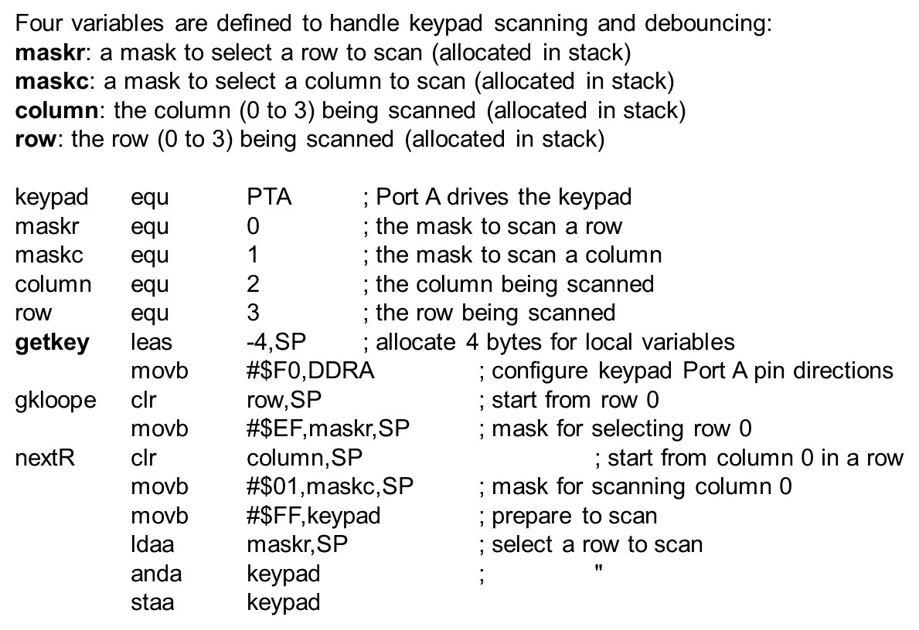
Examples
Why C?
ANSI C
The Embedded
Difference
Examples

Slide 166
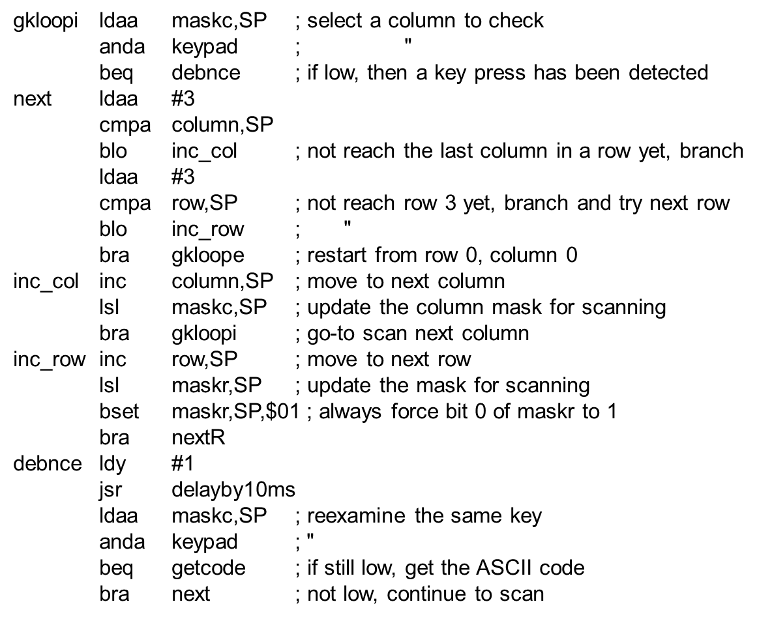
Examples
Why C?
ANSI C
The Embedded
Difference
Examples

Slide 167
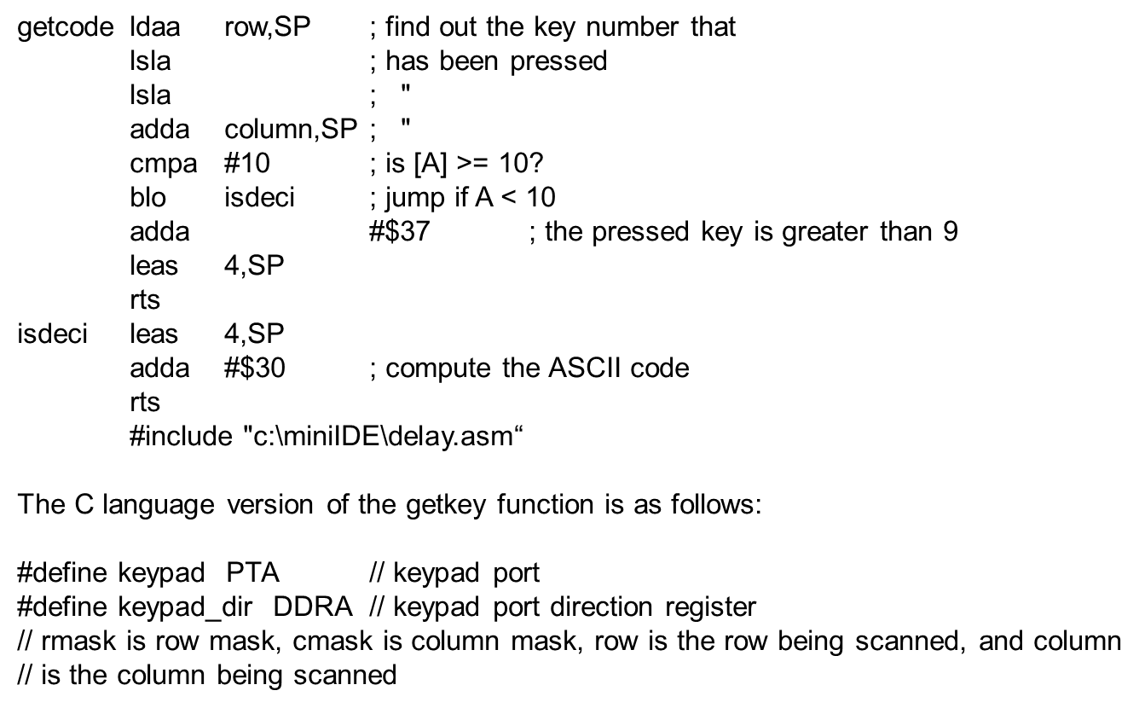
Examples
Why C?
ANSI C
The Embedded
Difference
Examples

Slide 168
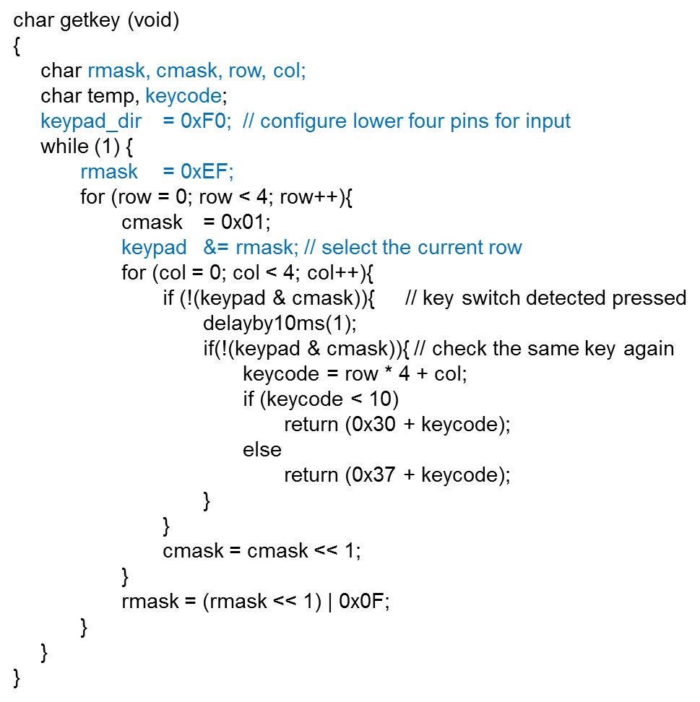
Examples
Why C?
ANSI C
The Embedded
Difference
Examples

Slide 169
Examples
Why C?
ANSI C
Example 4: Write a program to display 123456 on the seven-segment
display circuit shown in Figure 4.18 from display #5 to #0 and repeat this pattern
lasting for 600 ms
Example 5: Write a C program to rotate the stepper motor using the full-step sequence, in the counterclockwise direction
Example 6: Write a C program to rotate the stepper motor in the counterclockwise direction using the half-step sequence
Example 7: Write a C program to rotate the stepper motor clockwise using the full-step sequence.
Solution: Homework ☺
The Embedded
Difference
Examples

Slide 170
References
C Programming Language (2nd Edition)
    Brian W. Kernighan and Dennis M. Ritchie; Prentice Hall
First Steps with Embedded Systems
    Byte Craft Limited
C Programming for Embedded Systems
    Kirk Zurell; R&D Books

