Slide 1
Interrupts and resets
Razvan Bogdan
Embedded Systems

Slide 2
Content
Fundamental Concepts of Interrupts
HCS12 Exceptions
Interrupt programming in C Language
Clock and Reset Generation Block
Computer Operating Properly
Low-Power Modes
Stop Mode, Resets
HCS12 Operation Modes

Slide 3
Fundamental Concepts of Interrupts
What is an interrupt?
  A special event that requires the CPU to stop normal program execution and perform some service related to the event
  Examples of interrupts include
    I/O completion, timer time-out;
    illegal opcodes, arithmetic overflow, divide-by-0, underflow (software interrupts, also known as traps, exceptions)
Functions of Interrupts
  Coordinating I/O activities and preventing CPU from being tied up
  Providing a graceful way to exit from errors
  Reminding the CPU to perform routine tasks
Notes:
• Coordinating I/O activities and preventing the CPU from being tied up during
the data transfer process. The CPU needs to know if the I/O device is ready before
it can proceed. Without the interrupt capability, the CPU will need to check the
status of the I/O device continuously or periodically. The interrupt mechanism is
often used by the I/O device to inform the CPU that it is ready for data transfer.
CPU time can thus be utilized more efficiently because of the interrupt mechanism.
• Performing time-critical applications. Many emergent events, such as power
failure and process control, require the CPU to take action immediately. The
interrupt mechanism provides a way to force the CPU to divert from normal
program execution and take immediate actions.
• Providing a graceful way to exit from an application when a software error occurs.
The service routine for a software interrupt may also output useful information
about the error so that it can be corrected.
• Reminding the CPU to perform routine tasks. There are many microprocessor
applications that require the CPU to perform routine work, such as the following:
1. Keeping track of time of day. Without the timer interrupt, the CPU will need
to use program loops in order to update the current time. The CPU cannot do
anything else without a timer interrupt in this application. The periodic timer
interrupts prevent the CPU from being tied up.
2. Periodic data acquisition. Some applications are designed to acquire data
periodically.
3. Task switching in a multitasking operating system. In a modern computer
system, multiple application programs are resident in the main memory, and the
CPU time is divided into many short slots (one slot may be from 10 to 20 ms).
A multitasking operating system assigns a program to be executed for one time
slot. At the end of a time slot or when a program is waiting for the completion
of an I/O operation, the operating system takes over and assigns another
program for execution. This technique is called multitasking. Multitasking can
dramatically improve the CPU utilization and is implemented by using periodic
timer interrupts.

Slide 4
Fundamental Concepts of Interrupts
Interrupt Maskability
  Interrupts that can be ignored by the CPU are called maskable interrupts.
  A maskable interrupt must be enabled before it can interrupt the CPU.
  An interrupt is enabled by setting an enable flag.
  Interrupts that can’t be ignored by the CPU are called non-maskable interrupts.

Slide 5
Fundamental Concepts of Interrupts
Interrupt priority
  Allow multiple pending interrupt requests
  Resolve the order of service for multiple pending interrupts
Interrupt Service
  CPU executes a program called the interrupt service routine
  A complete interrupt service cycle includes
    Saving the program counter value in the stack
    Saving the CPU status (including the CPU status register and some other registers) in the stack
    Identifying the cause of interrupt
    Resolving the starting address of the corresponding interrupt service routine
    Executing the interrupt service routine
    Restoring the CPU status and the program counter from the stack
    Restarting the interrupted program

Slide 6
Fundamental Concepts of Interrupts
Interrupt Vector
  Starting address of the interrupt service routine;
Interrupt Vector Table
  A table where all interrupt vectors are stored.
Methods of Determining Interrupt Vectors
  Predefined locations (Microchip PIC18, 8051 variants)
  Fetching the vector from a predefined memory location (HCS12, Atmel avr)
  Executing an interrupt acknowledge cycle to fetch a vector number in order to locate the interrupt vector (68000 and x86 families)
Notes:
1. Predefined. In this method, the starting address of the service routine is predefined
when the microcontroller is designed. The processor uses a table to store all the
interrupt service routines. The Intel 8051 microcontrollers use this approach. Each
interrupt is allocated the same number of bytes to hold its service routine. The Intel
8051 allocates eight words to each interrupt service routine. When the service routine
requires more than eight words, the solution is to place a jump instruction in the
predefined location to jump to the actual service routine.
2. Fetch the vector from a predefined memory location. In this approach, the interrupt
vector of each interrupt source is stored at a predefined location in the interrupt vector
table, where the microprocessor can get it directly. The Freescale HCS12 and
most other Freescale microcontrollers use this approach.
3. Execute an interrupt acknowledge cycle to fetch a vector number in order to locate
the interrupt vector. During the interrupt acknowledge cycle, the microprocessor
performs a read bus cycle, and the external I/O device that requested the interrupt
places a number on the data bus to identify itself. This number is called the interruptvector
number. The CPU can figure out the starting address of the interrupt service
routine by using this number. The CPU needs to perform a read cycle in order to
obtain it. The Freescale 68000 and Intel x86 family microprocessors support this
method. The Freescale 68000 family of microprocessors also uses the second method.
This method is not used by microcontrollers because of the incurred latency.

Slide 7
Fundamental Concepts of Interrupts
Steps of Interrupt Programming
– how to provide service to the interrupt
  Step 1. Initializing the interrupt vector table
  Step 2. Writing the interrupt service routine:
    A service routine is similar to a subroutine—the only difference is the last instruction. An interrupt service routine uses the return-from-interrupt (or return-from-exception) instruction instead of return-from-subroutine instruction to return to the interrupted program
  Step 3. Enabling the interrupt:
    an interrupt can be enabled by clearing the global interrupt mask and setting the local interrupt enable bit in the I/O control register
    Don’t forget to enable interrupts when writing the code ☺

Slide 8
Fundamental Concepts of Interrupts
The Overhead of Interrupts
    Saving and restoring of CPU status and other registers. (HCS12 needs to save all CPU registers).
    Execution time of instructions of the interrupt service routine.
    The execution of the RTI instruction that will restore all the CPU registers.
  Exercise: try to calculate it ☺
Resets
    The initial values of some CPU registers, flip-flops, and the control registers in I/O interface chips must be established in order for the computer to function properly.
    The reset mechanism establishes these initial conditions for the computer system.
    There are at least two types of resets: power-on reset and manual reset.
    The power-on reset establishes the initial values of registers and I/O control registers.
    The manual reset without power-down allows the computer to get out of most error conditions if hardware doesn’t fail.
    A reset is non-maskable.
Notes:
Saving the CPU registers, including accumulators (A:B), index registers X and Y, and
the condition code register (CCR), and fetching the interrupt vector. This takes at
least 9 E-clock cycles.
2. The execution time of the RTI instruction. This instruction restores all the CPU
registers that have been stored in the stack by the CPU during the interrupt and takes
from 8 to 11 E-clock cycles to complete for the HCS12.
3. Execution time of instructions of the interrupt service routine. This depends on the
type and the number of instructions in the service routine.
The total overhead is thus at least 17 to 20 E-clock cycles, which amounts to almost 1 μs for a
24-MHz E-clock. We need to be aware of the overhead

Slide 9
HCS12 Exceptions
Maskable interrupts: including IRQ pin and all peripheral function interrupts.
Nonmaskable interrupts: including XIRQ pin, SWI interrupt, and unimplemented opcode trap.
Resets: including the power-on reset, RESET pin manual reset, the COP reset (computer operate properly), and clock monitor reset. For other microcontrollers, the COP reset is also called the watchdog reset.

Slide 10

HCS12 Exceptions. Maskable interrupts
Different HCS12 members implement different number and types of peripheral functions, and hence may have different number of maskable interrupts.
One of the maskable interrupts can be raised to the highest priority among the maskable interrupt group and receive quicker service. This is achieved by programming the HPRIO register.
Notes:
Since different HCS12 members implement a different number of peripheral functions,
they have a different number of maskable interrupts. The I flag in the CCR register is the global
mask of all maskable interrupts. Whenever the I flag is 1, all maskable interrupts are disabled.
All maskable interrupts have a local enable bit that allows them to be selectively enabled. They
are disabled (I flag is set to 1) when the HCS12 gets out of the reset state.

Slide 11
HCS12 Exceptions. Maskable interrupts
The priority and vector addresses of all HCS12 exceptions are listed in Table 6.1.
To raise a maskable interrupt source to the highest priority, write the low byte of the vector address of this interrupt to the HPRIO register.
  For example, to raise the capture timer channel 6 interrupt to the highest priority, write the value of $E2 to the HPRIO register.
In Table 6.1, exceptions that have higher vector addresses are at higher priorities.
Not all the exceptions are available in all HCS12 members.
IRQ Pin Interrupt
  The only external maskable interrupt for the HCS12.
  IRQ interrupt can be edge-triggered or level-triggered.
  IRQ interrupt has a local enable mask in the IRQCR register.
  The IRQ interrupt is configured by programming the IRQCR register.
  The contents of the IRQCR register are shown in Figure 6.2.

Slide 12
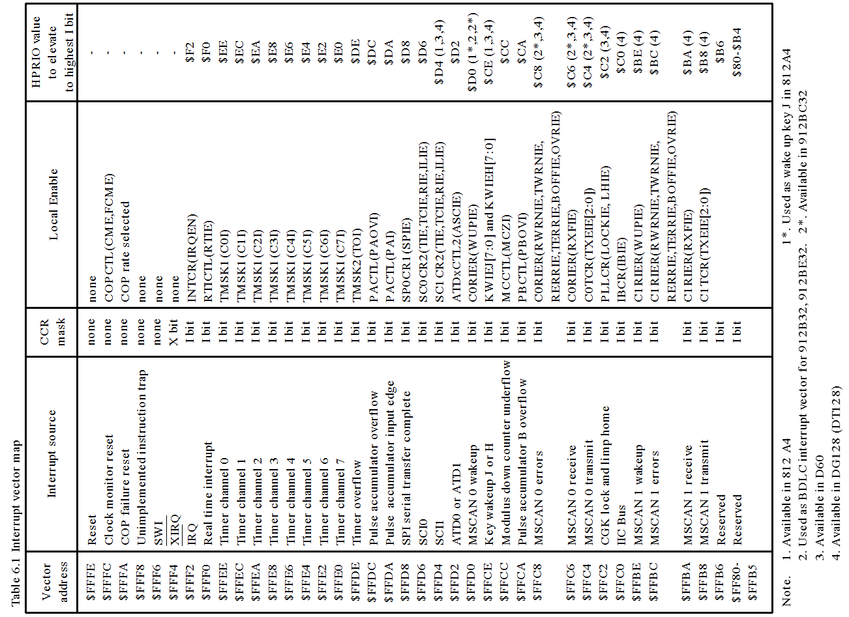
HCS12 Exceptions.
Maskable interrupts

Slide 13
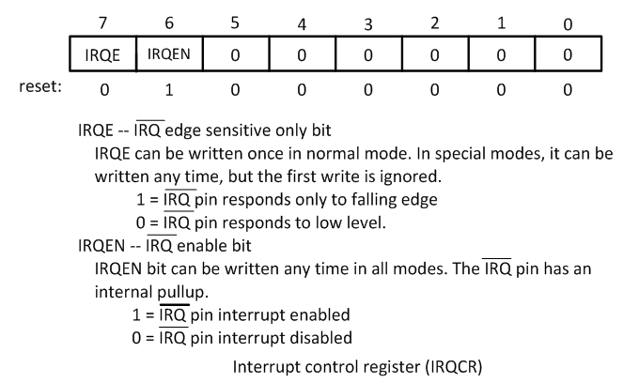
HCS12 Exceptions. Maskable interrupts

Slide 14
HCS12 Exceptions. Maskable interrupts
Making IRQ Level-Sensitive (active low): Whenever one of the interrupt sources (that are tied to the IRQ pin) is low, an interrupt request will be detected by the HCS12
Pros:
  Multiple interrupt sources can be tied to this pin.
Cons:
  Need to make sure that the IRQ signal has become inactive before the IRQ service routine is complete if there is only one interrupt request pending.
Making IRQ Edge-Sensitive (falling edge)
Pros:
  No need to control the duration of the IRQ pulse.
Cons:
  Not suitable for noisy environment because every falling edge caused by noise will be recognized as an interrupt.
When does the MCU recognize interrupt requests?
The MCU recognizes the interrupt request when it completes the execution of the current instruction unless the current instruction is a fuzzy logic instruction. For fuzzy logic instructions, the HCS12 recognizes the interrupt immediately.

Slide 15
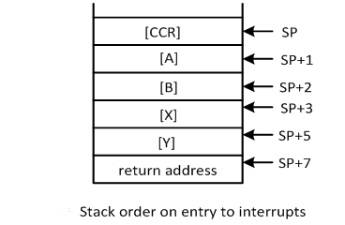
HCS12 Exceptions. Maskable interrupts
The Stack Order on Entry of an Interrupt
  The HCS12 saves all CPU registers on an interrupt.
  The order of saving CPU registers is shown in the figure
The RTI Instruction
  RTI is used to terminate interrupt service routines.
  RTI will restore CPU registers from the stack.
  The HCS12 will continue to execute the interrupted program unless there is another pending interrupt.
Notes:
Before the HCS12 starts to service an interrupt, it will set the I mask to disable other maskable
interrupts. When the CPU begins to service an interrupt, the instruction queue is refilled,
a return address is calculated, and then the return address and the contents of all CPU registers
(except SP) are saved in the stack in the order shown in Figure
RTI is used to terminate interrupt service routines. RTI is an 8-cycle instruction when no
other interrupt is pending and an 11-cycle instruction when another interrupt is pending. In
either case, the first 5 cycles are used to restore the CCR, B:A, X, Y, and return address from the
stack. The HCS12 then clears the I mask to enable further maskable interrupts

Slide 16
HCS12 Exceptions. Nonmaskable interrupts
Non-maskable Interrupts
  There are three interrupts in this category: XIRQ pin, SWI instruction, & unimplemented instruction opcode trap.
XIRQ Pin Interrupt
  XIRQ interrupt is disabled during a system reset and upon entering the service routine of another XIRQ interrupt.
  After minimal system initialization, software can clear the X bit of the CCR register to enable the (using the andcc #$BF instruction) XIRQ interrupt. Software cannot reset the X bit once it has been set.
  When a non-maskable interrupt is recognized, both the X and I bits are set after CPU registers are saved.
  The execution of an RTI instruction at the end of the XIRQ service routine will restore the X and I bits to the pre-interrupt request state.
Notes:
The HCS12 uses up to 16 bits (2 pages) to encode the opcode. All 256 combinations in the
page 1 opcode map have been used. However, only 54 of the 256 positions on page 2 of the opcode
map are used. If HCS12 attempts to execute one of the 202 unused opcodes on page 2, an
unimplemented opcode trap occurs. The 202 unimplemented opcodes are essentially interrupts
that share a common interrupt-vector address, $FFF8:$FFF9. The HCS12 uses the next address
after an unimplemented page 2 opcode as a return address.

Slide 17
HCS12 Exceptions. Nonmaskable interrupts
Unimplemented Opcode Trap
  There are 202 unimplemented opcode (16-bit opcode).
  These unimplemented opcode share the same vector $FFF8:$FFF9.
Software Interrupt Instruction (SWI)
  Execution of the SWI instruction causes an interrupt without an interrupt request signal.
  The SWI instruction is commonly used in the debug monitor to implement breakpoints and to transfer control from a user program to the debug monitor.
  A breakpoint in a user program is a memory location where we want program execution to be stopped and information about instruction execution (in the form of register contents) to be displayed.

Slide 18
Interrupt programming in C Language
CodeWarrior Template for Interrupt Service Routine
Interrupt void ISR_name (void)
{
… // statements to service the interrupt
}
There are two parts in setting up the interrupt service routine:
  Declare the interrupt service to be external
  Insert the name of interrupt service routine into the appropriate place of the interrupt vector table
For example, IRQ interrupt vector can be setup as follows:

Slide 19
Interrupt programming in C Language
external void near irqISR(void); // IRQ pin is defined outside this file
#pragma CODE_SEG_NEAR_SEG NON_BANKED // interrupt section for this module
_interrupt void UnimplementedISR(void)
{
for(;;); // do nothing, but return from interrupt
}
#pragma CODE_SEG DEFAULT
typedef void (*near tIsrFunc)(void);
const tIsrFunc _vect[] @0xFF80 = {// interrupt vector table starts from this line
// interrupt vector table
UnimplementedISR,
…
irqISR, // IRQ interrupt vector (at the address 0xFFF2)
…
};
The entry UnimplementedISR is provided as a catch-all handler for all unintended interrupts.

Slide 20
Interrupt programming in C Language
Interrupt Programming in EGNU IDE
1. Use the interrupt attribute of the GCC compiler. Add the following statements at the beginning of the program:
#define INTERRUPT __attribute__((interrupt))
2. Apply the interrupt attribute to the interrupt service routine.
void INTERRUPT irqISR(void);
3. Include the header file vectors12.h to your program :
#include “c:\egnu\include\vectors12.h”
4. Store the name of the IRQ service routine at the designated address:
UserIRQ = (unsigned short)&IRQISR;
5. Write the actual IRQ service routine.

Slide 21
Interrupt programming in C Language
Example 1: The IRQ pin of the HCS12DP256 is connected to a 1-Hz digital waveform and port B is connected to eight LEDs. Write a program to configure port B for output and enable the IRQ interrupt and also write the service routine for the IRQ interrupt. The service routine for the IRQ interrupt simply increments a counter and outputs it to port B. C language version of the program is to be compiled by GNU C compiler.
Solution:
#include "c:\egnu\include\hcs12.h"
#include "c:\egnu\include\vectors12.h"
#define INTERRUPT __attribute__((interrupt))
void INTERRUPT IRQISR(void);
unsigned char cnt;
void main(void)
{
UserIRQ = (unsigned short)&IRQISR;
DDRB = 0xFF;
cnt = 0;
DDRJ |= BIT1; // configure PJ1 pin for output
PTJ &= ~BIT1; // enable LEDs to light
IRQCR = 0xC0; // enable IRQ interrupt on falling edge
asm("cli"); // enable interrupt globally
while(1); // wait for interrupt forever
}
void INTERRUPT IRQISR(void)
{
cnt++;
PTB = cnt;
}

Slide 22
Clock and Reset Generation Block (CRG)
CRG generates the clock signals required by the HCS12 instruction execution and all peripheral operations.
  The clock signal has the form of square waveform.
Crystal oscillators are often used to generate clock signals.
  The crystal oscillator output is a sinusoidal wave and must be converted to square wave before it can be used.
  The HCS12 has internal circuit to do this square up operation.
  The CRG block also has a PLL circuit that can multiply the frequency of the incoming clock signal.
The CRG can also accept oscillator output (square waveform) directly.
  The XCLKS signal must be tied low (for MC9S12DP256B) in order to use external clock signal.
Notes:
A microcontroller needs a clock signal to operate. The clock signal has the waveform of
a square wave. Most people use a crystal oscillator to generate the clock signal. However, the
output of a crystal oscillator is a sinusoidal waveform that cannot be used to drive digital circuitry
directly. Most microcontrollers and microprocessors have an on-chip oscillator to square
up the incoming sinusoidal waveform so that it can be used as the clock signal. Many crystal
oscillators also include the circuitry to square up the sinusoidal waveform. The on-chip oscillator
circuitry can be bypassed for this type of crystal oscillator (also called external oscillators in
Freescale literature).

Slide 23
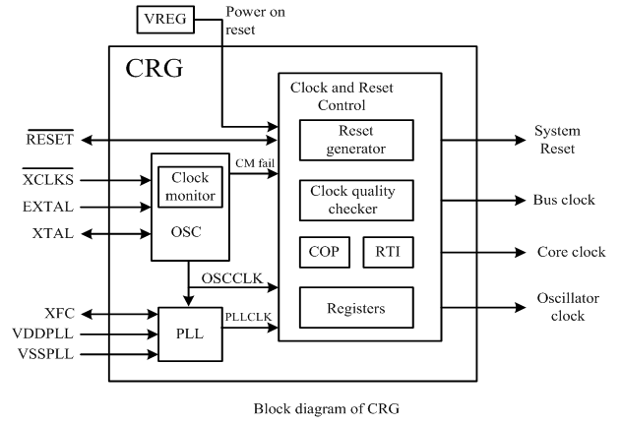
Clock and Reset Generation Block (CRG)

Slide 24
CRG Configuration Registers

Slide 25
CRG Configuration Registers: MC9S12DP256B Device User Guide

Slide 26
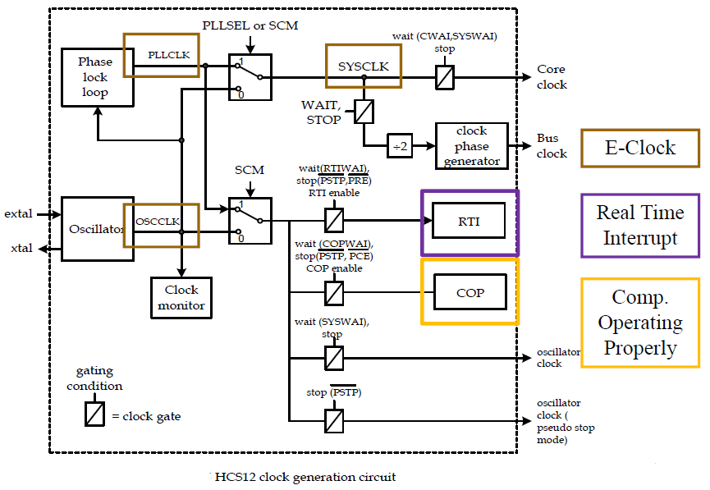
Choice of clock Source
This circuit generates the system and core clocks used in the microcontroller. When dealing with external memory or peripheral modules, the bus clock (E-clock) is used.
The E-clock is derived by dividing the SYSCLK clock by 2. If the PLLCLK is chosen to be the SYSCLK, then the frequency of the E-clock is half that of PLLCLK.
Either the oscillator output OSCCLK (when PLLSEL = 0) or the PLL output PLLCLK (PLLSEL = 1) can be selected as SYSCLK.
The oscillator can be completely bypassed and turned off by selecting an external clock source instead. The clock monitor, PLL, RTI, COP, and all clock signals based on OSCCLK are driven by this external clock instead of the output of the oscillator.

Slide 27
Choice of clock Source
The user can choose between using the external crystal or oscillator to produce the clock signal.
  The external crystal is connected between the EXTAL and XTAL pins and needs an on-chip oscillator circuitry to square it up.
  The external clock source provided by the oscillator is connected to the EXTAL pin and has a 2.5V peak to peak magnitude for D family (9s12DP256)
Notes:
If I have an external crystal => 1 (Vdd)
If I have an external source or a PLL => 0

Slide 28
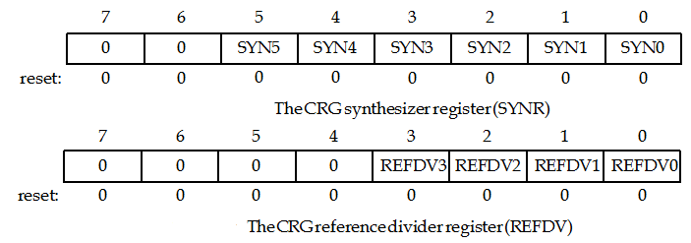
Phase Locked Loops
The PLL circuit has the capability to multiply incoming signal frequency and stabilize its output signal frequency.
The frequency of the PLLCLK is controlled by registers SYNR and REFDY using the following equation:
PLLCLK = 2 × OSCCLK × (6.1)
(SYNR + 1)
(REFDV + 1)
NOTE: PLLCLK must not exceed the maximum operating system frequency; maximum bus frequency is 25 MHz. => maximum PLLCLK is 50 MHz.

Slide 29
Phase Locked Loops
Selection of PLL for clock generation is controlled by the CRGSEL register.

Slide 30
Phase Locked Loops
PLL is also controlled by the PLLCTL register.

Slide 31
Phase Locked Loops: CRG and PLL status

Slide 32
Phase Locked Loops: CRG and PLL status

Slide 33
Phase Locked Loops
Example 2: There is a system that derives its bus clock (E-clock) from the PLL circuit and an external clock of 8 MHz is selected. The desired bus clock is 24 MHz. Write an assembly routine and a C function to perform the configuration.
Solution:
- Since the E-clock frequency is higher than the external clock’s, we need to use the PLL circuit
- The SYSCLK frequency is 48 MHz
- The frequency of OSCCLK is 8 MHz
      The XCLKS pin must be grounded to select oscillator as clock source!
48 MHz = 2 X 8 MHz X [SYNR + 1] /[REFDV + 1]
One solution is to set SYNR and REFDV to 2 and 0, respectively.
SetClk8 movb #02,SYNR ; set SYNR to 2
movb #0,REFDV ; set REFDV to 0
movb #$80,CLKSEL ; enable PLL, keep SYSCLK running in wait mode,
; keep RTI, COP, PLL & core running in wait mode
movb #$60,PLLCTL ; disable clock monitor, enable PLL, set automatic
; bandwidth control, disable RTI & COP in pseudo stop
brclr CRGFLG,LOCK,* ; wait until PLL locks into the target frequency
rts

Slide 34
Phase Locked Loops
Example 2 (cntd.): There is a system that derives its bus clock (E-clock) from the PLL circuit and an external clock of 8 MHz is selected. The desired bus clock is 24 MHz. Write an assembly routine and a C function to perform the configuration.
Solution:
- Since the E-clock frequency is higher than the external clock’s, we need to use the PLL circuit
- The SYSCLK frequency is 48 MHz
- The frequency of OSCCLK is 8 MHz
      The XCLKS pin must be grounded to select oscillator as clock source!
48 MHz = 2 X 8 MHz X [SYNR + 1] /[REFDV + 1]
One solution is to set SYNR and REFDV to 2 and 0, respectively.
void SetClk8(void)
{
SYNR = 0x02; // use PLL and 8-MHz crystal to generate 24-MHz E clock
REFDV = 0; // “
CLKSEL = 0x80; //enable PLL, keep SYSCLK running in wait mode
PLLCTL = 0x60; // enable PLL, set automatic bandwidth control
while(!(CRGFLG & 0x08); // wait until PLL locks into the target frequency
}

Slide 35
Phase Locked Loops
Example 3: There is a system that uses a 4 MHz crystal oscillator to derive a 24 MHz bus clock (E-clock). Write an instruction sequence to perform the required configuration.
Solution:
- The SYSCLK frequency is 48 MHz
- The frequency of OSCCLK is 4 MHz
      The XCLKS pin must be pulled to high to select external crystal to generate clock signals !!!
48 MHz = 2 X 8 MHz X [SYNR + 1] /[REFDV + 1]
One solution is to set SYNR and REFDV to 5 and 0, respectively.
SetClk4:
movb #05,SYNR ; set SYNR to 5
movb #00,REFDV ; set REFDV to 0
movb #$80,CLKSEL ; enable PLL, keep SYSCLK running in wait mode,
; keep RTI, COP, PLL & core running in wait mode
movb #$60,PLLCTL ; disable clock monitor, enable PLL, set automatic
; bandwidth control, disable RTI & COP in pseudo stop
ClkWait: brclr CRGFLG,LOCK ,ClkWait ; wait until PLL locks
rts

Slide 36
Clock Monitor
The clock monitor circuit is based on an internal resistor-capacitor (RC) time delay so that it can operate without any MCU clocks.
  If no OSCCLK edges are detected within this RC time delay, the clock monitor indicates failure which asserts self clock mode or generates a system reset depending on the state of SCME bit.
  If the clock monitor is disabled or the presence of clocks is detected no failure is indicated.
The clock monitor function is enabled/disabled by the CME control bit. (PLLCTL)
  If no OSCCLK edges are detected within the RC time delay, the clock monitor may reset the MCU if the CME bit in the PLLCTL register is set to 1.
  The SCME bit of the PLLCTL register must be cleared to 0 for clock monitor to work.

Slide 37
Real-Time Interrupt
The RTI can be used to generate a hardware interrupt at a fixed periodic rate.
  If enabled (by setting RTIE=1), this interrupt will occur at the rate selected by the RTICTL ($003B) register.
  At the end of the RTI time-out period the RTIF flag is set to 1 and a new RTI time-out period starts immediately.
A write to the RTICTL register restarts the RTI time-out period.
  If the PRE bit is set, the RTI will continue to run in Pseudo-Stop Mode (in PLLCTL)
The RTI interrupt is enabled by the interrupt enable register (CRGINT).
Problem: How to construct the interrupts periods?

Slide 38
Real-Time Interrupt

Slide 39
Real-Time Interrupt
Analysis: Seven bits (RTR6-0) in the RTICTL register specify the interrupt rate. The 7-bit value is composed of two parts:
  Let RTR6, RTR5, RTR4 be n, which is a 3-bit number ranging from 0 to 7
  Let RTR3, RTR2, RTR1, RTR0 be m, which is a 4-bit number ranging from 0 to 15
  Remember that 3 registers are to be used with RTI:
  If n is 0 then RTI is off

Slide 40
Real-Time Interrupt
A 9S12C32 with an 8 MHz crystal will have an OSCCLK frequency of 8 MHz and a default E-clock frequency of 4 MHz. A 9S12DP512 with a 16 MHz crystal will have an OSCCLK frequency of 16 MHz and a default E-clock frequency of 8 MHz. Let fcrystal be the crystal frequency, then the RTI interrupt frequency can be calculated using
=> The interrupt rate is determined by the crystal clock and the RTICTL value

Slide 41
Real-Time Interrupt
9S12 real-time interrupt period in ms, assuming an 8 MHz crystal:

Slide 42
Real-Time Interrupt
9S12 real-time interrupt period in ms, assuming an 16 MHz crystal:

Slide 43
Real-Time Interrupt
Exercise 4: Write a software that increments a global variable every 32.768 ms.
Solution: The solution will use a periodic RTI interrupt that occurs every 32.768 ms. RTI is simple, and accurate if the desired interrupt period matches one of the possibilities shown in the previous value tables. The main program executes RTI_Init to initialize the RTI interrupts. The RTI rate is determined by the crystal frequency and the RTICTL register. Bit 7 of the CRGINT register is set to arm the RTI system. The RTI_Init routine initializes the global variable and enables interrupts (cli). The ISR will acknowledge the interrupt and increment a global variable, Time. The ISR makes the trigger flag zero by writing a one to it

Slide 44
Real-Time Interrupt
Exercise 4 (cntd.): Write software that increments a global variable every 32.768 ms.
Solution:
Exercise: Write software that increments a global variable every 16.38 ms, 16 MHz crystal.

Slide 45
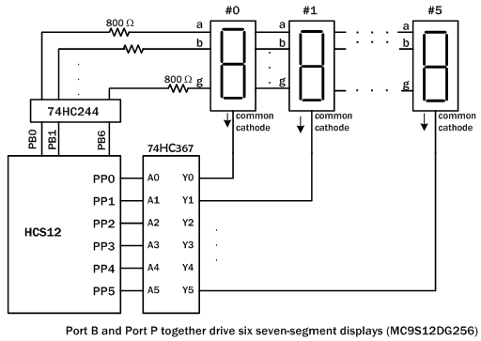
Real-Time Interrupt
Exercise 5: Write a C program to use the RTI interrupt to time-multiplex four seven segment displays using the circuit shown below and shift the seven-segment display pattern as described. Turn on one display at a time and light each display for about 1 ms then switch to the next display. Use display #0 to display #5. Use CodeWarrior and a demo board programmed with serial monitor to implement the circuit.
123456
234567
345678
456789
567890
678901
789012
890123
901234
012345

Slide 46
Real-Time Interrupt
Exercise (cntd.) - Solution: Arangement:
  Place the segment patterns in one array segPat[].
  Place digit select values in the array digit[].
  Use the variable seq as index to the segment array that identifies the first digit of the current sequence.
  Use the variable ix as an index to the digits within one sequence (ix = 0..5).
  Use the variable count to specify the repetition count of a sequence
#include "c:\cwHCS12\include\hcs12.h"
#include "c:\cwHCS12\include\SetClk.h"
int seq; // start index to segPat[] of a sequence of digits (0 to 9)
int ix; // index of digits of a sequence (0 to 5)
int count; // repetition count of a sequence
char segPat[13] = {0x06,0x5B,0x4F,0x66,0x6D,0x7D,0x07,0x7F,0x67,0x3F,0x06,
0x5B,0x4F};
char digit[6] = {0xFE,0xFD,0xFB,0xF7,0x7F,0xBF};

Slide 47
Real-Time Interrupt
Exercise (cntd.) - Solution:
  void main (void) {
  seq = 0; // initialize the start index to segPat[] for the display sequence
  ix = 0; // initialize the index of a new sequence
  count = 400; // initialize the RTI interrupt count of a sequence
  SetClk8(); // set E clock to 24 MHz from an 8-MHz crystal oscillator
  RTICTL = 0x40; // RTI interrupt interval set to 1 msec
  DDRB = 0xFF; // configure Port B for output
  DDRP = 0xFF; // configure Port P for output
  CRGINT|= RTIE; // enable RTI interrupt
  asm("CLI"); // enable interrupt globally
  while(1);
  }
  // RTI interrupt service routine
  interrupt void rtiISR(void) {
  CRGFLG = 0x80; // clear RTIF bit
  PTB = segPat[seq+ix]; // send out digit segment pattern
  PTP = digit[ix]; // turn on the display
  ix++; // increment the index to digits of a sequence
  if (ix == 6) // make sure the index to digits of a sequence is from 0 to 5
  ix = 0; // “
  count--;
  if(count == 0){ // is time for the current sequence expired?
  seq++; // change to a new sequence of digits
  count = 400; // reset repetition count
  }
  if(seq == 10) // is this the last sequence?
  seq = 0; // reset start index of a sequence
  }
  This project also contains the vectors.c file.

Slide 48
Real-Time Interrupt
Exercise 5 (cntd.) - Solution: Arangement:
  extern void near rtiISR(void);
  #pragma CODE_SEG __NEAR_SEG NON_BANKED
  #pragma CODE_SEG DEFAULT // Change code section to DEFAULT.
  typedef void (*near tIsrFunc)(void);
  const tIsrFunc _vect[] @0xFFF0 = {
  rtiISR
  };

Slide 49
Computer Operating Properly (COP)
COP is a free running watchdog timer that allows the user to determine whether the user program is running and sequencing properly.
  The COP is a timer circuit that will time out if it is not rearmed within a preset time limit.
  The COP will reset the MCU when it times out and the user would know if the software operated properly.
  The time out period of the COP is controlled by the COPCTL register.
The application software must include an instruction sequence to prevent the COP from timing out when this is enabled.
To prevent the COP from timing out for applications that uses COP function, write $55 and then $AA into the ARMCOP register.

Slide 50
Computer Operating Properly (COP)

Slide 51
Low-Power Modes
It is desirable to minimize power consumption when the MCU is not busy performing useful operations.
The execution of the WAI instruction places the HCS12 MCU in wait mode and reduces power consumption significantly.
  In wait mode, CPU clocks are stopped but clock signals for peripheral functions continue to run.
The CPU leaves the wait mode when one of more of the following events occur:
  (1) Maskable interrupts that are not disabled
  (2) Non-maskable interrupts
  (3) Resets
    Reset is not the best way to get out of wait state because it will restart everything and takes longer time to resume normal operation.
Notes:
The wait mode is entered by executing the wai instruction. The wai instruction pushes all
CPU registers (except the stack pointer) and the return address onto the stack and enters a wait
state. During the wait state, CPU clocks are stopped (clock signals that drive the ALU and register
file), but other clocks in the microcontroller (clock signals that drive peripheral functions)
continue to run.

Slide 52
Stop Mode, Resets
Stop Mode
Stop mode is entered when the MCU executes the STOP instruction. When this instruction is executed, the MCU enters standby mode.
  The STOP instruction has no effect if the S flag of the CCR register is 1.
In stop mode, all clock signals in the MCU are stopped.
Asserting the RESET, IRQ, or XIRQ signal ends the standby mode.
Resets
There are four sources of reset:
  (a) Power-on (POR) and low-voltage detector (LVD) reset
  (b) RESET pin
  (c) COP reset
  (d) Clock monitor reset

Slide 53
Resets. Power-On Reset
The HCS12 has a circuit to assert reset when VDD supply to the MCU has reached a certain level.
The CRG module performs a quality check on the incoming clock signal as soon as a power-on reset is triggered.
The CRG module will release the reset signal only when the clock check is successful.

Slide 54
Resets. External Reset
The RESET pin allows the user to reset the MCU.
The MCU can differentiate the external and internal reset signals.
When the power supply drops to certain level, it may corrupt the EEPROM. It is desirable to have a circuit that can detect this situation and asserts a reset to the MCU.
The Motorola MC34064 is a chip that can detect low voltage on power supply and reset the CPU.

Slide 55
HCS12 Operation Modes
The HCS12 can operate in eight different operation modes
The states of MODC, MODB, and MODA pins are latched to determine the MCU operation modes.
Expanded modes allow the user to access external memory where single chip modes do not.
In expanded modes, Port A and B become the time-multiplexed address and data port.

Slide 56
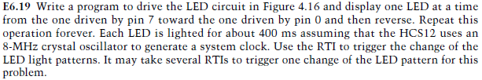
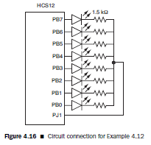
Exercises

Slide 57

Content
Fundamental Concepts of Interrupts
HCS12 Exceptions
Interrupt programming in C Language
Clock and Reset Generation Block
Computer Operating Properly
Low-Power Modes
Stop Mode, Resets
HCS12 Operation Modes

