Slide 1
Performance – meaning and metrics
Computer Organization and Architecture

Slide 2
Content
Moore’s Law
Performance and Design
Computer Metrics
Amdahl’s Law
Benchmarks
SPEC

Slide 3
Invited Lecturer: Eng. Alexandru Sisu
“Big Data: Q&As”
https://www.linkedin.com/in/alexandru-sisu-7224393
Pragmatic engineer specialised in analysing big amounts of data and scaling things. Also interested in linguistics, hence wrote a book about it (“Cognitive Biases in Reconstructing Languages” with D. Ungureanu). Getting a phd for fun (or at least trying to) by optimising the training in neural networks using special orthogonal groups and black magic. Co-founder of bigdataresearch.io. Timisoara big-data meetup group organizer. Speaker at #devtalks Romania, and local big data meetups (Timisoara, Bucharest).
WHEN? 22.04, Friday!!!, Room A109, 2 PM

Slide 4
Performance
A little old man goes into a computer store and a sales assistant approaches him.
“Can I help you, sir?”
“Yes. I’m looking for a new computer.”
“You’ve come to the right place. Is there anything you’re looking for in particular?”
“Yes, I want one with a SPEC 2006 rating of better than 350 and a total power dissipation of 150 watts. Oh yes, and I’d like a GPU with a rating of 1 TFLOPS”
“Would that be the one with the silver case or the black case, sir?”

Slide 5
Performance
These notes examine computer performance. We are interested in:
What performance is
How we measure performance
What factors affect performance
In practice, the performance of a computer is very difficult to quantify as we shall see.

Slide 6
Moore’s Law
Moore’s Law suggests an exponential increase in the maximum number of components on a chip with time.
There’s no precise formulation of Moore’s Law. The term Moore’s Law was coined by Carver Meade in 1970. Over time, Moore’s Law has also come to imply a doubling in the performance of digital systems every 18 months.
Moore’s Law is based on an observation of the progress of semiconductor technology. The trends that Gordon Moore observed in the 1960s have continued largely unbroken until 2010.
For example, the 2010 update to the International Technology Roadmap for Semiconductors (ITRS) predicted that growth would slow at the end of 2013, with a projection of a slowing of the doubling period for transistor counts and densities to every three years.

Slide 7
Moore’s Law
Moore’s Law suggests an exponential increase in the maximum number of components on a chip with time.
This is something that is probably unique in human endeavor. If a man in 1960 was sauntering along the street and he increased his speed in accordance with Moore’s law, he would be moving at 33,554,432 miles/hour in 2010 which is nearly 10,000 miles/s.

Slide 8
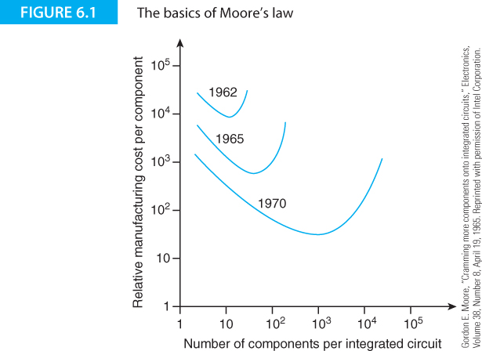

Slide 9
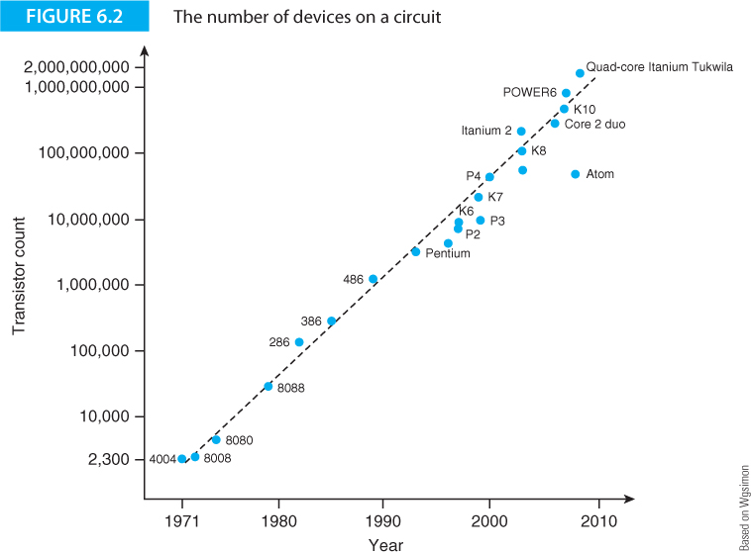
Figure 6.2 displays the number of transistors per microprocessor chip as a function of time. In barely five decades the chip density has gone from in the region of two thousand to two billion devices.

Slide 10
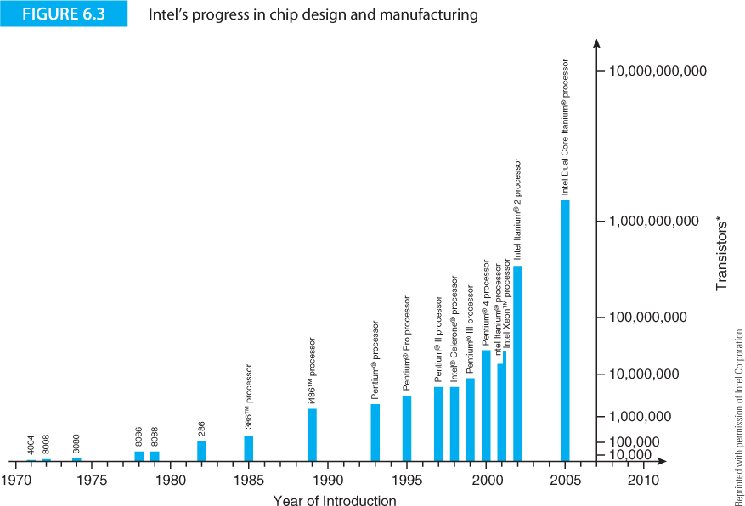

Slide 11
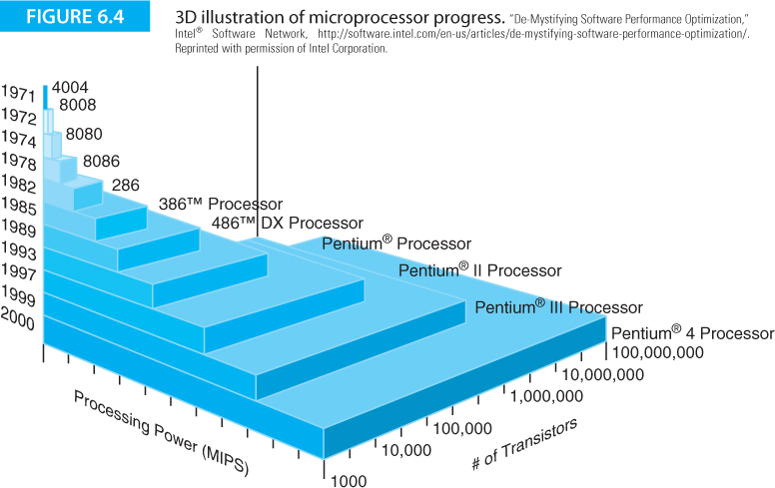

Slide 12
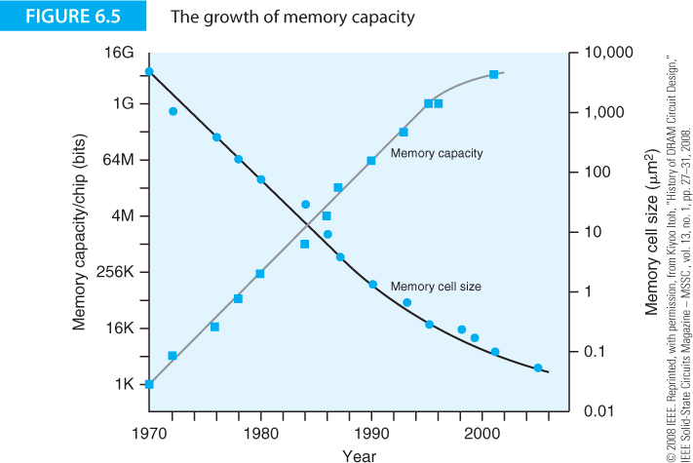

Slide 13
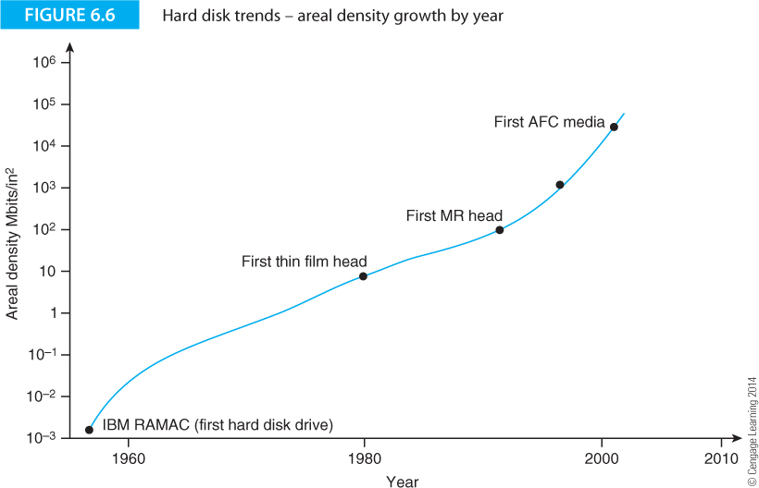

Slide 14
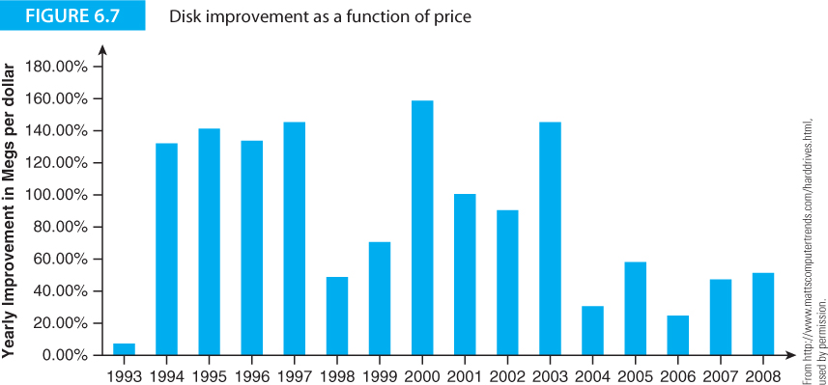

Slide 15
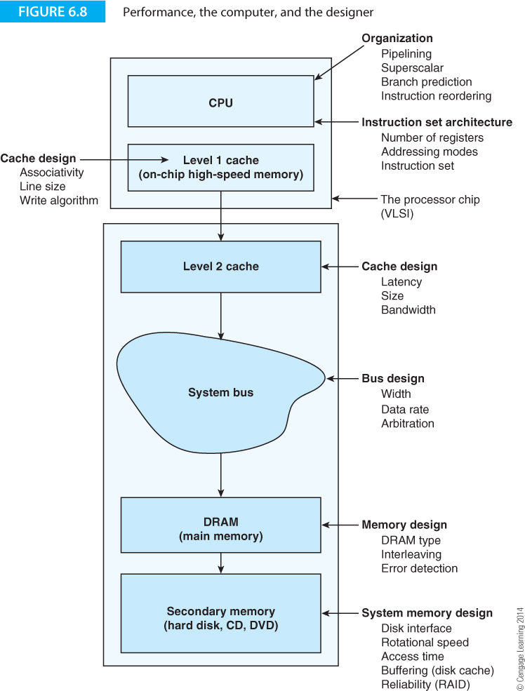
Performance and Design
Figure 6.8 shows the structure of a typical PC from the point of view of the systems designer.
The performance of a computer is dependent on factors like cache memory, main memory, buses, and secondary storage such as hard disks and optical drives.
Every one of these systems contributes to the overall performance of the computer and you cannot maximize the performance of a computer by improving only one of its components.

Slide 16
Performance and Design
The designer’s view of the computer is characterized by the parameters and specifications that have to be refined and optimized to suit any specific computer application. Only by generating appropriate metrics can anyone optimize the system being designed.
In principle, you can analyze the performance of a computer mathematically by modeling all its features. However, computers are generally too complex to model sufficiently accurately.

Slide 17
Performance and Design
David Lilja (Measuring Computer Performance: A Practitioner’s Guide) provides a list of criteria by which we can judge the metrics of computer performance:
  linearity,
  reliability,
  repeatability,
  ease of measurement,
  consistency,
  independence .
The linearity criterion suggests that a metric should be linear; that is, increasing the performance of a computer by a fraction x should be reflected by an increase of fraction x in the metric. If computer A has a metric of, say 200, and is twice as fast as computer B, then computer B’s metric should be 100.

Slide 18
Performance and Design
Performance metrics should be reliable and correctly indicate whether one computer is faster than another. You could also call this property monotonicity; that is, an increase in the value of a metric should indicate an increase in the speed of the computer and never vice versa.
This isn’t true of all metrics. Sometimes, a computer may have a metric implying a higher-level performance than another computer when its performance is worse. This situation arises when there is a poor relationship between what the metric actually measures and the way in which the computer operates.

Slide 19
Performance and Design
A good metric should be repeatable and always yield the same result under the same conditions. Not all computer systems are deterministic because the number of parameters that affect a computer’s performance is very large indeed and you can’t always achieve the same results for each test run of a program.
  Suppose you are carrying out a test that requires the reading of data from a disk. In the first run, the data may be about to fall under the read head at the time it is required and, therefore, the data will be immediately ready.
  In the next run of the same test, the data may have just passed under the read head and the system will have to wait for a complete rotation to access the data. In a third run, the data might be cached in RAM and the system will entirely bypass the disk’s hardware.
Consequently, we can have three runs of a test yielding three different metrics using the same data.

Slide 20
Performance and Design
Lilja’s ease of measurement criterion is self-explanatory. If it is difficult to measure a performance criterion, then few users are likely to make that measurement. Moreover, if a metric is difficult to measure, an independent tester will have great difficulty in confirming it.
A metric is consistent if it is precisely defined and can be applied across different systems. Perhaps this metric should be called universality or generality to avoid confusion with repeatability.

Slide 21
Performance and Design
Consistency can be difficult to achieve if the metric measures a feature of a specific processor and that feature is not constant across all platforms.
  Using clock rate as a metric demonstrates a lack of consistency because the relationship between clock rate and performance is not consistent across different platforms.
  The relationship between clock rate and the performance of a PowerPC processor is not the same as the corresponding relationship between clock rate and a Core i7 processor.
One metric that was commonly used to indicate the performance of graphics cards in PCs in the late 1990s was the maximum number frames per second at which the Quake game could refresh the display.

Slide 22
Computer Metrics
We’re going introduce some of the ways of comparing the performance of various computers. However, we have to state here that computer metrics can be notoriously unreliable. We begin by introducing some of the terminology of performance and then demonstrate why clock frequency alone is not a reliable indicated of performance.
William Thomson (1824 – 1907), the British scientist whose work on transmission lines underpins all modern electronics said:
"When you can measure what you are speaking about, and express it in numbers, you know something about it. But when you cannot measure it, when you cannot express it in numbers, your knowledge is of a meager and unsatisfactory kind. It may be the beginning of knowledge but you have scarcely in your thoughts advanced to the state of science."

Slide 23
Efficiency
A computer is, of course, always executing instructions unless it is in a halt state or suspended state.
A computer may not always be executing useful (i.e., application level) instructions because, for example, it may be repeatedly going round a polling loop waiting for data.
The efficiency of a computer is an indication of the fraction of time that it is doing useful work.
For example, if a computer takes 20 s to perform a computational task and 5 s is taken waiting for a disk that has been idle to spin up to speed, the efficiency is 20s/(20s + 5s) = 20/25 = 80%.
$$Efficiency=\frac{Total time executing useful work}{Total time}=\frac{Optimal time}{Actual time}$$

Slide 24
Throughput
The throughput of a computer is a measure of the amount of work it performs per unit time.
The upper limit to a system’s throughput can normally be determined from basic system parameters; for example, if a computer has a 500 MHz clock and it can execute up to two instructions in parallel per clock cycle and each instruction takes 1, 2, or 4 clock cycles, then the upper limit on throughput occurs when all instructions are being executed in parallel in one cycle; that is 10⁹ instructions/s.
Note that the definition of throughput includes the term amount of work because instruction execution is meaningful only if the instructions are performing useful calculations; a computer executing an endless stream of NOPs (no operations) may be operating at its peak rate but is achieving nothing other than to wait.
Instructions per second is a very poor indicator of the actual performance of a computer.

Slide 25
Latency
Latency is the delay between activating a process (for example, a memory write or a disk read, or a bus transaction) and the start of the operation; that is, latency is the waiting time.
Latency is an important consideration in the design of rotating disk memory systems where, for example, you have to wait on average half a revolution for data to come under the read-write head.
In some computer applications, the effects of latency may be negligible in comparison with processing time.
In some systems, the effects of latency may have an important effect on system performance.
Some define latency as the time to finish a process.

Slide 26
Relative Performance
We are interested in how one computer performs with respect to another. The relative performance of computers A and B is the inverse of their execution times; that is
If system A executes a program in 105 s and system B executes the same program in 125 s, we can calculate the relative performance as 125/105 = 1.190. You can say that machine A is 19% faster than B.

Slide 27
Relative Performance
When you are trying to improve a system, you are often most interested in how much better the new system is in comparison with the old system. The old system may be a previous machine, the same machine without the improvement, or even a competitor’s machine, and is called the reference machine or baseline machine. The speedup ratio is a measure of relative performance and is defined as
If a reference machine takes 100 seconds to run a program and the test machine takes 50 seconds, the speedup ratio is 100/50 = 2.

Slide 28

Time and Rate
Benchmarks can be expressed as the
time required to execute a task or
as the rate at which tasks are executed.
For example, one benchmark may yield a time of 20 s, whereas another benchmark may yield a rate of 12 tasks/s.
The computer game Quake has become a popular benchmark for PCs with the figure of merit being the rate at which frames are displayed by the processor (although the Quake frame rate is probably a reasonable indication of how your computer performs relative to other computers running Quake, it is not a good general benchmark).
They say people feel more comfortable with metrics that increase numerically with performance (i.e., rate) rather than those that reduce with performance (time).

Slide 29
Time and Rate
Time and rate benchmarks don’t behave in the same way with respect to averaging.
Suppose we benchmark a computer and get execution times for tasks A and B, respectively, of 2 and 4 seconds.
We can also say that the rates at which tasks A and B execute are 0.5/s and 0.25/s, respectively.
The average execution time is ½(2 + 4) = 3s. The average rate of execution for the tasks is ½(0.5 + 0.25) = 0.375.
The average execution time is 3s. This is an average rate of 1/3s = 0.333/s, which is not the same as the 0.375/s that we calculated by averaging the rates.

Slide 30
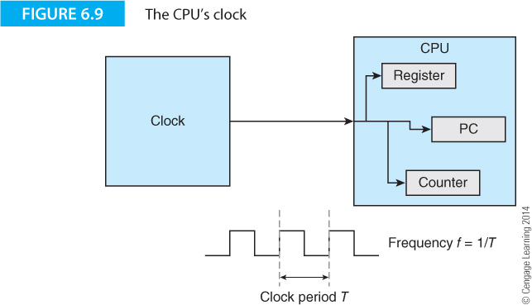
Clock Rate
The obvious indicator of a computer’s performance is its clock rate, the speed at which internal operations are carried out within the computer.
Using the clock rate as a metric to compare processors is probably the worst metric by which to judge computers.
Figure 6.9 illustrates the CPU clock. At each clock cycle, the processor carries out an internal operation. At first sight it's tempting to think that the processor’s performance is proportional to its clock rate and therefore clock rate is a precise metric.
Is this true?

Slide 31
Clock Rate
There is no single clock in most computers. Some systems may have entirely independent clocks (i.e., there’s a separate clock generator for each functional part such as the CPU, the bus, and the memory).
The CPU itself may have several functional units, each driven by its own clock. Some systems have a single master clock that generates pulses at the highest rate required by any circuit and all other clocks run at a sub-multiple of this frequency.
Some processors have variable clock rates. For example, mobile processors designed for use in laptops can reduce the clock rate to conserve power. This is called clock throttling or dynamic frequency scaling.
Some processors switch to a lower clock speed if the core temperature rises and the chip is in danger of overheating.

Slide 32
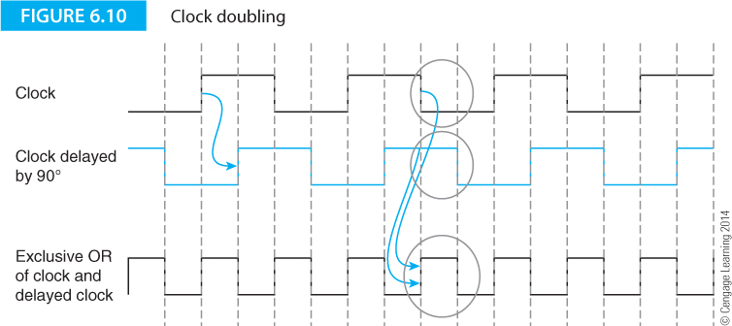
Note – the frequency of a clock can be doubled using simple logic

Slide 33
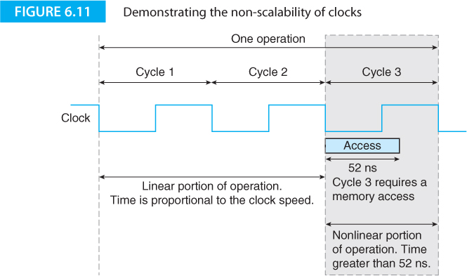
Clock scaling
Let’s look at speeding up the clock. Consider Figure 6.11.

Slide 34
Three cycles are required to perform an operation. The first two clock cycles are scalable and we can increase the clock rate.
The third cycle has an operation that requires 52 ns for its completion. If the clock cycle is less than 52 ns then cycle three must be stretched either by slowing the clock or by lengthening cycle three (by wait states)

Slide 35
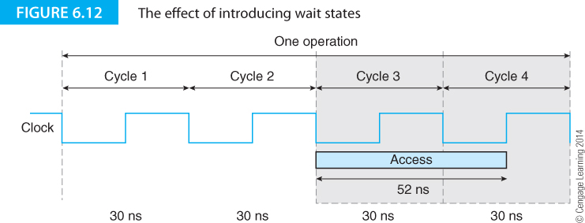
It’s difficult to alter the clock rate from clock pulse to clock pulse.
Most systems extend an operation by an integer number of cycles called wait states. In figure 6.12, the cycle time is 30 ns and the 52 ns memory access requires two cycles. The operation now takes 4 x 30 ns to complete.
The non-scalable clock property of systems described by Figure 6.11 demonstrates why some computers become unstable if you try and overclock them (a mechanism beloved of hackers who clock processors at a rate higher than that specified by the manufacturer).

Slide 36
Is Megahertz Enough?
The following is taken from an IDC (Independent Directors Council) White Paper written by Shane Rau and sponsored by AMD .
PC buyers often rely on the clock speed of a PC's microprocessor to determine their purchasing decision. Because the industry lacks a simple, universally accepted way to judge performance, users have become conditioned to substituting clock speed to gauge how fast their applications will run. This practice has grown common over many years because:
The popularization of the PC among general consumers has increased the available pool of buyers unfamiliar with factors in PC performance.
The growth of the direct model of PC purchases has made it more likely that the actual end user will buy a PC without the help of a third party familiar with factors that influence PC performance.
The increasing sophistication of the PC exposes the buyer to a growing number of often arcane technical specifications, from which clock speed promises a convenient escape.

Slide 37
Is Megahertz Enough?
In some ways, the power barrier has rendered clock speed arguments rather moot.
Since about 2008, clock speed has ceased to increase dramatically because the limits of power dissipation have been reached and power dissipation is proportional to the square of the clock frequency.
Manufacturers have directed their efforts towards multicore processors rather than faster processors.
Clock speeds may rise again if power consumption falls because of the introduction on new semiconductor materials or because of circuit innovations such as asynchronous clocking where circuits are not driven by a master clock and one event triggers another.
Asynchronous circuits can operate at up to 70% lower power levels than their clocked counterparts, but design, testing, and verification is problematic.

Slide 38
MIPS
A slightly better metric than clock rate is MIPS, or millions of instruction per second.
This metric removes the discrepancy between systems with different numbers of clocks per operation by measuring instructions per second rather than clocks per second.
For a given computer
where n is the number of instructions executed and t_{execute} is the time taken to execute them.

Slide 39
MIPS
The MIPS rating is a poor metric that fails for the same reason as the clock rate.
MIPS tells you only how fast a computer executes instructions, but doesn’t tell you what is actually achieved by the instructions being executed.
Consider the following example of computation on two computers A and B, where computer A has a load/store architecture without a multiplier and B has a memory-to-register architecture. Computer A is more verbose than B. Both the computers evaluate the expression z = 4(x + y).
Computer A (LOAD/STORE) | Computer B (memory-register)
LDR r1,[r0] ;load x LDR r2,[4,r0] ;load y ADD r2,r1,r2 ;x+y ADD r2,r1,r2 ;2(x+y) ADD r2,r2,r1 ;4(x+y) STR r2,[8,r0] ;store z | LDR r1,[r0] ;load x ADD r1,[4,r0] ;x+y MUL r1,#4 ;4(x+y) STR r1,[8,r0] ;store z

Slide 40
MIPS
Suppose computers A and B have the same MIPS and execute code equally rapidly.
If you relied solely on MIPS as a metric of performance, you'd conclude that the computers offer the same performance.
As you can see, computer B is faster than computer A because only four instructions are required to do the work (this argument is based on the assumption that all instructions take the same time).
In practice, computer A might be faster than B because memory-to-register architectures are slower than register-to-register architectures.

Slide 41
MIPS
MIPS is sensitive to the way in which a compiler generates code.
The duration of a single instruction is cycles x t_{cycle}, where cycles is the number of machine cycles required to execute the instruction and t_{cycle} is the cycle time (usually the clock period).
The total execution time for a program is given by:
t_{execution} = t_{cycle} x ∑n_{i} x c_{i}
where n_{i} is the number of times instruction i occurs in the program and c_{i} is the number of cycles required by instruction i.
If we plug this formula into the equation for MIPS, we get

Slide 42
Example 1: A program is compiled to run on a computer and the compiler generates two million one-cycle instructions and one million two-cycle instructions. If we assume that the cycle time is 10 ns, the time taken is given by:
2 x 10⁶ x 1 x 10 ns + 1 x 10⁶ x 2 x 10 ns = 4 x 10⁶ x 10 ns = 4 x 10⁻²s.
Suppose that a different compiler generates code for this problem but with 1.5 million one-cycle instructions and 1.2 million two-cycle instructions. Now the time required to execute the code is
1.5 x 10⁶ x 1 x 10 ns + 1.2 x 10⁶ x 2 x 10 ns = 3.9 x 10⁶ x 10 ns = 3.9 x 10⁻²s.
=> The second compiler generated faster code.
Now let’s evaluate the MIPS for each case. In the first case, the MIPS is given by

Slide 43
MIPS
MIPS = 3 x 10⁶/(10 ns x (2 x 10⁶ x 1 + 1 x 10⁶ x 2) x 10⁶) = 0.75 x 10² = 75 MIPS
In the second case, the MIPS is given by
MIPS = 2.7 x 10⁶/(10 ns x (1.5 x 10⁶ x 1 + 1.2 x 10⁶ x 2) x 10⁶)
= 0.69 x 10⁻² = 69 MIPS
The faster computer has a lower MIPS even though it is clearly superior to the slower computer.
This failure of the MIPS metric is inevitable because instruction throughput takes no account of how much work each instruction actually performs.

Slide 44
MIPS
The average number of clock cycles per instruction is determined by the instruction mix (i.e., the relative number of 1-cycle, 2-cycle, 3-cycle instructions etc.) and by the organization or logic design of the processor.
F_{i} is the fraction of instructions taking C_{i} clock cycles to execute.
The value of N is the length of the longest instruction in terms of clock cycles.
Notes:
In a non-scalar processor, the value of i ranges from 1 (one instruction per cycle) to N.

Slide 45
The clock period is governed by: device physics, the ability to dissipate heat, and the chip’s logic design.
The rate at which signals propagate through semiconductor devices can be improved only either shrinking the device or by changing the semiconductor’s electronic properties.
When a signal changes level in a chip, it is necessary to charge inter-electrode capacitances of the transistors on the chip. This process requires energy and raising the switching rate increases the energy consumption.
Since all energy eventually ends up as heat, increasing the clock rate causes the chip to become hotter. This heat can be dissipated only via conduction to the outside. The maximum clock rate is often limited by the ability of system to dissipate heat.

Slide 46
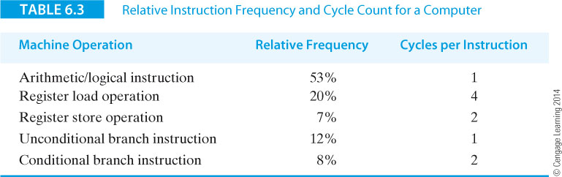
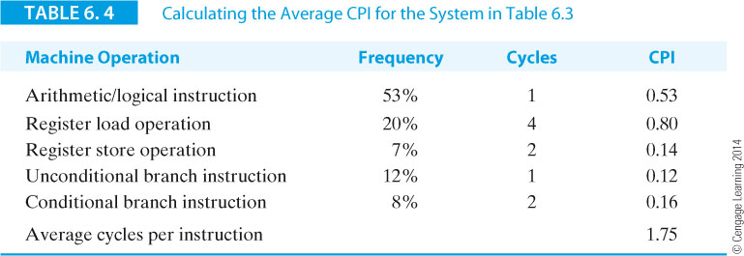
A benchmark runs on a hypothetical processor to give the results in Table 6.3. We can obtain the cycles per instruction for each class of operation by multiplying the frequency by the instruction to get the values in Table 6.4.

Slide 47
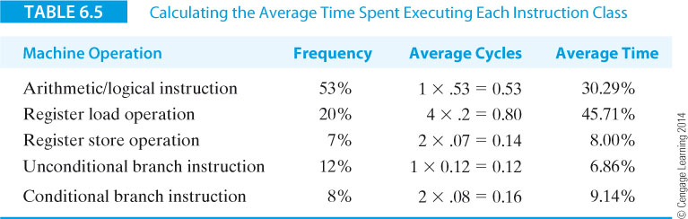
We can also relate the relative instruction frequencies to the percentage of time an instruction class takes by multiplying the instruction class frequency by the number of cycles and dividing the result by the average cycles per instruction (i.e., 1.75), Table 6.5.
In Table 6.5 the register load instruction takes up 20% of the code, but is responsible for 45.71% of the processor cycle time; this is telling us that loading registers from memory is expensive.

Slide 48
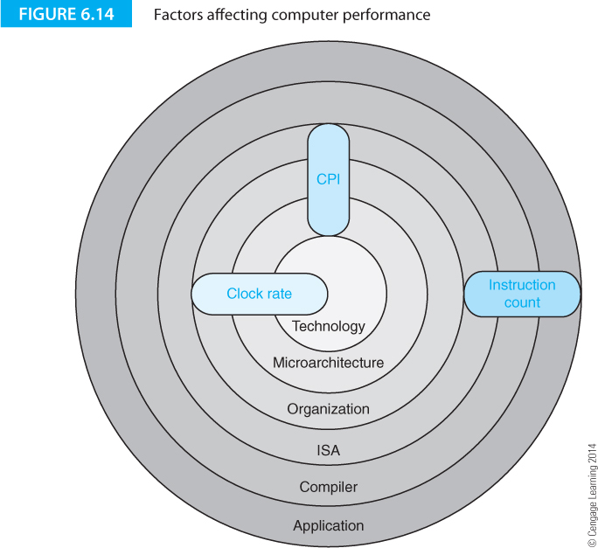
Figure 6.14 sums up the relationship between clock rate, MIPS, instruction count, and computer systems design. The concentric layers represent the components of a computer from its technology to the programs that run on it. The three ovals in blue represent the factors that affect the performance of the system, such as clock rate. This figure demonstrates (approximately) the relationship between the design layers and the performance factors.

Slide 49
MFLOPS
MFLOPS indicates millions of floating-point instructions per second.
In principal, the same objections to MIPS apply to the MFLOPS metric and therefore you might expect MFLOPS to be as poor an indicator of performance as MIPS.
MFLOPS is a better metric than MIPS because MFLOPS measures the work done rather than instruction throughput.
MIPS counts all instructions executed by a computer, many of which perform no useful work in solving a problem (e.g., data movement operations).
MFLOPS considers only floating-point operations which are at the heart of the algorithm being implemented.

Slide 50
MFLOPS
The MFLOPS metric isn’t easy to understand because all computers don’t implement floating-point arithmetic in the same way.
One computer might use dedicated hardware to calculate a trigonometric function such as a sine, whereas another computer might evaluate sin(x) by directly evaluating the appropriate series for sin(x).

Slide 51
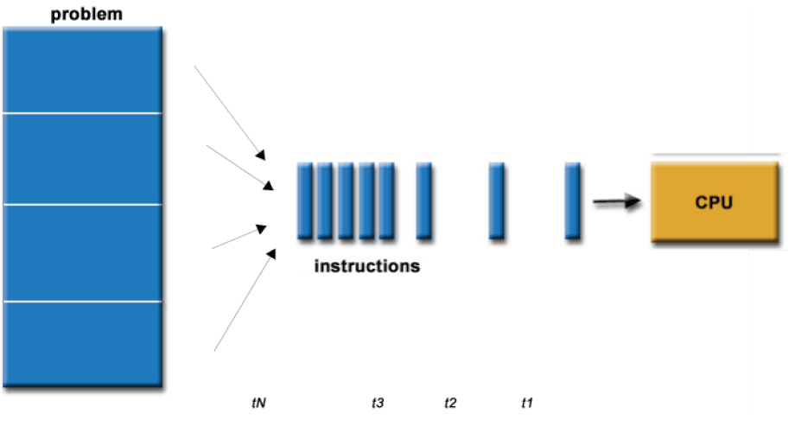
Sequential programming
Most applications are written by logic sequential
The application is executed on a single processor
The problem is divided into a series of processor instructions
Instructions are executed sequentially
Only one instruction is executed at a given time

Slide 52
The performance of sequential execution
Speed calculation: number of operations per second
If an application requires N operations
These operations are running a fraction f rate
V_{F} and the rest is done with speed V_{S}
The total time of execution:
Application performance:

Slide 53
The performance of sequential execution
In sequential applications, if there are blocks of operations running at a speed much lower than the rest operations, the performance of the whole application may be limited by their effects.
In order to obtain the highest possible performance at execution of sequential applications must be identified the blocks that requires the largest number of operations (f) and must implemented with as higher performance (V_{F})
How can an application be optimized?
How can we identify those blocks from the application that affect the performance (algorithm)?

Slide 54
The performance of sequential execution

Slide 55
The performance of sequential execution. Code profiling
Profiling application is a tool used to investigate the behavior of a software application at runtime.
Valgrind
  Valgrind is a suite of simulation based debugging and profiling tools for applications running on Linux operating system
Gprof, sprof
  Another popular profiling tool for Linux is the GNU profiler, gprof

Slide 56
The performance of sequential execution. Code profiling
ValGrind
  This tool consists of a core, which implements a synthetic processor, and a set of plugins, each of which performs certain type of profiling or debugging task
  memcheck - detects memory management problems;
  cachegrind - a cache profiler which performs detailed simulations of I1, D1 and L2 in the CPU. Using this tool the source code in an application that generate a large number of cache misses is detected;
  callgrind - is a call graph generating profiler. It is very useful for determining bottleneck functions in an application therefore it is used for optimizing a program;
  massif - is a heap profiler that measure how much heap memory a program uses;
  helgrind - detects synchronization errors in programs that use pthreads threading
https://www.youtube.com/watch?v=fvTsFjDuag8&nohtml5=False

Slide 57
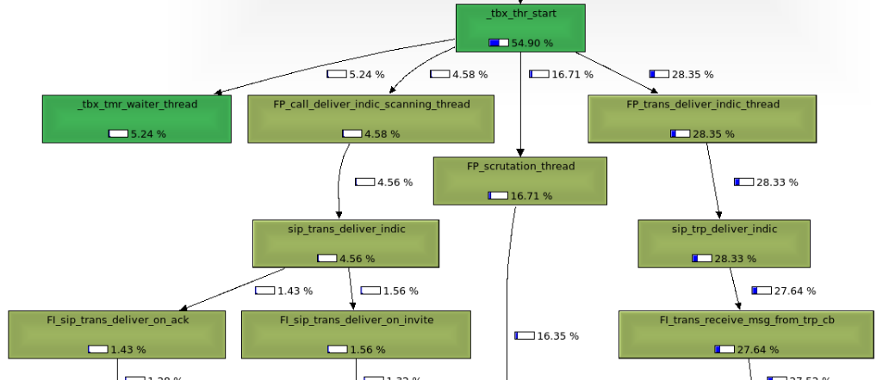
The performance of sequential execution. Code profiling

Slide 58
The performance of sequential execution. Code profiling
gprof
  this tool has two major disadvantages:
    need the application to be recompiled with enable profiling option and
    it does not work with shared libraries
  The alternative of gprof is the internal profiling feature of Linux dynamic linker and loader module, by using the environment variables LD_PROFILE and LD_PROFILE_OUTPUT
sprof
  If LD_PROFILE is set with the name of a shared library, when running one application which uses this library, a profiling file is generated.
  sprof command is further used to extract flat or call graph data from the profiling file
VTune
  uses performance monitoring hardware to collect statistics and coding information of your application and its interaction with the microarchitecture

Slide 59
The performance of sequential execution. Code profiling

Slide 60
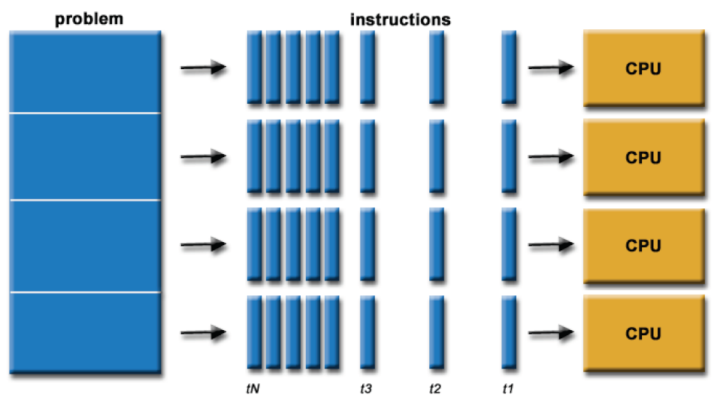
The performance of parallel execution
An application (algorithm, task) can be executed sequentially on a uniprocessor system
Or the application can be decomposed into several tasks that run simultaneously on multiple processors
How to express the performance of applications executed on a multiprocessor system compared to execution on a uniprocessor system?

Slide 61
The performance of parallel execution
MIPS and MFLOPS are no match for parallel systems performance measurement.
There are other parameters that can estimate the performance of parallel applications:
  Speedup
  Efficiency

Slide 62
Amdahl’s Law
The most famous law governing computer performance is Amdahl’s law.
It’s also an infamous law because it appears to place a limit on the maximum performance increase that can be achieved by optimizing a computer’s subsystems.
Amdahl’s law describes the performance increase you get when a program is run in a system where some of the operations can take place in parallel.
Amdahl’s law tells you what performance increase you get for greater parallelism.
Amdahl’s law is applicable to any system where you are interested in the effect of local improvements on the system globally.
Amdahl’s law highlights the effects of bottlenecks in a system.

Slide 63
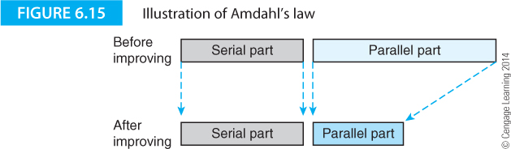
Amdahl’s Law
Figure 6.15 illustrates the effect of parallelizing part of an activity.
The diagram demonstrates that the serial (irreducible) part of the process remains the same while the parallel (reducible or improvable) part of the system is reduced.
Ultimately, system performance is dominated by the serial part of the system and the motto of the computer designer has become make the common case fast.

Slide 64
Amdahl’s Law
Suppose a computer executes a program on a single processor in time t_{s} seconds. If we have p processors and the program is divided into p equal chunks, the same program will run in t_{s}/p seconds.
Assume that a fraction of the program f_{p} can run on the p processors and a fraction f_{s} can run only on one processor.
The execution time on the parallel computer system T_{p} will be:
T_{p} = t_{s}⋅f_{s} + t_{p}⋅f_{p}
Since f_{s} + f_{p} = 1 and t_{p} = t_{s}/p, we can write T_{p} = t_{s}(f_{s} + (1 - f_{p})/p)
The speedup ratio for this system is the ratio of the speed without parallelization to the speed with parallelization; that is, S = t_{s}/T_{p}.

Slide 65
Amdahl’s Law
Amdahl’s law illustrates the effect of a bottleneck on system performance and shows that there is a limit beyond which attempts at further improvement are futile, unless the bottleneck can be removed.
The most popular formulation of Amdahl’s law is

Slide 66
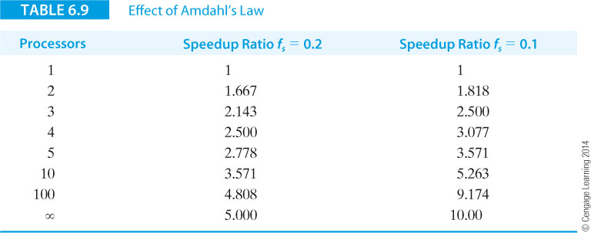
Example 2: Consider the two cases in Table 6.9 in which f_{s} = 0.2 and f_{s} = 0.1, respectively for various degrees of parallelism.
The speedup ratio falls off rapidly once the serial part of the process begins to dominate the equation.
In the limit, an infinite number of processors cannot make the speedup ratio greater than the reciprocal of the fraction of time devoted to serial processing.

Slide 67
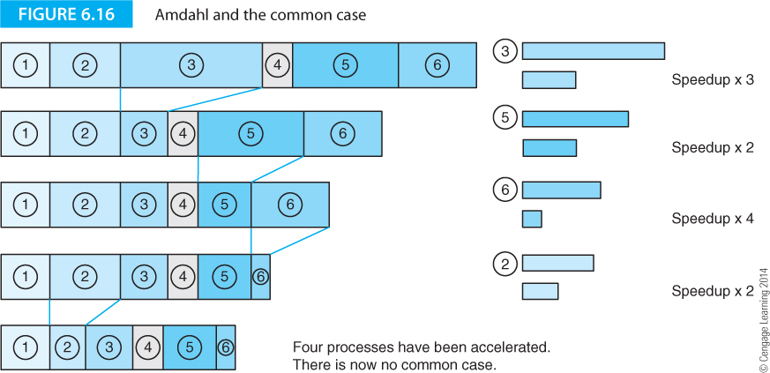
Example 3: we have an operation that consists of six sequential operations or processes as described in Figure 6.16.
Five of the processes are accelerated using the stated factors. This shows the change in the total time after each process has been accelerated.
By the time the bottom line has been reached, the six processes are now of roughly similar durations. We have reached the state at which the common case has been eliminated and there is nothing left to accelerate.

Slide 68
Benchmarks
The ideal program with which to evaluate a computer is the one you are going to run on that computer. Unfortunately, it’s normally impractical to carry out such a test. Moreover, computers execute a mix of programs that changes from moment to moment.
One approach to benchmarking is based on kernels or fragments of real programs that require intense computation, such as the LINPACK benchmark.
Another approach is to run synthetic benchmarks that are programs constructed for the express purpose of evaluating computer performance and which purport to be similar to the type of code that users might actually execute.
Benchmarks can be divided into two categories: fine-grained and coarse-grained. The granularity of a benchmark is a function of the object being measured; for example, a benchmark that measures the performance of a complete computer system can be considered coarse-grained, whereas a benchmark that measures the performance of, say, branch instructions, can be considered fine-grained.

Slide 69
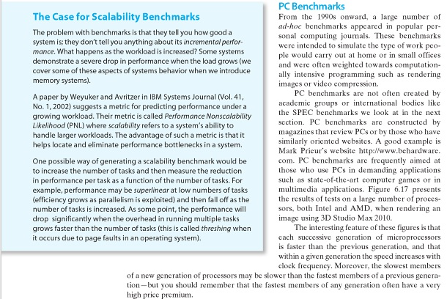
Benchmarks. PC Benchmarks

Slide 70
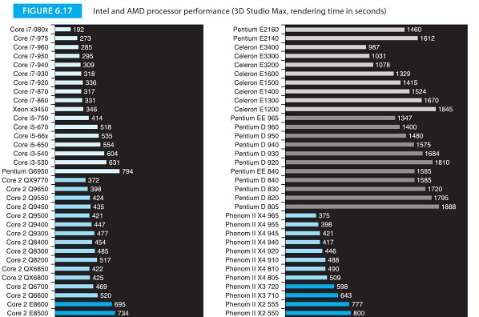
Benchmarks. PC Benchmarks

Slide 71
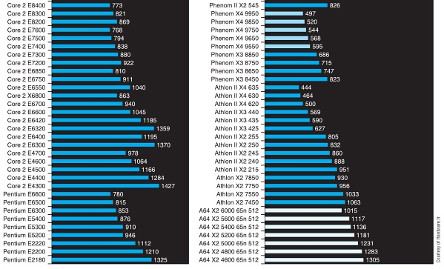
Benchmarks. PC Benchmarks

Slide 72

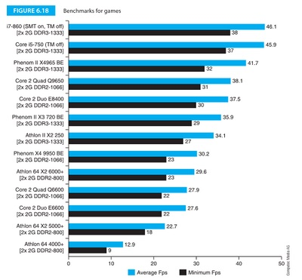
Benchmarks. PC Benchmarks

Slide 73
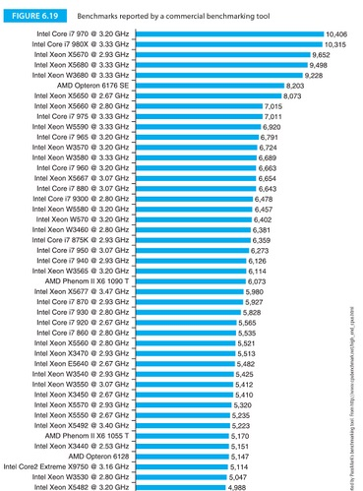
Benchmarks. PC Benchmarks

Slide 74
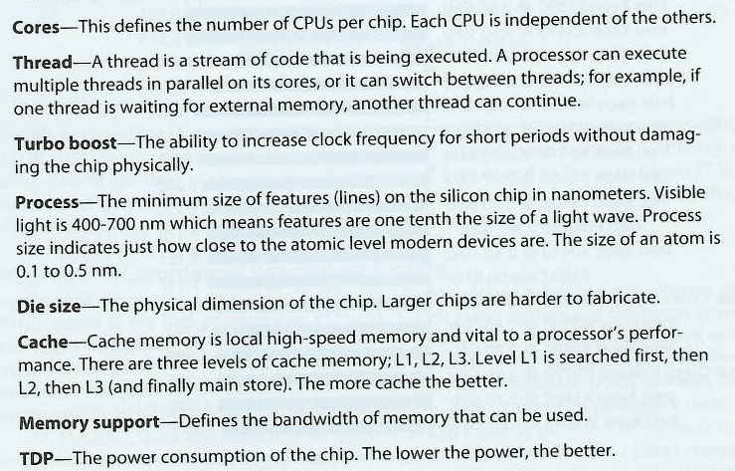
Benchmarks. Comparison of High-Performance Processors
Another example of processor performance is from HEXUS. Table 6.10 illustrates basic data for high-performance IA32 architectures in late 2010

Slide 75
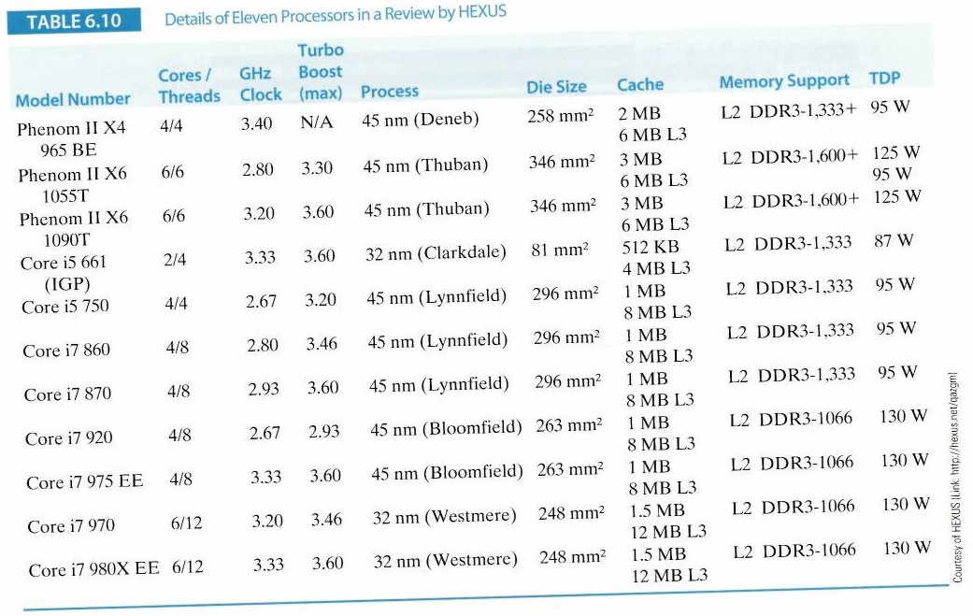
Benchmarks. Comparison of High-Performance Processors
Another example of processor performance is from HEXUS. Table 6.10 illustrates basic data for high-performance IA32 architectures in late 2010

Slide 76
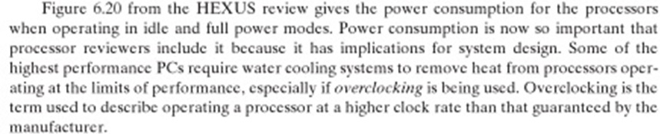
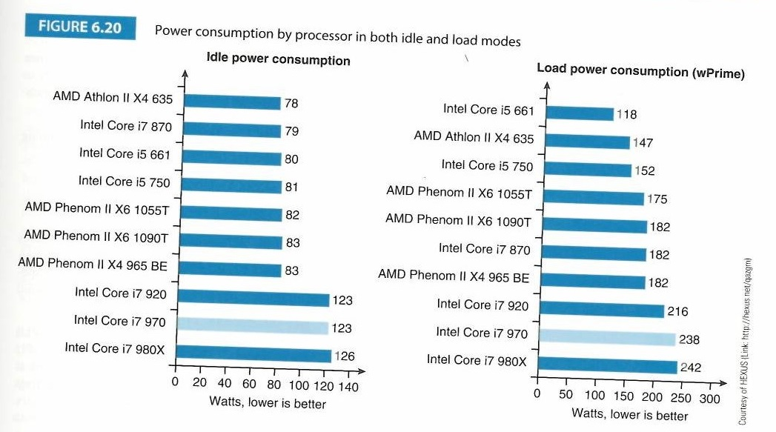
Benchmarks. Comparison of High-Performance Processors

Slide 77


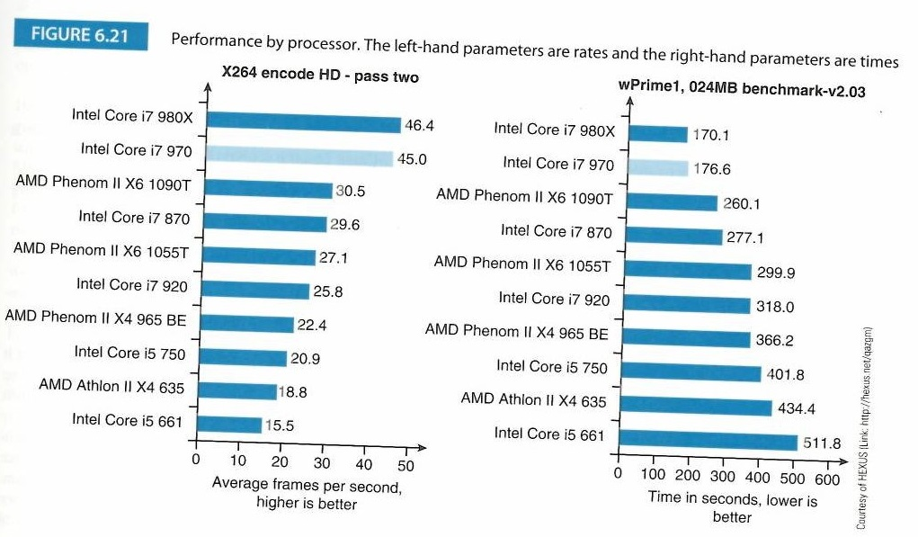
Benchmarks. Comparison of High-Performance Processors

Slide 78
SPEC
Various organizations exist to offer the consumer unbiased advice, whether it be about the quality of systems or the safety of automobiles.
Such an organization has arisen to create benchmarks. SPEC, the Standard Performance Evaluation Corporation, is a non-profit making organization with the status of a charity that’s been formed to establish, maintain and endorse a standardized set of relevant benchmarks that can be applied to the newest generation of high-performance computers.
The user is responsible for compiling the benchmarks before they are run. SPEC allows two types of compilation. One type of compilation is restrictive in terms of compiler flags and switches and that provides a base result. The other type of compilation is more liberal and allows switches to be optimized for each individual program. This provides a peak metric.

Slide 79
SPEC
SPEC benchmarks appeared in 1988 with SPEC89, a suite of ten programs. The next major change was in 1992 when SPEC CINT92 (6 integer programs) and SPEC CFP92 (14 floating-point programs) were published. In 1995 SPEC CINT95 and SPEC CFP95 (8 integer, 10 floating-point programs, respectively) were introduced. The fourth revision to the benchmarks was SPEC CPU2000 with SPEC CINT2000 and SPEC CFP2000 (12 integer and 14 floating-point programs). SPEC 2000 also introduced benchmarks in C, C++, Fortran 77, and Fortran 90. SPEC 2006 uses 12 integer programs and 17 floating-point programs.
SPEC suites have changed to remove some of their inefficiencies and errors; for example, in 2001 SPEC CPU95 was retired and replaced by CPU2000.
In turn, CPU2000 was replaced by CPU2006. The benchmark programs of a SPEC suite vary over a wide range of applications; from Lisp interpreters to compilers to data-compression programs in older SPECs, and from Quantum mechanics to fluid dynamics in more recent SPECs. The complexity of applications grows with each new set of SPEC benchmarks to reflect the increasing demand on computers.

Slide 80
SPEC Methodology
The SPEC methodology is to measure the time required to execute each program in the test suite; for example, the times might be T_{p1}, T_{p2}, T_{p3},… where the subscripts p1, p2, etc refer to the components of the suite.
The SPEC suite is also executed on a so-called standard basis machine to give the values B_{p1}, B_{p2}, B_{p3},…
The measured times are divided by the reference times to give the values T_{p1}/B_{p1}, T_{p2}/B_{p2}, T_{p3}/B_{p3},… This step normalizes the execution times of the components of the SPEC suite.
Finally, the normalized times are averaged to generate a final SPEC metric for the machine being tested.

Slide 81
SPEC Methodology
Here, we will simply state that the individual SPEC benchmarks are averaged by taking the geometric mean, rather than the arithmetic mean.
The geometric mean is calculated by multiplying together n values and then taking the nth root; for example, the arithmetic mean of the values 4,5,6 is (4+5+6)/3 = 3 and the geometric mean is ³√4 x 5 x 6 = 3.915.

Slide 82
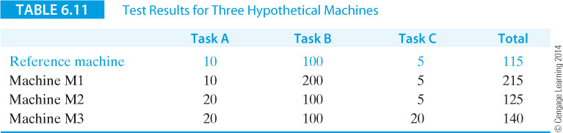
SPEC Methodology
The advantage of normalizing a machine with respect to a standard machine is that large differences in individual benchmarks is reduced.
Suppose that a reference machine takes 10, 100, and 5 seconds to perform tasks A, B, and C, respectively. Now, imagine that three test machines M1, M2, and M3 are tested to give the results specified in Table 6.14.
Machine M2 has the best execution (total) time.

Slide 83
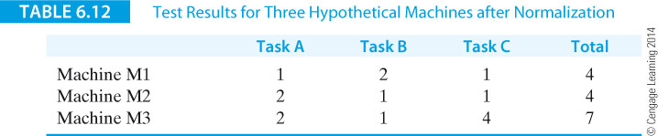
SPEC Methodology
Table 6.15 gives the same results normalized to the reference machine.
As you can see, test machine M3 has the worst case execution time.

Slide 84
SPEC Methodology
The SPEC benchmarks are sometimes called the best of a bad lot or the best metrics in the absence of anything that is more successful.
A criticism of SPEC is that it is CPU intensive and doesn’t test the computer system. In particular, the effect of memory systems is not fully taken into account. Moreover, the SPEC tests are not necessarily representative of the type of workload found in a multitasking environment – although the situation appears to have improved with the introduction of SPEC CPU2006.
The SPEC organization has been criticized for periodically changing its benchmarks. You could say that this prevents all systems being compared against an agreed baseline. Equally, you could say that the nature of computers is changing and the way in which they are used is changing, and therefore it is essential to update the basis for comparison.

Slide 85
SPEC Methodology
The SPEC benchmarks are sometimes said to be given in unitless values because the actual measurements for a given machine are divided by the same measurements for the reference or baseline machine.
For example, if the test machine gives the values 1s 10s 10s and the reference machine gives 2s 10s 20s, the normalized unitless results are ½ 1 ½.
However, we will see that these values do have the properties of either time or rate with respect to averaging and it is necessary to employ the appropriate averaging technique.

Slide 86
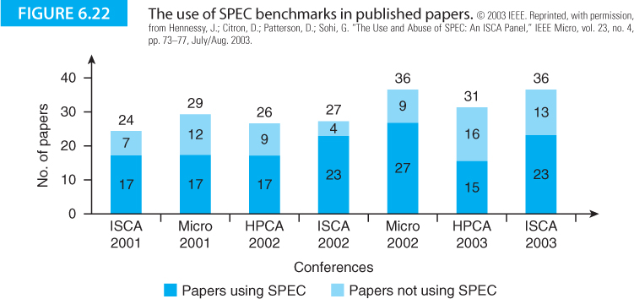
SPEC Methodology
The SPEC benchmarks have proved very successful in some areas. Figure 6.19 gives the number of papers on computer architecture submitted to computer architecture conferences between 2001 and 2003.
These papers are divided into those that use the SPEC benchmark and those that don’t. SPEC is employed by a large majority of researchers.

Slide 87
SPEC CPU2006 and the Academic Community
One of the key users of SPEC benchmarks is the computer architecture research community. A paper by Sarah Bird provides an insight into how SPEC benchmarks are used. This paper looks at CPU2006 benchmarks as applied to Intel’s Core processors. Both CPU2006 integer and floating point benchmarks are examined in terms of their interactions with the processor architecture; for example, the benchmarks are broken down in terms of instruction mix. It is instructive to see the percentages of branches, loads and studies in the 12 integer and 17 floating-point benchmarks.
In the integer benchmarks, the percentage of branches ranges from 7.5% to 27.3%; the percentage of loads ranges from 14.4% to 35%, and the percentage of stores ranges from 4.6% to 17.7%. For the floating-point benchmarks, the corresponding ranges are 0.2 – 16.4% (branches), 23.3% - 46.5% (loads), and 3.0% - 14.5% (stores).
These figures tell you what aspects of the computer architecture are being tested (or stressed) by the benchmarks.

Slide 88
SPEC CPU2006 Benchmarks
SPEC CPU2006 integer benchmarks are written in either C or C++, two languages that are widely used in academia, the graphics world, and high-performance computing.
These benchmarks cover both commercial and scientific applications. One of the key features of CPU2006 is that the benchmarks represent real-world applications rather than synthetic applications.
The 17 floating-point SPEC CPU2006 benchmarks are written in C, C++, and FORTRAN (used in numerical applications in the engineering world.

Slide 89
SPEC and Power
Power is now a first-class consideration in computer design and had become a component of benchmarking. SPEC has created a standard to measure a server’s power and performance across multiple loads, SPECpower_ssj2008.
The metric reports the server’s performance in ssj_ops (server side Java operations per second) divided by the power consumed in watts.
This benchmark is primarily intended for servers in commercial applications where power consumption is of importance; that is, the cost of buying the power at a time when energy costs are rising, the cost of cooling and ventilation to remove the power, and the additional cost due to increased failure rate in hot environments.

Slide 90
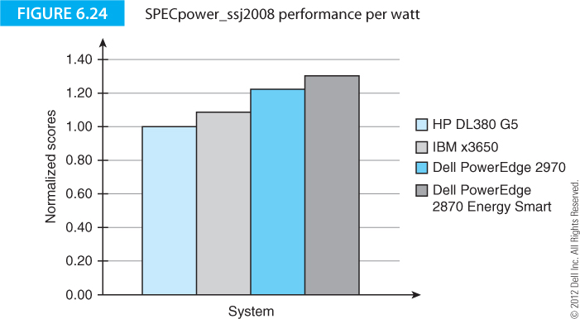
Figure 6.24 from Dell provides an example of the normalized performance per watt for four commercial servers.

Slide 91

Content
Moore’s Law
Performance and Design
Computer Metrics
Amdahl’s Law
Benchmarks
SPEC

Slide 92
Additional resources:
  Benchmarking Your Gaming PC https://www.youtube.com/watch?v=RUhNrCjV3RM
  Tech Reviews:
    http://www.anandtech.com/
  Intel Skylake Core i7 6700K vs 4790K/3770K/2600K Stock Gaming Benchmarks
    https://www.youtube.com/watch?v=VDo-j00vUtw
  Quake Live Test
    https://www.youtube.com/watch?v=3kVX8elibLc
    https://www.youtube.com/watch?v=25lss9hyczs
  Intel Core i7-6700K Review & Gaming Benchmarks https://www.youtube.com/watch?v=5o-bBT6GDmg

Slide 93
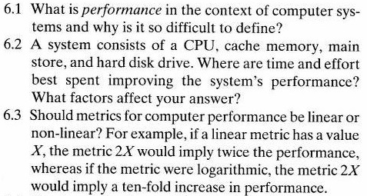
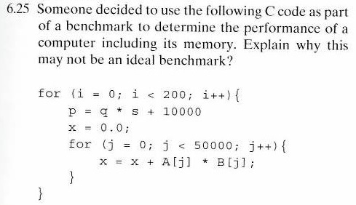
Homework
Max. 1000 words for first 3 questions

