Slide 1
Superscalar, VLIW, and Itanium
Razvan Bogdan
Microprocessors Systems

Slide 2
Content
Superscalar Architecture
VLIW Processors
The IA64 Itanium architecture

Slide 3
We now look at how computer performance has been pushed beyond the limit of one instruction per cycle set by pipelining, and introduce superscalar processing that uses multiple ALUs to enable instructions to be executed in parallel.
Superscalar computers are also referred to as post-RISC processors.
We introduce the very long instruction word, VLIW, processor that encodes multiple operations in a single instruction.
We provide an introduction to Intel’s IA64 architecture, Itanium, that combines several powerful architectural features to enhance its performance.

Slide 4
Parallel Execution
Superscalar processors rely on arranging instructions so that they can be executed simultaneously. Consider:
ADD r1,r2,r3
ADD r5,r4,r1 ;cannot be executed until r1 created
ADD r6,r5,r7 ;cannot be executed until r5 created
The above code cannot be executed in parallel because of data dependency. However, the following fragment can be executed in parallel.
ADD r1,r2,r3
ADD r4,r5,r6 ;no waiting for r5 and r6
ADD r7,r8,r9 ;no waiting for r8 and r9

Slide 5
Architecture, Organization, Performance, and Challenges
The instruction sets of today’s processors are remarkably similar to ISAs of the 1980s. However, their organization has changed dramatically. Changes in the way we implement processors has considerably increased performance.
A purist could maintain that organization and architecture are independent. However, a particular architecture may have a preferred organization. Pipelining is easier to implement in RISC than in CISC architectures, although Intel has successfully married CISC with pipelining.
Superscalar organization extends the performance gains of pipelining by using multiple execution units. Pipelining and superscalar technologies are orthogonal in the sense that they are independent of each other.
Superscalar organization creates new challenges for the systems designer, because of structural hazards – conflicts that occur when different instructions request the same resources. For example, if two additions are computed sequentially, the state of the zero flag can be tested separately after each addition. However, if the additions are performed in parallel, then what meaning is associated with testing the status flag?

Slide 6
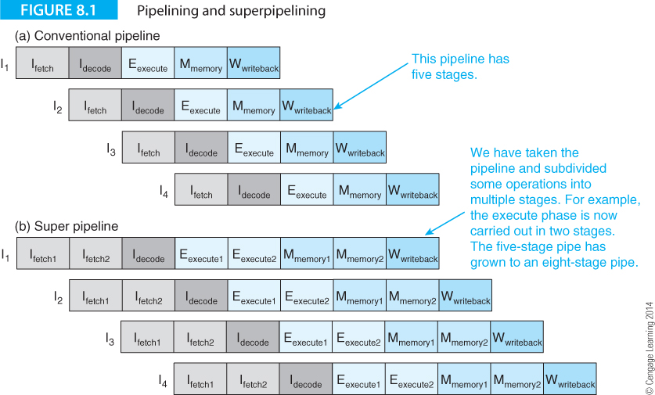
Superscalar Architecture
Let’s first look at how pipelining can be extended. Figure 8.1a illustrates pipelining where instruction execution is overlapped.

Slide 7
Superscalar Architecture
Figure 8.1b illustrates superpipelining where some stages are subdivided; for example, the fetch stage is split into I_{fetch1} and I_{fetch2}, whereas the decode stage remains a single operation.

Slide 8
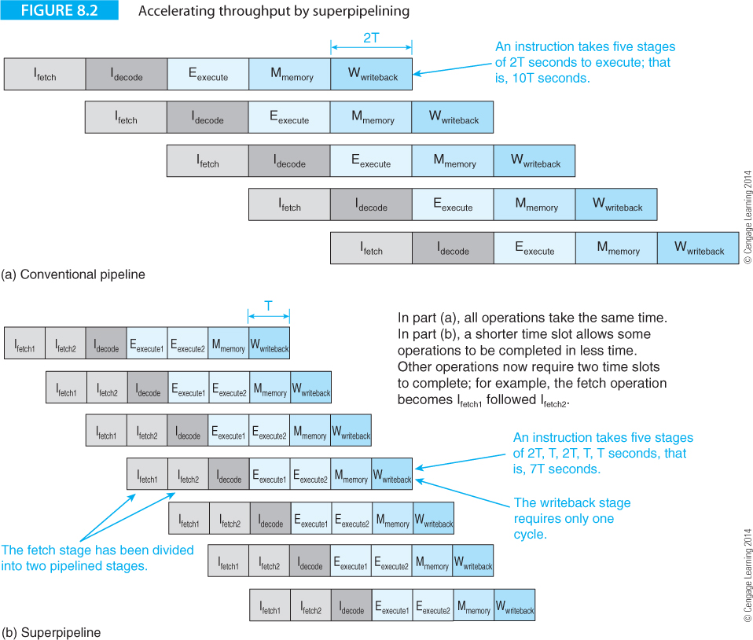
Figure 8.1 doesn’t tell you what is happening because it omits time. Figure 8.2 demonstrates the effect of superpipelining by allowing some operations to take place in half a clock cycle.

Slide 9
Superpipelining reduces the granularity of the processes in the pipeline by reducing the size of the smallest task that a stage can handle.
Average instruction throughput is increased at the cost of a higher clock rate.
However, the branch penalty is increased because of the larger number of stages that have to be flushed on a mispredicted branch.
At best, superepipelining offers only a modest increase in performance.
Moreover, increasing the number of pipelined states requires a greater interstage delay because the extra registers have their own setup and hold times.
A more radical approach to pipelining is required to break the one instruction per cycle barrier.

Slide 10
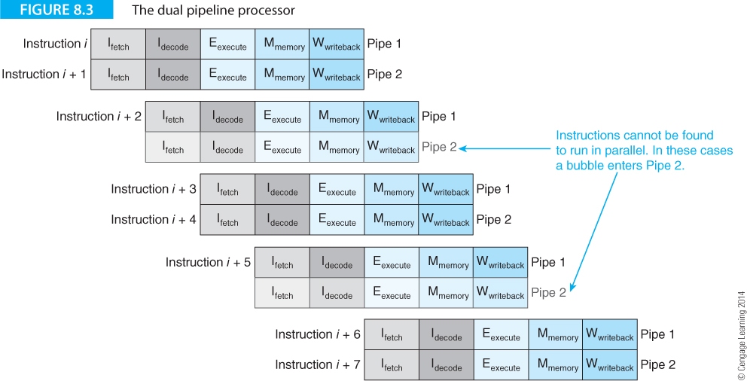
The only way that to increase throughput beyond the one cycle per instruction barrier is to employ multiple execution units.
Figure 8.3 illustrates a processor with two parallel five-stage pipelines that can double the throughput without increasing the clock rate. Both pipelines are not always used; sometimes it’s impossible to find two instructions to execute in parallel.

Slide 11
An arrangement with m parallel pipelines is called an m-way superscalar processor.
However, you cannot expect an m-fold increase in performance.
In practice, it’s even harder to approach the m instructions per cycle ideal for an m-way superscalar processor than it is to approach the one instruction per cycle goal for a pipelined processor.
The Pentium P5, introduced in 1993, had two integer pipelines but its second pipeline could be used for only about 30% of the time.
The original Pentium introduced in 1993 with a speed of 60 or 66 MHz had two 5-stage integer pipelines U and V and a six-stage floating-point unit.
The U and V pipelines were not identical because the U pipe included a shifter.

Slide 12
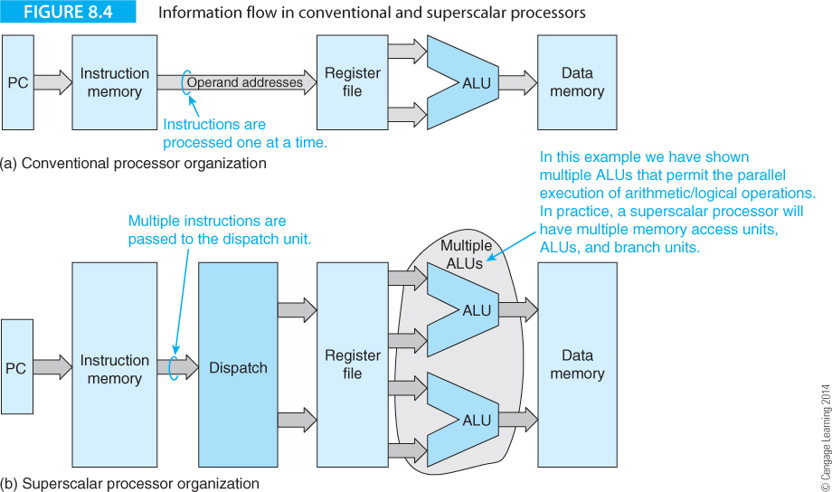
Superscalar processors are not implemented by taking a RISC and increasing the number of pipelines.
They are implemented by adding resources such as multiple processing units to allow parallel instruction overlap. Figure 8.4(a) illustrates the information flow in a conventional pipelined processor and Figure 8.4(b) shows the information flow in a generic superscalar processor with two ALUs.

Slide 13
The superscalar processor takes multiple instructions from the instruction source and then dispatches them in parallel to a multiported register file, where the operands are looked up and transmitted to multiple ALUs.
This is a simplistic picture because it omits a key consideration; the way in which instructions are dispatched in parallel.
Instructions come from several sources, such as the cache memory and local instruction buffers, and have to be executed in the correct semantic order.
The expression correct semantic order indicates that the order of instruction execution must not change the meaning of the program and end result.
In an out-of-order processor the actual order of instruction execution can be changed from the program order as long as the meaning of the program remains unaltered. Consider :
Case 1 Case 2
ADD r1,r2,r3 ADD r1,r2,r3
ADD r4,r1,r3 ADD r5,r6,r7
ADD r5,r6,r7 ADD r4,r1,r3

Slide 14
Case 1 Case 2
ADD r1,r2,r3 ADD r1,r2,r3
ADD r4,r1,r3 ADD r5,r6,r7
ADD r5,r6,r7 ADD r4,r1,r3
Suppose the instruction sequence in Case 1 is the original program sequence. In Case 2 we have re-ordered this sequence.
The semantic meaning has not been changed; that is, executing the code of Case 1 and Case 2 will yield the same result.
The object of a superscalar processor is to allow code to be executed in parallel without changing the semantic order.

Slide 15
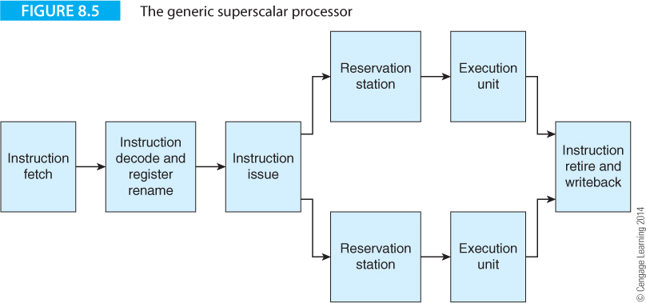
Figure 8.5 provides a more realistic structure of a superscalar processor that consists of five elements.

Slide 16
Instruction fetch
The instruction fetch stage obtains the instructions from memory, the cache or any other mechanism used to hold instructions to be executed.
Instruction decode
The instruction decode and register rename stage decodes the instructions and renames any resources required by the instructions.
Register renaming reduces the effect of bottlenecks caused by the limited number of user-visible registers by using temporary registers.
Instruction issue
The instruction issue stage forwards instructions to the execution units and ensures that the maximum number of instructions possible is executed in parallel.
The two terms issue and dispatch describe the forwarding of instructions for execution.
Dispatch indicates that an instruction is transmitted to functional units for execution, and issue indicates that an instruction is transmitted to an execution unit even though that instruction may not yet be ready for immediate execution.

Slide 17
Reservation stations
The reservation stations and execution units are the instruction buffers and ALUs (or other functional devices) that interpret the stream of op-codes.
The reservation stations dispatch instructions to the associated processing units only when all the required resources are available.
Instruction retire
The instruction retire and writeback stage is responsible for writing back the result to registers and ensuring that instructions are completed in the correct order.
This stage also communicates with the reservation stages when instruction completion frees resources.

Slide 18
When instructions are executed strictly sequentially in program order they are said to be processed in-order.
If instructions are not executed in program sequence with one instruction being executed before the previous instruction, they are said to be processed out-of-order.
Parts of a superscalar pipeline may operate in-order and other parts operate out-of-order.
Note that out-of-order execution is not a characteristic of superscalar processing but a technique that can be exploited to enhance superscalar processing; that is, out-of-order execution is not a fundamental requirement of superscalar processing; it is a necessary evil.

Slide 19
In Figure 8.5 the instruction retire stage is responsible for ensuring that instructions are completed in order whether or not they were executed out-of-order. Consider the following example that demonstrates the concept of in order and out-of-order execution:
Instruction Case 1 Case 2 Case 3
1 ADD R1,R2,R3 ADD R1,R2,R3 ADD R1,R2,R3
2 ADD R4,R1,R7 ADD R6,R3,R8 ADD R8,R6,R2
3 ADD R5,R1,R2 ADD R4,R1,R7 ADD R4,R1,R7
4 ADD R6,R3,R8 ADD R5,R1,R2 ADD R5,R1,R2
      ADD R8,R6,R2 ADD R8,R6,R2 ADD R6,R3,R8
Case 1 demonstrates a sequence of instructions that could generate hazards (data dependencies) when executed in a pipelined computer because of the two read before write hazards; that is, R1 in instruction 2 and R6 in instruction 5.

Slide 20
Instruction Case 1 Case 2 Case 3
1 ADD R1,R2,R3 ADD R1,R2,R3 ADD R1,R2,R3
2 ADD R4,R1,R7 ADD R6,R3,R8 ADD R8,R6,R2
3 ADD R5,R1,R2 ADD R4,R1,R7 ADD R4,R1,R7
4 ADD R6,R3,R8 ADD R5,R1,R2 ADD R5,R1,R2
      ADD R8,R6,R2 ADD R8,R6,R2 ADD R6,R3,R8
Case 2 demonstrates the effect of introducing out-of-order execution by reordering the instruction stream to remove these dependencies. In this case the semantics of the code is unaltered.
In case 3, out-of-order execution has also been applied to remove the dependencies. However, the semantics of the code is changed because R6 is used in instruction 2 but is not created until instruction 5.
This demonstrates that out-of-order execution is possible, but only with care.

Slide 21
Let’s look at an example that illustrates superscalar execution by demonstrating the effect of both in-order and out-of-order execution. Consider the following code fragment.
The comments in the rightmost column indicate the restrictions placed on the execution of the corresponding instruction; for example, the load requires two cycles, and there is only one multiplier (a resource dependency) which prevents parallel multiplications.
I1 x = b* LDR X,[B] a load takes two cycles
I2 b = b + 1 ADD B,B,#4
I3 y = c.g MUL Y,C,G only one multiplication at a time
I4 d = c.x MUL D,C,X multiply (only one at a time)
I5 f = d – q SUB F,D,Q RAW data dependency with I4
I6 e = p + g ADD E,P,G
I7 x = a.f MUL X,A,F multiply (only one at a time)
I8 c = c + 1 ADD C,C,#1
I9 e = e + 1 ADD E,E,#1

Slide 22
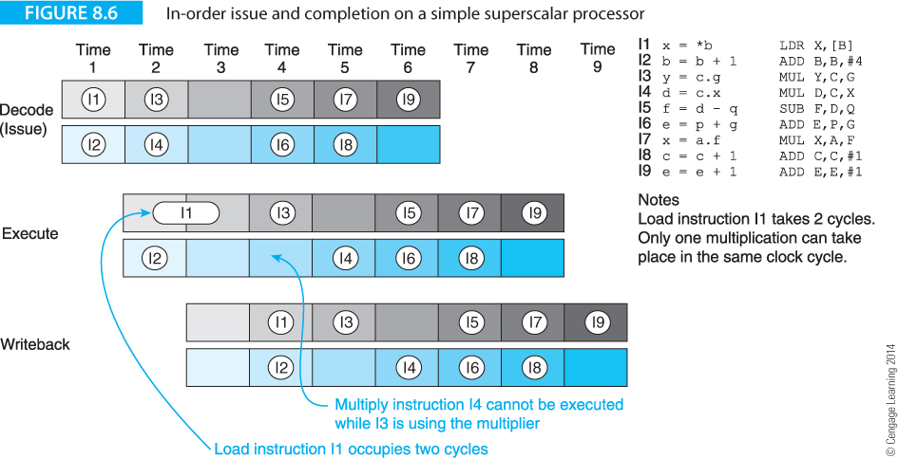
Figure 8.6 illustrates a superscalar model where instructions are issued and executed in-order in a simple two-way superscalar machine. This machine has only three stages: decode/issue, execute, and write-back (store operand). A non-superscalar RISC processor with a three-stage pipeline would take four cycles to complete the first instruction (the load), and 12 cycles to execute all the instructions. (Twelve cycles are required because of the 3 cycle latency, 8 successive cycles and the 1-cycle stall caused by I1.)

Slide 23
Figure 8.6 demonstrates that the superscalar achieves a reduction of only three cycles over a single 3-stage pipeline. Initially, instructions I1 and I2 are issued in parallel. However, because I1 has a two-cycle latency, I2 can be executed but cannot be retired (written-back) in the next cycle until I1 has been completed. If I2 were permitted to write its results before I1 had finished, and an interrupt were taken, the architectural state in registers and memory would be in error. Instructions I1 and I2 are retired in time slot 4.

Slide 24
The hardware dependencies between multiplication instructions I3 and I4 ensures that only one pipe can be used in time slots t4 and t5; that is, superscalar processing cannot be exploited. Moreover, the RAW hazard between instructions I4 and I5 ensures that I4 must be executed before I5. Although we have implemented superscalar processing, we have achieved a speedup of 12/9 = 1.3, rather than the desired 2 that could have been achieved if both execution units had been fully used.

Slide 25
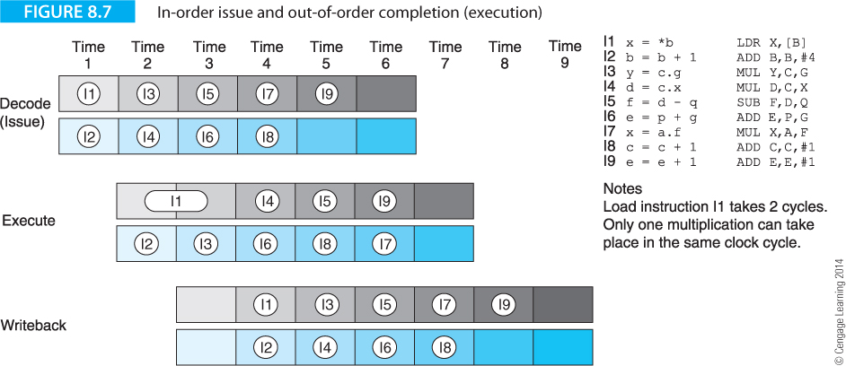
Let’s now modify the processor to permit a degree of out-of-order processing. Figure 8.7 illustrates in-order issue and out-of-order completion.
In this case I2 is completed before I1, and the number of cycles reduced by one. Instructions I1 to I9 are executed in 8 cycles with out-of-order processing. An instruction can complete out of order, but is never retired out of order, since retiring involves updating the state of the machine.

Slide 26
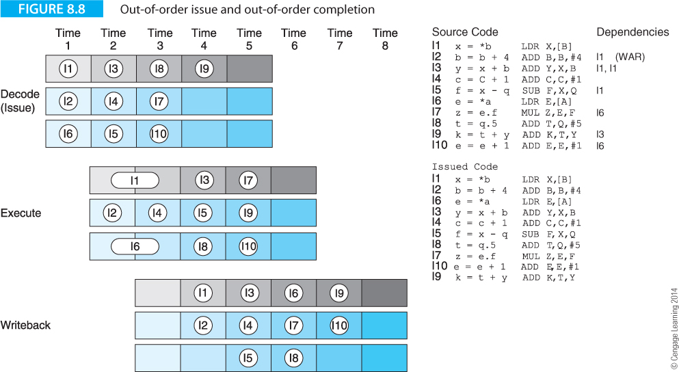
Figure 8.8 extends this example by permitting out-of-order issue and out-of-order completion. We have used a three-way superscalar model with different code and have included two loads and a multiplication. In Figure 8.8 we have given the issued code below the original code. Note that the writeback (retire) stage ensures that instructions are retired in order.

Slide 27
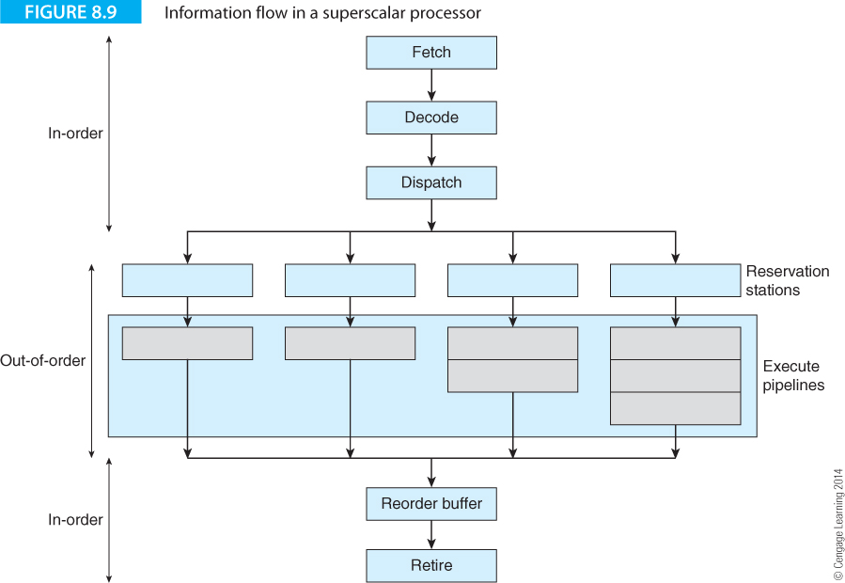
Figure 8.9 illustrates information flow in a conceptual out-of-order superscalar processor. The front end resembles a RISC processor and ensures a continuous flow of instructions.
The middle part consists of the reservation stations and the pipelined execution units, where some pipelines have one stage such as integer operations and others have multiple stages such as floating-point operations. This middle stage operates in an out-of-order fashion. The end stage consists of the reorder buffer and the retire (i.e., writeback) stage, where instructions are completed in order.

Slide 28
The strength of a superscalar processor is that it is able to execute an arbitrary number of instructions in parallel.
The weakness is that those instructions have to be fetched from memory, which requires a corresponding increase in the performance (i.e., transfer bandwidth) of the upstream stages and the processor hardware has to identify which instructions can be executed in parallel without changing a program’s semantics.
Moreover, it has to manage resources by optimally allocating them to instructions.
All these operations can perhaps be better performed by the compiler.

Slide 29
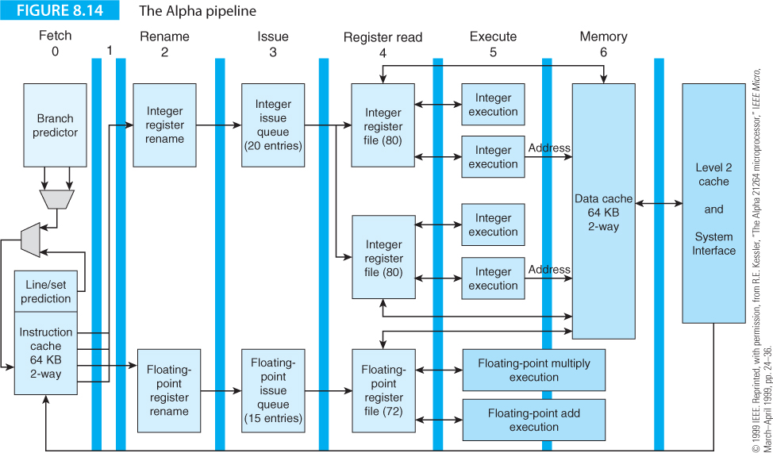
Examples of Superscalar Processors

Slide 30
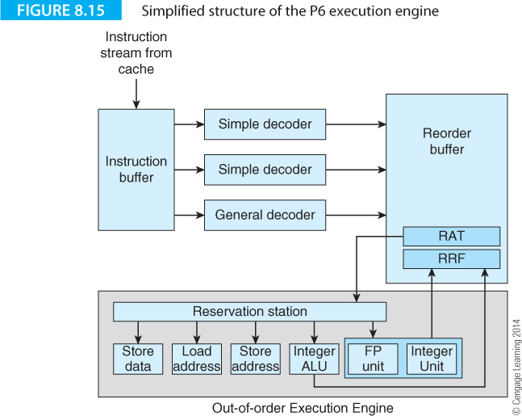

Slide 31
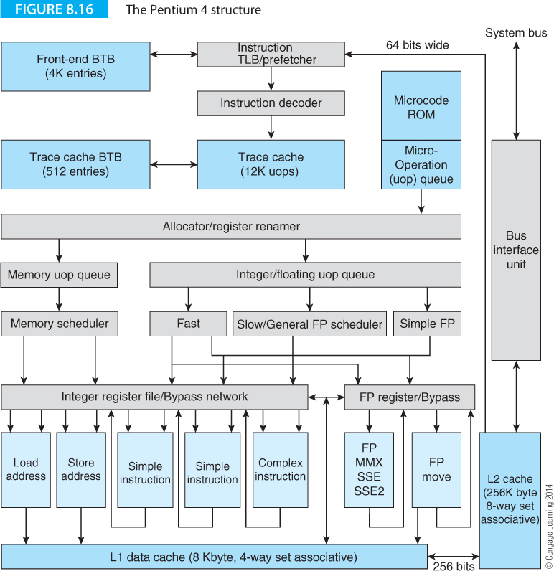

Slide 32
VLIW Processors
The VLIW or very long instruction word processor uses a long instruction word to specify a fixed number of operations that are to be executed in parallel
A VLIW processor allows the programmer or compiler to specify multiple instructions that are to be executed concurrently.
The instruction word is long (i.e., wide) simply because it is made up of several individual instructions; for example, you could construct a 96-bit VLIW processor that is able to execute three 32-bit MIPs instructions concurrently.
Some use the term molecule or bundle to describe the VLIW instruction that consists of several operations called atoms or syllables, respectively.

Slide 33
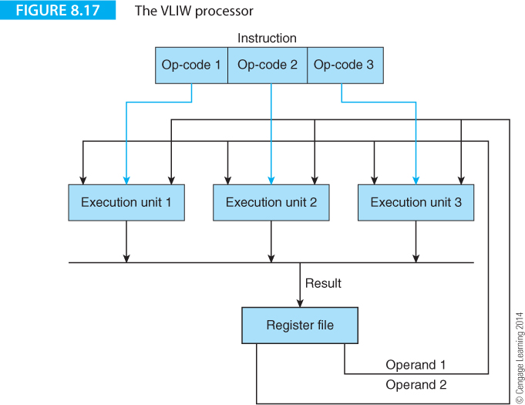

Slide 34
To compare the notions of superscalar with VLIW means comparing organization with architecture.
However, there are important differences between these two paradigms.
VLIW processors identify parallelism at compile time, because the instructions generated by a compiler are suitable for parallel execution and no dependencies have been detected; that is, the compiler has the time and resources to optimally arrange instructions to exploit the most parallelism.
A superscalar processor has to dynamically issue multiple instructions and deal with the problems of control and resource dependencies dynamically in the processor’s hardware at run time.

Slide 35
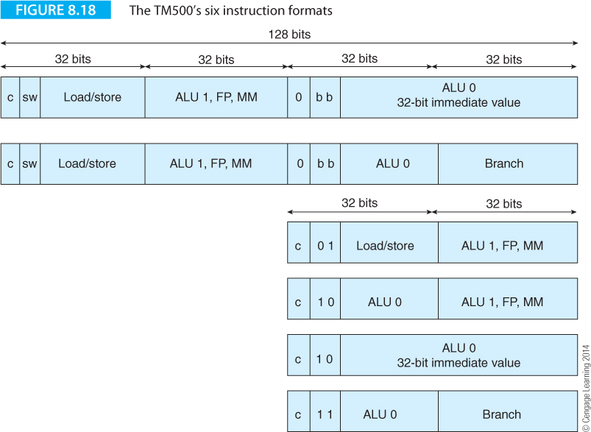
Crusoe – a Failed VLIW Processor
Transmeta created a VLIW processor to emulate the IA32 architecture by means of code morphing. The Crusoe uses a 128-bit word, called a molecule, that is divided into four 32-bit atoms. The expressions molecule and atom are Transmeta’s own terms.
Figure 8.18 illustrates the Crusoe’s six instruction formats. Two formats are 128-bit bundles and two are 64-bit bundles.

Slide 36
Typically, VLIW instruction formats are limited by restrictions on the operations that may be assigned to the three slots. For example, the first two slots might be reserved for integer operations, whereas the third slot may hold only a floating-point operation. Such an arrangement would mean that the sequence
ADD r1,r2,r3
ADD r4,r5,r6
SUBF r7,r8,r9 ;floating point subtraction
could be fitted in one instruction,
ADD r1,r2,r3: ADD r4,r5,r6: SUBF r7,r8,r9

Slide 37
whereas the sequence
ADD r1,r2,r3
ADDF r4,r5,r6
SUBF r7,r8,r9 ;floating point subtraction
would require the two instructions
ADD r1,r2,r3
NOP ;the second integer slot
ADDF r4,r5,r6
NOP ;the first integer slot
NOP ;the second integer slot
SUBF r7,r8,r9
That can be represented as:
ADD r1,r2,r3: NOP: ADDF r4,r5,r6; first long instruction
NOP: NOP: SUBF r7,r8,r9; second long instruction

Slide 38
Two formats are 128-bit bundles and two are 64-bit bundles. By providing both 128-bit and 64-bit bundles, Transmeta ensures that no bundle will have to introduce two NOPs when the compiler can’t find four instructions to execute in parallel.
Ultimately, Crusoe was a commercial failure because it failed to deliver the necessary performance.

Slide 39
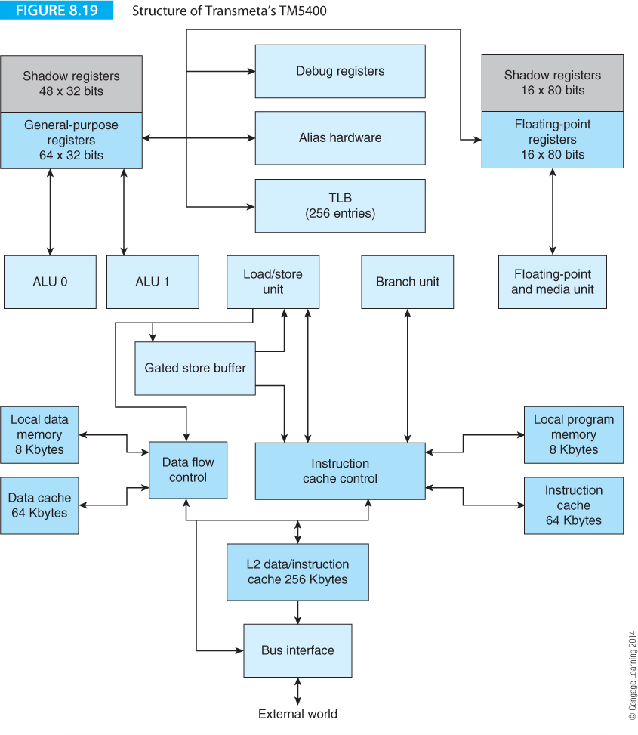

Slide 40
The IA64 Itanium architecture
We now introduce the IA64 or Itanium architecture, Intel’s big brother to the IA-32 architecture that encompasses the 80386, 80486 Pentium, and iCore families.
Successor to the IA-32 it may well be, but heir it ain’t.
The origins of the IA64 architecture lie within HP’s Explicitly Parallel Instruction Computing (EPIC) program;
EPIC architecture on which Itanium is based employs the long instruction format -> VLIW into a commercially viable product;
The introduction of the Itanium processor in 2001 represented one of the most significant developments in microprocessor architecture in a decade.

Slide 41
Itanium is aimed at the high-performance workstation market. The first version of the Itanium in 2001 proved somewhat disappointing.
A second version of the Itanium, codenamed McKinley, was launched in 2002 to better compete with other manufacturers in the RISC workstation market.
The McKinley version of Itanium 2 was constructed with 0.18 micron technology. In 2003 Intel launched a second version of the Itanium 2, the Madison, constructed with 0.13 micron technology and a massive 6 MB on-chip cache. By 2006 a dual-core Itanium was available.
In 2010 Intel announced its Itanium 9300 series that included multicore technology plus an enhanced memory interface. In spite of the Itanium’s pedigree, it has not yet grabbed a large share of the market for workstations.
In February 2010 Intel announced that 80% of the Global 100 corporations had chosen Itanium-based servers for their most mission-critical applications. In 2011 Intel announced an 8 core version of the IA64.

Slide 44
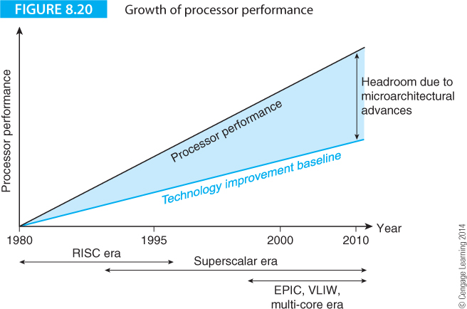
Performance Increase
Figure 8.20 shows the progression of computing performance over two decades as a function of improvements in semiconductor technology and in architecture and organization.
The trace at the bottom demonstrates the expected increase in performance if RISC technology alone had become standard and no future changes made other than by improving manufacturing techniques.

Slide 45
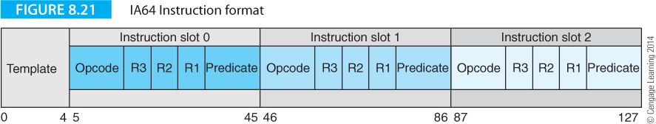
Figure 8.21 describes the format of an IA64 instruction, or, to be more precise, a bundle of three 41-bit instructions.
Each of these instructions has an op-code, three register fields and a predicate field that is used to implement predicated execution, something like ARM.
Predication is the conditional execution of instructions. Conditional execution is implemented through branches in traditional architectures. Predication removes branches used for conditional execution. Predicated execution avoids branches, and simplifies compiler optimization by converting a control dependency to a data dependency.
As well as the three instructions, there’s a 5-bit template that tells the processor something about the structure of the three following op-codes.

Slide 46
A feature peculiar to the Itanium VLIW is the use of a symbol to indicate the extent of a region of parallelism.
The Itanium uses two semicolons to indicate a stop between regions of parallelism, and the braces “{” and “}” enclose instruction bundles. We will cover stops and bundles later. A simple example of a stop is:
add r1 = r2,r3 //r1 = r2 + r3
add r4 = r6,r7 ;; //r4 = r6 + r7 We need a stop because of the RAW
// hazard in the next instruction
add r5 = r4,r1 //r4 = r6 + r7

Slide 47
A feature peculiar to the Itanium VLIW is the use of a symbol to indicate the extent of a region of parallelism.
The Itanium uses two semicolons to indicate a stop between regions of parallelism, and the braces “{” and “}” enclose instruction bundles. We will cover stops and bundles later. A simple example of a stop is:
add r1 = r2,r3 //r1 = r2 + r3
add r4 = r6,r7 ;; //r4 = r6 + r7 We need a stop because of the RAW
// hazard in the next instruction
add r5 = r4,r1 //r4 = r6 + r7
The stop ensures that all instructions are completed prior to proceeding.

Slide 48
A fragment of IA64 code looks like this:
{
cmp.ne p1 = rx,ry // Perform the comparison x == y with result in p1
(p1) br else // If true then do the else part
}
{.label then
add rp = rz, 1 // z++
add rp = rp, rq // p += q
br exit // jump over else part
}
{
.label else
add rr = rr, 1 // r++
}

Slide 49
IA64 instructions can be predicated; that is, they are executed or not executed depending on the contents of a predicate register.
A predicate register, p0 to p63, is placed in parentheses in front of the instruction that is predicated; for example, the construct
(p1) add r1 = r2,r3
means “if the contents of predicate register p1 are true then execute add r1 = r2,r3”.
This is analogous to the ARM processor’s conditional execution mechanism, except that the IA64 has 64 predicate registers.

Slide 50
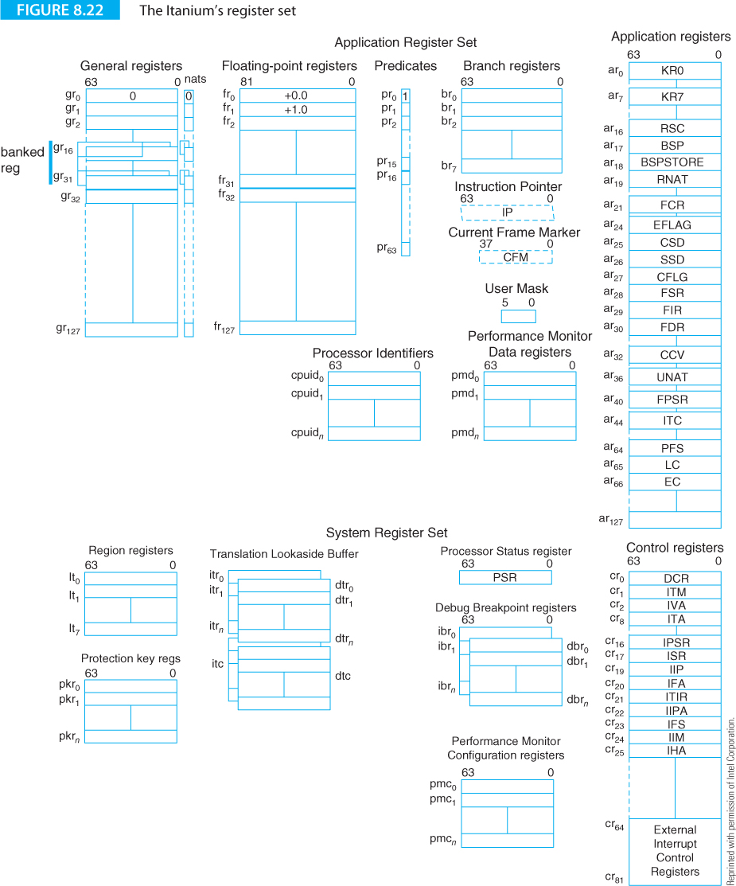
The IA64 has one of the most extensive user-visible register sets of any microprocessor.
General registers, Gr₀ to Gr₁₂₇, can be written as r0 to r127 and provide 128 64-bit-wide integer registers as you’d expect in almost any architecture.

Slide 51
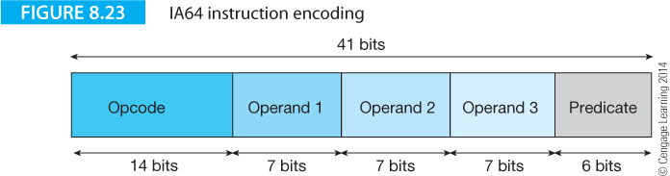
IA64 Instruction Format
The IA64 instruction is 41 bits wide.
The most-significant 14 bits provide an op-code that defines the operation to be carried out.
Three 7-bit operand fields support three-operand, register-to-register instructions with a set of 128 registers.
The least-significant six bits of the op-code select one of 64 predicate registers that determines whether this instruction is to be executed or not.

Slide 52
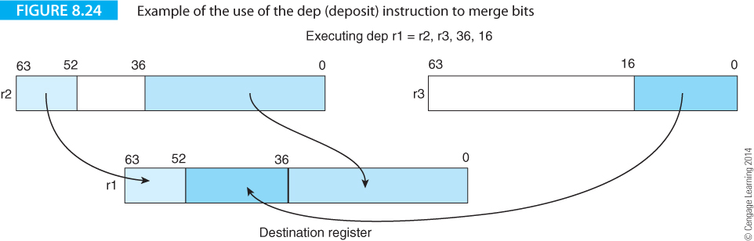
IA 64 Instruction Set
We don’t cover the IA64 in detail. Here we mention some interesting instructions.
The merge or deposit instruction, dep, takes a right-justified bit field from the source and deposits it in an arbitrary location in the destination. The format of the merge instruction is
dep r1 = r2,r3,start,length
where r1 is the destination, r2 the source, start a 6-bit integer that defines the beginning of the bit field in r1 and length a 4-bit integer that defines its width. Figure 8.24 demonstrates dep r1=r2,r3,36,16 instruction. This operation can be used to pack data structures.

Slide 53
A 16-bit parallel multiplication instruction is provided as part of the Itanium’s multimedia support that you could use as a conventional multiplication instruction, as Figure 8.25 demonstrates.

Slide 54
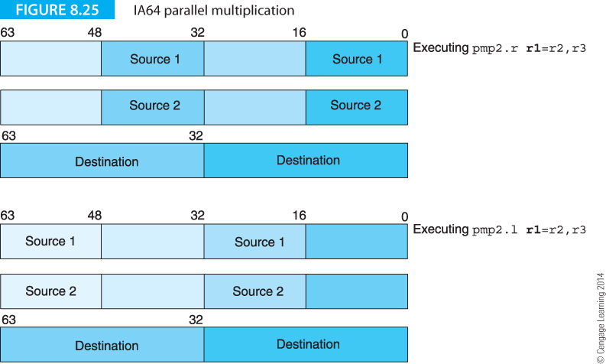
A 16-bit parallel multiplication instruction is provided as part of the Itanium’s multimedia support that you could use as a conventional multiplication instruction, as Figure 8.25 demonstrates.

Slide 55
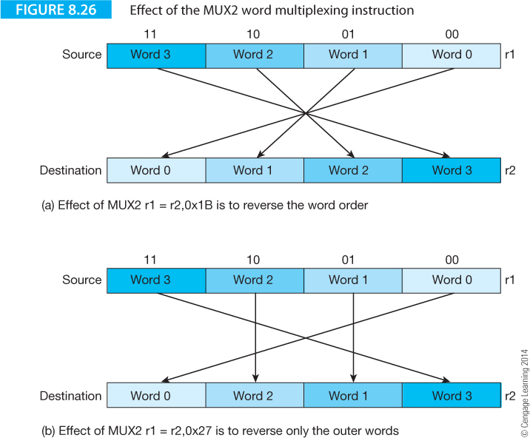
The IA64 provides a user programmable multiplex instruction, mux2, that allows you to specify the order of the words in a register. The format of the instruction is
mux2 r1 = r2,sequence,
where sequence is an integer specifying the order of the words.

Slide 56
Addressing Modes
The IA64 has a fairly simple memory accessing mechanism and supports only register indirect addressing. You can also apply an optional post-incrementing. The remarkable range of memory access operations supported by ARM processors is entirely absent in the IA64. Typical IA64 memory accesses are:
ld8 r1 = [r4] //load the 8 bytes pointed at by r4 into r1
ld8 r1 = [r4],r2 //load the 8 bytes pointed at by r4 into r1 and
//update r4 by adding r2
st8 [r2] = r5 //store the 8 bytes in r5 at the location pointed at by r2
st4 [r6] = r9,4 //store the 4 bytes in r9 at the location pointed at by r6
// and post increment r6 by 4
Note that the load and store operations have a size completer that indicates the number of byte loaded or stored (1, 2, 4, or 8); for example ld4, st8.

Slide 57
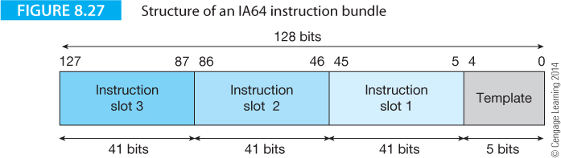
Instructions, Bundles and Breaks
We now return to two concepts that we have already briefly introduced, the bundle and the break that are related to the IA64’s VLIW-like architecture.
IA64 bundles are 128 bits long and the processor reads a 16-byte instruction bundle containing three op-codes.
The three op-codes occupy positions slot 1, slot 2, and slot 3. It’s not always possible to fill each slot with a useful instruction and sometimes you have to pad slots with no operations, NOPs.
Because an IA64 instruction is 41 bits long, a bundle has 128 – 3 x 41 = 5 bits left over to provide extra information about the current bundle.

Slide 58
The five low-order bits of an instruction bundle are called its template, because they indicate the type of the current bundle and map the instruction slots onto the IA64’s processing units.
The IA64 is a highly specific form of a superscalar processor with independent execution units that can deal with individual instructions which permits their parallel execution. Table 8.1 demonstrates the relationship between instruction type and execution unit. The IA64’s execution units are the I-unit that performs integer operations, the F-unit that performs floating-point operations, the M-unit that performs memory related operations (load and store), and the B-unit that performs branch operations.
Instruction Type | Description | Execution Unit Type
A | Integer ALU | I-unit or M-unit
I | Non-ALU integer | I-unit
M | Memory | M-unit
F | Floating-point | F-unit
B | Branch | B-unit
L+X | Extended | I-unit/B-unit

Slide 59
Template | Encoding | Type | Slot 0 | Slot 1 | Slot 2
0 | 00000 | MII | M | I | I
1 | 00001 | MII | M | I | I
2 | 00010 | MI_I | M | I | I
3 | 00011 | MI_I | M | I | I
4 | 00100 | MLX | M | L | X
5 | 00101 | MLX | M | L | X
6 | 00110
7 | 00111
8 | 01000 | MII | M | M | I
9 | 01001 | MII | M | M | I
10 | 01010 | M_MI | M | M | I
11 | 01011 | M_MI | M | M | I
12 | 01100 | MFF | M | F | I
13 | 01101 | MFF | M | F | I
14 | 01110 | MMF | M | M | F
15 | 01111 | MMF | M | M | F
16 | 10000 | MIB | M | I | B
17 | 10001 | MIB | M | I | B
18 | 10010 | MBB | M | B | B
19 | 10011 | MBB | M | B | B
20 | 10100
21 | 10101
22 | 10110 | BBB | B | B | B
23 | 10111 | BBB | B | B | B
24 | 11000 | MMB | M | M | B
25 | 11001 | MMB | M | M | B
26 | 11010
27 | 11011
28 | 11100 | MFB | M | F | B
29 | 11101 | MFB | M | F | B
30 | 11110
31 | 11111
Table 8.2 relates the encoding of each bundle’s template to the instruction type in terms of processing units. Some of the instructions are in blue to indicate the presence of a stop or break in the instruction sequence that defines the limit of a region of parallel execution.

Slide 60
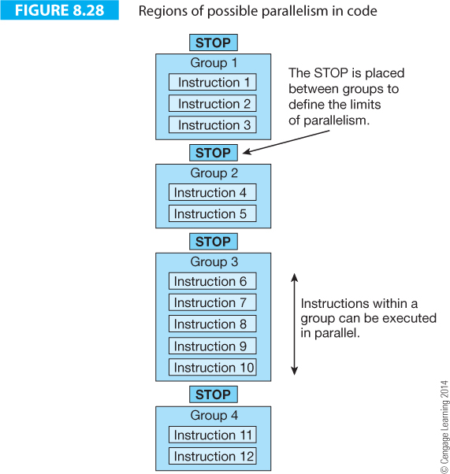
A STOP is placed between groups to limit the extent of the parallelism; for example, the instructions in group 1 must be executed before the instructions in group 2. The sequence in which instructions are executed is determined by the compiler, which places the STOPs in the instruction stream. A STOP ensures that a RAW (read after write) hazard does not take place by ensuring the competition of instructions up to the STOP.

Slide 61
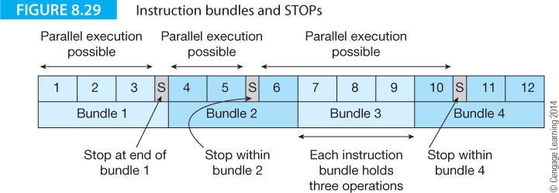

Slide 62
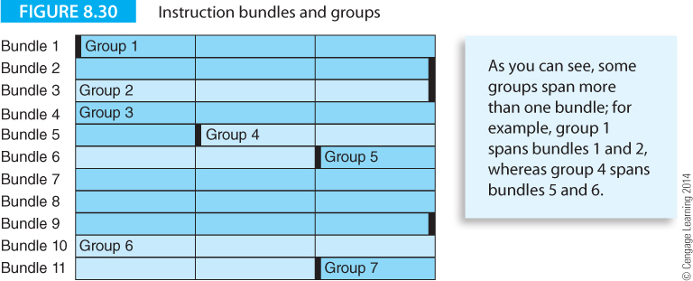

Slide 63
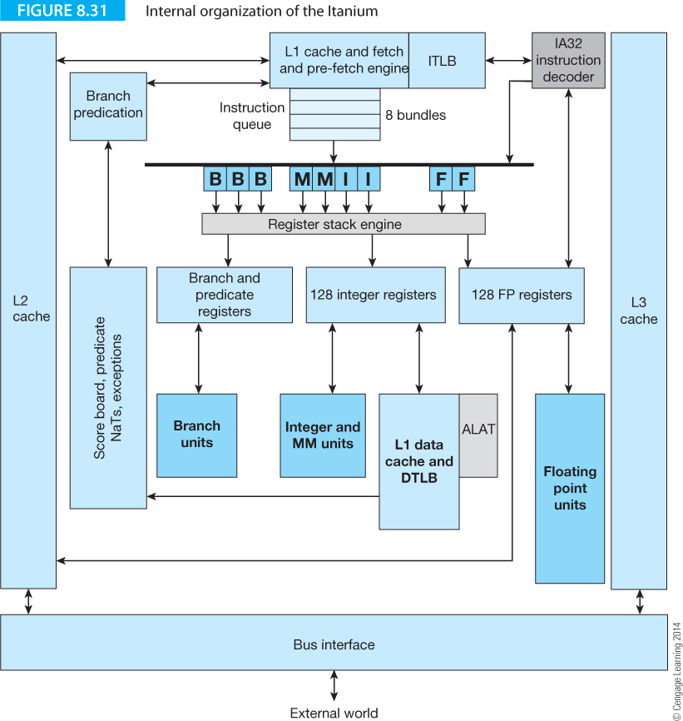

Slide 64
Appending (p1) to an IA64 instruction causes it to be executed if and only if the Boolean value in predicate register p1 is true. Consider the following construct:
if (x != y) s = 4;
else s = s + 4;
We can express this construct IA32, 68K, ARM and IA64 forms:

Slide 65
The IA64 code is branchless, more compact than the CISC code, and the two predicated instructions can be carried out in parallel in the same cycle. A simple example of the effective uses of predication is provided by Geva and Morris. Consider the code fragment
    if (x == y) {
    z++;
    p += q;
    } else {
    r++;
    }
This sequence can be translated into the following IA64 code.
To keep things simple we will use register names consisting of “r” plus the variable name; for example rx is the register that holds x.

Slide 66
This sequence can be translated into the following IA64 code.
{
cmp.ne p1 = rx,ry // Perform the initial compare x == y
(p1) br else // If true then do the else part
}
{.label then
add rz = rz, 1 // z++
add rp = rp, rq // p += q
br exit // jump over else part
}
{
.label else
add rr = rr, 1 // r++
}

Slide 67
This is conventional but inefficient code because it is divided into blocks separated by conditional or unconditional branches. If the conditional test is mispredicted, the cost is high. Why? Because the IA64 is a parallel processor and a lost cycle potentially throws away up to three instructions.
The following version of the algorithm makes better use of prediction by setting two predicate registers when the test is performed and then executing three simultaneous operations; two of which are predicated on true and one on false. The second block performs all the computation in a single cycle.
{
cmp.ne p1,p2 = rx,ry // Perform the initial compare x == y
} { //This block executes in one cycle
(p1) add rp = rz, 1 // z++
(p1) add rp = rp, rq // p += q
(p2) add rr = rr, 1 // r++
}

Slide 68
{
cmp.ne p1,p2 = rx,ry // Perform the initial compare x == y
} { //This block executes in one cycle
(p1) add rp = rz, 1 // z++
(p1) add rp = rp, rq // p += q
(p2) add rr = rr, 1 // r++
}
The cmp.ne instruction compares the contents of rx and ry and sets predicate registers p1, p2 to 1,0 if the outcome of the test is true and 0,1 if the outcome is false. The next three instructions are executed if the associated predicate register is true.

Slide 69
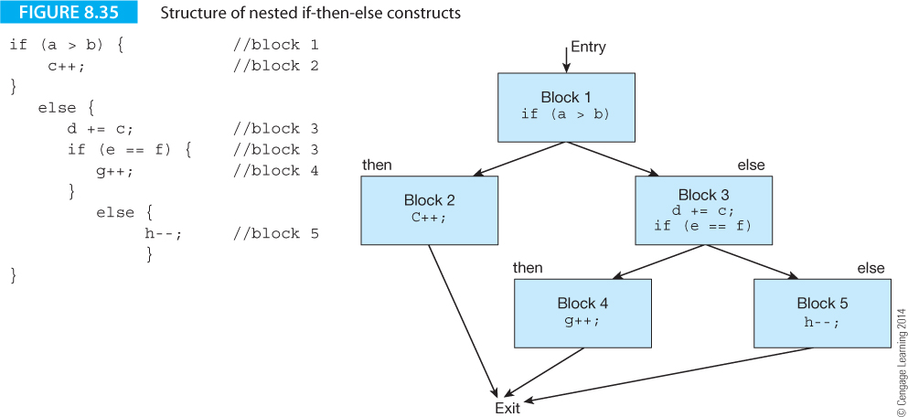
Let’s look at another example of predication from Geva and Morris.
Figure 8.35 illustrates an if-then-else construct with a second nested if-then-else in the first else path.
Predication provides efficient code because compare instructions themselves may be predicated (as we found with ARM code).

Slide 70
The construct of Figure 8.35 can be written as.
{
cmp.gt p1, p2 = ra, rb // block 1
} {
(p1) add rc = rc,1 // block 2
(p2) add rd = rd, rc // block 3
(p2) cmp.eq.unc p3, p4 = re, rf // block 3
} {
(p3) add rg = rg, 1 // block 4
(p4) add rh = rh, -1 // block 5

Slide 71
Note how the two components of block 3 are both predicated by p2. The second component of block 3 is the test
(p2) cmp.eq.unc p3, p4 = re, rf
which carries out the test if (e == f) and sets predicate registers p3 and p4.
However, the additional completer, unc (unconditional) overrides the normal behavior of the comparison.
If the qualifying predicate is true, the cmp.eq.unc behaves normally and p3, p4 are set to 0,1 or 1,0 depending whether the outcome of the test was false or true, respectively.
Now, if the qualifying predicate in p2 is false and the .unc completer is specified, the two predicates are forced to 0. In this case, if (p2) is zero then both (p3) and (p4) are forced to zero.

Slide 72
The .unc completer can be used to prevent both paths of a nested conditional being executed; in this case blocks 4 and 5.
Predicated execution can be used as an effective way of implementing multiway braches as the following example demonstrates.
{ .mii
cmp.eq p1,p2 = r1,r2
cmp.ne p3,p4 = 4, r5
cmp.lt p5,p6 = r8,r9
}
{.bbb
(p1) br.cond label1
(p3) br.cond label2
(p5) br.cond label3
}
In this example three comparisons are performed in the first cycle and a branch made in the second cycle if any of the conditions is satisfied.

Slide 75

Content
Superscalar Architecture
VLIW Processors
The IA64 Itanium architecture

