Slide 1
GSM and GPRS

Slide 2
MCS: GSM
Global System for Mobile Communications

Slide 3
GSM evolution
GSM=Global System for Mobile Communications
GSM Evolution:
1979 the 900MHz band reserved
1982 Groupe Spécial Mobile under CEPT (Post &Telecom European Conference)
1988-89 GSM taken over by ETSI (European Telecommunication Standard Institute)
1990-91
‘Phase 1’ recommendations
DCS1800
1992 first commercial GSM networks
1995 ‘Phase 2’ recommendtions issued
1998 3GPP (3rd Generation Partnership Project)

Slide 4
GSM 900, 1800, 1900
GSM 900: 2 x 25 MHz frequency bands:
890-915 MHz UL, 935-960 MHz DL
124 carriers, 200 kHz each
Extended version: 2x35MHz 880-915MHz UL, 925-960MHz DL, 174 carriers, 200kHz each
GSM 1800 (Digital Cellular System -DCS)
At the request of the UK
2x75MHz frequency bands:
1710-1785 MHz UL, 1805-1880 MHz DL
374 carriers (200kHz/carrier)
GSM 1900 (Personal Communication System or PCS1900)
North and South American version of DCS 1800
GSM 850
same frequency range like AMPS, D-AMPS, IS-95 (American standards)
824-890MHz UL, 869-894MHz DL, 124x200kHz carriers

Slide 5
Architecture of the GSM system [JS]
GSM is a PLMN (Public Land Mobile Network)
several providers setup mobile networks following the GSM standard within each country
components
MS (mobile station)
BS (base station)
MSC (mobile switching center)
LR (location register)
subsystems
RSS (radio subsystem): covers all radio aspects
NSS (network and switching subsystem): call forwarding, handover, switching
OSS (operation subsystem): management of the network

Slide 6
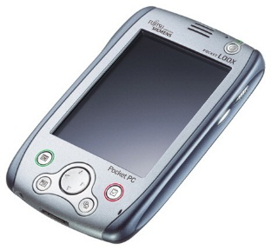
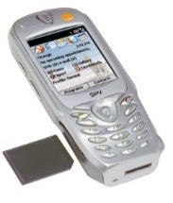
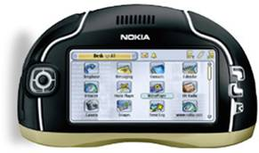
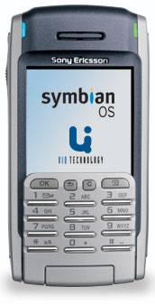
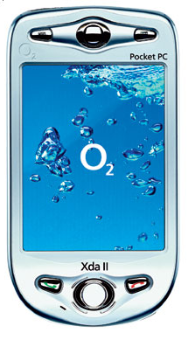
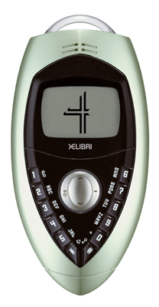
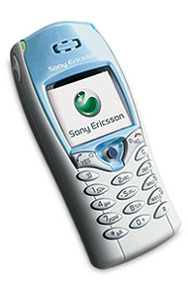
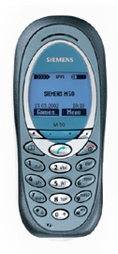
Ingredients 1: Mobile Phones [JS]
The visible but smallest
part of the network!

Slide 7
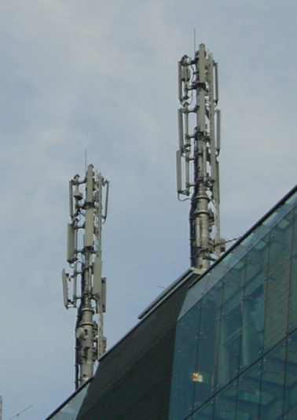
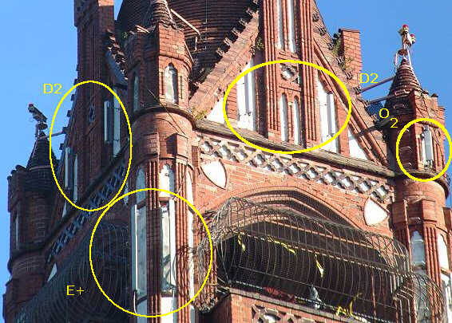
Ingredients 2: Antennas [JS]
Still visible – cause many discussions…

Slide 8
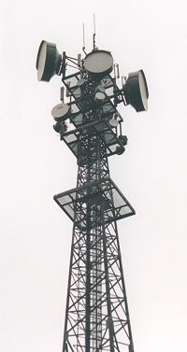
Ingredients 3: Infrastructure 1[JS]
Base Stations
Cabling
Microwave links

Slide 9
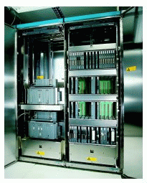
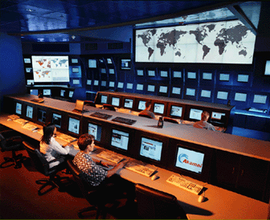
Ingredients 3: Infrastructure 2[JS]
Not „visible“, but comprise the major part of the network (also from an investment point of view…)
Management
Data bases
Switching units
Monitoring

Slide 10
GSM: overview[JS]
OMC, EIR, AUC
HLR
fixed network
GMSC
NSS
with OSS
VLR
MSC
VLR
MSC
BSC
BSC
RSS

Slide 11
GSM architecture

Slide 12
GSM architecture. Elements
Radio subsystem (RSS) (mobile station + base station subsystem)
Used for radio access
If the network deals with both CS and PS traffic, their path is common in RSS
Core network or Network Sub System (NSS):
Separate CS and PS paths, if both are available
Operation Sub System (OSS) – resources used by the operator to manage the network.
Often called OMC (Operation and Management Center)

Slide 13
GSM architecture. Radio subsystem
MS (Mobile Station) (or UE – user equipment)
used by a subscriber to call another subscriber
Consists of SIM (Subscriber Identity Module) and MT (Mobile Terminal)
SIM stores administrative and security data, location data
Only emergency calls can be done without SIM
MT: radio transmission, speech encoding/decoding, cyphering, Human machine interface, SMS, etc
BSS (Base Station Subsystem), consisting of
BTS (Base Transceiver Station): sender and receiver, antenna, deals with physical channels, consists of high power elements
BSC (Base Station Controller): controlling several BTSs, manages radio resources, logical channel management, handover management
BSS = BSC + sum(BTS) + interconnection

Slide 14
GSM architecture. Core network
MSC:
Main component of the public land mobile network (PLMN) of GSM
switch exchange with specific GSM functions regarding mobility, handover, etc
Covers a geographical area and manages several BSCs
Databases:
HLR (home location register – permanent and semi-permanent data of all subscribers, including the current VLR )
VLR (located on MSC) – contains copy of HLR data for the users in the area of the MSC + location information (location area – group of cells)
Network nodes involved in authentication process: AuC – authentication center

Slide 15
Data services in GSM II [JS]
GPRS (General Packet Radio Service)
packet switching
using free slots only if data packets ready to send (e.g., 50 kbit/s using 4 slots temporarily)
standardization 1998, introduction 2001
advantage: one step towards UMTS, more flexible
disadvantage: more investment needed (new hardware)
GPRS network elements
GSN (GPRS Support Nodes): GGSN and SGSN
GGSN (Gateway GSN)
interworking unit between GPRS and PDN (Packet Data Network)
SGSN (Serving GSN)
supports the MS (location, billing, security)
GR (GPRS Register)
user addresses: in HLR

Slide 16
MCS: GPRS
General Packet Radio Service

Slide 17
GPRS - motivation
Data transmission in GSM: CSD (fixed 9.6 kbps data rate), SMS (max 256 characters/message), HSCSD High Speed Circuit Switched Data
Drawbacks of using circuit switching for data transfer:
Long connection establishment duration (due to negociations for resource reservations) compared to data transfer duration
Network resources are reserved for the entire duration of the connection, even if there is no data to be transferred: not suited for bursty traffic, as it is most of the data traffic (e.g. WWW)
Billing is time-based, not based on the volume of data transfered
Packet switching (PS) is much more efficient for data traffic
GPRS: truly PS service for data transfer, implemented over the existing GSM networks
Requirements: minimum costs, different services than those offered in GSM
Applications: e-mail, FTP, WWW, multimedia, etc.

Slide 18
GPRS - Motivation
General Packet Radio Service (GPRS) – mainly IP
Connectionless data transfer - always on-line
New set of interfaces - new packet switched network
Instantaneous bit rates can range from 8 kbps to 115 kbps
Dynamic allocation of resources:
a MS can use several channels, and several MS can be multiplexed on the same channel
Problem is not only with the air interface
Channel path through the entire system should be different for packet data and voice
Entire new architecture required to overlay existing GSM system
EGPRS: uses a different modulation techniques in order to ensure higher data rates (approx 3 times higher than in GPRS)

Slide 19
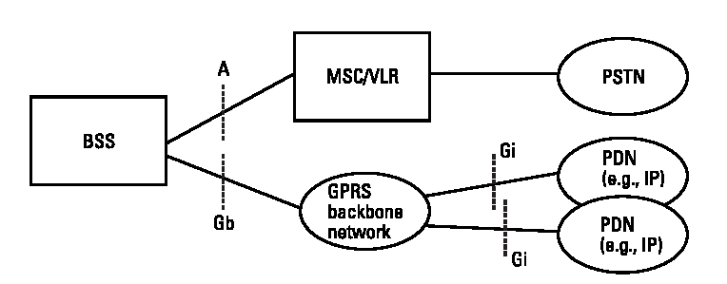
General architecture of GPRS network
Fig. 1.1 ‘General architecture of the GPRS network’ from [SSP03 ]
PS traffic routed through the GPRS backbone network (GSS – GPRS SubSystem) towards the external Packet Data Networks (PDNs)

Slide 20
GPRS system architecture
Fig 1.2. from [Tod06]. Based on [CG97] and [BVE99]

Slide 21
Legend
MS - Mobile Station
(MN - Mobile Node: UMTS designation for MS)
BTS - Base Transceiver Station
BSC - Base Station Controller
PCU - Packet Control Unit
SGSN - Serving GPRS Support Node
GGSN - Gateway GPRS Support Node
PCU is part of the BSS
BSC must communicate with an SGSN and an MSC
Packet switched traffic and circuit switched traffic have different core networks

Slide 22
Overview of resource allocation in GPRS
In GPRS, resources are allocated at different levels:
GPRS attach:
a logical link established between MS and SGSN
Session, or PDP context activation:
A route is established between MS, SGSN, GGSN and an external server outside GPRS network
Micro-connection (TBF establishment):
Between MS and BSS, in one direction and one cell
Radio channels are allocated to a user (a MS)
Radio block:
different users that share a PDCH are scheduled on a time basis
Level: MAC
Period: radio block period (20ms)

Slide 23
Main transactions. Resource allocation in GPRS
Fig. 2. ‘Three-stage QoS management’ from [SM01]

Slide 24
GPRS QoS specification
Release’97:
Characterised by:
The service precedence
Delay
reliability
Peak and mean throughput
Problems:
Only 1 QoS profile per PDP context
BSS not involved in QoS negotiation
Too manny QoS classes
Release’99:
Same like UMTS QoS
Characterised by traffic classes:
Conversational (voice, telent)
Streaming
Interactive (WWW)
Background (e-mail, FTP)
Solves the problems of Rel’97 QoS specifsication

